Slide 1

UNIT 5: GENDER EQUALITY
Lesson 2 – Pronunciation and Speaking
Page 43

Slide 2



LESSSON OUTLINE
Consolidation

Slide 3

By the end of this lesson,
students will be able to:
- know and apply how to use rising and falling intonation in a reported statment
- report the conversation using reported speech

Slide 4



Slide 5

Work in pairs.
Choose the word whose main stress is placed
differently from the others.
A. election B. committee C.property D. supporter
2. A. passionate B. determined C. delighted D. exciting
3. A. thankful B. equal C. amazed D. little
/iˈlekʃən/
/kəˈmɪti/
/ˈprɑ:pɑti/
/səˈpɔ:rtə/
/ˈpæʃənət/
/dɪˈtɜ:mɪnd/
/dɪˈlaɪtɪd/
/ɪkˈsaɪtɪŋ/
/ˈθæŋkfəl/
/ˈi:kwəl/
/əˈmeɪzd/
/ˈlɪtəl/

Slide 6
Work in pairs.
Choose the word whose underlined part is
pronounced differently from that of the other words.
A. support B. devote C. promote D. enclose
2. A. night B. flight C. right D. tick
3. A. injury B. minister C. importance D. lifesaver
/səˈpɔ:rt/
/dɪˈvoʊt/
/prəˈmoʊt/
/ɪnˈkloʊz/
/naɪt/
/flaɪt/
/raɪt/
/tɪk/
/ˈɪndʒəri/
/ˈmɪnəstə/
/ɪmˈpɔ:rtəns/
/ˈlaɪfˌseɪvə/

Slide 7
Put the arrows for the highlighted words to show how your voice goes UP and DOWN in the following reported speeches.
I told him I wouldn’t come.
She said she missed her mother.
They asked her why she had chosen that movie to watch.

Slide 8
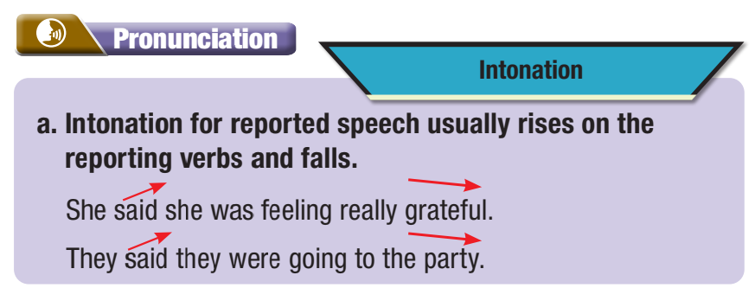

b. Listen to sentence and notice how the intonation rises and falls.
She said she was feeling exhausted.

Slide 9
c. Listen and cross out the sentence with the wrong intonation
He said he was really grateful.
She said she was determined to win the race.
d. Read the sentences with the correct intonation to a partner.

Slide 10

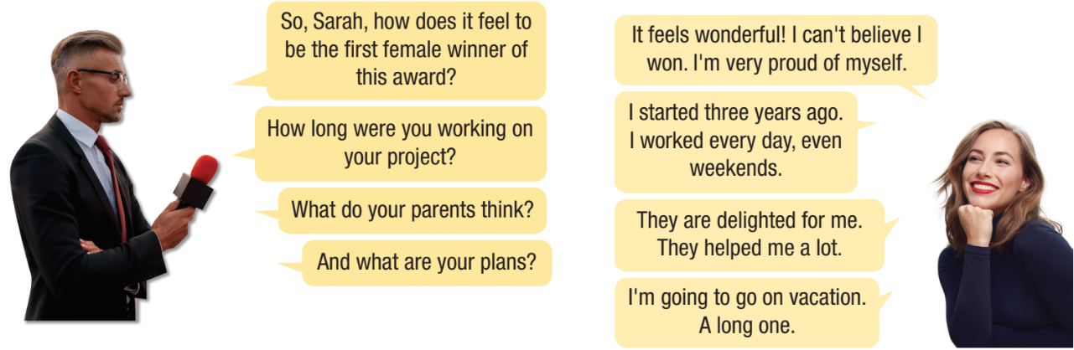
a. Practice the conversation. Swap roles and repeat.

Slide 11
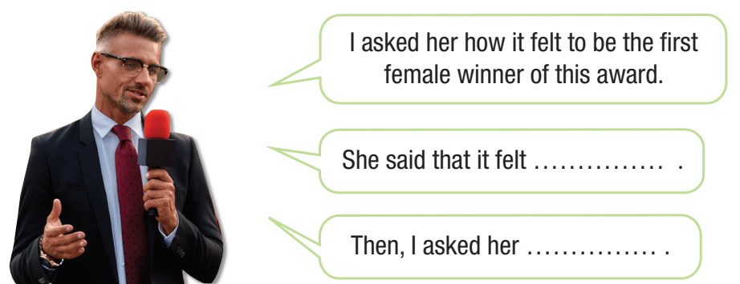
b. Take turns reporting the conversation using reported speech.

Slide 12



Slide 13
a. Student A, you’re a journalist. Add two more questions and then interview Lisa Hackett. Student B, you’re Lisa Hackett, an astronaut. You’ve just returned from a five-day mission to the Moon.

Slide 14
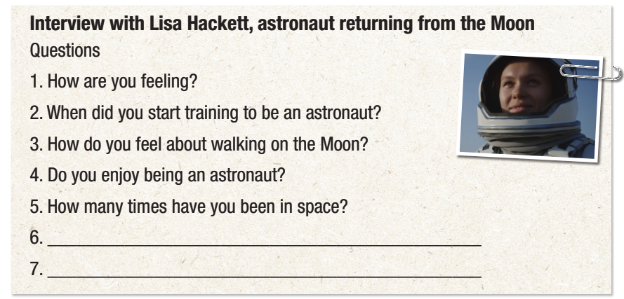


Slide 15

b. Find a new partner and report your interview with Lisa Hackett. Swap roles and repeat.

Slide 16

Consolidation

Slide 17

Now, write a report using the notes that you have taken from your interview and what you have reported to a new partner.
I had an interview with Lisa Hackett, an astronaut who has returned from a five-day the Moon.
She said she felt excited.
I feel excited

Slide 18
Consolidation
Today’s lesson
Pronunciation: Rising and falling intonation in the reported sentences
Speaking: Report the conversation using reported speech

Slide 19

Practice rising and falling intonation in the reported sentences.
Prepare the next lesson - Listening & Reading on page 44 in SB.
Review all vocabularies and grammar point in the unit.
Play the consolidation games in Tiếng Anh 10 i-Learn Smart World DHA App on www.eduhome.com.vn

Slide 20

Have a nice day!

