Slide 1

Unit 8: The World around Us
Lesson 1.2: Grammar
Page 63

Slide 2
Lesson Outline
Warm-up
Grammar
Consolidation
Wrap-up

Slide 3
Objectives
By the end of this lesson, students will be able to…
- Use “should” to ask for and give advice.
- Use “can” to talk about possibility.
- Use “can’t” for things that are very unsafe to do.

Slide 4

WARM-UP

Slide 5
Brainstorming
List down words related to vacation you learn from the last lesson
Hotel
vacation
Bird-watching

Slide 6

Presentation

Slide 7
Lan, I have a terrible toothache. What should I do?
Oh, you should go to the dentist
I don’t want to go. I hate dentists. I am afraid.
I think you shouldn’t be afraid. Everything will be fine.

Slide 8
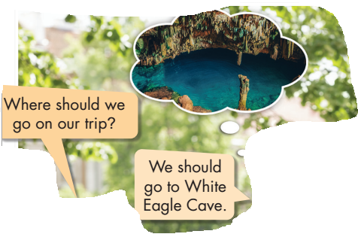
We use “should” to ask for and give advice.

Slide 9
I/You/We/They/He/She/It should go to Greenwater Cave.
I/You/We/They/He/She/It shouldn't go hiking there.
Should I travel there?
Yes, you should./ No, you shouldn't.
Fill in the rule
Should/ shouldn’t +…………………
Bare-infinitive

Slide 10
Should or Shouldn’t?
My friend loves cooking. She just cut her finger. I think she should/ shouldn’t go to the hospital. She should/ shouldn’t ride her bike. She should/ shouldn’t call a taxi.

Slide 11
Is your sister good at singing?
Oh, yes, she is. She can sing very well.
Is that the place for us to play football?
No, it isn’t. We can’t play there.

Slide 12
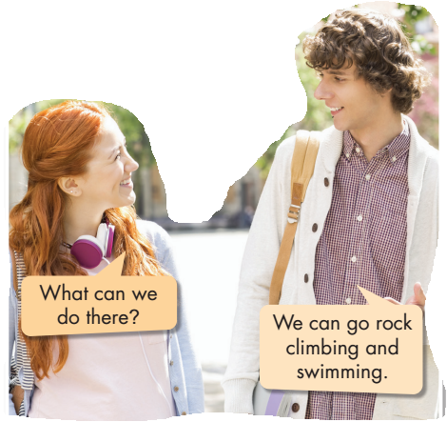
We use “can” to talk about possibility.
We often use “can’t” for things that are very unsafe to do.

Slide 13
I/You/We/They/He/She/It can go kayaking..
I/You/We/They/He/She/It can't swim in that water.
Can we swim there?
Yes, we can./ No, we can't.
Fill in the rule
Bare-infinitive
Can / can’t +……….……………

Slide 14

Practice

Slide 15
Can or Can’t
can’t
1. It’s 9.p.m in the evening. You ……………….. go out.
2. When I go to Da Nang, I …………………… see Dragon bridge.
3. I forgot the keys. We …………………….. go inside the house.
4. …………………….. we go camping there?
can
can’t
Can

Slide 16
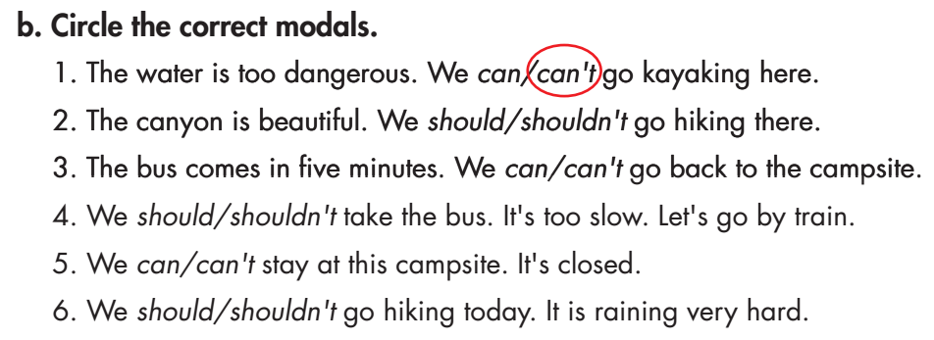

Slide 17
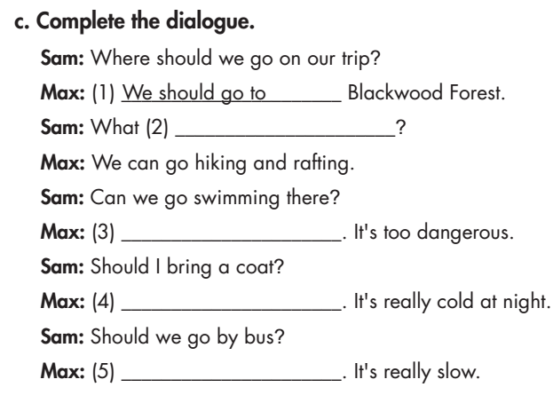
can we do there
No, we can’t
Yes, you should
No, we shouldn’t

Slide 18

Production

Slide 19
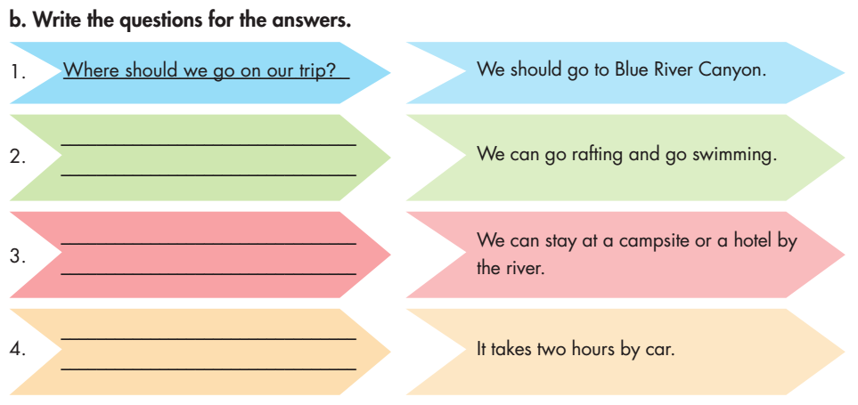
Extra activity
WB page 45
What can we do there?
Where can we stay?
How long does it take to get there?

Slide 20
Your friend plans to go on vacation. Write 3 sentences to give him/her some advice, using “should/shouldn’t”
You should go to……….
You should bring……….
You shouldn’t go by……….because……….

Slide 21
Write 3 sentences about what you can/ can’t do at school.
At school we can………..
At school we can……….
At school we can’t………..

Slide 22

CONSOLIDATION

Slide 23
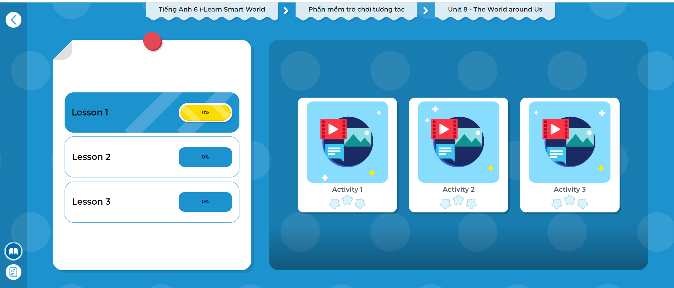
Click the picture below to play the games!

Slide 24
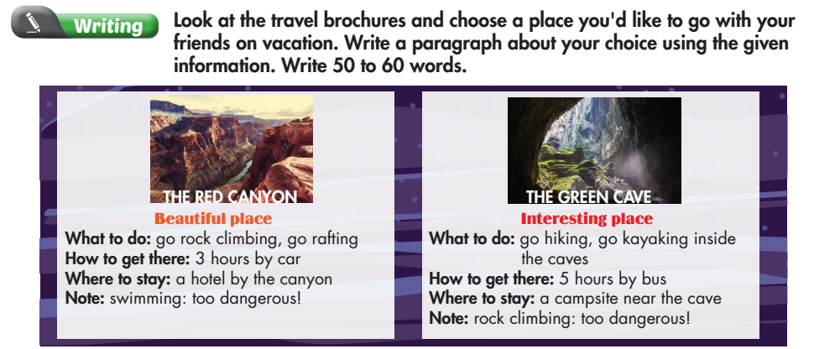
Extra activity
WB page 45

Slide 25
I think we should go to ……….. It’s a beautiful place. It takes about ……….. hours to go there by ……….. We can ……….. We can ……….. We can’t ……….. It’s too dangerous.

Slide 26

WRAP-UP

Slide 27
Today’s lesson
Grammar
- Use “should” to ask for and give advice.
- Use “can” to talk about possibility.
- Use “can’t” for things that are very unsafe to do.

Slide 28
Homework
Do the exercises on page 45 WB.
Complete the grammar notes in Tiếng Anh 6 i-Learn Smart World Notebook on page 47.
Prepare the next lesson (page 64 - SB).
Play the consolidation games in Tiếng Anh 6 i-Learn Smart World DHA App on www.eduhome.com.vn

Slide 29

Enjoy your day!

