Slide 1


Slide 2

Unit
8
1
Unit
FAMILY LIFE
NEW WAYS TO LEARN
LESSON 6
WRITING
Writing about the benefits of blended learning

Slide 3

Unit
1
1
FAMILY LIFE
Family Life
Unit
OBJECTIVES
1. Knowledge
- Use the lexical items related to the topic New ways to learn to write a paragraph about the benefits of blended learning.
2. Core competence
- Develop communication skills and creativity;
- Be collaborative and supportive in pair work and team work;
- Actively join in class activities.
3. Personal qualities
- Recognize the benefits of blended learning so that students can make use of their time in class to study better;
- Be more active in blended learning classrooms.

Slide 4
LESSON 6
WRITING
Unit
GETTING STARTED
WARM-UP
Menti game
PRE-WRITING
Task 1: Discuss and tick the benefits of blended learning.
Task 2: Use the benefits in Task 1 and your own ideas to complete the following outline.
WHILE-WRITING
Task 3: Write a paragraph about the benefits of blended learning
POST-WRITING
Peer review and evaluation
CONSOLIDATION
Wrap-up
Home work

Slide 5
LESSON 6
WRITING
Unit
GETTING STARTED
WARM-UP
Menti game

Slide 6
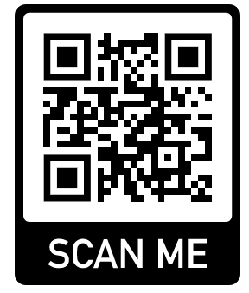
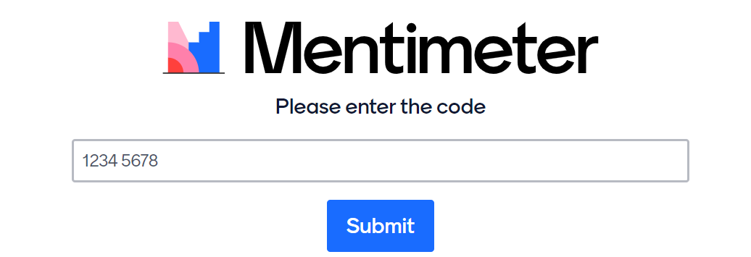
WARM-UP
Game rules
Enter: menti.com
Code: …

Slide 7
WARM-UP
Write down all types of learning that you have learnt.

Slide 8
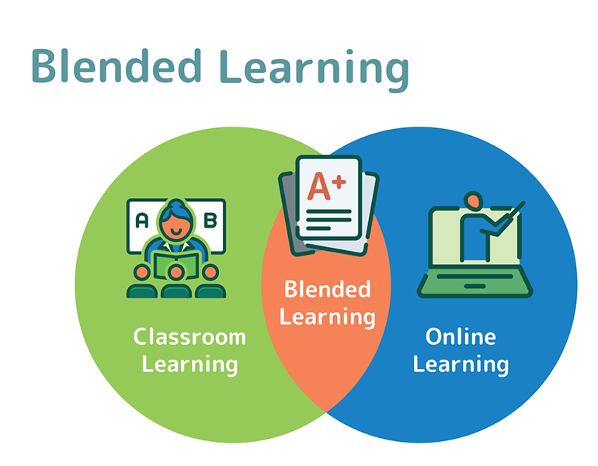
WARM-UP

Slide 9
LESSON 3
WRITING
Unit
GETTING STARTED
WARM-UP
Menti game
PRE-WRITING
Task 1: Discuss and tick the benefits of blended learning.
Task 2: Use the benefits in Task 1 and your own ideas to complete the following outline.

Slide 10

PRE-WRITING
1
Discuss and tick the benefits of blended learning
1. It helps students have more control over their own learning.
2. It is easier to get access to lesson materials.
3. It may not prepare students well for tests.
4. Students can develop better communication and teamwork skills.
5. It is not suitable for students who have no Internet connection or computers.

Slide 11
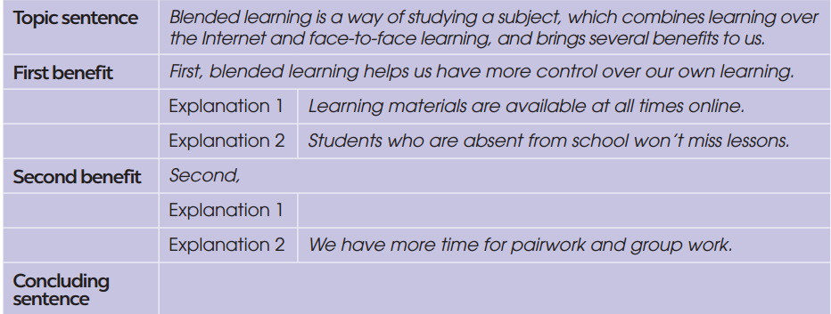
PRE-WRITING
2
Use the benefits in Task 1 and your own ideas to complete the following outline.
students can develop better communication and teamwork skills.
We can use different ways to communicate in class.
I think we should have more blended learning classes at school because they keep us engaged and help us learn useful skills.

Slide 12

PRE-WRITING
Put the following phrases in the appropriate columns:
- First/Second,
- The first/second benefit of … is + N/V-ing
- This enables + us + to-V
- Firstly/Secondly/Finally,
- This allows students to +V
- To conclude,
- In conclusion,
- It helps us + V
- We will be able + to-V
- In brief,
- First and foremost,
- Last but not least,
Linking words/structures | Expressions about the benefits of something

Slide 13
PRE-WRITING
Put the following phrases in the appropriate columns: (KEY)
Linking words/structures | Expressions about the benefits of something
- Firstly/Secondly/Finally, - First/Second, - The first/second benefit of … is +N/V-ing - To conclude, - In conclusion, - In brief, - First and foremost, - Last but not least, | - We will be able + to-V - This enables + us + to-V - It helps us + V - This allows students to +V

Slide 14
LESSON 6
WRITING
Unit
GETTING STARTED
WARM-UP
Menti game
PRE-WRITING
Task 1: Discuss and tick the benefits of blended learning.
Task 2: Use the benefits in Task 1 and your own ideas to complete the following outline.
WHILE-WRITING
Task 3: Write a paragraph about the benefits of blended learning

Slide 15
WHILE-WRITING
3
Use the outline in Task 2 and expressions below to write a paragraph (120 – 150 words) about the benefits of blended learning.

Slide 16
WHILE-WRITING
Useful expressions
Linking words/structures | Expressions about the benefits of something
- Firstly/Secondly/Finally, - First/Second, - The first/second benefit of … is +N/V-ing - To conclude, - In conclusion, - In brief, - First and foremost, - Last but not least, | - We will be able + to-V - This enables + us + to-V - It helps us + V - This allows students to +V

Slide 17
WHILE-WRITING
First, _________________________________________________________
______________________________________________________________
______________________________________________________________
Second, _______________________________________________________
____________________________________________________________________________________________________________________________
Finally, ________________________________________________________
______________________________________________________________
______________________________________________________________

Slide 18
LESSON 6
WRITING
Unit
GETTING STARTED
WARM-UP
Menti game
PRE-WRITING
Task 1: Discuss and tick the benefits of blended learning.
Task 2: Use the benefits in Task 1 and your own ideas to complete the following outline.
WHILE-WRITING
Task 3: Write a paragraph about the benefits of blended learning
POST-WRITING
Peer review and evaluation

Slide 19
POST-WRITING
WRITING CRITERIA
Topic sentence: …/10
Supporting detail sentences: …/10
Elaborating detail sentences: …/10
Legibility: …/10
Spelling and grammar: …/10
TOTAL: …/50

Slide 20
CONSOLIDATION
1
Wrap-up
1. Knowledge
- Use the lexical items related to the topic New ways to learn to write a paragraph about the benefits of blended learning.
2. Core competence
- Develop communication skills and creativity;
- Be collaborative and supportive in pair work and team work;
- Actively join in class activities.
3. Personal qualities
- Recognize the benefits of blended learning so that students can make use of their time in class to study better;
- Be more active in blended learning classrooms.

Slide 21
CONSOLIDATION
2
Homework
Do exercises in the workbook
Prepare for the next lesson: Communication and Culture

Slide 22

Website: hoclieu.vn
Fanpage: facebook.com/tienganhglobalsuccess.vn/

