Slide 1
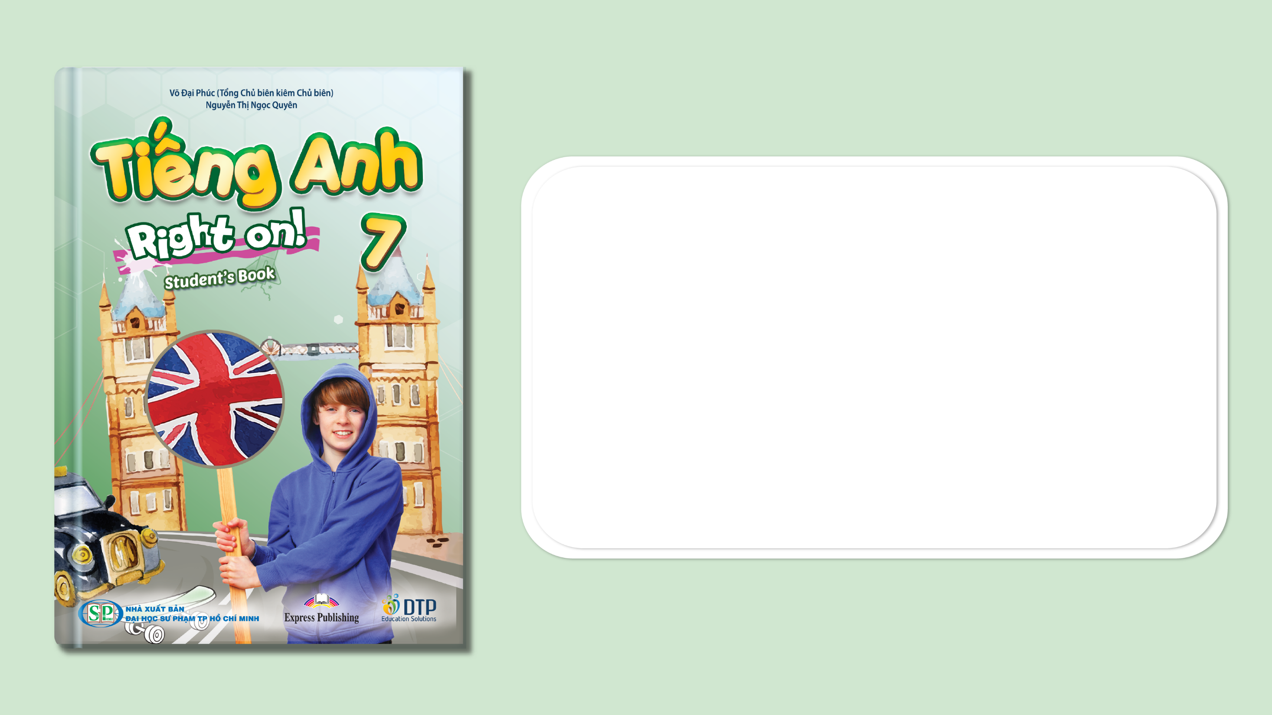
Unit 5: Travel & Transportation
Lesson 5f: Skills
Page 88

Slide 2
Lesson Outline
Warm-up
Vocabulary
Reading
Speaking
Consolidation
Wrap-up

Slide 3
Objectives
By the end of this lesson, students will be able to…
learn and use some vocabulary related to traveling: bank, guard, stupa, monument, statue.
read the text about travelling for important details.

Slide 4

WARM-UP

Slide 5

Work in pairs.
Choose the word whose main stress is placed
differently from the others.
1. A. museum B. hoverbike C. designer D. opinion
2. A. temple B. greetings C. landmark D. balloon
3. A. photographer B. celebration C. environment D. ingredient
/mjuˈziːəm/
/ˈhɒvəbaɪk/
/dɪˈzaɪnər/
/əˈpɪnjən/
/ˈtempl/
/ˈɡriːtɪŋz/
/ˈlændmɑːk/
/bəˈluːn/
/fəˈtɒɡrəfər/
/ˌseləˈbreɪʃn/
/ɪnˈvaɪrənmənt/
/ɪnˈɡriːdiənt/
Notes:
Celebration
gates bank
floor soon
great

Slide 6
Work in pairs.
If you have enough money to travel, where do you want to visit? Why?
E.g. If I have enough money to travel, I will visit Phong Nha – Kẻ Bàng. This is because I want to explore a beautiful natural cave with many strange kinds of trees and animals.

Slide 7

It’s time to learn …

Slide 8
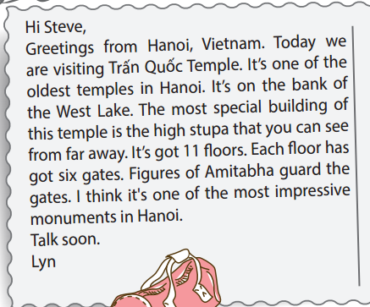
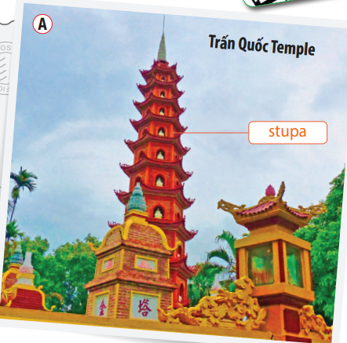
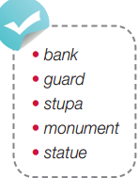
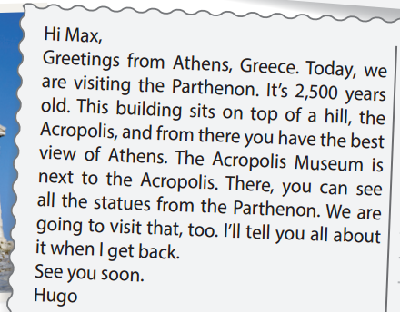
Pre-reading
Find these words in the text, try to guess their meanings.

Slide 9

Vocabulary
Listen and repeat.
bank /bæŋk/ (n) bờ sông
guard /ɡɑːd/ (v) bảo vệ, canh gác
stupa /ˈstuːpə/ (n) phù đồ, bảo tháp (Phật giáo)
monument /ˈmɒnjumənt/ (n) di tích, công trình kỉ niệm
statue /ˈstætʃuː/ (n) tượng đài

Slide 10
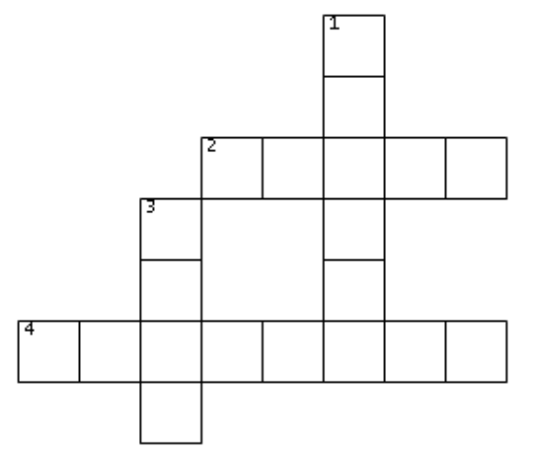
Do the crossword
Extra Practice
ACROSS
2. to protect or pay close attention to something in order to keep it safe
4. something built in memory of a person, event, or special act
DOWN
1. an object made from stone or metal, etc. to look like a person or animal
3. the side of the river
S
T
G
U
A
R
D
B
T
A
U
M
O
N
U
M
E
N
T
K

Slide 11

Pre-Reading
Read the instruction quickly. Underline the key words. What are we going to do?

Slide 12
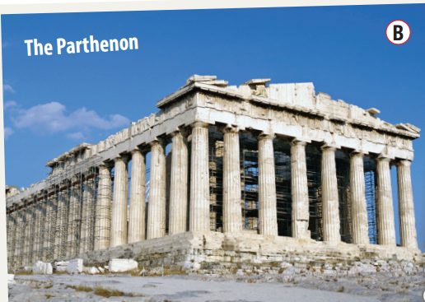
While-reading
Where is each?
A. Trấn Quốc Temple:
Hanoi, Vietnam
B. The Parthenon:
=> Athens, Greece

Slide 13
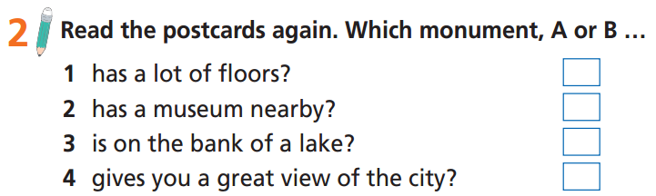
Pre-reading
Read the instruction quickly. Underline the key words. What are we going to do?

Slide 14
While-reading

Slide 15
Read the text and decide whether the following statements are True, False, or Doesn’t say.
Extra Practice
Trấn Quốc Temple is the biggest monument in Hanoi.
There is a stupa in Trấn Quốc Temple.
The Parthenon was built more than 2,000 years ago.
The Parthenon is far from Acropolis.
Hugo is standing in the Acropolis Museum.

Slide 16
Now, read again to check the answers.
Trấn Quốc Temple is the biggest monument in Hanoi.
Doesn’t say

Slide 17
Now, read again to check the answers.
2. There is a stupa in Trấn Quốc Temple.
True

Slide 18
Now, read again to check the answers.
3. The Parthenon was built more than 2,000 years ago.
True

Slide 19
Now, read again to check the answers.
4. The Parthenon is far from Acropolis.
False

Slide 20
Now, read again to check the answers.
5. Hugo is standing in the Acropolis Museum.
False

Slide 21
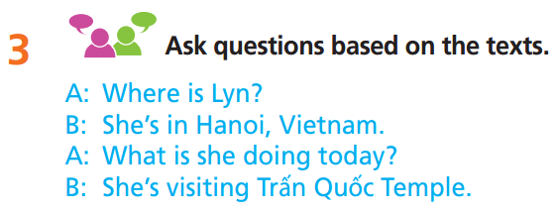
Post-reading
A: Where is Hugo?
B: He’s in Athens, Greece.
A: What’s is he doing today?
B: He is visiting the Parthenon today.
A: How old is the Parthenon?
B: It’s 2,500 years old.
A: Where is the Parthenon?
B: It’s on the top of the Acropolis Hill.
A: Where is Trấn Quốc Temple?
B: It’s on the bank of the West Lake?
A: What is the most special building of the temple?
B: It’s the high stupa. etc.

Slide 22
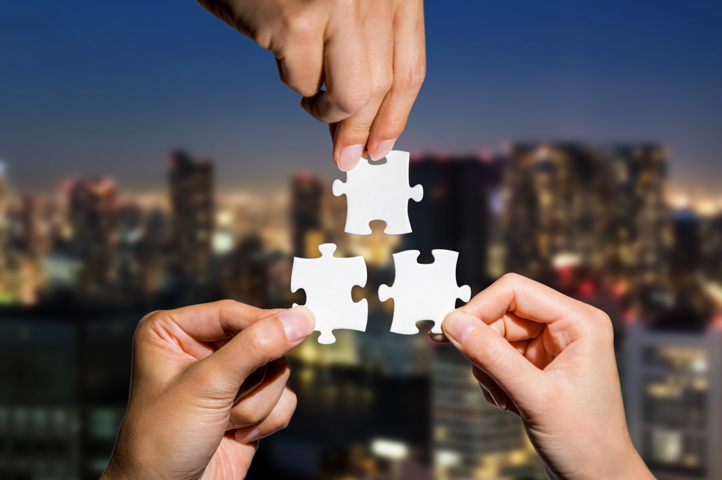
CONSOLIDATION

Slide 23
Write a paragraph (60-80 words) to describe a tourist destination you visited. You can use the following ideas:
Where is it?
When did you go there?
What is special about it?
What activities did you do there?
E.g.
I went to Ha Long Bay three years ago. It is in Quang Ninh Province, in the North of Vietnam. Ha Long Bay is very beautiful with many small islands. It was recognized as a world natural heritage by UNESCO. I enjoyed the fresh air and had an interesting boat trip to some small islands. I also went to see the beautiful natural caves there. The seafood there was delicious, too.

Slide 24

WRAP-UP

Slide 25
Today’s lesson
Vocabularies
bank
guard
stupa
monument
statue
Reading
Read the text about travelling for important details.

Slide 26
Homework
Practise the vocabularies and make sentences using them.
Do the exercises in TA 7 Right on WB (page 47)
Prepare the next lesson (page 89 SB)
Do the exercise in TA 7 Right on Notebook (page 41)

Slide 27
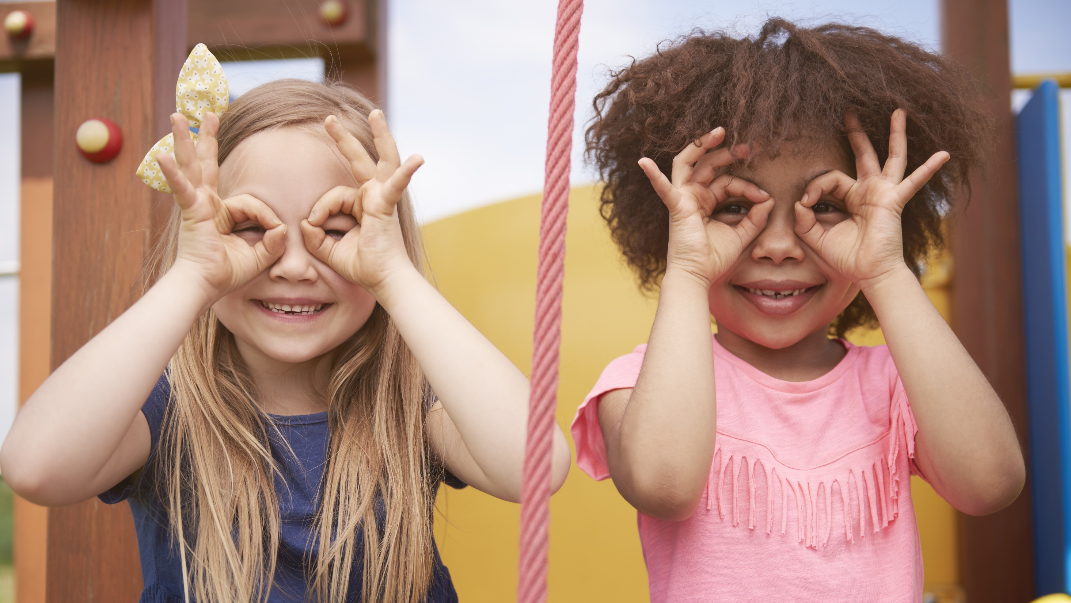
Enjoy your day!

