Slide 1


Slide 2

Unit
2
1
Unit
FAMILY LIFE
HUMANS AND THE ENVIRONMENT
LESSON 7
COMMUNICATION AND CULTURE

Slide 3

Unit
1
1
FAMILY LIFE
Family Life
Unit
OBJECTIVES
By the end of this lesson, students will be able to:
Ask for and give advice
Understand what a carbon footprint is.

Slide 4
LESSON 7
COMMUNICATION AND CULTURE
Unit
GETTING STARTED
WARM-UP
Clip watching
EVERYDAY ENGLISH
Task 1: Listen and complete the conversation.
Task 2: Make a similar conversation.
Vocabulary
Task 1: Read the text and complete the table.
Task 2: Discussion
CLIL
CONSOLIDATION
Wrap-up
Home work

Slide 5
LESSON 7
COMMUNICATION AND CULTURE
Unit
GETTING STARTED
WARM-UP
Clip watching

Slide 6
WARM-UP
Clip watching
Watch the clip and answer the questions:
1. What is carbon footprint?
2. What activities causes large carbon footprint?

Slide 7

WARM-UP
Clip watching

Slide 8
WARM-UP
Clip watching
Watch the clip and answer the questions:
1. What is carbon footprint?
Carbon footprint is the amount of carbon dioxide you produce due to your activities.
2. What activities causes large carbon footprint?
Using too much electricity and gas such as using the air conditional nonstop; taking a lot of flights; driving too much, eating a lot of red meat

Slide 9
LESSON 7
COMMUNICATION AND CULTURE
Unit
GETTING STARTED
WARM-UP
Clip watching
EVERYDAY ENGLISH
Task 1: Listen and complete the conversation.
Task 2: Make a similar conversation.

Slide 10
EVERYDAY ENGLISH
1
Listen and complete the conversation with the expressions in the box.
You should B. What should I do
C. I advise you D. Should I
Lan: I was asked to give a presentation on climate change next week. (1) ______________, Mai?
Mai: (2) __________ search for information about the topic on the Internet.
Lan: (3) __________ also read books in the library?
Mai: That’s a good idea. (4) ___________ to collect information from different sources. Then you can decide what to include in the presentation.
What should I do
You should
Should I
I advise you

Slide 11
EVERYDAY ENGLISH
2
Work in pairs. Make a similar conversation asking for and giving advice about green living. Use the expressions below to help you.
USEFUL EXPRESSIONS
Asking for advice | Giving advice
What should I do? | I think you should …
What do you advise me to do? | I advise you to …
Do you have any suggestions for me? | How about …?
What would you do if you were me? | If I were you, I would …
Can you give me some advice about…? | My advice would be to …

Slide 12
LESSON 7
COMMUNICATION AND CULTURE
Unit
GETTING STARTED
WARM-UP
Clip watching
EVERYDAY ENGLISH
Task 1: Listen and complete the conversation.
Task 2: Make a similar conversation.
Vocabulary
Task 1: Read the text and complete the table.
Task 2: Discussion
CLIL

Slide 13
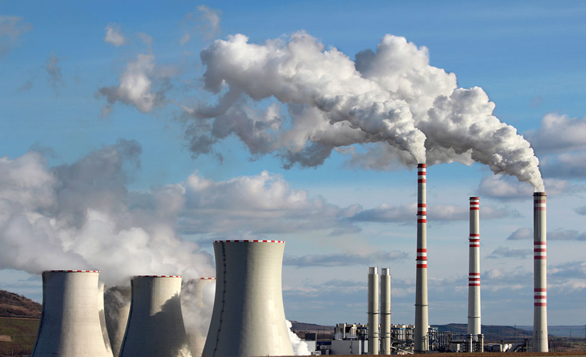

VOCABULARY
emission (n)
/ɪˈmɪʃn/
an amount of something, especially a gas that harms the environment, that is sent out into the air
khí thải

Slide 14
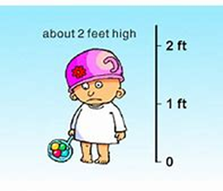
VOCABULARY
estimate (v)
/ˈestɪmeɪt/
guess or calculate the cost, size, value, etc. of something
ước tính

Slide 15
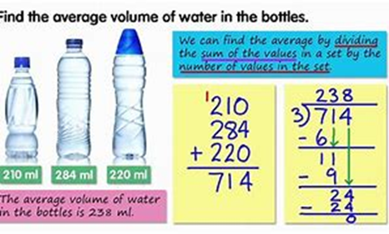
VOCABULARY
average (n)
/ˈævərɪdʒ/
An average number is the number you get by adding two or more amounts together and dividing the total by the number of amounts
trung bình

Slide 16
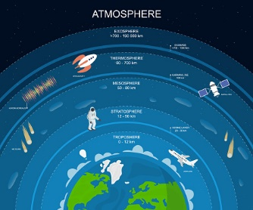
VOCABULARY
atmosphere (n)
/ˈætməsfɪə(r)/
the mixture of gases that surrounds the earth
bầu khí quyển

Slide 17
CLIL
PRACTICE
1
Read the text and complete the table.
Carbon footprint
Definition | Effects of large carbon footprint | Ways to reduce it
Carbon footprint is: - the total amount of (1) _______ produced by human activities - emissions of other greenhouse gases | - Increasing (2) __________________ and air pollution - Destroying the natural world | Make your daily activities eco-friendly by: - taking shorter (3) ________ - using (4) ______________, walking or cycling
global temperatures
CO2
showers
public transport

Slide 18
CLIL
PRACTICE
2
Work in pairs. Discuss things you can do to reduce your carbon footprint.
For example:
Lan thinks that her carbon footprint is not very big, but she’ll try to reduce it to further help the environment. First, she’ll start cycling to school instead of asking her dad to drive her. Second, she’ll stop using plastic bags for groceries. Finally, she'll start drinking filtered tap water instead of buying bottled water.

Slide 19
LESSON 7
COMMUNICATION AND CULTURE
Unit
GETTING STARTED
WARM-UP
Clip watching
EVERYDAY ENGLISH
Task 1: Listen and complete the conversation.
Task 2: Make a similar conversation.
Vocabulary
Task 1: Read the text and complete the table.
Task 2: Discussion
CLIL
CONSOLIDATION
Wrap-up
Home work

Slide 20
CONSOLIDATION
1
Wrap-up
The ways to ask for and give advice
What carbon footprint is and the ways to reduce it in our life.

Slide 21
CONSOLIDATION
2
Homework
Do exercises in the workbook

Slide 22

Website: hoclieu.vn
Fanpage: facebook.com/www.tienganhglobalsuccess.vn

