Slide 1

Unit 2: Health
Lesson 3.2: Writing
Page 19

Slide 2

LESSSON OUTLINE
Presentation
Practice
Production
Consolidation
Wrap-up

Slide 3

By the end of this lesson, students will be able to…
write a request letter.

Slide 4

WARM-UP

Slide 5

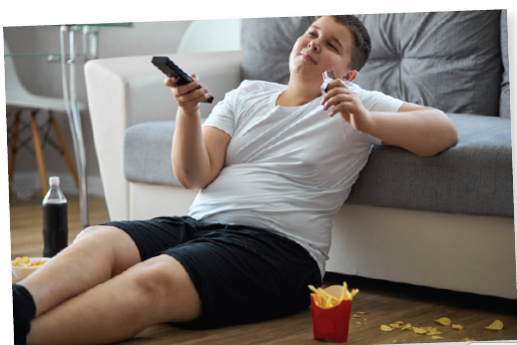

a. Name the activities in the following photos.
2. Eating ___________
French fries
asleep
3. Falling __________
Eating ______ and _________
fruit
1.
vegetables
Click here for the answers.

Slide 6


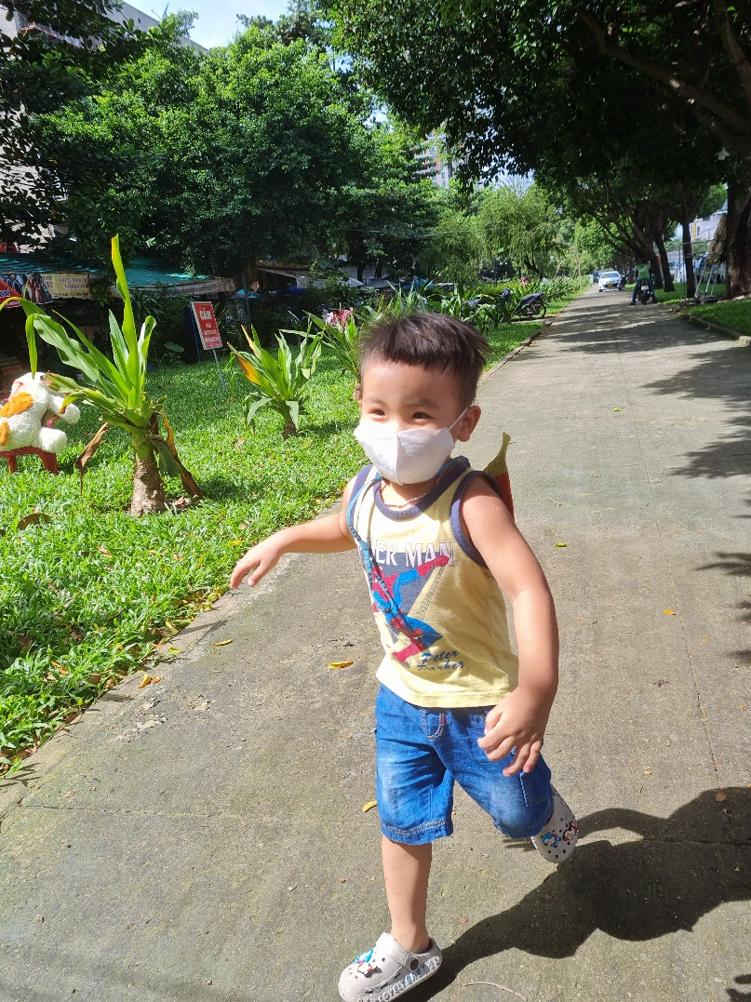

bicycle
1. Riding a ______
4. _____ ____ __________
Going to sleep / bed
3. ________
running
up late
2. staying ____ ____
Click here for the answers.

Slide 7
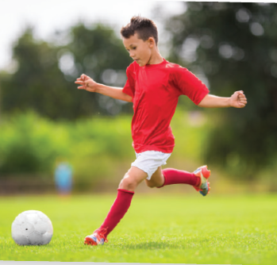


football
1. Playing _______
some rest
2. Getting _____ _____
3. feeling ____
weak
Click here for the answers.

Slide 8
a. Becky is having some problems. Some of the phrases in exercise A are Becky’s problems and some are advice. Match the problems to the correct advice.
Becky’s problems
Eating lots of French fries
Falling asleep
Staying up late every day
Feeling weak
Advice for Becky
a. She should play sports like football.
b. She should get some rest every one hour.
c. She should go to bed early.
d. She should eat more fruit and vegetables.
d
____
____
b
____
c
a
____
Click here for the answers.

Slide 9

WRITING

Slide 10
a. Read about writing request letters.
Writing Skill Box
To make requests effectively in a letter, you should:
1. Write your address at the top and the receiver's address below.
2. Write a greeting.
3. Say who you are and why you are writing.
4. Introduce the problem.
5. Give useful solutions.
6. Ask the reader to do something.
7. Finish the letter with a farewell and your name.

Slide 11
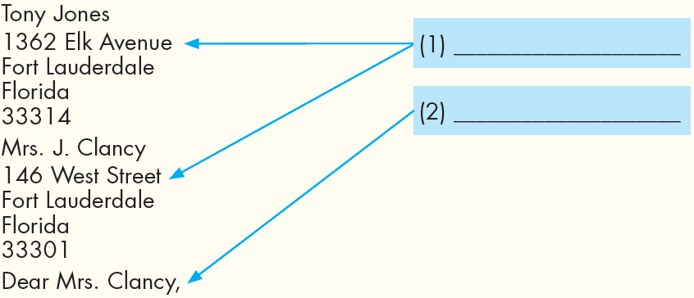
b. Read Tony’s letter again and fill in the labels.
Address
Greeting
Click here for the answers.

Slide 12
b. Read Tony’s letter again and fill in the labels.
3. ___________
____________
____________
Say who you are and why you are writing
My name is Tony and I am in Class 7D. I am writing
to ask you to provide us with healthier food in the cafeteria.
At the moment, it only sells things like soda and fast food. It really isn’t good for students. It makes us feel tired after eating lunch. My classmate even fell asleep at his desk in math class and got in lots of trouble. It makes it so difficult for us to study.
4. ________
___________
Introduce
the problem
Click here for the answers.

Slide 13
Put the sentences (1–7) in the correct order of a request letter.
Use the skill box to help you.
____
____
____
____
____
____
____
4
a. The cafeteria sells lots of fast food and it makes the students tired.
b. Joe Adams, 167 Clay Hall Drive, Grantham, G1 5EP
Ms. Jones, 29 Woodland Road, Grantham, G1 5ED
Dear Ms. Jones,
My name is Joe from Class 7B and I am writing to ask for more healthy food in the cafeteria.
e. Sincerely,
Joe Adams
f. I think it should sell some salad and fruit juices.
g. Please help us and make the cafeteria healthier.
1
2
3
7
5
6
Click here for the answers.

Slide 14
a. In pairs: Look at the pictures and name the foods.
Click here for the answers.
_____________
fruits
instant noodles
nuts
___________
___________
ice cream
___________
Discuss which foods you think would help you study better.
Why or why not? Can you buy any of these at your school?
Instant noodles and ice cream are not healthy, so they wouldn’t help me study better.
Nuts and fruits are really healthy, so they would help me study better.

Slide 15
b. Now, complete the table about your school.
Address of your school
Name of your principal
Unhealthy things you can buy in your cafeteria
Healthy things you want in your cafeteria

Slide 16

c. Now, write a letter to your school’s principal asking for better food in your cafeteria. Use the feedback form to help you. Write 60 to 80 words.
The letter follows the model and uses the correct structure.
It is interesting. (Suggest ideas, if not.)
I can understand everything.
(Underline anything you don't understand.)

Slide 17
Sample answer
Duy Nguyễn
189 Nguyễn Phúc Chu Street, Ward 15,
Tân Bình District, Ho Chi Minh City
Mr. Anh Trần
148 Nguyễn Đình Chính Street, Ward 8,
Phú Nhuận District, Ho Chi Minh City
Dear Mr. Anh,
I am writing to ask for more healthy food in the cafeteria.
It sells lots of soda and fast food. They have too much sugar and salt in them. It is not good for students.
I think it should sell more fruit and smoothies. This will help students learn better and be healthier.
Please help us by asking the cafeteria to sell healthier food and drinks soon.
Sincerely,
Duy Nguyễn

Slide 18
- Exchange your letter with a partner.
- Double check, using the feedback form to see if you can help your friend write better! ​
The letter follows the model and uses the correct structure.
It is interesting. (Suggest ideas, if not.)
I can understand everything.
(Underline anything you don't understand.)

Slide 19
Workbook page 13
Number the sentences (1–7) in correct order of a request letter.
____
a. Our fitness hall is closed until next month.
b. John West, 215 Penny Lane, Liverpool L15 9EB
Ms. Harris, 83 Pound Street, Liverpool L15 9AY
c. Dear Ms. Harris,
d. My name is John from Penny Lane Fitness Center and I am writing to ask if we can use the town hall for our fitness classes.
e. Sincerely,
John West
f. We would like to use the town hall on Wednesdays from 7 until 9 p.m.
g. Please help us by saying yes.
4
____
1
____
2
3
____
7
____
____
5
6
____
Click here for the answers.

Slide 20
Think about sports and fitness in your school. Is there enough space to play sports and do exercise? What kind of sports equipment (bats, balls, table tennis) or facilities (swimming pool, football pitch) would you like to have? Complete the table about your school.
Address of your school
Name of your principal
Space and equipment in your school
Sports and fitness equipment you would like to have

Slide 21

CONSOLIDATION

Slide 22
Today’s lesson
1. Write your address at the top
and the receiver's address below.
2. Write a greeting.
3. Say who you are and
why you are writing.
WRITING
A REQUEST LETTER
4. Introduce the problem.
5. Give useful solutions.
6. Ask the reader to do something.
7. Finish the letter with a farewell and your name.

Slide 23

WRAP-UP

Slide 24
Today’s lesson
Writing:
Understand steps to write a request letter.
Practice writing a request letter.

Slide 25
Homework
Do the writing exercise in Workbook, page 13.
Complete the writing notes in Tiếng Anh 7 i-Learn Smart World Notebook on page 13.
Prepare Review Unit 2 (pages 86 & 87, SB).
Play consolidation games in Tiếng Anh 7 i-Learn Smart World DHA App on www.eduhome.com.vn

Slide 26

Lesson 3
Stay positive and have a nice day!

