Slide 2
MAKING COMPLAINTS AND RESPONDING TO THEM
Unit 4
urbanization
COMMUNICATION AND CULTURE / CLIL
Here is where your presentation begins

Slide 3
LESSON 6
COMMUNICATION AND CULTURE / CLIL
WARM-UP
Watch a video and answer the questions.
EVERYDAY ENGLISH
Task 1: Listen and complete the conversations.
Task 2: Work in pairs.
Task 1: Read the text and complete the table.
Task 2: Work in groups and discuss.
CULTURE/ CLIL
Task 4: Peer review
FURTHER PRACTICE
CONSOLIDATION
Wrap-up
Homework

Slide 4

Choose the correct information about the video
“The Planet Earth” to get bonus
https://www.youtube.com/watch?v=gKdxPw9HDUs&t=1s

Slide 5

1. What percentage of Earth's atmosphere is composed of oxygen?
78%
21%
12%
6%

Slide 6
2. Which climate type doesn't fit into any specific group?
30 days
24 hours
12 hours
365 days

Slide 7
3. Which climate type doesn't fit into any specific group?
Continental
Tropical
Highland
Polar

Slide 8
4. What is the approximate rate of gravity pulling objects toward the Earth's surface?
5.2 meters per second
12.5 meters per
second
15.3 meters per second
9.8 meters per
second

Slide 9
5. How many different types of climates are mentioned in the description?
12
16
4
8

Slide 10
6. What is the tilt of Earth's axis mentioned in the description?
23.5 degrees
45 degrees
10 degrees
30 degrees

Slide 11

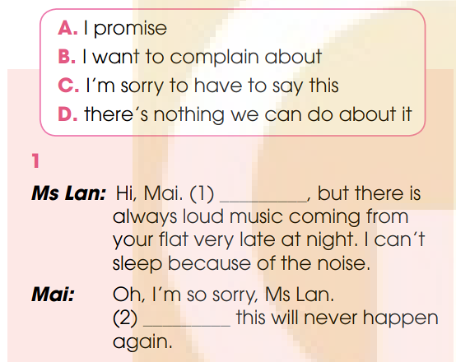

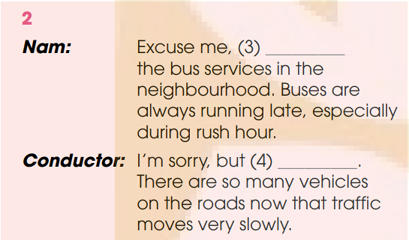
EVERYDAY ENGLISH
1
Listen and complete the conversations with the expressions in the box. Then practise them in pairs.
C
D
B
A

Slide 12

EVERYDAY ENGLISH
2
Work in pairs.
Use the models in 1 to make similar conversations for these situations.
One of you is a, the other is B. Use the expressions to help you.
1. A has recently moved to a busy urban area. He/She is attending a community meeting chaired by B, who is an urban planner. A is complaining to B about the frequent traffic jams in the area. B is giving a response.
2. B is attending a talk by A, a local government official, who is discussing problems in their city. B is complaining to A about the city’s overcrowded living conditions. A is giving a response.

Slide 13

EVERYDAY ENGLISH
2
Work in pairs.
Use the models in 1 to make similar conversations for these situations.
One of you is a, the other is B. Use the expressions to help you.
Situation 1:
A: B, I’m sorry to say this, but your dog is running around without a lead.
It is very dangerous for many people in this park.
B: I’m sorry, I promise this will never happen again.
Situation 2:
B: Excuse me, I want to complain about the delay of this train, especially during the holiday season.
A: I’m sorry, but there’s nothing we can do about it.
There are too many passengers during the holiday season, you know.

Slide 14
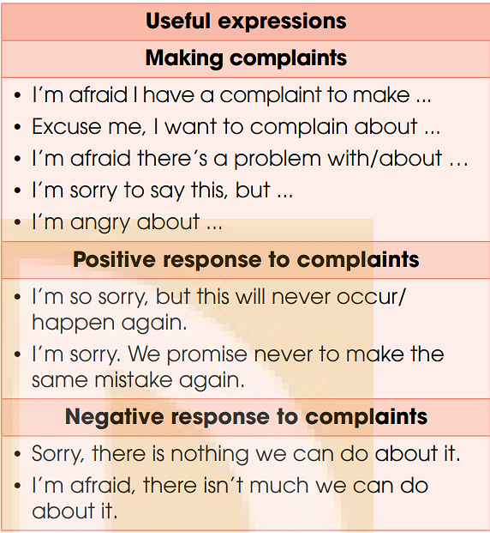
EVERYDAY ENGLISH

Slide 15
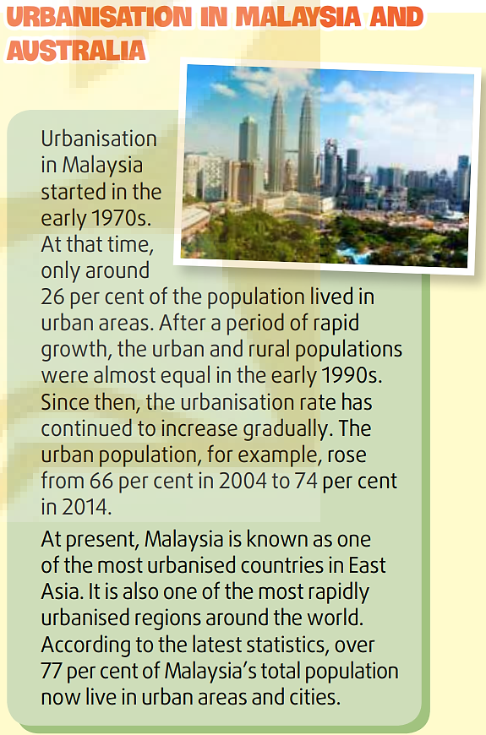
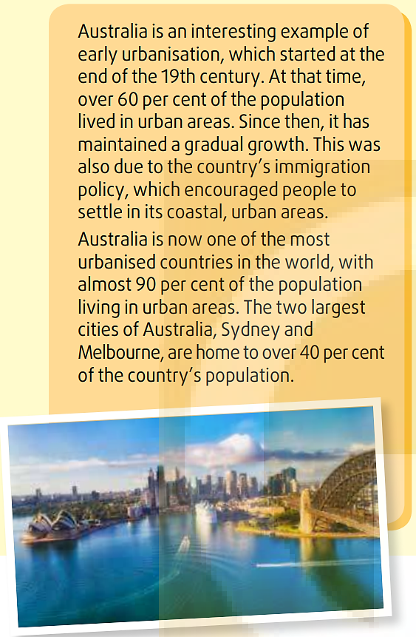
CULTURE/CLIL
1
Read the text and complete the table.

Slide 16
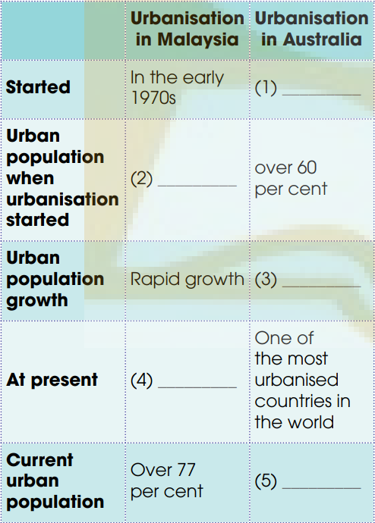
CULTURE/CLIL
At the end of
19th century
about 26
per cent
gradual
growth
One of
the most
urbanised
countries in
East Asia
Almost 90
per cent

Slide 17

CULTURE/CLIL
4
Work in groups. Compare urbanisation in Viet Nam with that in Malaysia and/or Australia. Use the information in Writing and Culture/CLiL and the questions below to help you.
• Was the proportion of urban population in Viet Nam higher or lower than that in Malaysia/Australia in the 1970s?
• Which country has a faster urbanisation rate?
• Which one is more urbanised?
• What is the overall trend in urbanisation in each country?

Slide 18
CULTURE/CLIL
4
Work in groups. Compare urbanisation in Viet Nam with that in Malaysia and/or Australia. Use the information in Writing and Culture/CLiL and the questions below to help you.
In the 1970s, the proportion of the urban population in Viet Nam was lower than that in Malaysia by around 10 per cent. Compared to Australia, the figure was almost 10 times smaller. Since the 1970s, in both Viet Nam and Malaysia urbanisation is increasing, but in Malaysia, the rate is faster. At present, about 40 per cent of Viet Nam’s population lives in urban areas, while more than 77 per cent of Malaysia’s and almost 90 per cent of Australia’s population live in urban areas. Australia is one of the most urbanised countries in the world while Malaysia is the most urbanised country in East Asia.

Slide 19
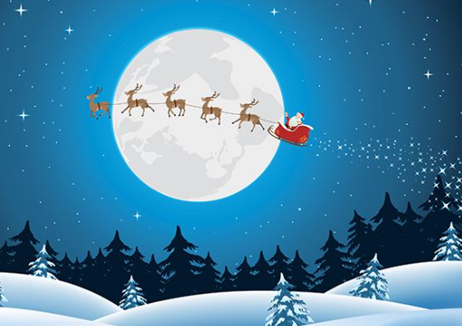
FURTHER PRACTICE
4
Work in group and discuss some questions about Christmas

Slide 20

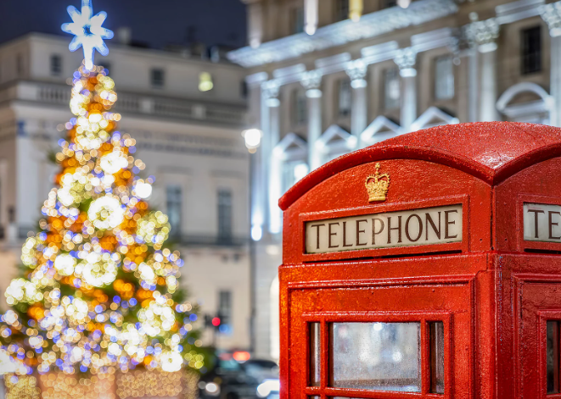
FURTHER PRACTICE
4
1. What are some of your favorite Christmas traditions that you and your family participate in?
2. If you could give a special Christmas gift to someone you care about, who would it be and why?

Slide 21
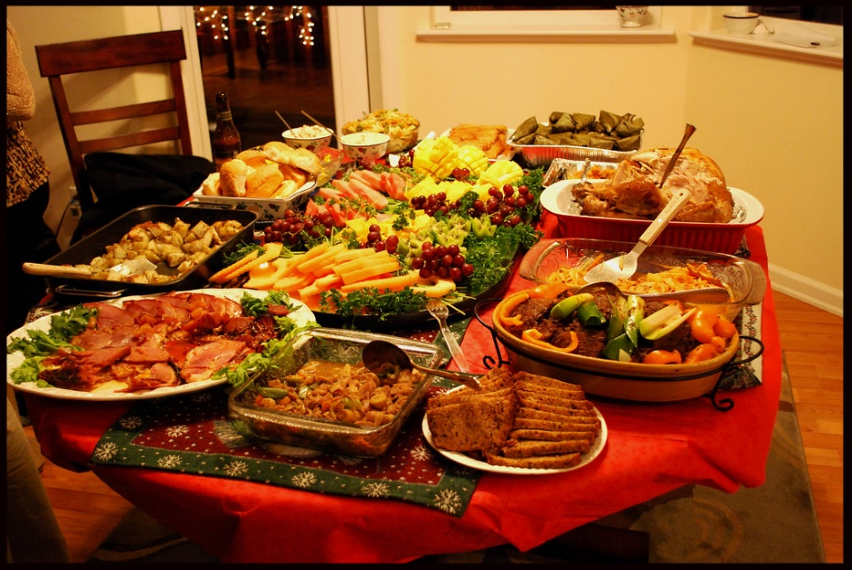

FURTHER PRACTICE
4
2. If you could give a special Christmas gift to someone you care about, who would it be and why?
1. What are some of your favorite Christmas traditions that you and your family participate in?
On Christmas Eve, the family members reunite. We sing, play, dance and have Christmas dinner together.

Slide 22

FURTHER PRACTICE
4
2. If you could give a special Christmas gift to someone you care about, who would it be and why?
I would give Christmas card to my younger sister because I want to give her best wishes.

Slide 23

CONSOLIDATION
1
Wrap-up
What have you learnt today?
Listen for main ideas and specific information in a conversation about making a complaint and responding to them

Slide 24

CONSOLIDATION
2
Homework
Learn new words by heart.
Do exercises in the workbook.
Prepare for Lesson 6 - Unit 4.

Slide 25
Website: hoclieu.vn
Fanpage: facebook.com/www.tienganhglobalsuccess.vn

