Slide 1

Unit 3: Arts and Music
Lesson 3a: Reading
Page 47

Slide 2
Lesson Outline
Warm-up
Vocabulary
Speaking
Writing
Consolidation
Wrap-up

Slide 3
Objectives
By the end of this lesson, students will be able to…
- develop public speaking skills.
- develop research skills.
- learn and use some vocabulary related to the topic.

Slide 4

WARM-UP

Slide 5

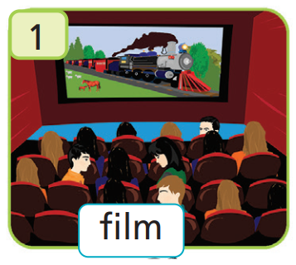
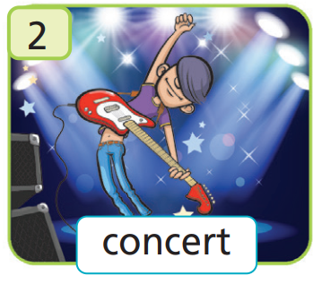
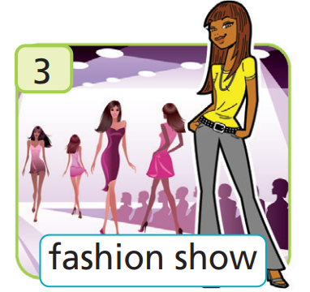
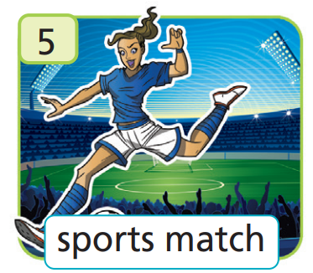
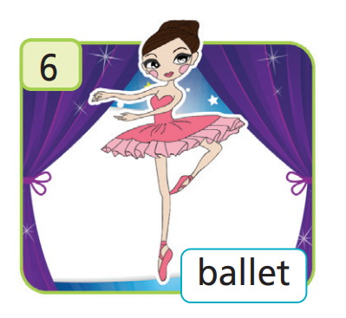
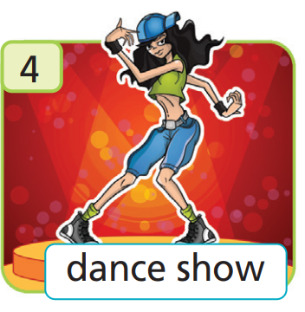
Work in pairs.
Match the words with the correct pictures.
A. ballet
B. fashion show
C. concert
D. dance show
E. film
F. sports match

Slide 6
Answer
E. film
C. concert
FILM
B. fashion show
D. dance show
F. sports match
A. ballet

Slide 7

It’s time to learn …

Slide 8

Vocabulary
Listen and repeat. Click each phrase to hear the sound.
film /fɪlm/ (n) phim
concert /ˈkɒnsət/ (n) buổi hòa nhạc
fashion show /ˈfæʃən ʃəʊ/ (n) buổi biểu diễn thời trang
dance show /dɑːns ʃəʊ/ (n) buổi biểu diễn khiêu vũ/nhảy
sports match /spɔːts mætʃ/ (n) trận đấu thể thao
ballet /ˈbæleɪ/ (n) múa ba lê

Slide 9
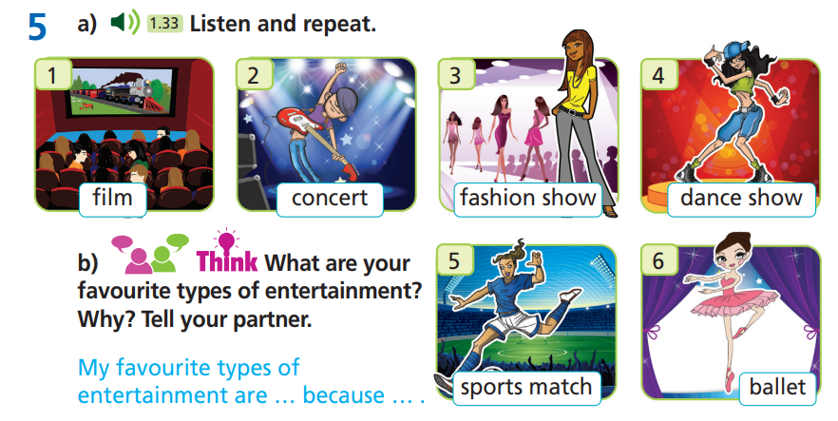

Slide 10
Extra Exercise
WB page 26
Match the descriptions (1-6) to the types of entertainment
(a-f).
1. You can see lots of dancers and dance to music at this.
2. You can see footballers there.
3. You can see models there.
4. You can listen to bands and singers at this.
5. You can see it at the cinema.
6. You can see dancers performing a story in this play.
a. sports match d. concert
b. fashion show e. film
c. ballet f. dance show

Slide 11
Extra Exercise
WB page 26
Pay attention to underlined parts.
1. You can see lots of dancers and dance to music at this.
2. You can see footballers there.
3. You can see models there.
4. You can listen to bands and singers at this.
5. You can see it at the cinema.
6. You can see dancers performing a story in this play.
a. sports match d. concert
b. fashion show e. film
c. ballet f. dance show

Slide 12
Extra Exercise
WB page 26
Answer key
1. You can see lots of dancers and dance to music
at this.
2. You can see footballers there.
3. You can see models there.
4. You can listen to bands and singers at this.
5. You can see it at the cinema.
6. You can see dancers performing a story in this play.
f. dance show
a. sports match
b. fashion show
d. concert
e. film
f. ballet

Slide 13

What are your favourite types of entertainment? Why? Tell your
partner.
Are you going to work in pairs or in groups?
In pairs.
What are you talking about?
Favourite types of entertainment and explain the reasons.

Slide 14
Suggested answer
Hi, B. What are your favourite types of entertainment?
My favourite types of entertainment are films and concerts.
Why?
Because I like going to the
cinema and I like music. And you?
Mine are fashion show because I love clothes.
That’s great.

Slide 15
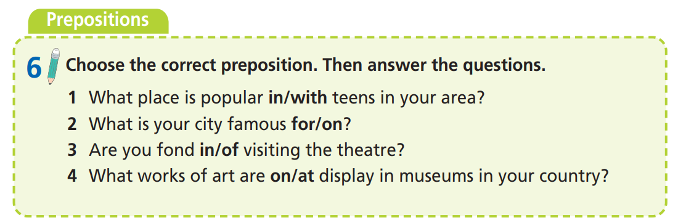
1. What are “in/with/for/on/of/at”?
Prepositions.
2. What are you going to do?
Choose the correct prepositions and answer the questions.

Slide 16
Choose the correct preposition.
1. What place is popular in/with teens in your area?
2. What is your city famous for/on?
3. Are you fond in/of visiting the theatre?
4. What works of art are on/at display in museums in your country?

Slide 17
Answer the questions.
1. What place is popular with teens in your area?
2. What is your city famous for?
3. Are you fond of visiting the theatre?
4. What works of art are on display in museums in your country?
The mall is popular with teens in my area.
My city is famous for its museums.
Yes, I’m fond of visiting the theatre.
Vietnamese silk paintings are mostly on display.

Slide 18

Speaking

Slide 19
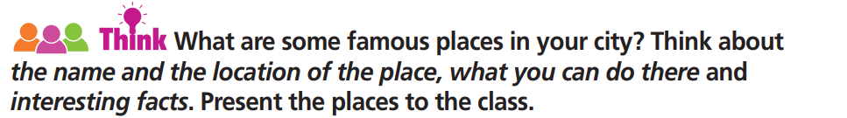

Slide 20

Pre-Speaking
Work in groups.
What are some famous places in your city? Think about the name
and the location of the place, what you can do there and interesting facts. Present the places to the class.
Are you going to work in pairs or in groups?
→ In groups.
What are you going to do?
→ Think about the name and location of some famous places in our city. Talk about interesting facts and activities to do there.

Slide 21
While-Speaking
Suggested Answer
1. Name: Saigon Opera House
Place: Ho Chi Minh City, Vietnam
What you can do there: attend cultural entertainment activities
Interesting facts: statues at the entrance, 468 seats
2. Name: Bến Thành Market
Place: Ho Chi Minh City, Vietnam
What can you do there: try Vietnamese foods and buy souvenirs
Interesting facts: 4 main gates, nearly 1,500 booths

Slide 22
Post - Speaking
In pairs, ask and answer about your favorite place to visit.

Slide 23
STUDENT A
STUDENT B
Hi, B. What is your favourite place to visit?
I would like to go Bến Thành Market.
It’s in Ho Chi Minh City.
Where is it?
I can try Vietnamese foods and buy souvenirs.
What can you do there?
What are the interesting facts?
It has 4 main gates, nearly 1,500 booths.

Slide 24
While-Speaking
Present the place to the class.
In Ho Chi Minh City, you can visit many amazing places of great history and architecture. Saigon Opera House and Bến Thành Market are two famous places. In Saigon Opera House, you can attend many cultural entertainment activities such as opera plays and concerts. The opera house has 468 seats and has beautiful statues at the entrance.
As for Bến Thành Market, you can visit this amazing market to try tasty Vietnamese foods and buy interesting souvenirs. It has four entrance gates; each gate has an area to sell local specialties. There are nearly 1,500 booths selling from junk food to luxury goods.

Slide 25

CONSOLIDATION

Slide 26
Write a paragraph (60-80 words) about a visit to a city in your country.
When do you visit?
Where do you visit?
What is the city famous for?
What can you do there?

Slide 27
Collect information, then prepare a poster about famous places around the world. Use the poster to present those places to the class.
The poster should include: name, location, interesting facts and activities you can do there.

Slide 28
Suggested Answer
The Leaning Tower of Pisa is in Pisa, Italy. It is a freestanding bell tower of the cathedral of the Italian city of Pisa. People built it between 1173 and 1372. It has 296 steps to reach the top. You can take beautiful photos here and climb to the top of the tower for a surreal tilted view of the surrounding city.

Slide 29

WRAP-UP

Slide 30
Today’s lesson
Vocabularies
film
concert
fashion show
dance show
sports match
ballet
Speaking: develop public speaking skills.
Writing: develop research skills.

Slide 31
Homework
Practise the vocabularies and make sentences using them.
Do the exercises in TA 7 Right on WB (page 26).
Prepare the next lesson (page 48 SB).
Do the exercise in TA 7 Right on Notebook (page 20).

Slide 32
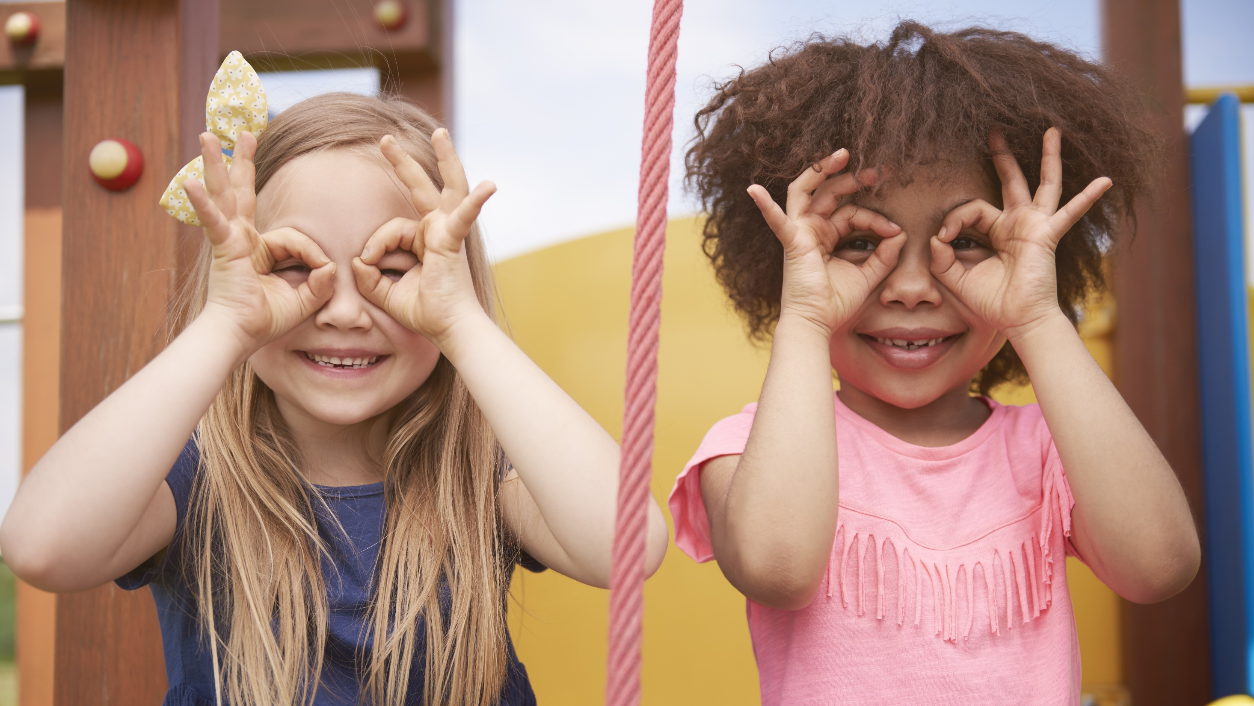
Enjoy your day!

