Slide 1

Unit 4: Festivals and Free Time
Lesson 1.3: Pronunciation & Speaking
Page 32

Slide 2
Lesson Outline
Warm-up
Pronunciation
Practice
Speaking
Consolidation
Wrap-up

Slide 3
Objectives
By the end of this lesson, students will be able to…
- Stress on the Adverbs of frequency in a sentence.
- Ask and answer about their free time activities.

Slide 4

WARM-UP

Slide 5

How often do you do these free time activities?

Slide 6

Pronunciation

Slide 7
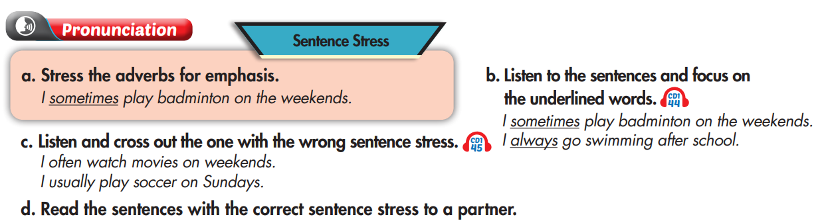

Stress on the adverbs of frequency

Slide 8
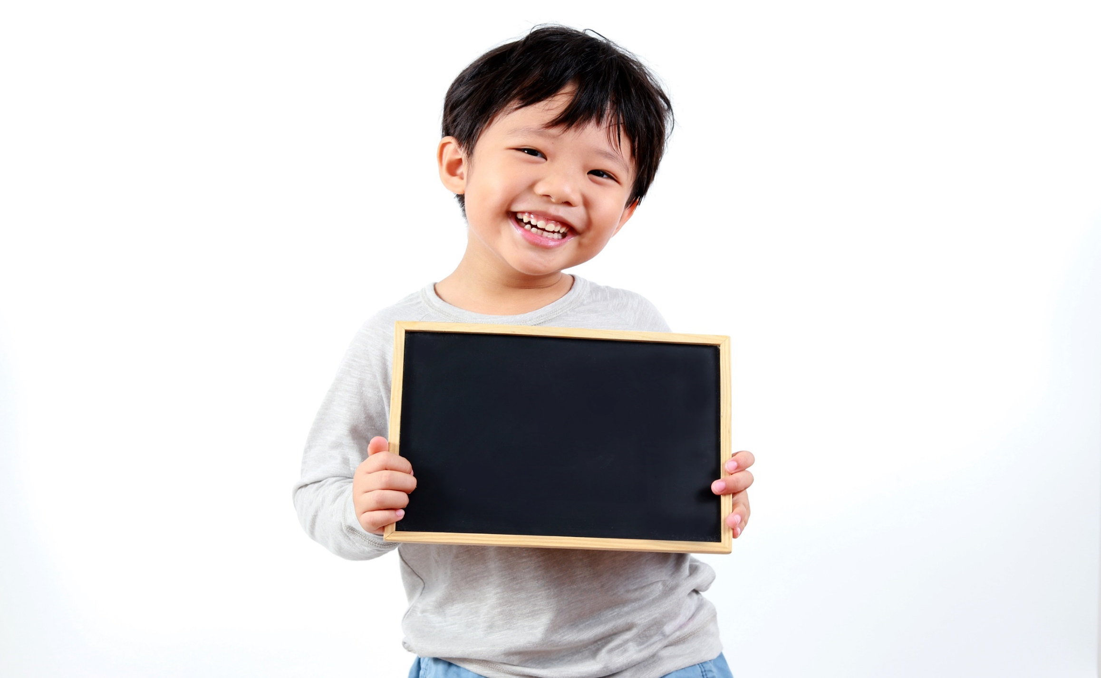
Practice

Slide 9

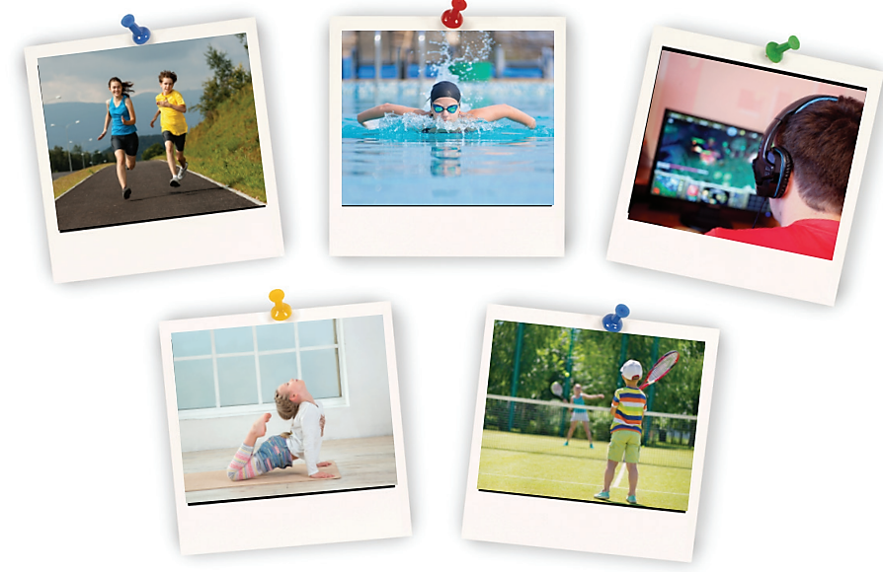
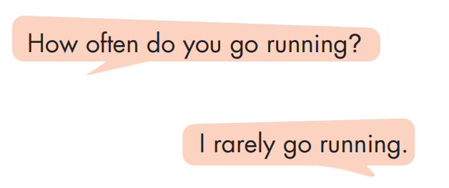
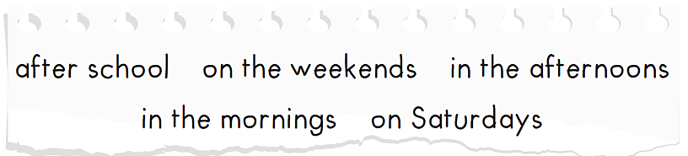
go swimming
go running
play computer games
do yoga
play badminton

Slide 10

Speaking

Slide 11
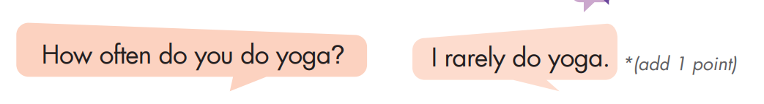
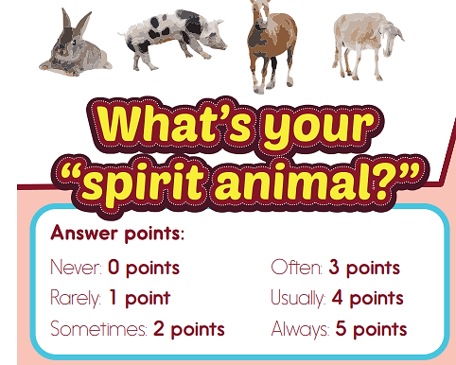
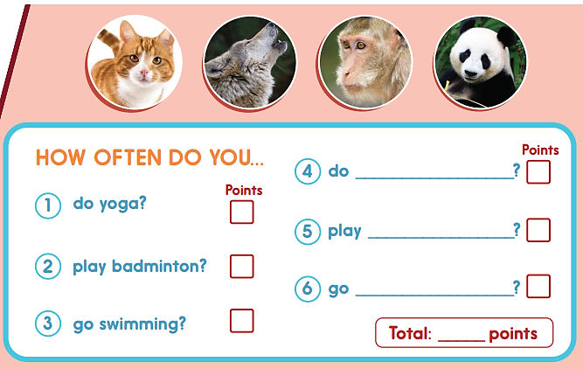
arts and crafts/ martial arts….
hopscotch /
tennis….
climbing /
shopping….

Slide 12


Slide 13

CONSOLIDATION

Slide 14
Talk about your free time activities.

Slide 15
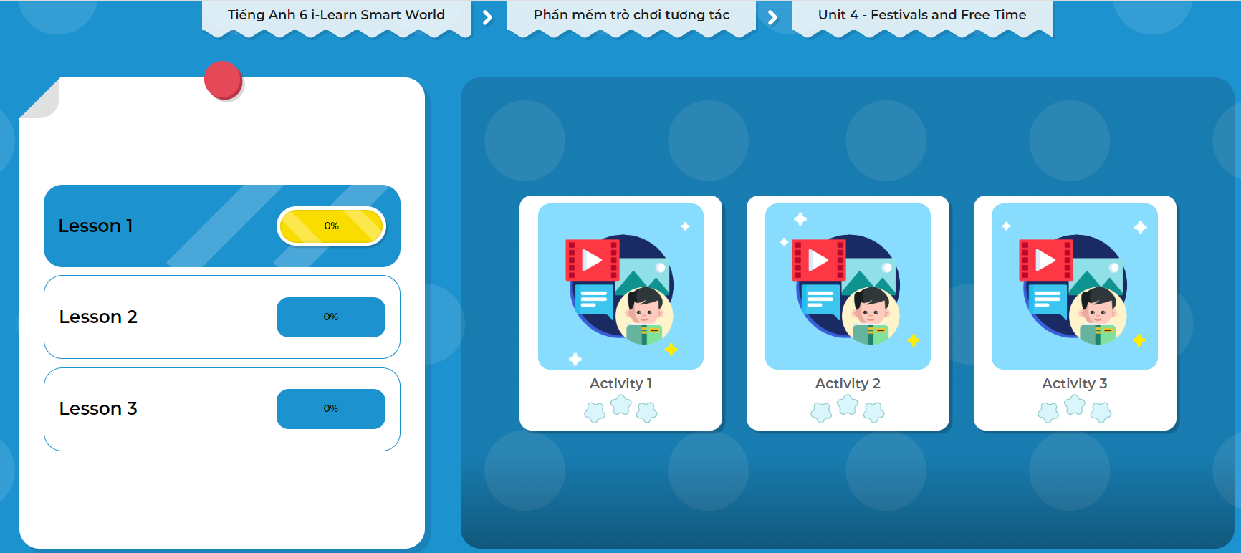
Click on the picture to play the games.

Slide 16

WRAP-UP

Slide 17
Today’s lesson
Speaking:
- Use the Adverbs of frequency to talk about free time activities.
- Practice stressing on the Adverbs of frequency in a sentence.

Slide 18
Homework
Practice stressing on the adverbs of frequency in a sentence.
Redo the exercises in Tiếng Anh 6 i-Learn Smart World Workbook (page 21).
Prepare the next lesson (page 33 - SB).
Play the consolidation games in Tiếng Anh 6 i-Learn Smart World DHA App on www.eduhome.com.vn

Slide 19
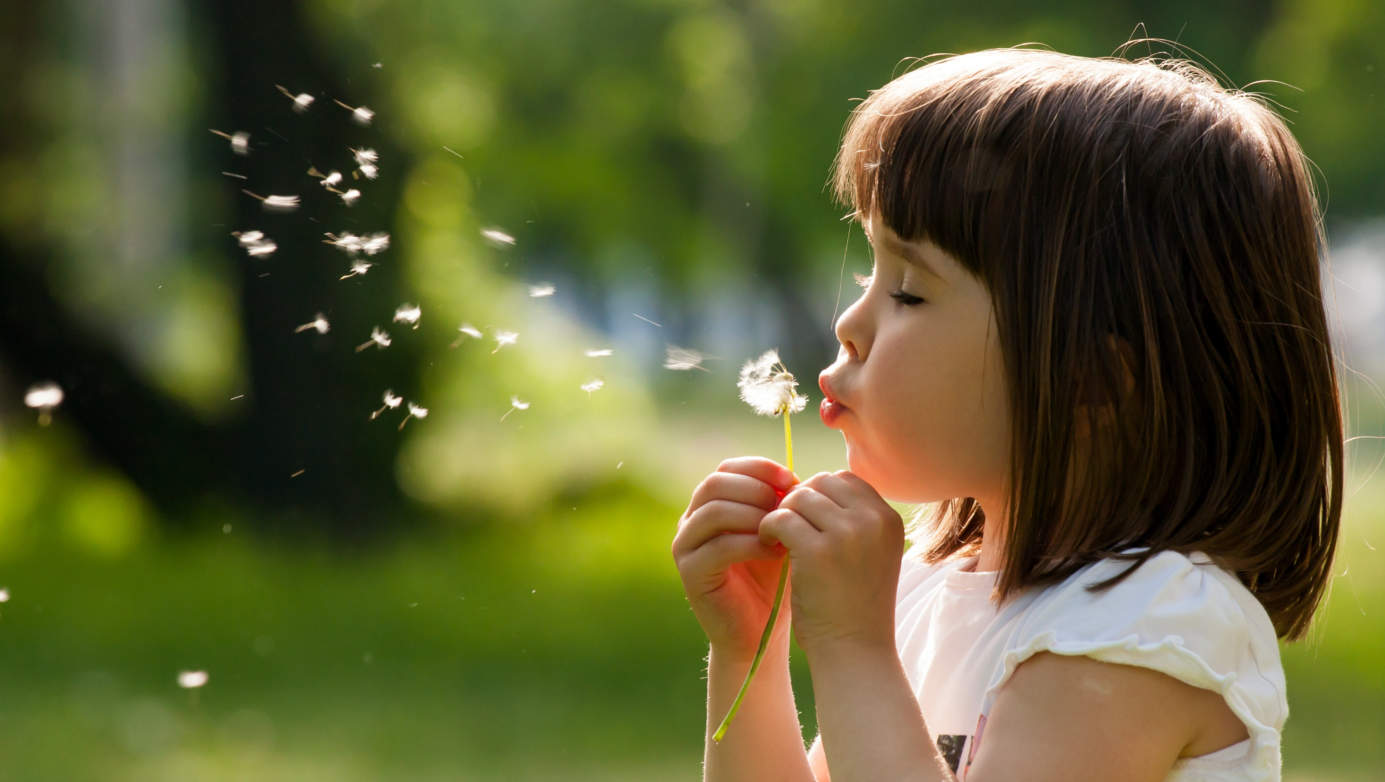
Enjoy your day!

