Slide 1

Unit 3: Arts and Music
Lesson 3f: Skills (Cont.)
Page 55

Slide 2
Lesson Outline
Warm-up
Vocabulary
Listening
Writing
Consolidation
Wrap-up

Slide 3
Objectives
By the end of this lesson, students will be able to…
- learn vocabularies and talk about things to do at festivals/celebrations.
- listen for key information.
- write an email of invitation.

Slide 4

WARM-UP

Slide 5

Work in pairs.
MATCHING
Match the verbs in column A and phrases in column B to make complete phrases.
A | B
1. visit | a. home in the morning
2. watch | b. a fireworks display
3. take part in | c. the Strawberry Festival
4. leave | d. the Kids’ Strawberry Race

Slide 6

It’s time to learn …

Slide 7

New words
……..
…….
…….
……..

Slide 8
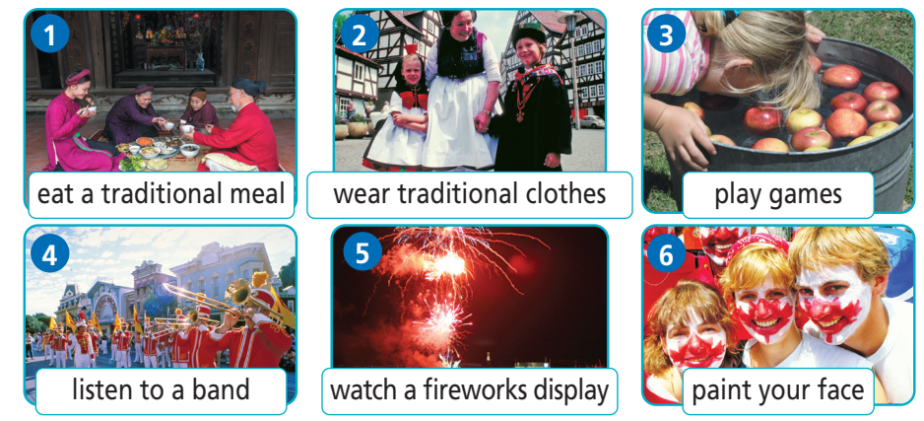
Label the pictures with the prompts
eat a traditional meal
wear traditional clothes
listen to a band
- watch a fireworks display
- play games
- paint your face

Slide 9

Answer
eat a traditional meal
wear traditional clothes
play games
listen to a band
watch a fireworks display
paint your face

Slide 10
Listen and repeat. Click each phrase to hear the sound.
eat a traditional meal /iːt ə trəˈdɪʃənəl mɪəl/ (v. phr): ăn một bữa ăn truyền thống
listen to a band /ˈlɪsən tə ə bænd/ (v. phr): nghe một ban nhạc
watch a fireworks display /wɒtʃ əˈfɑɪərwɜrks dɪˈspleɪ/ (v. phr): xem trình diễn pháo hoa
paint your face /peɪnt jɔːr feɪs/ (v. phr): hóa trang
play games /pleɪ ɡeɪmz/ (v. phr): chơi các trò chơi
wear traditional clothes /weər trəˈdɪʃənəl kləʊðz/ (v. phr): mặc lễ phục truyền thống
Notes:
GV click vào từng cụm nghe âm thanh

Slide 11
Look at the IPA and the meanings of each word to read out the word.
/iːt ə trəˈdɪʃənəl mɪəl/ (v. phr): ăn một bữa ăn truyền thống
/ˈlɪsən tə ə bænd/ (v. phr): nghe một ban nhạc
/wɒtʃ əˈfɑɪərwɜrks dɪˈspleɪ/ (v. phr): xem trình diễn pháo hoa
/peɪnt jɔːr feɪs/ (v. phr): hóa trang
/pleɪ ɡeɪmz/ (v. phr): chơi các trò chơi
/weər trəˈdɪʃənəl kləʊðz/ (v. phr): mặc lễ phục truyền thống
Notes:
GV click vào từng cụm nghe âm thanh

Slide 12
Look at the the meanings and part of speech of each word to read out the word.
(v. phr): ăn một bữa ăn truyền thống
(v. phr): nghe một ban nhạc
(v. phr): xem trình diễn pháo hoa
(v. phr): hóa trang
(v. phr): chơi các trò chơi
(v. phr): mặc lễ phục truyền thống
Notes:
GV click vào từng cụm nghe âm thanh

Slide 13

Speaking

Slide 14

Pre - Speaking
Work in pairs.
A friend wants to attend one of the festivals in the pictures. Suggest one to him/her. Use your answers in Exercises 1 and 2 to give him/her information about it as in the example.
What does your friend want?
→ Attend one of the festivals.
What are you going to do?
→ Suggest and give information.

Slide 15
Pre - Speaking
Work in pairs.
Think of a festival in your country or in other countries.
Use the phrases you have learnt and your own ideas to talk about it.
What does your friend want?
→ A festival in our country or in other countries.
What are you going to do?
→ Talk about it.

Slide 16
STUDENT A
STUDENT B
Do you know any festivals?
Yes, of course.
What is it?
Notting Hill Carnival.
What do people do in this festival?
They wear traditional clothes, listen to bands and dance to music.
That’s great.
Spot on.

Slide 17

While - Speaking
Work in pairs.
Make similar conversations with the information below.

Slide 18
Name | What to do?
Ho Chi Minh International Food Festival | eat traditional dishes and watch live music
Hung Kings Festival | take part in rice cooking competitions and dragon dancing
Brighton Festival | see parades, fireworks displays, street performances, theater, music, literature, and the visual arts on display
Buxton Festival | listen to classical music and watch operas

Slide 19
Post - Speaking
In groups, discuss about your favourite festival.
You can begin with:
I like … festival best because …

Slide 20
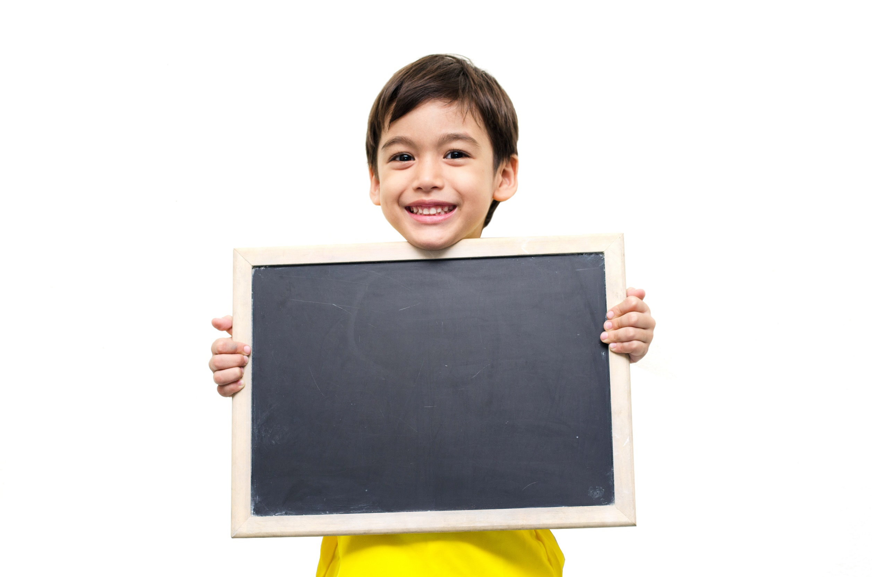
Listening

Slide 21
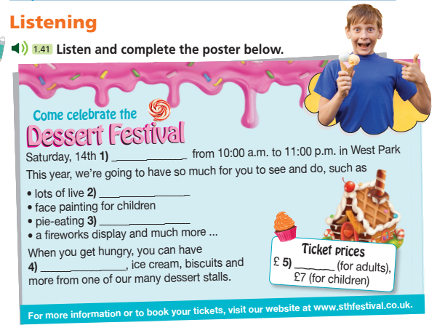
Pre - listening
What is the picture about?
A poster about a festival.
What are you going to do?
Listen and complete it.

Slide 22
Pre - listening
Read the instruction quickly. Underline the key words.
Listen and complete the poster below.

Slide 23
While - listening
Now listen and complete the poster.  FIRST TIME
Saturday, 14th (1) _______________ from 10:00 a.m. to 11:00 p.m. in West Park. This year, we’re going to have so much for you to see and do, such as
• lots of live (2) __________________
• face painting for children
• pie-eating (3) __________________
• a fireworks display and much more ...
When you get hungry, you can have (4) _________________, ice cream, biscuits and more from one of our many dessert stalls.
Ticket prices
£ (5) ________ (for adults), £7 (for children).

Slide 24
While - listening
Now listen again and check.  SECOND TIME
While you are listening, focus on what the speaker says.
So this Saturday, 14th July, I’m going to visit the Dessert Festival.
☞ THE ANSWER IS …
(1). July
While you are listening, focus on what the speaker says.
Here’s going to be so much to see and do, including lots of live music.
☞ THE ANSWER IS …
(2). music

Slide 25
While - listening
Now listen again and check.  SECOND TIME
While you are listening, focus on what the speaker says.
Make sure you arrive in time to take part in the pie eating contest!
☞ THE ANSWER IS …
(3). contest
While you are listening, focus on what the speaker says.
There’s going to be cake, ice cream, biscuits and so much more.
☞ THE ANSWER IS …
(4). cake

Slide 26
While - listening
Now listen again and check.  SECOND TIME
While you are listening, focus on what the speaker says.
Tickets are 10 pounds for adults and 7 pounds for children.
☞ THE ANSWER IS …
(5). 10

Slide 27
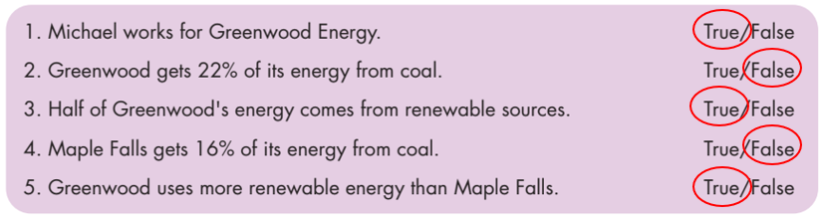
While - listening
While - listening
Now listen again and check.  THIRD TIME
Saturday, 14th (1) _______________ from 10:00 a.m. to 11:00 p.m.
1. July
lots of live (2) __________________
2. music
pie-eating (3) __________________
3. contest

Slide 28
While - listening
While - listening
Now listen again and check.  THIRD TIME
When you get hungry, you can have (4) ________________, ice cream, biscuits and more from one of our many dessert stalls.
4. cake
£ (5) ________ (for adults), £7 (for children).
5. 10

Slide 29
Post- listening
Extra Practice
Listen again and choose the correct option.
First, underline the key words, then listen and choose correct option.
Where is Dessert Festival?
A. In North Park. B. In West Park. C. In East Park.
2. What time does it start and finish?
9 a.m – 10 p.m. B. 10 a.m. – 11 p.m. C. 11 a.m. – 12 p.m.
3. What time can you see fireworks display?
A. At 7:00 p.m. B. At 8:00 p.m. C. At 9:00 p.m.
4. What is the ticket price for children?
A. £7 B. £8 C. £9

Slide 30
Extra Practice
Now, listen again to choose correct option.
1. Where is Dessert Festival?
A. In North Park. B. In South Park. C. In West Park.
2. What time does it start and finish?
9 a.m.– 10 p.m. B. 10 a.m. – 11 p.m. C. 11 a.m. – 12 p.m.
So this Saturday, 14th July, I’m going to visit the Dessert Festival in West Park.
It starts at 10 a.m. and finishes at 11:00 p.m.

Slide 31
Extra Practice
Now, listen again to choose correct option.
3. What time can you see fireworks display?
A. At 7:00 p.m. B. At 8:00 p.m. C. At 9:00 p.m.
4. What is the ticket price for children?
A. £7 B. £8 C. £9
You can still see the fantastic fireworks display at 9:00 p.m.
Tickets are 10 pounds for adults and 7 pounds for children.

Slide 32
Audio Scripts
Good morning, listeners! Who has got a sweet tooth? I certainly have! So this Saturday, 14th July, I’m going to visit the Dessert Festival in West Park. It starts at 10 a.m. and finishes at 11:00 p.m. There’s going to be so much to see and do, including lots of live music and free face painting for children. Make sure you arrive in time to take part in the pie eating contest! Even if you can’t get there until late, you can still see the fantastic fireworks display at 9:00 p.m. And let’s not forget the highlight of the day – the desserts! There’s going to be cake, ice cream, biscuits and so much more. Tickets are 10 pounds for adults and 7 pounds for children. You can reserve them, and find out more information, at www.sthfestival.co.uk. See you there!

Slide 33
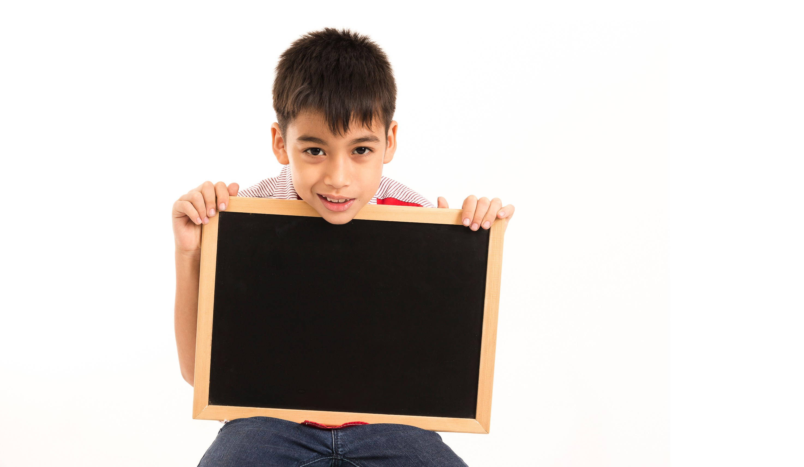
Writing

Slide 34

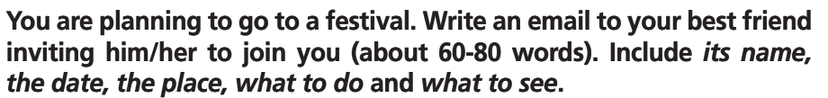
Pre - writing
Work in pairs.
1. What are you going to write?
2. Who are you going to write to?
3. What information are you going to
include?
4. How many words are you going to
write?
An email of invitation.
Our best friend.
Name, date, place, what to do and see at the festival.
60-80 words.

Slide 35
Work in pairs.
Pre - writing
Writing an email of invitation
8 You are planning to go to a festival. Write an email to your best friend inviting him/her to join you (about 60-80 words). Include its name, the date, the place, what to do and what to see.

Slide 36
While - writing
Make notes.
Talk about: • The name of the festival
• Date
• What to do
• What to see
Notes
_______________________
________________________
________________________
________________________
________________________
________________________
________________________
Treehouse Festival
from 3rd to 8th July
Attend interesting workshops, watch live performances with folk musicians, do arts and crafts.
People build eco-houses from grass, wood and stone.

Slide 37
Post - writing
Model of an email of invitation
Hi Olga,
How are you? Do you fancy coming to the Treehouse Festival in Norfolk? It takes place from 3rd to 8th July.
People are going to build eco-houses from grass, wood and stone, and there are going to be interesting workshops to attend, too!
We can also watch live performances with folk musicians and do arts and crafts.
I really hope you can come.
Fiona.

Slide 38

CONSOLIDATION

Slide 39
Talk about a festival you have joined.
When did it take place?
Where was it?
What activities could you see?
What activities could you do?

Slide 40
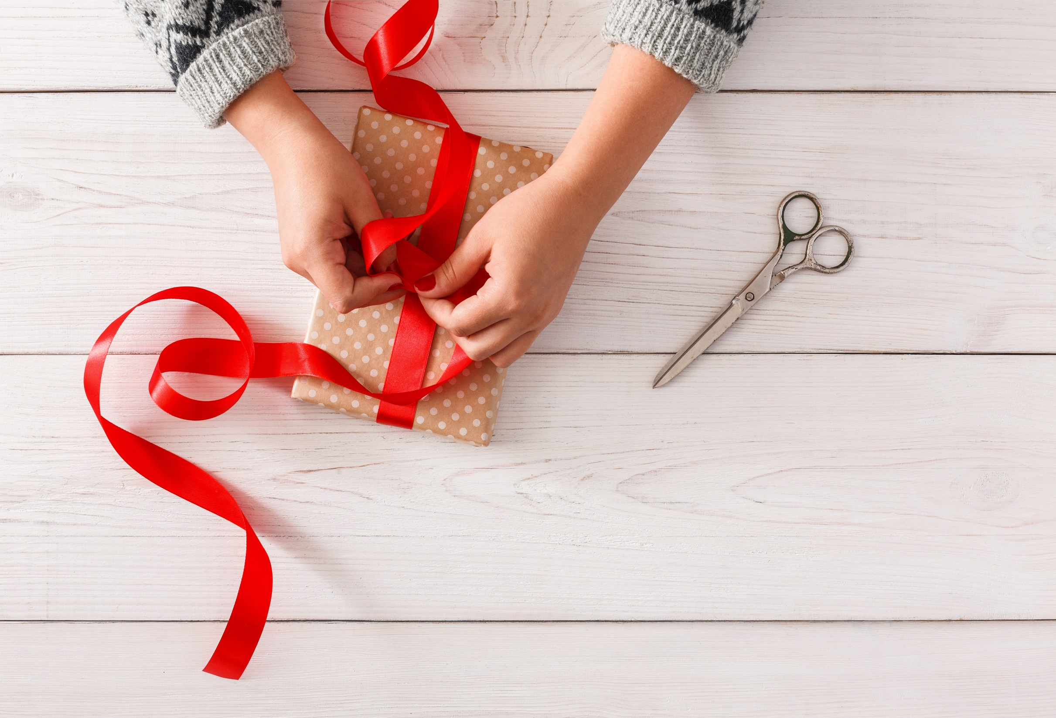
WRAP-UP

Slide 41
Today’s lesson
Vocabularies:
eat a traditional meal
listen to a band
watch a fireworks display
paint your face
play games
wear traditional clothes
Speaking: talk about things to do at festivals/celebrations.
Listening: for key information.
Writing: an email of invitation.

Slide 42
Homework
Practise the vocabularies and make sentences using them.
Prepare the next lesson (page 56 SB).
Do the exercise in TA 7 Right on Notebook (page 25).
Do Unit 3 Test 1 in Bài Tập Bổ Trợ TA 7 Right on (pp. 28&29).

Slide 43
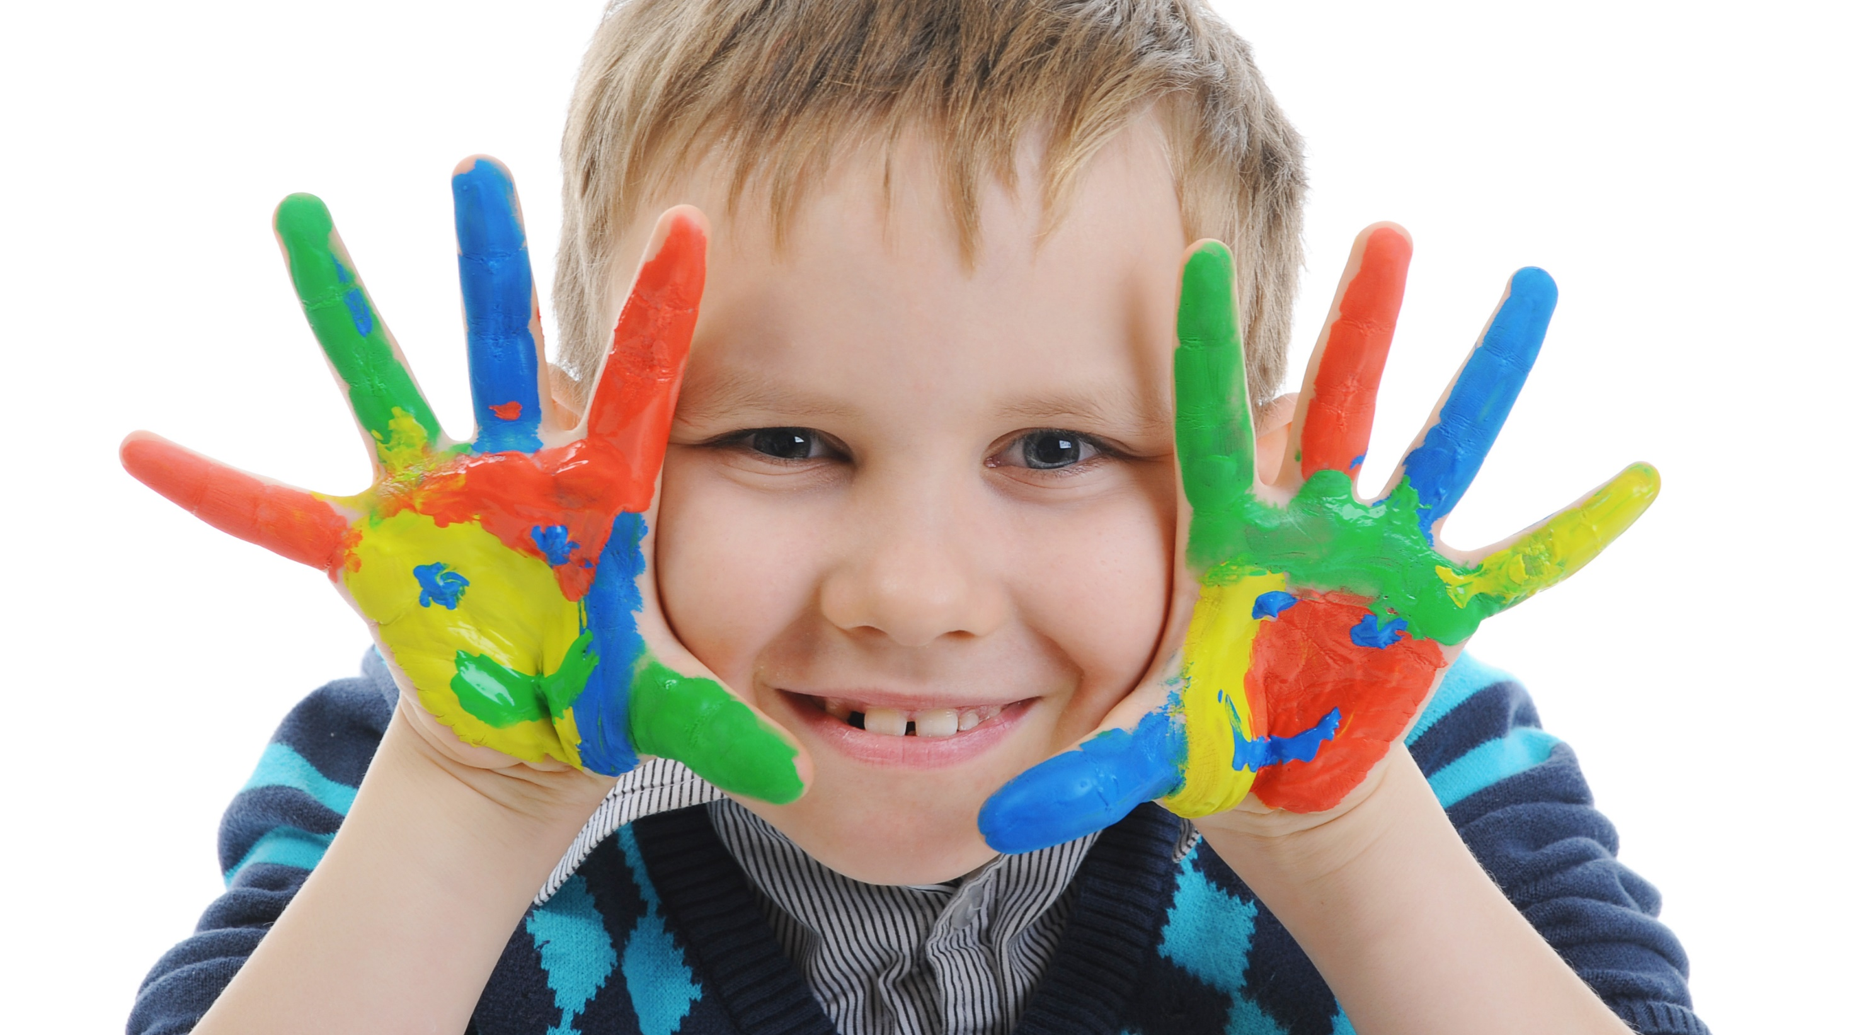
Enjoy your day!

