Slide 2
Unit
9
Social issues
Unit
FAMILY LIFE
LESSON 5
LISTENING
Types of bullying

Slide 3
LESSON 5
LISTENING
WARM-UP
Quiz: Peer pressure
PRE-LISTENING
Task 1: Choose the correct meanings.
Task 2: Listen to a conversation and match the pictures with type of bullying.
Task 3: Circle the correct answers.
WHILE-LISTENING
POST-LISTENING
Task 4: Discussion.
CONSOLIDATION
Wrap-up
Homework

Slide 4
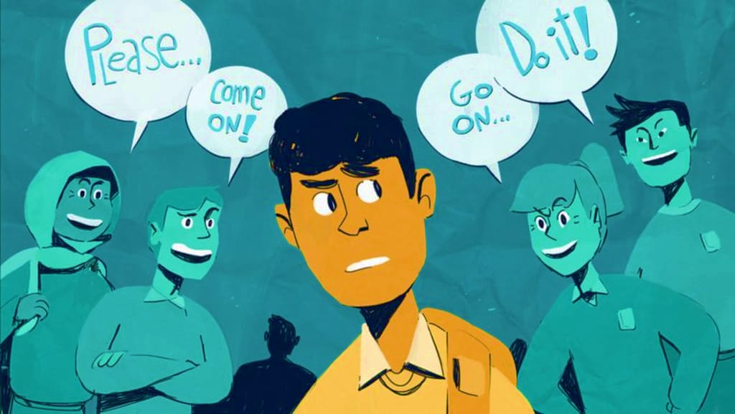
WARM-UP
Let‘s Quiz!
What do you know about peer pressure?

Slide 5
1. A friend encourages you to try out for the basketball team.
This is which type of pressure?
Positive peer pressure
A
Negative peer pressure
B

Slide 6
2. What qualities can help a person to resist negative peer pressure?
Speed and coordination
A
A nice smile
B
Self-confidence & assertiveness
C
Nice hair
D

Slide 7
3. When you are under pressure you should...
Stay calm & be confident
A
B
Leave the situation if your friend persists
C
Make eye-contact & repeat "NO"!
D
All of the above

Slide 8
4. Which is NOT an effective way to handle peer pressure?
Avoid or leave the unsafe situation
A
Give reasons for your refusal
B
Talk to an adult you trust
C
D
Give in and join in the same unsafe activity

Slide 9
5. What is ‘guilt’?
Telling a person something nice about himself/herself
A
Making someone feel bad if they do not do something
B

Slide 10
PRE-LISTENING
1
Choose the correct meanings of the underlined words.
1. I find your comments very offensive, so you should apologise to me.
A. nice B. rude
2. I don’t believe his lies!
A. things that are true B. things that are not true
3. Don’t feel ashamed to admit that you do not know something.
A. proud B. embarrassed

Slide 11
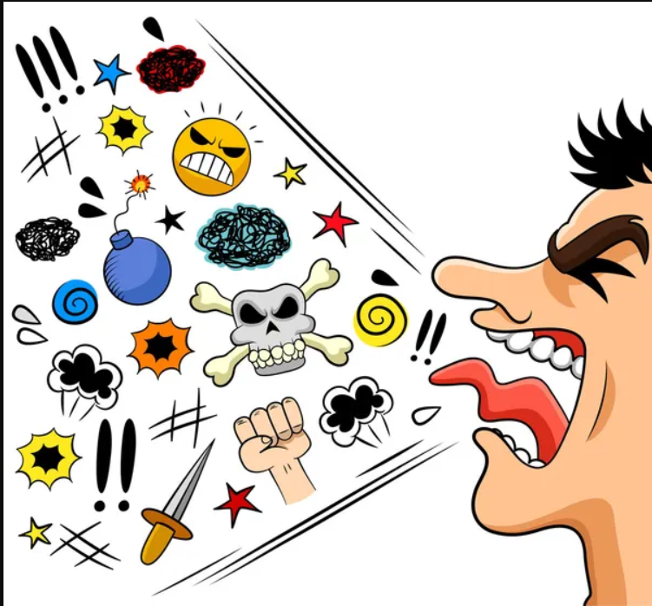
PRE-LISTENING
offensive (adj)
/əˈfensɪv/
causing someone to feel upset and angry, often because of being rude

Slide 12
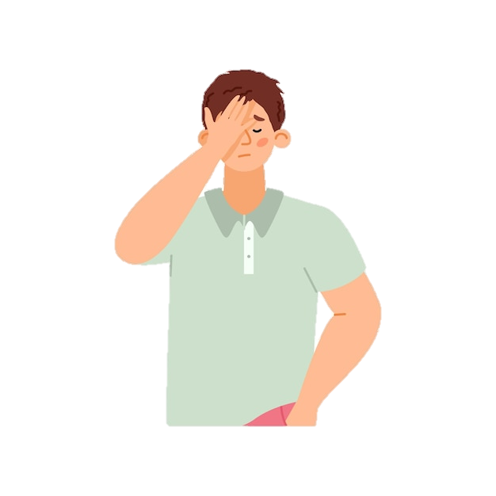
PRE-LISTENING
ashamed (adj)
/əˈʃeɪmd/
feeling guilty or embarrassed about something you have done or about a quality in your character

Slide 13
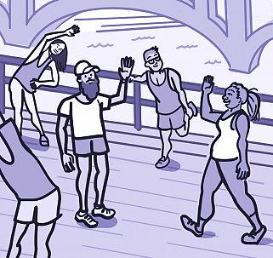
PRE-LISTENING
physical (adj)
/ˈfɪzɪkəl/
relating to things you can see or touch, or relating to the laws of nature

Slide 14
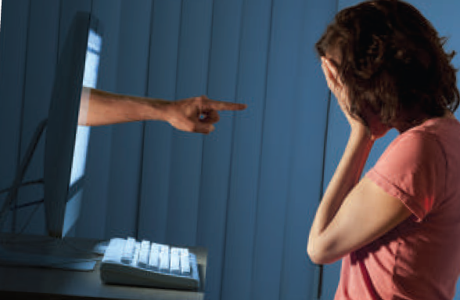
PRE-LISTENING
cyberbullying (n)
/ˈsaɪbəbʊliɪŋ/
the activity of using the internet to harm or frighten another person, especially by sending them unpleasant messages

Slide 15
Form | Pronunciation | Meaning
1. offensive (adj) | /əˈfensɪv/ | causing someone to feel upset and angry, often because of being rude
2. ashamed (adj) | /əˈʃeɪmd/ | feeling guilty or embarrassed about something you have done or about a quality in your character
3. physical (adj) | /ˈfɪzɪkəl/ | relating to things you can see or touch, or relating to the laws of nature
4. cyberbullying (n) | /ˈsaɪbəbʊliɪŋ/ | the activity of using the internet to harm or frighten another person, especially by sending them unpleasant messages

Slide 16
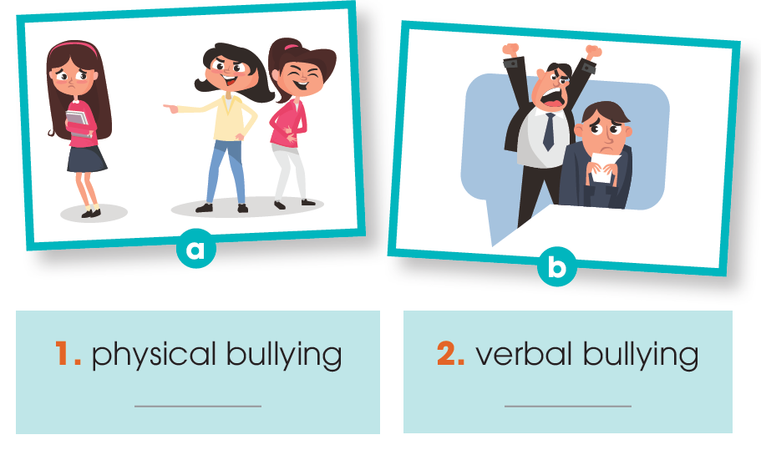
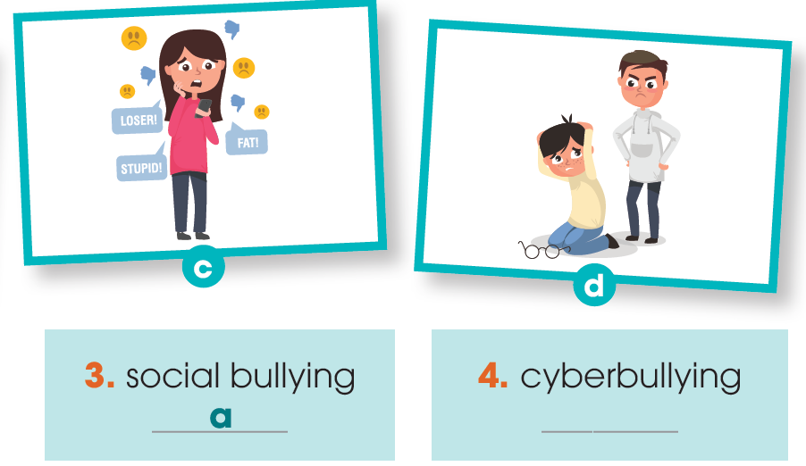
WHILE-LISTENING
2
Listen to a conversation between two students and match the pictures with the type of bullying.
d
b
c

Slide 17
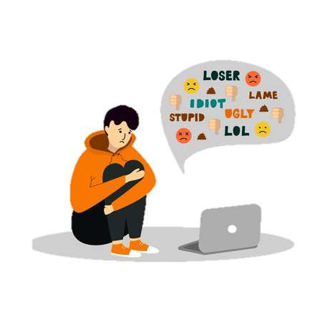
WHILE-LISTENING
3
Listen again. Circle the correct answers.
1. Technology has made bullying more / less common.
2. Mai’s friend was bullying others / was bullied by others on social media.
3. One of the most common forms of physical bullying / cyberbullying is body shaming.
4. In their next meeting, they are most likely
to talk about when / how bullying can be stopped.

Slide 18
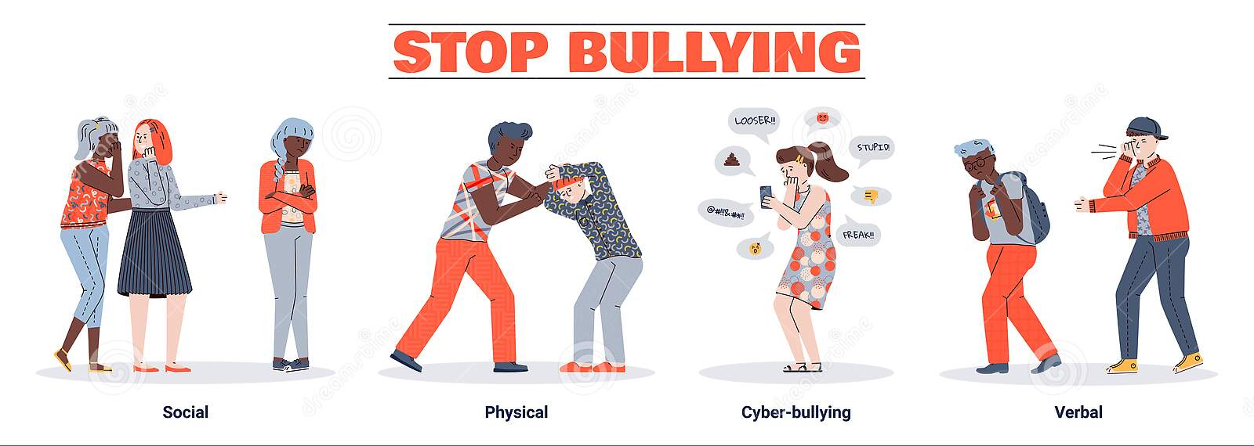
POST-LISTENING
4
Work in groups. Discuss the following questions.
What types of bullying have you experienced or seen happening to people around you?

Slide 19
CONSOLIDATION
1
Wrap-up
What have you learnt today?
New vocabulary
Listen for specific information in a conversation about types of bullying, and make predictions.

Slide 20
CONSOLIDATION
2
Homework
Do exercises in the workbook.
Prepare for Lesson 6 - Unit 9.

Slide 21
Website: hoclieu.vn
Fanpage: facebook.com/www.tienganhglobalsuccess.vn/

