Slide 2
Unit
12
ENGLISH-SPEAKING COUNTRIES
LESSON 3: A CLOSER LOOK 2
Unit

Slide 3
OBJECTIVES
By the end of the lesson, students will be able to:
understand the use of articles
practise using articles correctly

Slide 4
LESSON 3: A CLOSER LOOK 2
WARM-UP
Picture describing
PRESENTATION
Articles: a / an and the
Task 1: Complete the sentences with a / an or the.
Task 2: Put in the where necessary.
Task 3: Put in a / an or the.
Task 4: Complete the sentences with a / an, or the.
Task 5: Game – Faster detective
PRACTICE
CONSOLIDATION
Wrap-up
Homework

Slide 5
LESSON 3: A CLOSER LOOK 2
WARM-UP
Picture describing

Slide 6
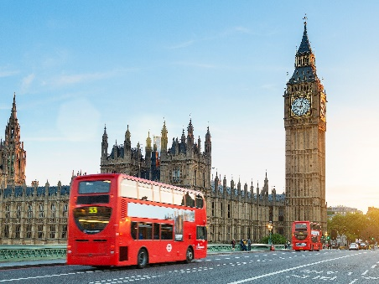
WARM-UP
Describe the picture

Slide 7
LESSON 3: A CLOSER LOOK 2
WARM-UP
Picture describing
PRESENTATION
Articles a / an review & article the

Slide 8
PRESENTATION
Notes:
https://www.youtube.com/watch?v=drTyYqbz6Xk

Slide 9
LESSON 3: A CLOSER LOOK 2
WARM-UP
Picture describing
PRESENTATION
Articles a / an review & article the
Task 1: Complete the sentences with a / an or the
Task 2: Put in the where necessary.
Task 3: Put in a / an or the.
Task 4: Complete the sentences with a / an, or the
Task 5: Game – Faster detective
PRACTICE

Slide 10
PRACTICE
1
Complete the sentences with a / an or the.
1. Is Washington D.C. __________ capital of the USA? 2. Can you give me __________ example of an English-speaking country? 3. The London Eye is __________ great attraction in London. 4. Canada is __________ very cold country. 5. I love __________ New Zealand’s countryside.
the
an
a
a
the

Slide 11
PRACTICE
2
Put in the where necessary.
1. __________ Statue of Liberty is in __________ New York. 2. __________ Scotland is a part of __________ UK. 3. New Zealand consists of __________ North Island and __________ South Island. 4. Disneyland in ______ California is one of __________ biggest entertainment centres in the world. 5. Bangkok is __________ most popular city for tourists in __________ Kingdom of Thailand.
The
x
x
the
the
the
x
the
the
the

Slide 12
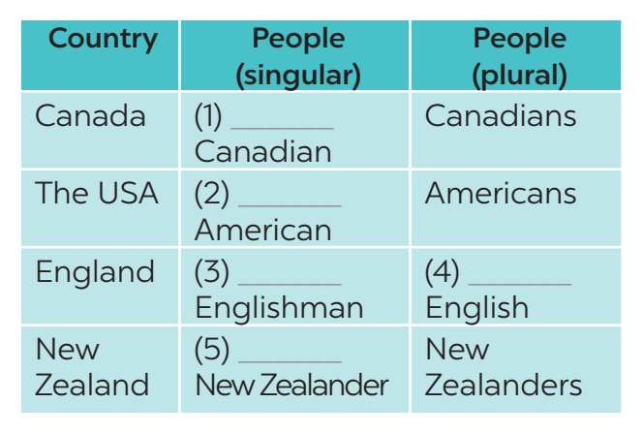
PRACTICE
3
Put in a / an or the.
a
an
an
the
a

Slide 13
PRACTICE
4
Complete the sentences with a / an, or the.
1. The man sitting next to her is ____________ Englishman. 2. ____________ River Thames runs through London. 3. Here is ____________ map of the city of Edinburgh. 4. What is ____________ most popular sport in Canada? 5. We want to visit ____________ attraction in Sydney. 6. ____________ Statue of Liberty was a present from France.
an
The
the
the
an
The

Slide 14
PRACTICE
5
Game – Faster detective.
Tick if the underlined articles are correct. If they aren’t, write the correct ones in the space provided.
1. “What do you call a person from England?” – “The Englishman.” ________________ 2. Edinburgh is a capital city of Scotland. ________________ 3. Queenstown is a amazingly beautiful town. ________________ 4. Are ancient castles an attraction of Scotland? ________________ 5. Where can you see a red telephone box? ________________
An
the
an

Slide 15
LESSON 3: A CLOSER LOOK 2
WARM-UP
Picture describing
PRESENTATION
Articles a / an review & article the
Task 1: Complete the sentences with a / an or the
Task 2: Put in the where necessary.
Task 3: Put in a / an or the.
Task 4: Complete the sentences with a / an, or the
Task 5: Game – Faster detective
PRACTICE
CONSOLIDATION
Wrap-up
Homework

Slide 16
CONSOLIDATION
1
WRAP-UP
In this lesson, students have:
understood the use of use articles
practised using articles correctly

Slide 17
CONSOLIDATION
2
HOMEWORK
Complete exercises in the Workbook.

Slide 18
Website: hoclieu.vn
Fanpage: facebook.com/www.tienganhglobalsuccess.vn/

