Slide 1

Unit 5: Travel & Transportation
Lesson 5b: Grammar (Cont.)
Page 83

Slide 2
Lesson Outline
Warm-up
Grammar
Wrap-up

Slide 3
Objectives
By the end of this lesson, students will be able to…
use the superlative form to compare one person/thing or a group of people/things to several others.

Slide 4

WARM-UP

Slide 5
Teacher invites 3 or 4 students to come to the front of the class. Teacher reads about 5 words they learnt in the previous lessons (e.g. landmark, cable car, sights, cruise, etc.). Ask those students to write the word on the board and jump up to show that they finished.
The first student to finish the word correctly is the winner. Then, ask the rest of the class ‘Who is the fastest?’, and all students should answer using a superlative sentence (e.g. ‘Sarah is the fastest.’).
If some students finish the word correctly at the same time, teacher will ask the rest of the class ‘Who can jump the highest?’, and all students should answer using a superlative sentence (e.g. ‘John can jump the highest.’). That student will be the winner.

Slide 6

It’s time to learn …

Slide 7

PRESENTATION
Superlative

Slide 8
Look at the sentences and choose suitable phrases to complete the rule for superlative:
-est * Long * most * the* Short * the
Jack is the tallest student in my class.
The eraser is the smallest thing in my bag.
I am the youngest member of my family.
The white shirt is the most expensive in the store.
This is the most delicious food of the restaurant.
Ho Chi Minh City is one of the most crowded cities in Vietnam.
_____ adjectives:
___ + adjective + ___(+ noun) + of/in
_____ adjectives:
___ + ____ + adjective (+ noun) + of/in
Short
Long
the
-est
the
most

Slide 9
Complete the table with the rules for irregular forms of superlative:
Adjectives | Superlative forms
good | the best
 | the worst
much / many
little
bad
the most
the least

Slide 10
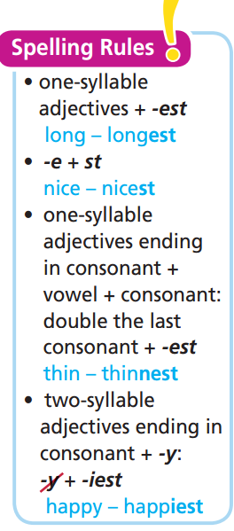
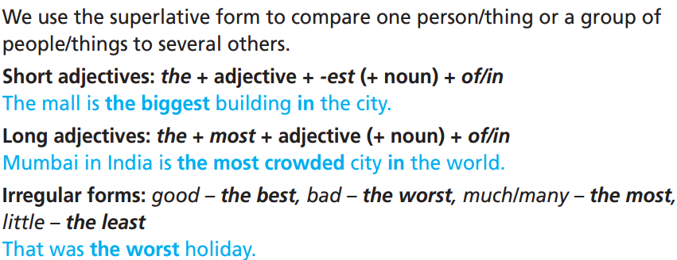
Remember:

Slide 11


Slide 12

PRACTICE

Slide 13
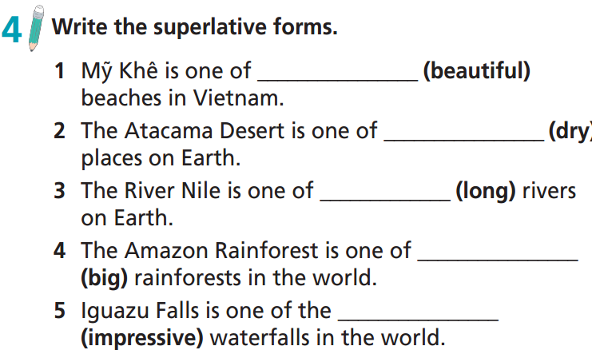
the most beautiful
the driest
the longest
the biggest
the most impressive

Slide 14
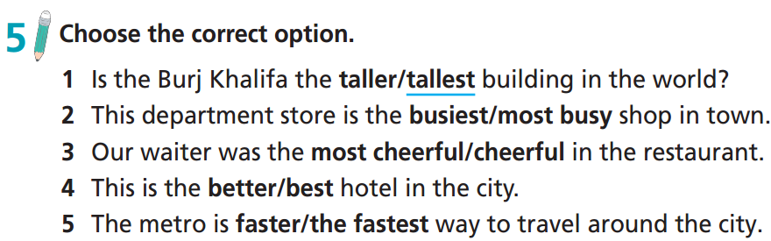

Slide 15
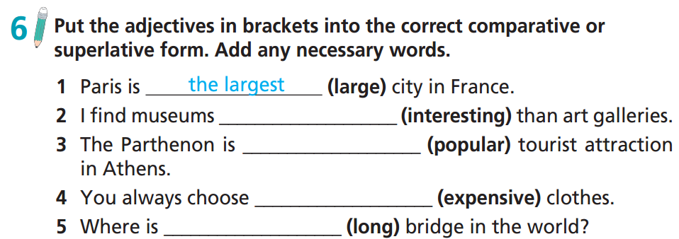
more interesting
the most popular
the most expensive
the longest

Slide 16
59 ★ Complete the text with the adjectives in brackets in the superlative form.
Hi Sue,
Hope you are well. We were in Cairo last week. It’s one of 1) the most beautiful (beautiful) places in the world. It’s 2) _________________ (large) city in Africa, so there are a lot of things to see. It’s definitely 3) __________________ (hot) place we visited during our holiday. We had coffee in the Cairo Tower last Wednesday.
It was lovely. It is 4) __________________ (high) structure in the city and has 5) __________________ (good) view. Then, we went to the Pharaonic Village. It was amazing. We are in Italy now. I can’t wait to see the sights. This is 6) __________________ (exciting) holiday of my life!
See you soon.
Betty
the largest
the hottest
the highest
the best
the most exciting
Extra Practice
Grammar Bank, WB, p. 74

Slide 17
60 ★ Complete the sentences with the adjectives in brackets in the superlative form.
1 The Louvre Museum in France is _________________ (big) museum in the world.
2 The Nile in Africa is _________________ (long) river in the world.
3 The Great Pyramid of Giza in Egypt is one of _________________ (ancient) wonders in the world.
4 The site of the Nazca Lines in Peru is one of _________________ (mysterious) places on Earth.
the biggest
the longest
the most ancient
the most mysterious

Slide 18
PRODUCTION

Slide 19

Work in pairs
e.g.
Landmark 81 is the tallest building in Ho Chi Minh City.
It is newer than Bitexco.

Slide 20
Report about places in your city/town. Use the comparative or superlative forms.
Hi, my name is ……. I live in ……... ………….. is the tallest building in ….. …………………………………………………

Slide 21

Who is that?
Ask students to write the name of the student they want to describe and use comparative or superlative sentences to describe him/her onto paper. Teacher collects all the papers and read those sentences. The rest of the class will guess who is being described. Who can have more correct guesses is the winner.

Slide 22
Work in pairs.
Please discuss the following questions:
Who is the tallest in your class?
What is the most difficult subject?
What is the most interesting thing you do in your free time?
Who is the funniest in your class?
Who is friendliest in your class?
Who is the best at maths / English / history / etc. in your class?

Slide 23

CONSOLIDATION

Slide 24
Write at least 4 sentences about your city / town with superlative forms.
e.g.
HCM City is one of the most famous tourist attractions in Vietnam.
The tallest building in HCM City is Landmark 81.
One of the most interesting activities to do in HCM City is to go shopping.
HCM City is the largest city in Vietnam.
Banh trang tron is one of the most popular street foods in HCM City.

Slide 25

WRAP-UP

Slide 26
Today’s lesson
Grammar
Use the superlative form to compare one person/thing or a group of people/things to several others.

Slide 27
Homework
Practise the grammar point and make sentences using them.
Do the exercises in TA 7 Right on WB (page 43)
Prepare the next lesson (page 84 SB)
Complete the grammar notes in TA 7 Right on Notebook (page 38)

Slide 28

Enjoy your day!

