Slide 1
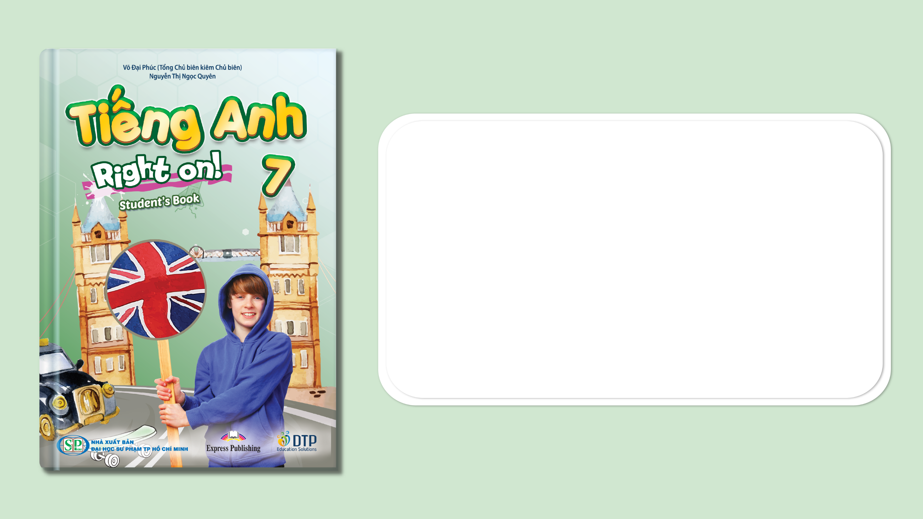
Welcome back (cont.)
Pages 8, 9

Slide 2
Lesson Outline
Warm-up
Vocabulary
Grammar
Consolidation
Wrap-up

Slide 3
Objectives
By the end of this lesson, students will be able to…
- revise vocabulary for family members.
- revise and practise have got, Possession, Plurals, this/these - that/those.
- tell the time and talk about clothes.

Slide 4

WARM-UP

Slide 5
Answer the questions
1. How many people are there in your family?
2. Who are they?

Slide 6

It’s time to learn …

Slide 7

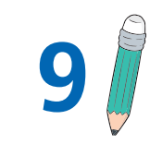
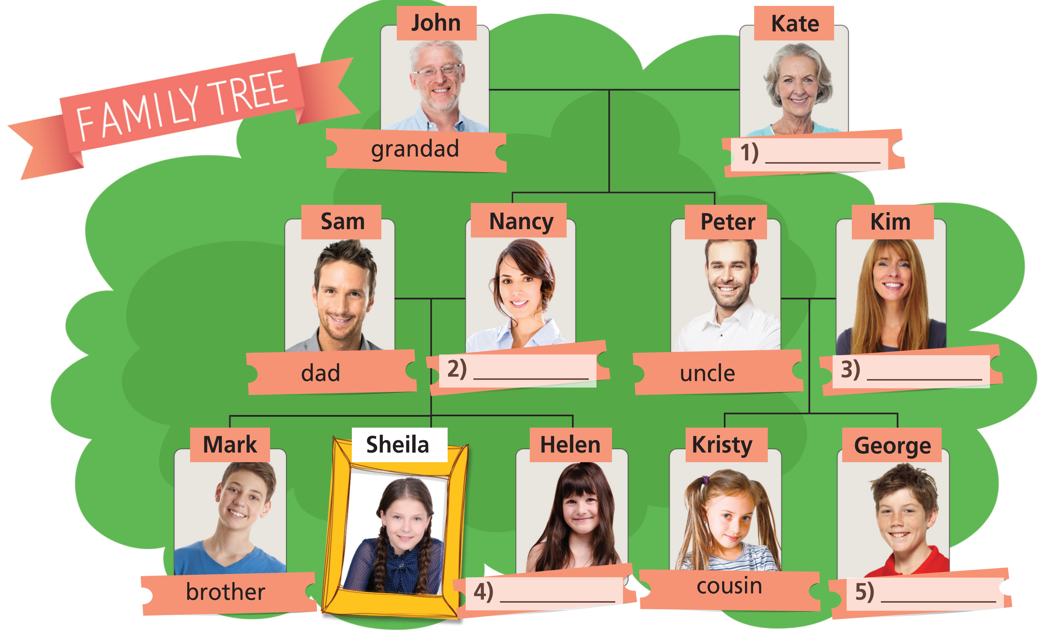
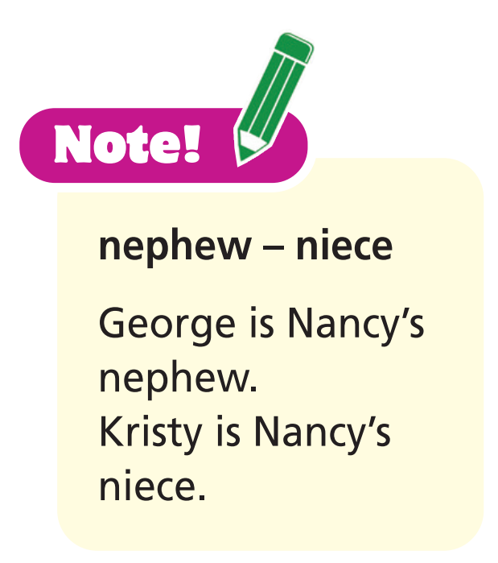
Vocabulary

Slide 8
grandma
mom
aunt
sister
cousin

Slide 9

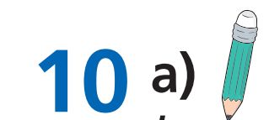
Grammar
Look at the family tree in Exercise 9 and fll in each gap with have got, has got, haven’t got or hasn’t got.
Note: plural + have / singular + has
Only 2 children: Nancy and Peter.
1 John and Kate ___________ four children.
2 Nancy and Sam ___________ a nephew, George,
and a niece, Kristy.
3 Kristy ___________ three cousins.
4 Mark ___________ two brothers.
5 Sheila and Helen ___________ a brother.
6 Peter ___________ a brother.
haven’t got
have got
Mark, Sheila, Helen
has got
Mark has got 2 sisters: Sheila and Helen.
hasn’t got
have got
Mark
hasn’t got
He has got a sister: Nancy.

Slide 10

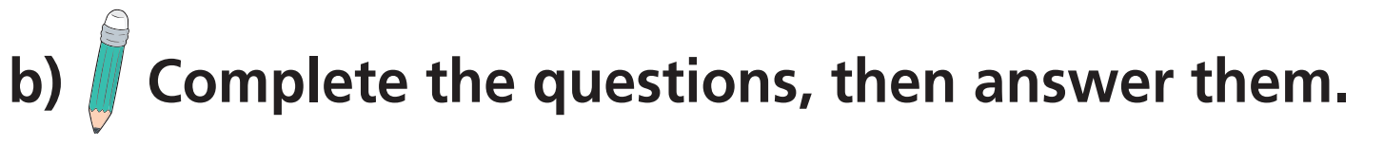
Has
got
1 ________ John ________ a wife? Yes,____________________ .
2 ________ Sam and Nancy ________ three children? _______________________ .
3 ________ Kim ________ two daughters? _______________________ .
4 ________ John and Kate ________ four grandchildren? _______________________ .
he has
Have
got
Yes, they have
Has
got
No, she hasn’t
Have
got
No, they haven’t

Slide 11
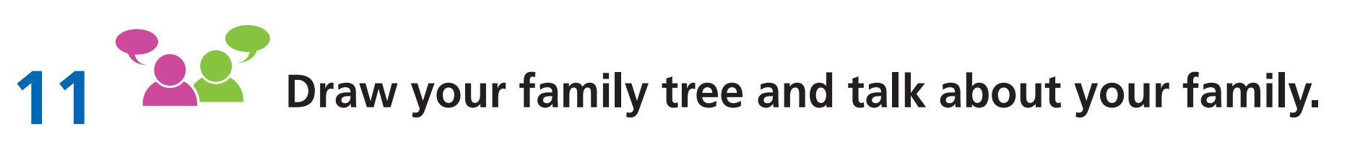
Speaking
Sample diagram
grandpa
grandma
dad
mom
uncle
aunt
brother
YOU
sister
cousin

Slide 12

Grammar
1 Peter is Kims/Kim’s husband. He’s Kristy’s and George’s/
Kristy and George’s dad.
2 Kristy and George are John and Kate’s/John’s and Kate’s
grandchildren.
3 Mark is Sheila’s and Helen’s/Sheila and Helen’s brother.
4 Mark and George are cousins. The boys’/boy’s grandparents are
John and Kate.
5 Sheila and Helen are sisters. The girls’/girl’s parents are Sam and
Nancy.

Slide 13

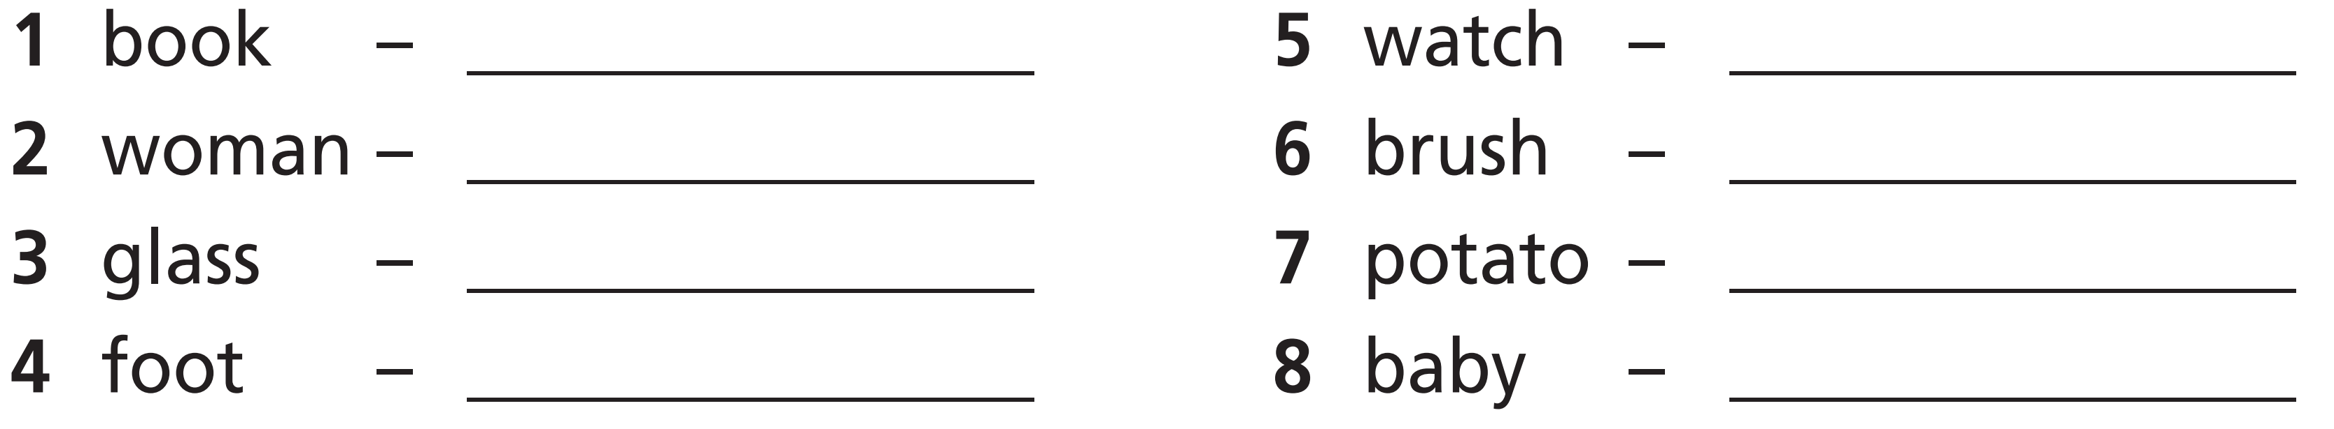
Grammar
books
watches
women
brushes
glasses
potatoes
feet
babies

Slide 14


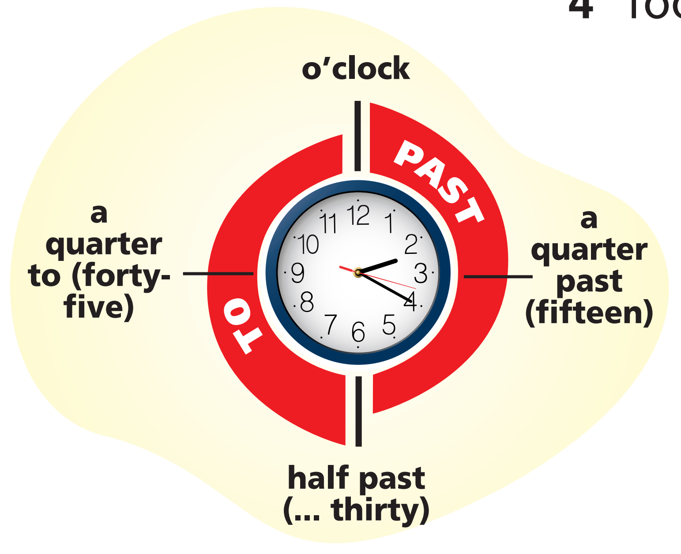



Vocabulary
Write the times in two ways as in the example in your notebook.
Example

Slide 15




It’s a quarter past eight.
It’s half past four.
It’s four thirty.
It’s eight fifteen.
It’s ten past six.
It’s a quarter to seven.
It’s six ten.
It’s six forty-five.

Slide 16


Speaking
Answer the questions.
What time do you….
1 …. get up?
2 …. have breakfast?
3 …. go to school?
4 …. come back home?
5 …. have lunch?
6 …. do your homework?
7 …. have dinner?
8 …. go to bed?

Slide 17
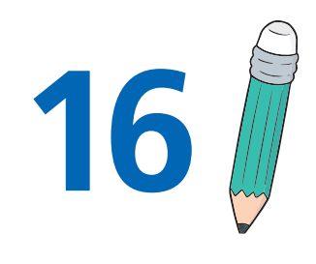
Grammar
Fill in each gap with this, these, that or those and choose the
correct option.
Note!
this + singular nouns near the speaker
that + singular nouns far away from the speaker
these + plural nouns near the speaker
those + plural nouns far away from the speaker

Slide 18
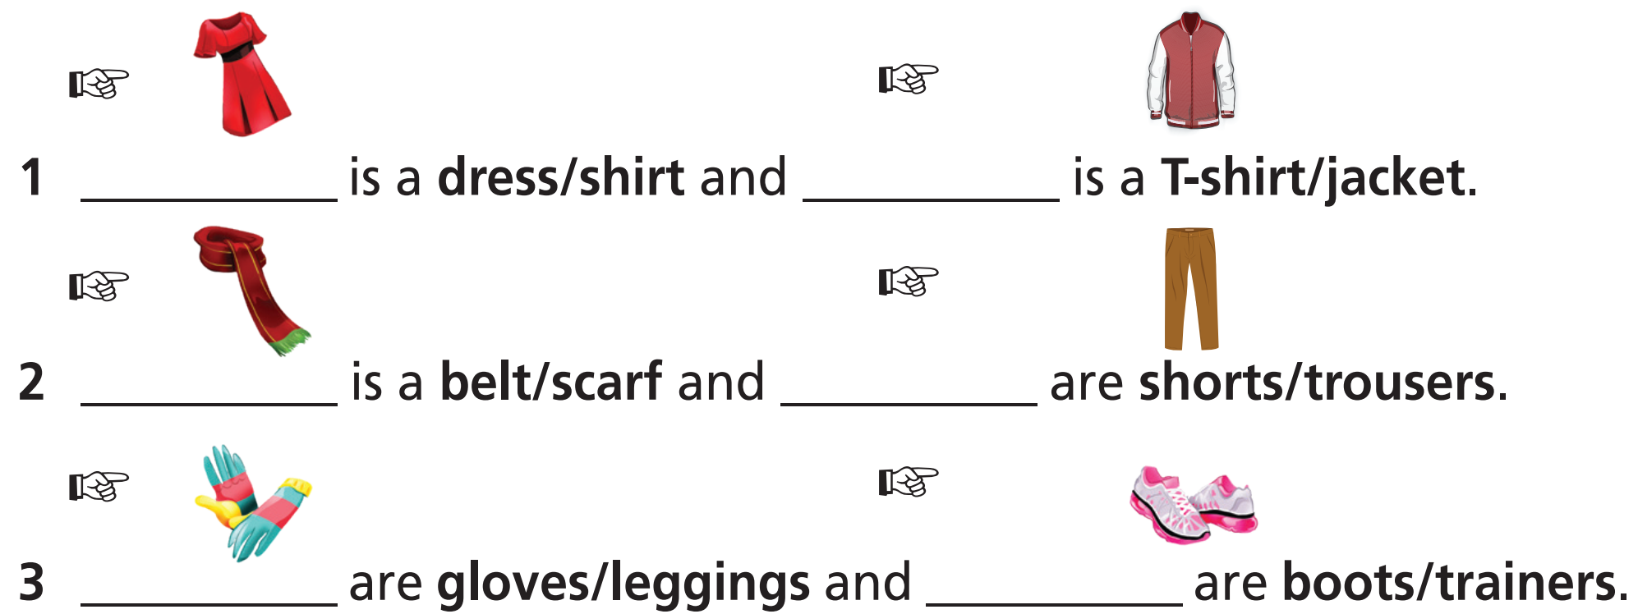
Grammar
Fill in each gap with this, these, that or those and choose the
correct option.
This
that
This
those
These
those

Slide 19
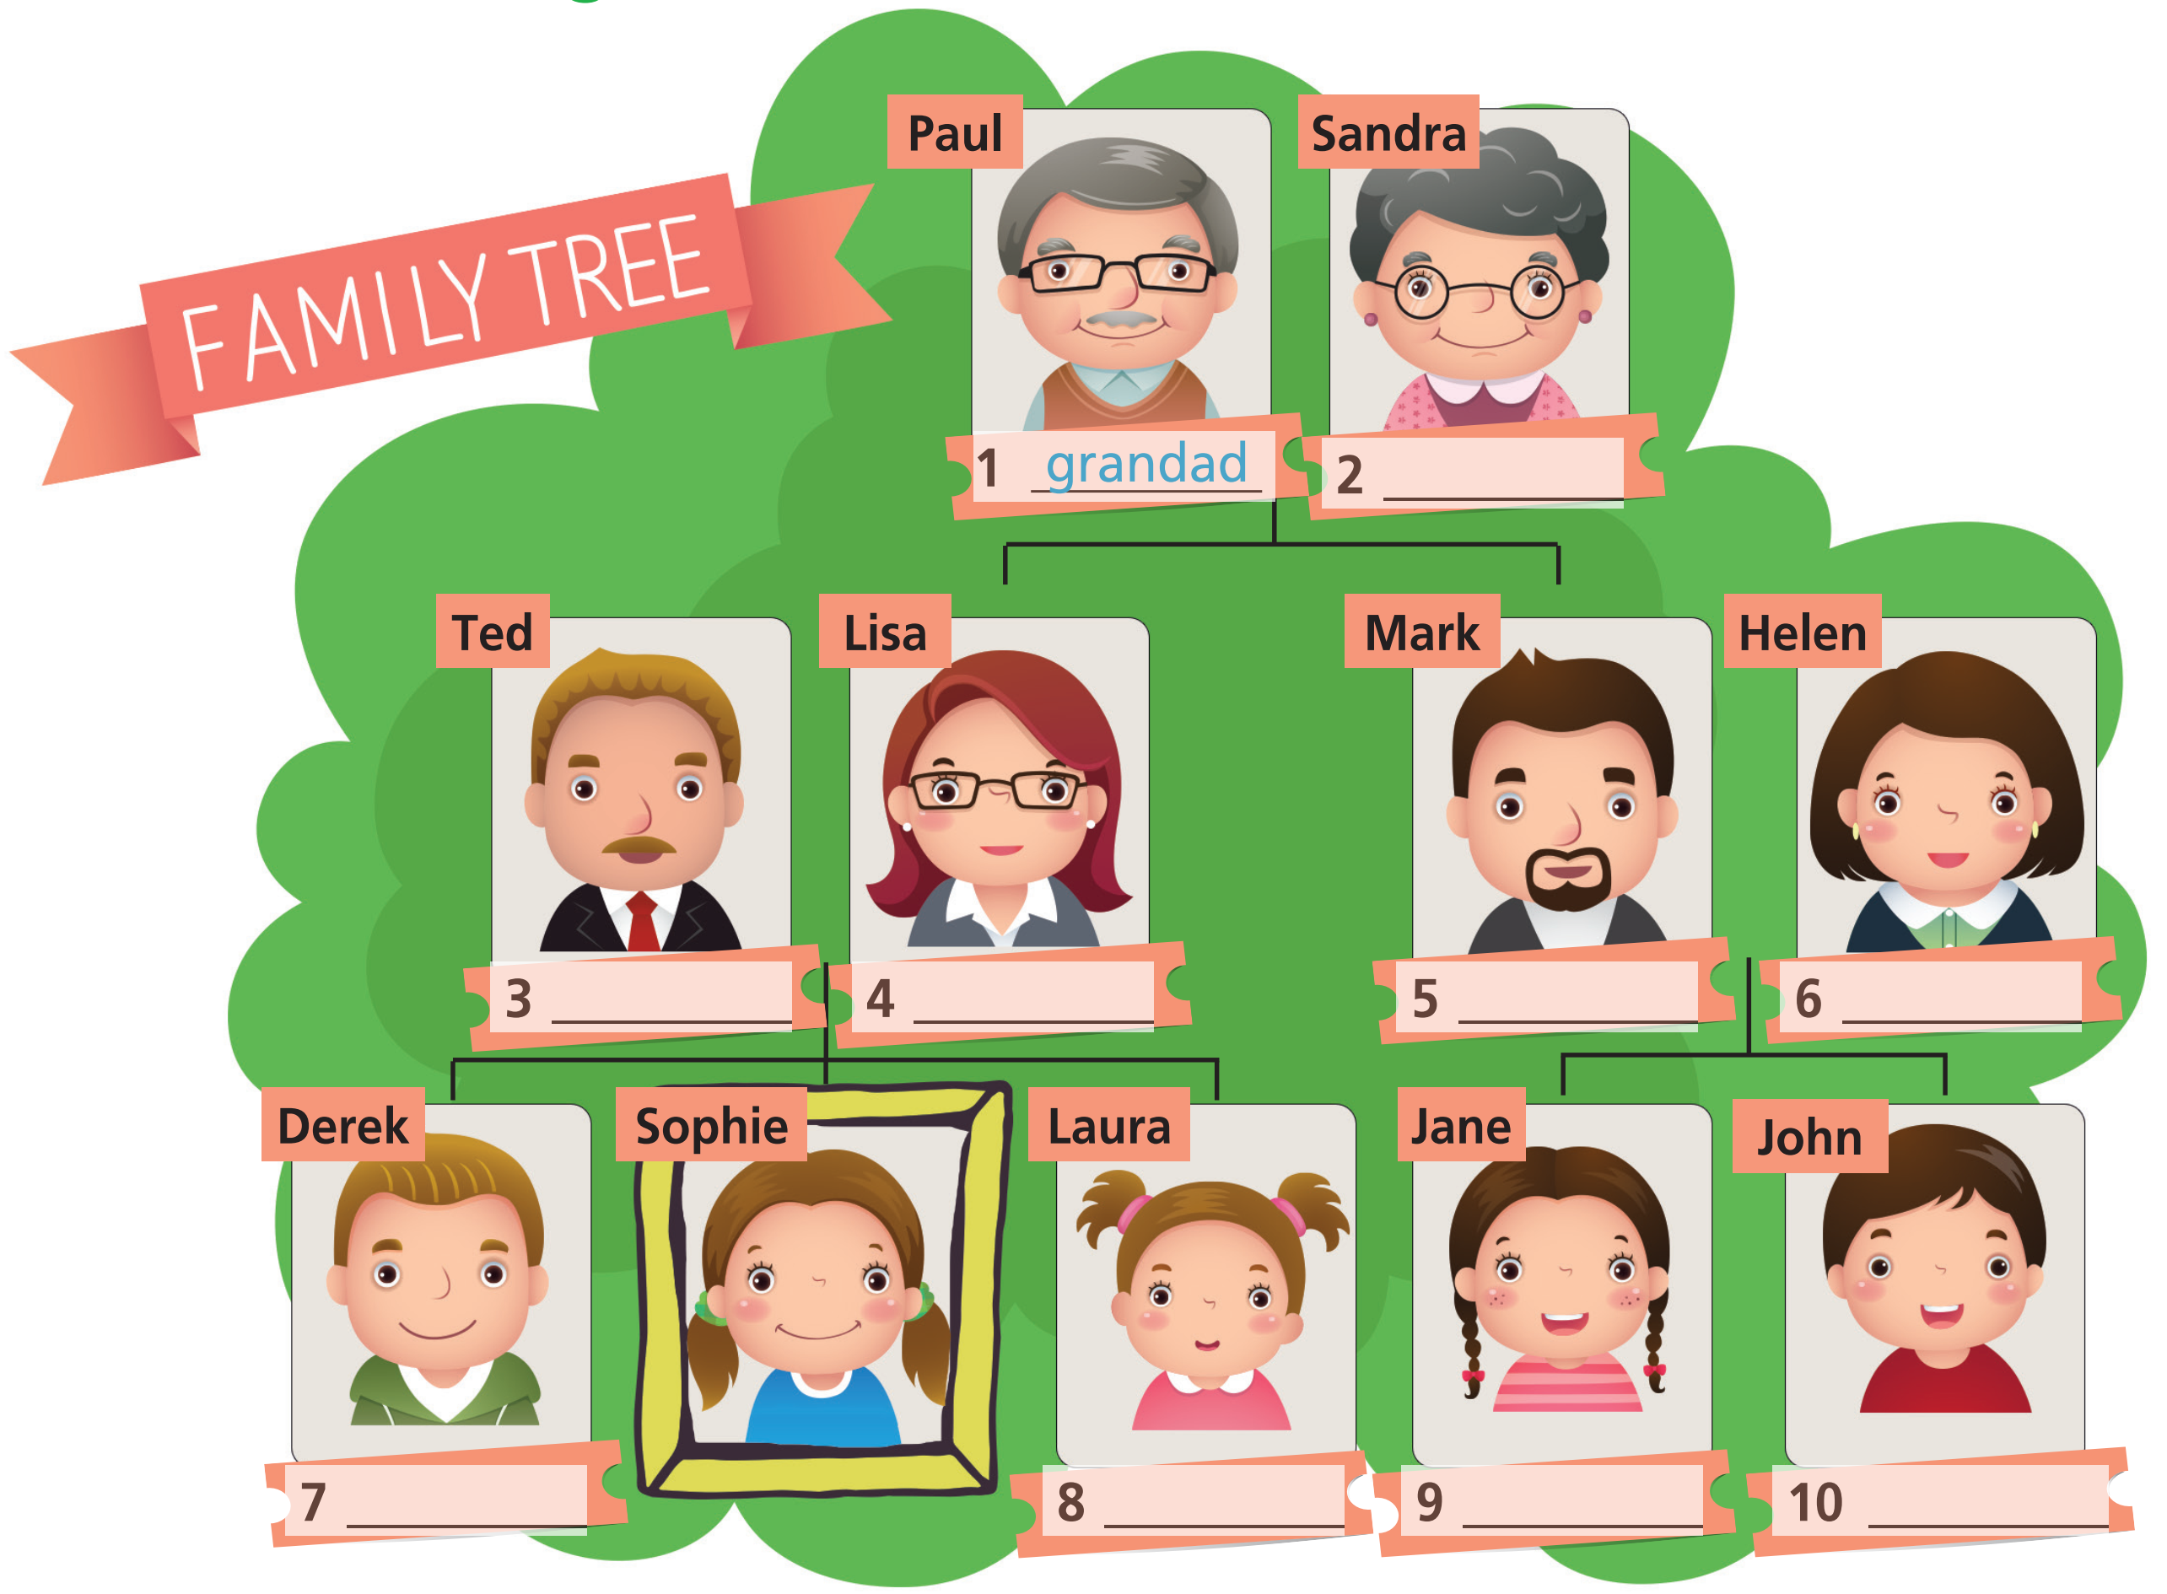
Extra Practice
WB, page 8
grandma
dad
mom
uncle
aunt
brother
sister
cousin
cousin

Slide 20
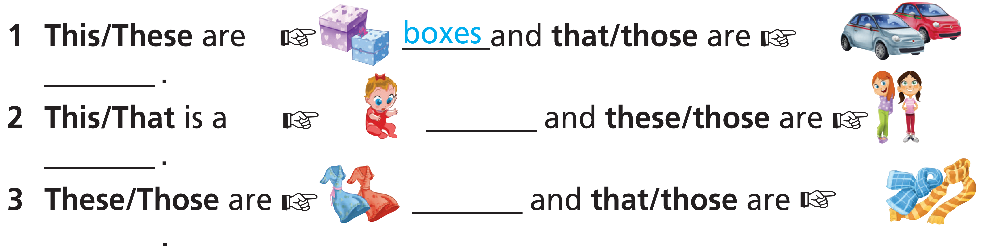


Extra Practice
WB, page 8
cars
baby
girls
dresses
scarves

Slide 21


Extra Practice
WB, page 9
It’s twenty past ten.
It’s a quarter to one.
It’s half past six.
It’s five o’clock.
It’s a quarter past nine.
It’s ten twenty.
It’s twelve forty-five.
It’s six thirty.
It’s nine fifteen.

Slide 22

CONSOLIDATION

Slide 23
Write a paragraph (60-80 words) about your family.

Slide 24

WRAP-UP

Slide 25
Today’s lesson
Vocabularies
Family members
Time
Clothes
Structures/ Sentence patterns
have got
Possession
Plurals
this/that/these/those

Slide 26
Homework
Practise the vocabularies and grammar and make sentences using them.
Do the exercises in TA 7 Right on WB (pages 8 & 9).
Prepare the next lesson (pages 10 & 11 SB).

Slide 27

Enjoy your day!

