Slide 1
Cool Startup business plan
Infographics
Here is where your presentation begins

Slide 2
About Cool Startup Business Plan Infographics
This template contains an assortment of complementary infographic resources for the Cool Startup Business Plan Infographics
These infographics are adapted to the style of the aforementioned presentation, so you can insert them easily and have them completely integrated at once. You just need to do the following:
Select the element that you want to copy
Right-click and choose “Copy”
Go to the slide where you want the element to appear
Right-click and choose “Paste”

Slide 3
Cool Startup Business Plan Infographics
Market trends
Trend #1
Trend #2
Trend #3
Mercury is the closest planet to the Sun
Earth is the beautiful planet where we all live
Despite being red, Mars is actually a cold place

Slide 4
Cool Startup Business Plan Infographics
PROBLEMS
Business Plan
1.
2.
solutions
1.
Neptune is the farthest planet from the Sun
Mercury is the closest planet to the Sun
Venus has a beautiful name, but it’s hot
2.
Despite being red, Mars is actually a cold place

Slide 5
Cool Startup Business Plan Infographics
INNOVATION
Earth is the beautiful planet where we all live
Technology
Venus has a beautiful name, but also high temperatures
OUR COMPANY
Mindset
Despite being red, Mars is actually a cold place
Skills
Jupiter is the biggest planet in the Solar System

Slide 6
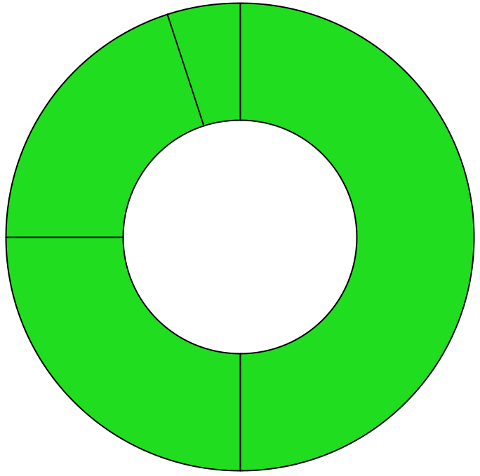
Cool Startup Business Plan Infographics
5%
50%
Mercury
Mars
Mercury is the closest planet to the Sun
Mars is actually a very cold place
20%
25%
Venus
Saturn
It’s the second planet from the Sun
It’s composed of hydrogen and helium
Follow the link in the graph to modify its data and then paste the new one here. For more info, click here

Slide 7
Cool Startup Business Plan Infographics
Mercury
Earth
Mercury is the closest planet to the Sun
30%
5%
Earth is the third planet from the Sun
Venus
MArs
Venus is the second planet from the Sun
20%
45%
Despite being red, Mars is actually a cold place

Slide 8
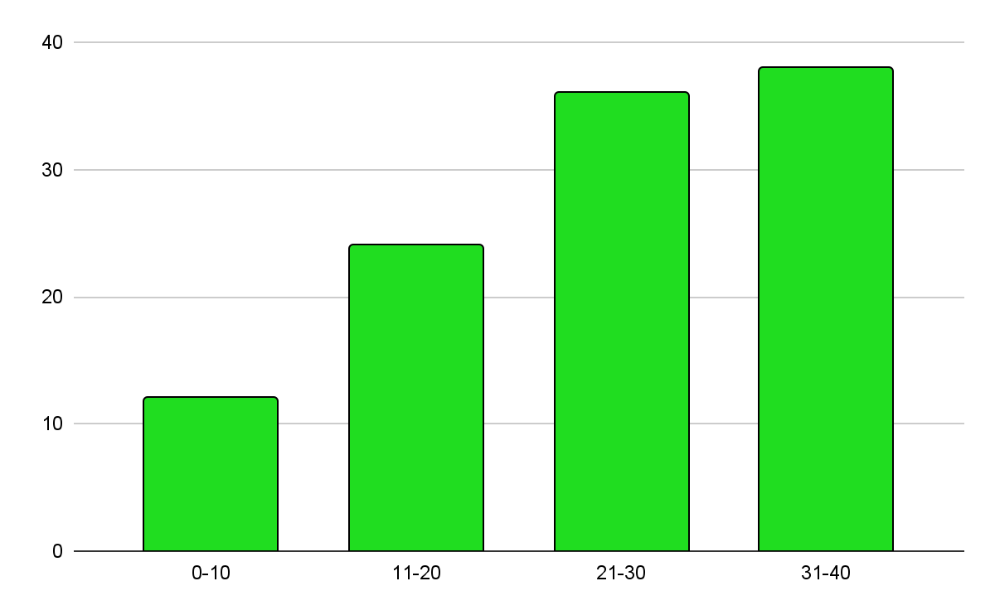
Cool Startup Business Plan Infographics
Age
Earth is the third planet from the Sun
Gender
Despite being red, Mars is actually a cold place
60%
40%
Follow the link in the graph to modify its data and then paste the new one here. For more info, click here
Mars
Venus

Slide 9
Cool Startup Business Plan Infographics
Mars
Us
Them
Despite being red, Mars is actually a cold place. It's full of iron oxide dust, which gives the planet its reddish cast
Earth is the third planet from the Sun and the only one that harbors life in the Solar System. This is where we all live
Venus
Mercury

Slide 10
Cool Startup Business Plan Infographics
Mercury
Mercury is the closest planet to the Sun
10%
60%
Mars
Despite being red, Mars is actually a cold place
30%
Jupiter
Jupiter is the biggest planet in the Solar System

Slide 11
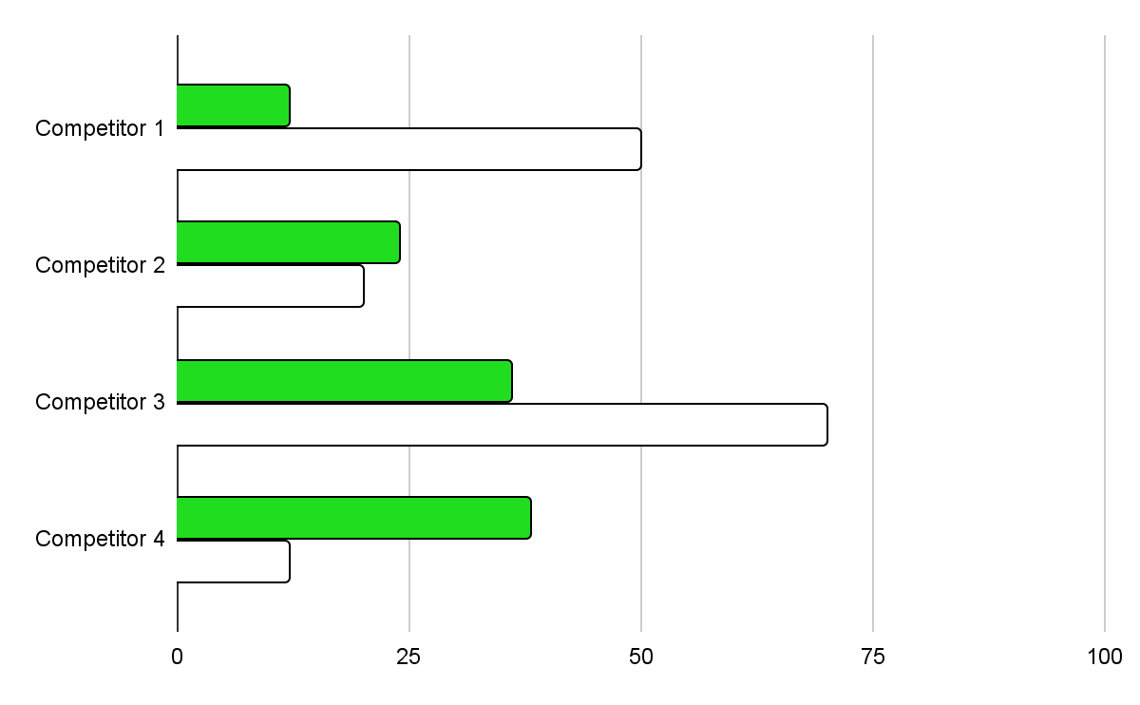
Cool Startup Business Plan Infographics
MArket share
Despite being red, Mars is actually a cold place. It’s full of iron oxide dust
Venus
It has a beautiful name, but it’s terribly hot
Neptune
Neptune is the farthest planet from the Sun
Follow the link in the graph to modify its data and then paste the new one here. For more info, click here

Slide 12
Cool Startup Business Plan Infographics
02
04
01
03
Venus
Earth
Venus is the second planet from the Sun
Earth is the only planet known to harbor life
Mercury
Mars
Mercury is the closest planet to the Sun
Despite being red, Mars is actually a cold place

Slide 13
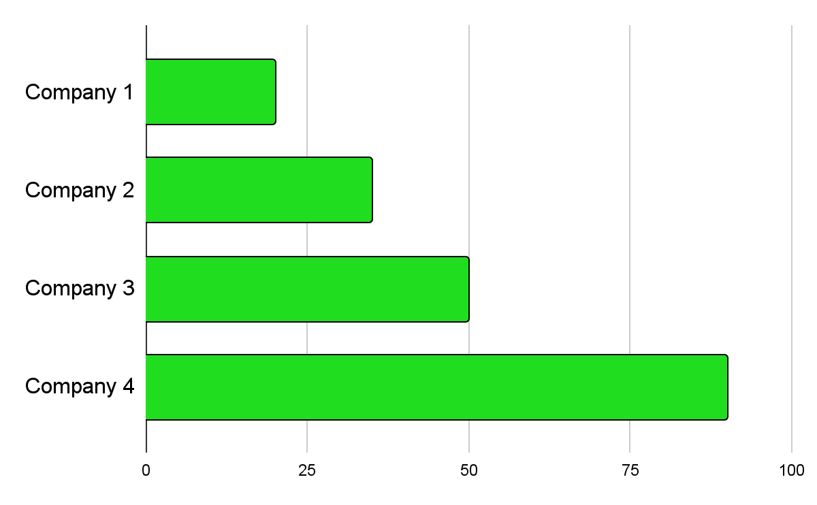
Cool Startup Business Plan Infographics
20%
35%
Market share
50%
90%
Follow the link in the graph to modify its data and then paste the new one here. For more info, click here

Slide 14
Cool Startup Business Plan Infographics
01
02
03
04
Mercury
Jupiter
Venus
Earth
Mercury is the closest planet to the Sun
Jupiter is the biggest planet in the Solar System
Venus is extremely hot, even more than Mercury
Earth is the beautiful planet where we all live

Slide 15
Cool Startup Business Plan Infographics
Competitor 1
Competitor 2
Competitor 3

Slide 16
Cool Startup Business Plan Infographics
Mars
Earth
Despite being red, Mars is actually a cold place
Earth is the third planet from the Sun
Our services
Mercury
Saturn
Mercury is the closest planet to the Sun
Saturn is not the only planet with rings

Slide 17
Cool Startup Business Plan Infographics
Big loss
Loss
Profit
High Profit
Break even point
Mercury
MArs
Jupiter
Saturn
Mercury is the closest planet to the Sun
Despite being red, Mars is a cold place
Jupiter is the biggest planet in the Solar System
Saturn is a gas giant and has several rings

Slide 18
Cool Startup Business Plan Infographics
Premium
Jupiter is the biggest planet in the Solar System
Pro
Mercury is the smallest planet of them all
Basic
Saturn is the second-largest planet in the Solar System

Slide 19
Cool Startup Business Plan Infographics
Sales & distribution
Channel 1
Channel 2
Channel 3
Channel 4
Mercury
Saturn
Neptune
Venus
Mercury is the closest planet to the Sun
Saturn is a gas giant and has several rings
It’s the fourth largest planet in the Solar System
It has a beautiful name, but high temperatures

Slide 20
Cool Startup Business Plan Infographics
25%
Advertising
Mercury is the closest planet to the Sun
45%
Pr
Earth is the third planet from the Sun
80%
Online
Despite being red, Mars is very cold

Slide 21
Cool Startup Business Plan Infographics
Our team
Designers
Administration
Jupiter is the biggest planet of them all
Mars is actually a very cold place
Jenna Doe
Paul Smith
Lily Bones
Kim Davis
Tom Brown
Sam Jones
You can speak a bit about this person here
You can speak a bit about this person here
You can speak a bit about this person here
You can speak a bit about this person here
You can speak a bit about this person here
You can speak a bit about this person here

Slide 22
Cool Startup Business Plan Infographics
Paul Smith
You can speak a bit about this person here
Team 1
Robert Brown
You can speak a bit about this person here
Kimmy Smith
You can speak a bit about this person here
ceo
Lily Williams
You can speak a bit about this person here
Team 2
Susan Bones
You can speak a bit about this person here
Diana Miller
You can speak a bit about this person here

Slide 23
Cool Startup Business Plan Infographics
Our partners
Partner 1
Partner 2
Mercury is a small planet
Venus is a hot planet
We all live on Earth
Mars is a cold planet
Jupiter is a gas giant
Saturn is a gas giant
Neptune is an ice giant
Mercury is very small
Venus is a hot planet
Earth has life

Slide 24
Cool Startup Business Plan Infographics
Day 1
Day 2
Day 3
Day 4
Day 5
It’s the fourth largest planet in the Solar System
Saturn is a gas giant and has several rings
It has a beautiful name, but high temperatures
Despite being red, Mars is actually a cold place
Venus is extremely hot, even more than Mercury

Slide 25
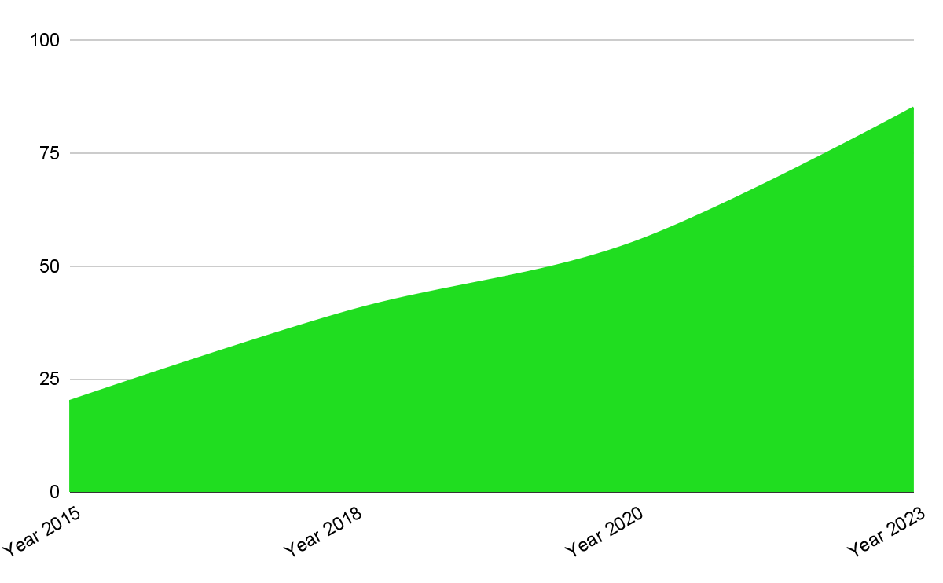
Cool Startup Business Plan Infographics
>30%
Predicted growth
Earth is the third planet from the Sun and the only one that harbors life in the Solar System
Follow the link in the graph to modify its data and then paste the new one here. For more info, click here

Slide 26
Cool Startup Business Plan Infographics
Balance |  | Assets | Liabilities | Equity
 | Mars | 1,600 | 3,500 | 6,800
 | Jupiter | 1,800 | 1,200 | 2,200
 | Mercury | 2,300 | 4,300 | 4,500

Slide 27
Cool Startup Business Plan Infographics
50%
25%
80%
10%
Neptune
Mars
Earth
Saturn
It’s the fourth largest planet in the Solar System
Despite being red, Mars is actually a cold place
Earth is the beautiful planet where we all live
Saturn is a gas giant and has several rings

Slide 28
Cool Startup Business Plan Infographics
Earth
Earth is the third planet from the Sun
Day 1
Venus
Day 2
Venus is extremely hot, even more than Mercury
Saturn
Saturn is not the only planet with rings
Day 3

Slide 29
Cool Startup Business Plan Infographics
Growth
Predicted growth
Mars | $10,000
Jupiter | $28,000
Neptune | $15,000
Saturn | $60,000
Earth | $3,000
01
02
03
Saturn has several rings
Jupiter is a very big plant
Neptune is far from the Sun
Predicted growth
$120,000

Slide 30
Cool Startup Business Plan Infographics
Venus
Saturn
Venus is extremely hot, even more than Mercury
Saturn is a gas giant and has several rings
Mars
Neptune
Despite being red, Mars is actually a cold place
It’s the fourth largest planet in the Solar System

Slide 31
Cool Startup Business Plan Infographics
Mercury is the closest planet to the Sun
Venus
Venus is extremely hot, even more than Mercury
Mercury
Mars
Earth is the only planet known to harbor life
Earth
Despite being red, Mars is a cold place

Slide 32
Cool Startup Business Plan Infographics
Venus
Saturn
Venus is extremely hot, even more than Mercury
Saturn is a gas giant and has several rings
Mars
Neptune
Despite being red, Mars is actually a cold place
It’s the fourth largest planet in the Solar System

Slide 33
Instructions for use
If you have a free account, in order to use this template, you must credit Slidesgo in your final presentation. Please refer to the next slide to read the instructions for premium users.
As a Free user, you are allowed to:
- Modify this template.
- Use it for both personal and commercial projects.
You are not allowed to:
- Sublicense, sell or rent any of Slidesgo Content (or a modified version of Slidesgo Content).
- Distribute Slidesgo Content unless it has been expressly authorized by Slidesgo.
- Include Slidesgo Content in an online or offline database or file.
- Offer Slidesgo templates (or modified versions of Slidesgo templates) for download.
- Acquire the copyright of Slidesgo Content.
For more information about editing slides, please read our FAQs or visit our blog:
https://slidesgo.com/faqs and https://slidesgo.com/slidesgo-school

Slide 34
Instructions for use (premium users)
As a Premium user, you can use this template without attributing Slidesgo.
You are allowed to:
Modify this template.
Use it for both personal and commercial purposes.
Share this template in an editable format with people who are not part of your team.
You are not allowed to:
Sublicense, sell or rent this Slidesgo Template (or a modified version of this Slidesgo Template).
Distribute this Slidesgo Template (or a modified version of this Slidesgo Template) or include it in a database or in any other product or service that offers downloadable images, icons or presentations that may be subject to distribution or resale.
Use any of the elements that are part of this Slidesgo Template in an isolated and separated way from this Template.
Register any of the elements that are part of this template as a trademark or logo, or register it as a work in an intellectual property registry or similar.
For more information about editing slides, please read our FAQs or visit our blog:
https://slidesgo.com/faqs and https://slidesgo.com/slidesgo-school

Slide 35
Infographics
You can add and edit some infographics to your presentation to present your data in a visual way.
Choose your favourite infographic and insert it in your presentation using Ctrl C + Ctrl V or Cmd C + Cmd V in Mac.
Select one of the parts and ungroup it by right-clicking and choosing “Ungroup”.
Change the color by clicking on the paint bucket.
Then resize the element by clicking and dragging one of the square-shaped points of its bounding box (the cursor should look like a double-headed arrow). Remember to hold Shift while dragging to keep the proportions.
Group the elements again by selecting them, right-clicking and choosing “Group”.
Repeat the steps above with the other parts and when you’re done editing, copy the end result and paste it into your presentation.
Remember to choose the “Keep source formatting” option so that it keeps the design. For more info, please visit our blog.

