Slide 1

Unit 2: Every Day
Lesson 2b: Grammar
Page 40

Slide 2
Lesson Outline
Warm-up
Presentation
Practice
Production
Consolidation
Wrap-up

Slide 3
Objectives
By the end of this lesson, students will be able to…
know the affirmative form of the Present Simple tense.
use the Present Simple tense to talk about habits and routines.
use adverbs of frequency correctly.

Slide 4

WARM-UP

Slide 5
Choose the word whose underlined part is pronounced differently form that of the others.
A. school B. foot C. food D. tooth
/skuːl/ /fʊt/ /fuːd/ /tuːθ/
2. A. draw B. talk C. walk D. play
/drɔː/ /tɔːk/ /wɔːk/ /pleɪ/
3. A. music B. science C. English D. practise
/ˈmjuːzɪk/ /ˈsaɪəns/ /ˈɪŋɡlɪʃ/ /ˈpræktɪs/

Slide 6
Pair work
Ask and answer about favourite school activities.
What are your favourite school activities?
• play basketball
• do computer-based activities
• play music
• draw
• do crafts
• sing songs, etc.
I like playing basketball and doing computer-based activities.

Slide 7

It’s time to learn …

Slide 8

Presentation

Slide 9
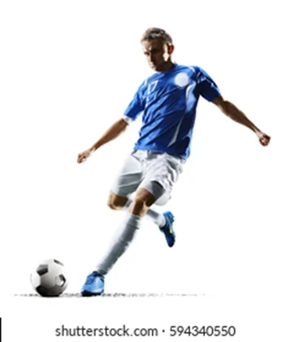
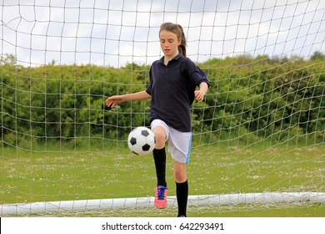
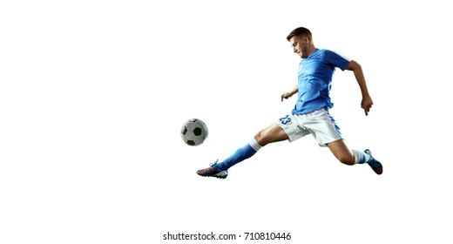
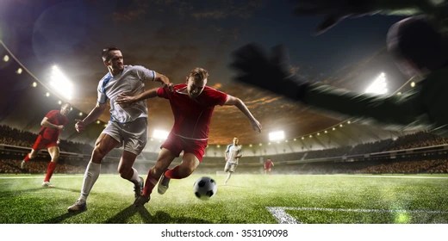
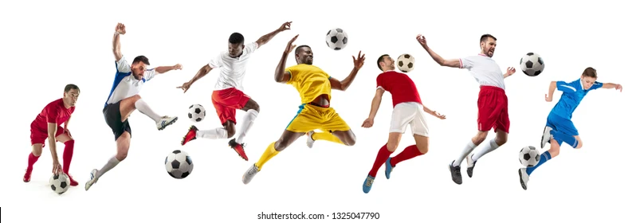
I play football everyday.
She plays football everyday.
He plays football everyday.
We play football everyday.
They play football everyday.

Slide 10
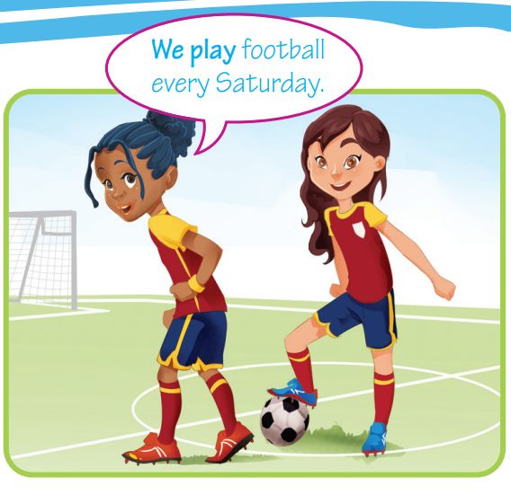
FORMATION
Present Simple tense
 | Affirmative
singular | I/You
 | He/She/It
plural | We/You/ They
play
plays
play

Slide 11
USAGE
We use the Present Simple for habits/routines.
e.g. I go to school at 8:00 a.m.
Time adverbs/phrases used with the Present Simple:
usually, often, every day/week, etc.
e.g. I go swimming every weekend.

Slide 12
Spelling Rules
3rd person singular
• verbs + -s
I eat – he eats I like – he likes
• verbs ending in -ss/-sh/-ch/-x/-o + -es
I go – he goes I push – he pushes
• verbs ending in consonant + -y: -y ➝ -ies
I cry – he cries
BUT verbs ending in vowel + -y + -s
I enjoy – he enjoys

Slide 13

Practice

Slide 14
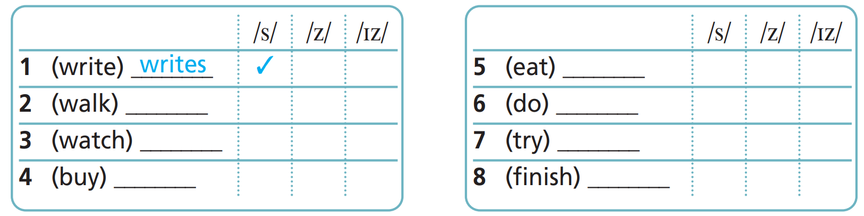
1 a) Read the theory box. Write the third-person singular of the verbs in brackets.
eats
walks
does
watches
tries
buys
finishes

Slide 15

1 b) Listen and tick (✓) the correct box. Then repeat.
eats
✓
walks
✓
does
✓
watches
tries
✓
✓
buys
✓
finishes
✓

Slide 16
1. Write the third person singular of the verbs below.
1 I catch – he/she _____________________
2 I cry – he/she _____________________
3 I finish – he/she _____________________
4 I buy – he/she _____________________
5 I wear – he/she _____________________
6 I go – he/she _____________________
catches
cries
finishes
buys
wears
Extra Practise
WB, P. 23
goes

Slide 17
2. Put the verbs in brackets into the Present Simple.
1. He ____________ (have) dinner at 8:00.
2. Ann ________________ (catch) the bus to school at 7:30 a.m.
3. Mary ________________ (reach) school at 8:00 a.m.
4. Eric ________________ (do) his homework in the afternoon.
5. Kate ________________ (enjoy) her lessons.
6. Bob ________________ (wash) his dog every Friday.
has
catches
reaches
does
enjoys
washes

Slide 18
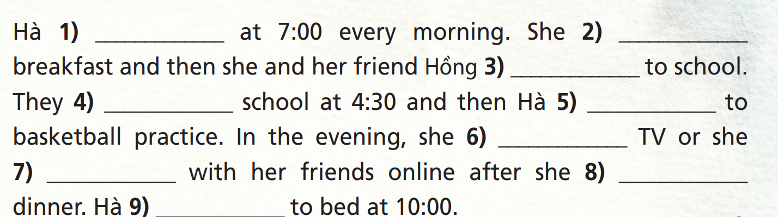
3. Complete the text with the verbs in the list in the correct form of the Present Simple.
• chat • finish • eat • get up • go (x2) • have • watch • walk
gets up
has
walk
finish
goes
watches
chats
eats
goes

Slide 19
Production

Slide 20
Tell your friend about your parents’ routine, using adverbs: always, usually, often, sometimes, never, every day.
PAIR WORK
My father always goes to work at 7:00.
My mother sometimes comes home late.

Slide 21

CONSOLIDATION

Slide 22
Write six sentences (about 50 words) about your family members’ routines, using the Present Simple tense and adverbs you have studied today.

Slide 23

WRAP-UP

Slide 24
Today’s lesson
Grammar
Present Simple tense (affirmative)
Adverbs used in Present Simple tense (always, usually, often, sometimes, never, every day, …)

Slide 25
Homework
Practise speaking and writing sentences, using the Present Simple tense.
Complete the grammar notes in TA 6 Right on Notebook (p. 22)
Prepare the next lesson (p. 41 SB)

Slide 26

Enjoy your day!

