Slide 1


Slide 2
Unit
8
BECOMING INDEPENDENT
Unit
FAMILY LIFE
LESSON 4
SPEAKING
Learning basic life skills

Slide 3
LESSON 4
SPEAKING
WARM-UP
Watch a video
CONTROLLED PRACTICE
Task 1. Discuss these questions.
Task 2: Choose the correct answers.
LESS CONTROLLED PRACTICE
Task 3: Practise giving instructions
Task 4: Add more steps and give instructions.
FURTHER PRACTICE
CONSOLIDATION
Wrap-up
Homework

Slide 4
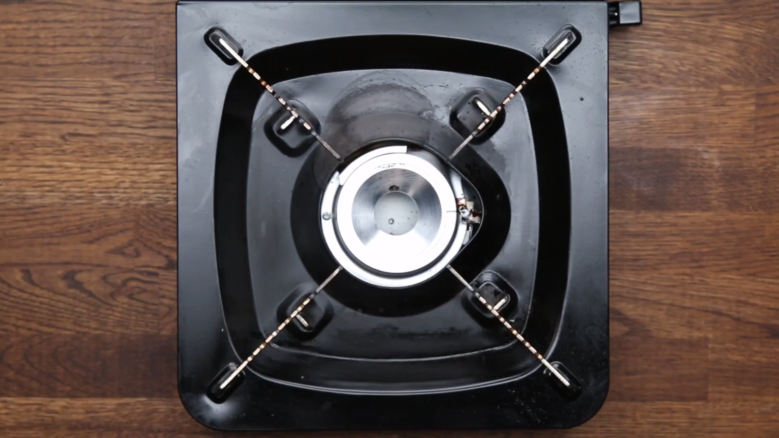
WARM-UP
WATCH A VIDEO
Notes:
https://www.youtube.com/watch?v=FTha4zARGN4

Slide 5
CONTROLLED PRACTICE
1
Work in pairs. Discuss these questions.
1. _____
2. _____
3. _____
4. _____
5. _____
B
D
E
C
A
A. Hang or fold, and store your own clothes
B. Sort the clothes by colour
C. Remove the wet clothes from the washing machine and dry them
D. Add the washing powder or liquid
E. Load the washing machine and turn it on

Slide 6
CONTROLLED PRACTICE
2
Read the following instructions on how to do laundry. Underline the correct answers.
There are several simple steps in doing laundry. First of all, (1) sort /don’t sort your clothes by colour. You should separate them into whites and colours, and wash them separately. (2) Secondly / Finally, add the washing powder or liquid. Read the instructions on the packet to make sure you use the right amount. Then, (3) load / you load the washing machine and turn it on. Make sure you place the items one at a time. Don’t put too many items as they need room to move about in the water. When the washing machine stops, (4) remove / you will remove the wet clothes. You can hang the items to dry, or put them in the dryer. Remember that air-drying clothes saves energy and money. (5) Finally / Afterwards, don’t forget to hang or fold each item. You could also iron your clothes before storing them in the wardrobe or drawer.

Slide 7
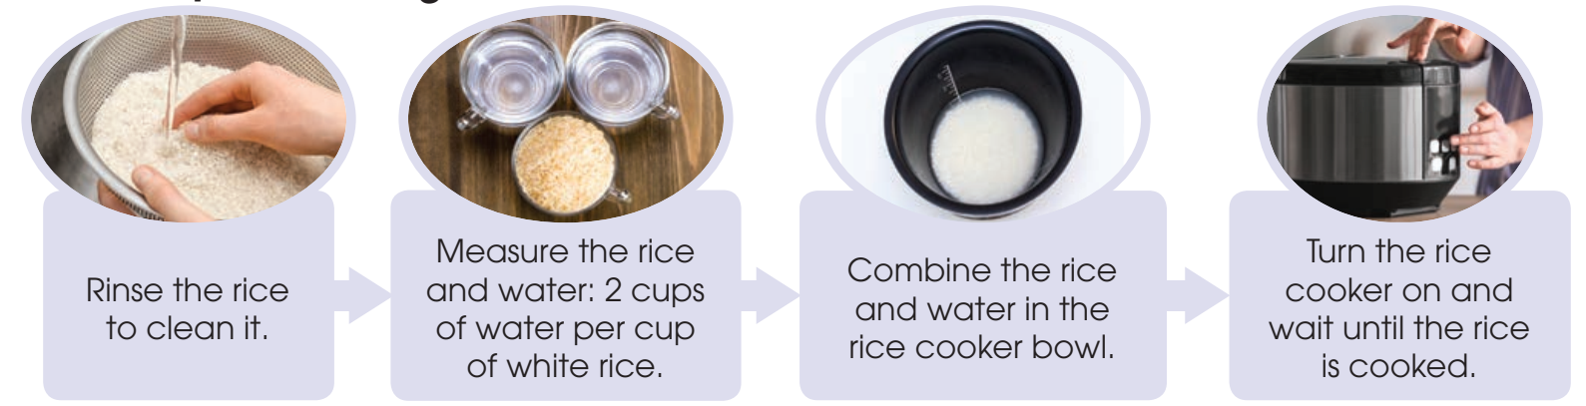
LESS CONTROLLED PRACTICE
3
Work in pairs. Read the steps in cooking rice in a rice cooker. Use the model in 2 and the tips above to give instructions.

Slide 8
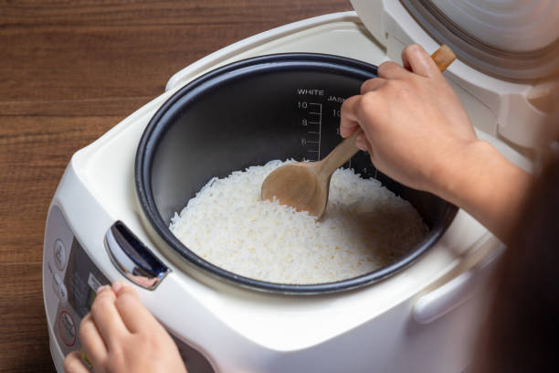
FURTHER PRACTICE
4
Work in groups. Add more steps or tips, and report to the whole class. Vote for the best recipe for cooking rice in a rice cooker.

Slide 9
CONSOLIDATION
1
Wrap-up
What have you learnt today?
How to give instructions on a basic life skill.

Slide 10
CONSOLIDATION
2
Homework
Do exercises in the workbook.
Prepare for Lesson 5 - Unit 8.

Slide 11

Website: hoclieu.vn
Fanpage: facebook.com/www.tienganhglobalsuccess.vn

