Slide 1
UNIT 9
FESTIVALS AROUND THE WORLD

Slide 2
Table of contents
01
02
03
Theory
Language
Communication Skills

Slide 3
PART 1 THEORY
I. VOCABULARY

Slide 4
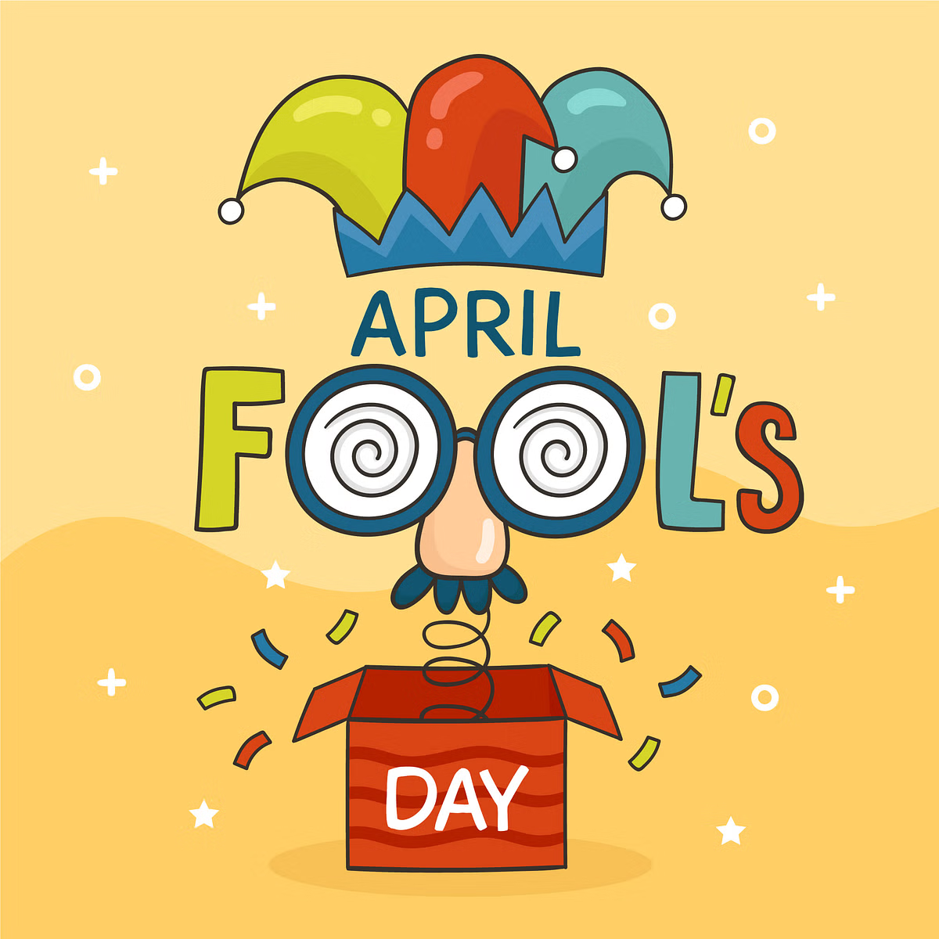

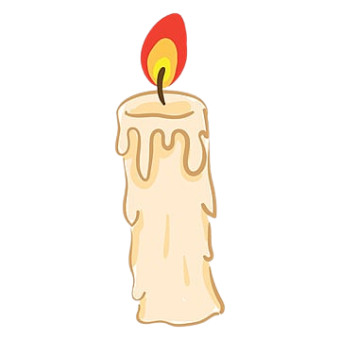

1. April Fool’s Day (n):
2. balloon (n):
3. candle (n):
/'eɪprəl fu:lz deɪ/
ngày Nói dối, ngày Cá tháng tư
/bə'lu:n/
bóng bay
/'kændl/
nến

Slide 5
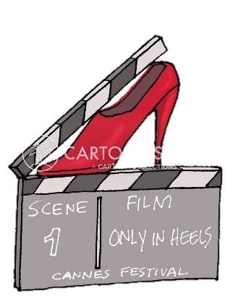
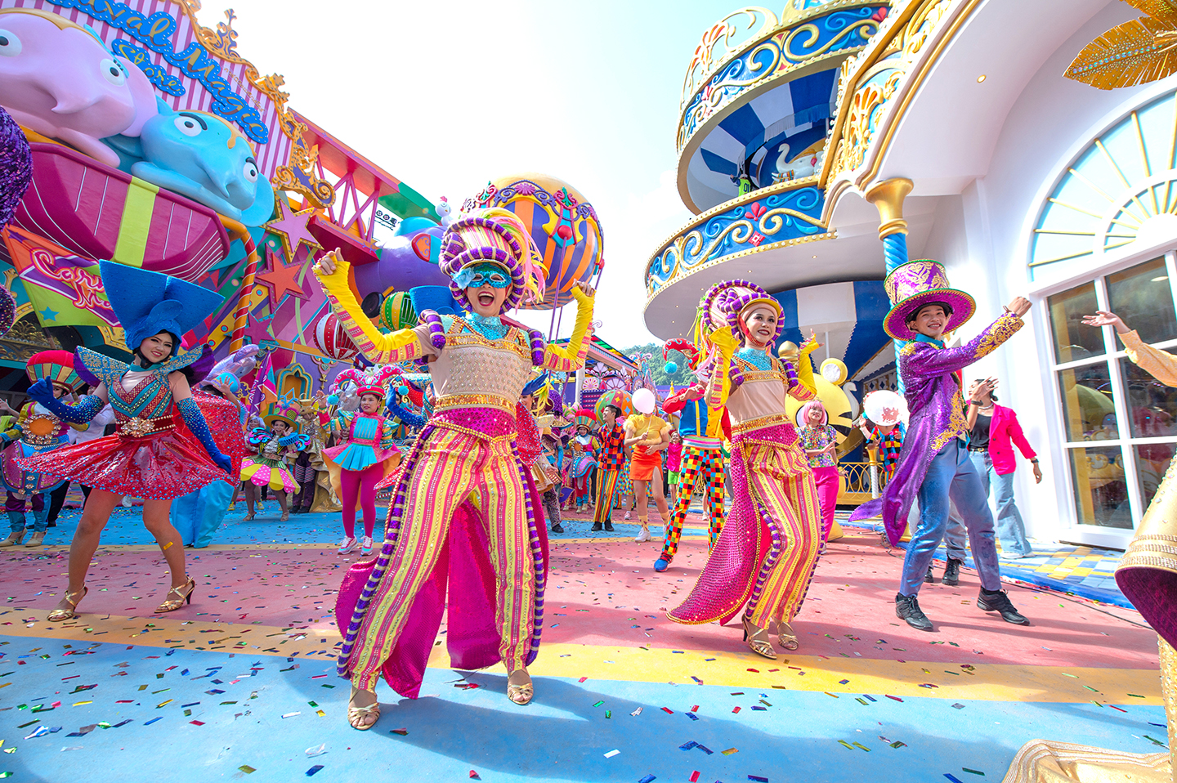
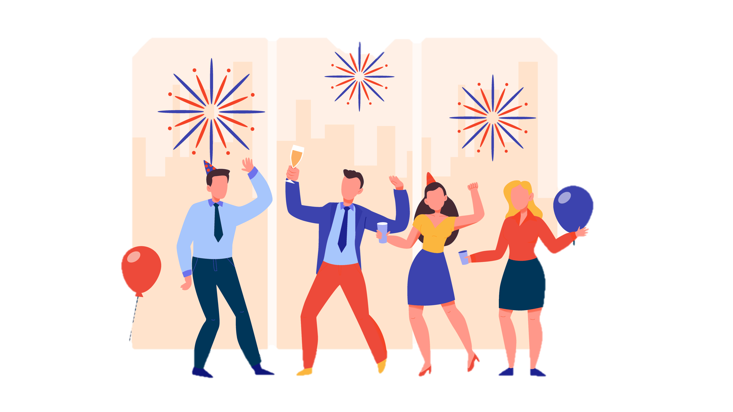
4. Cannes Film Festival (n):
6. celebration (n):
5. carnival (n):
/kæn fɪlm 'festɪvl/
Liên hoan phim Cannes
/'kɑ:nɪvl/
ngày hội, lễ hội
/.selɪ'breɪʃn/ lễ kỷ niệm

Slide 6
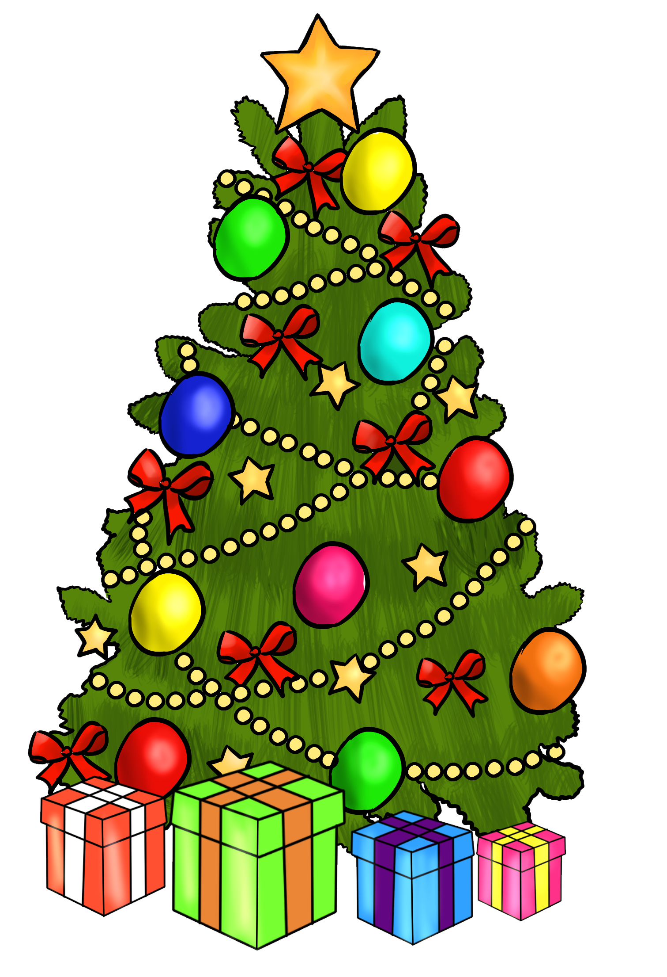
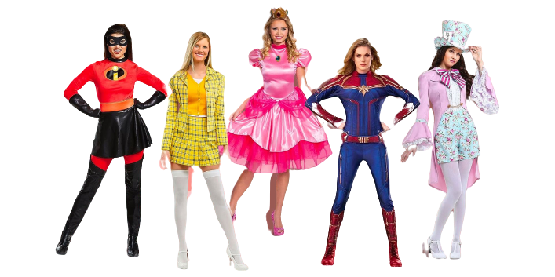
7. celebratory (n):
8. Christmas (n):
9. common (adj):
10. costume (n):
/.selə'breɪtərɪ/
sự kỷ niệm, tổ chức lễ để kỷ niệm
/'krɪsməs/
Giáng sinh
/'kɒrmən/ thông thường
/'kɒstju:m/ trang phục

Slide 7
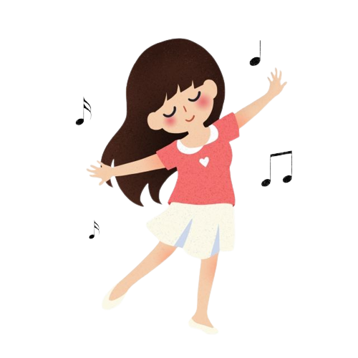
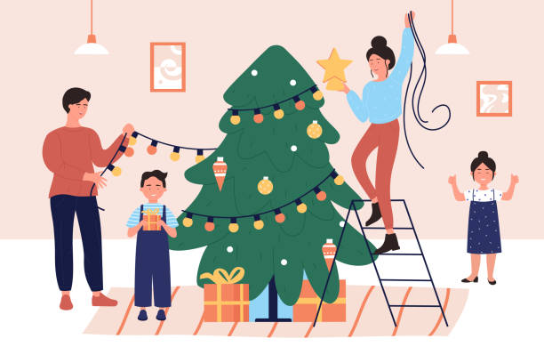
11. dance (v):
12. dancer (n):
13. decorate (v):
/dɑ:ns/
khiêu vũ, múa
/'dɑ:nsə(r)/
Vũ công
/'dekəreit/ trang trí

Slide 8
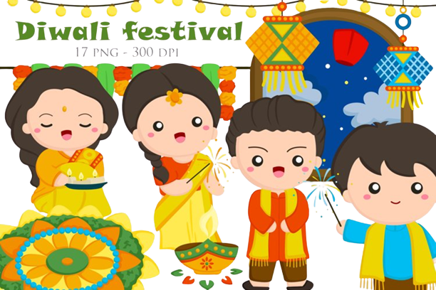
14. Diwali (n):
/di:'wɑ:lɪ/ lễ hội Diwali
("Lễ hội đèn", tiếng Sanskrit nghĩa là hàng đèn) là một lễ hội quan trọng trong văn hóa Ấn Độ Giáo. Đây là một lễ hội Hindu cổ đại.

Slide 9
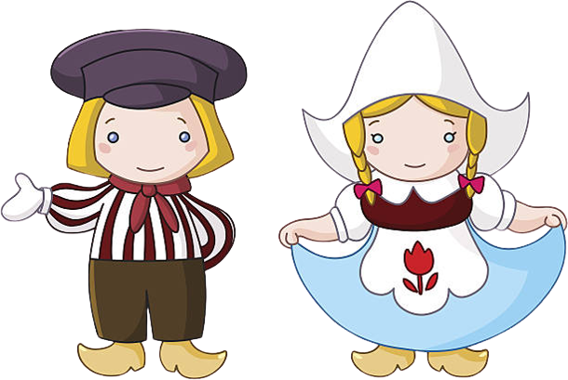
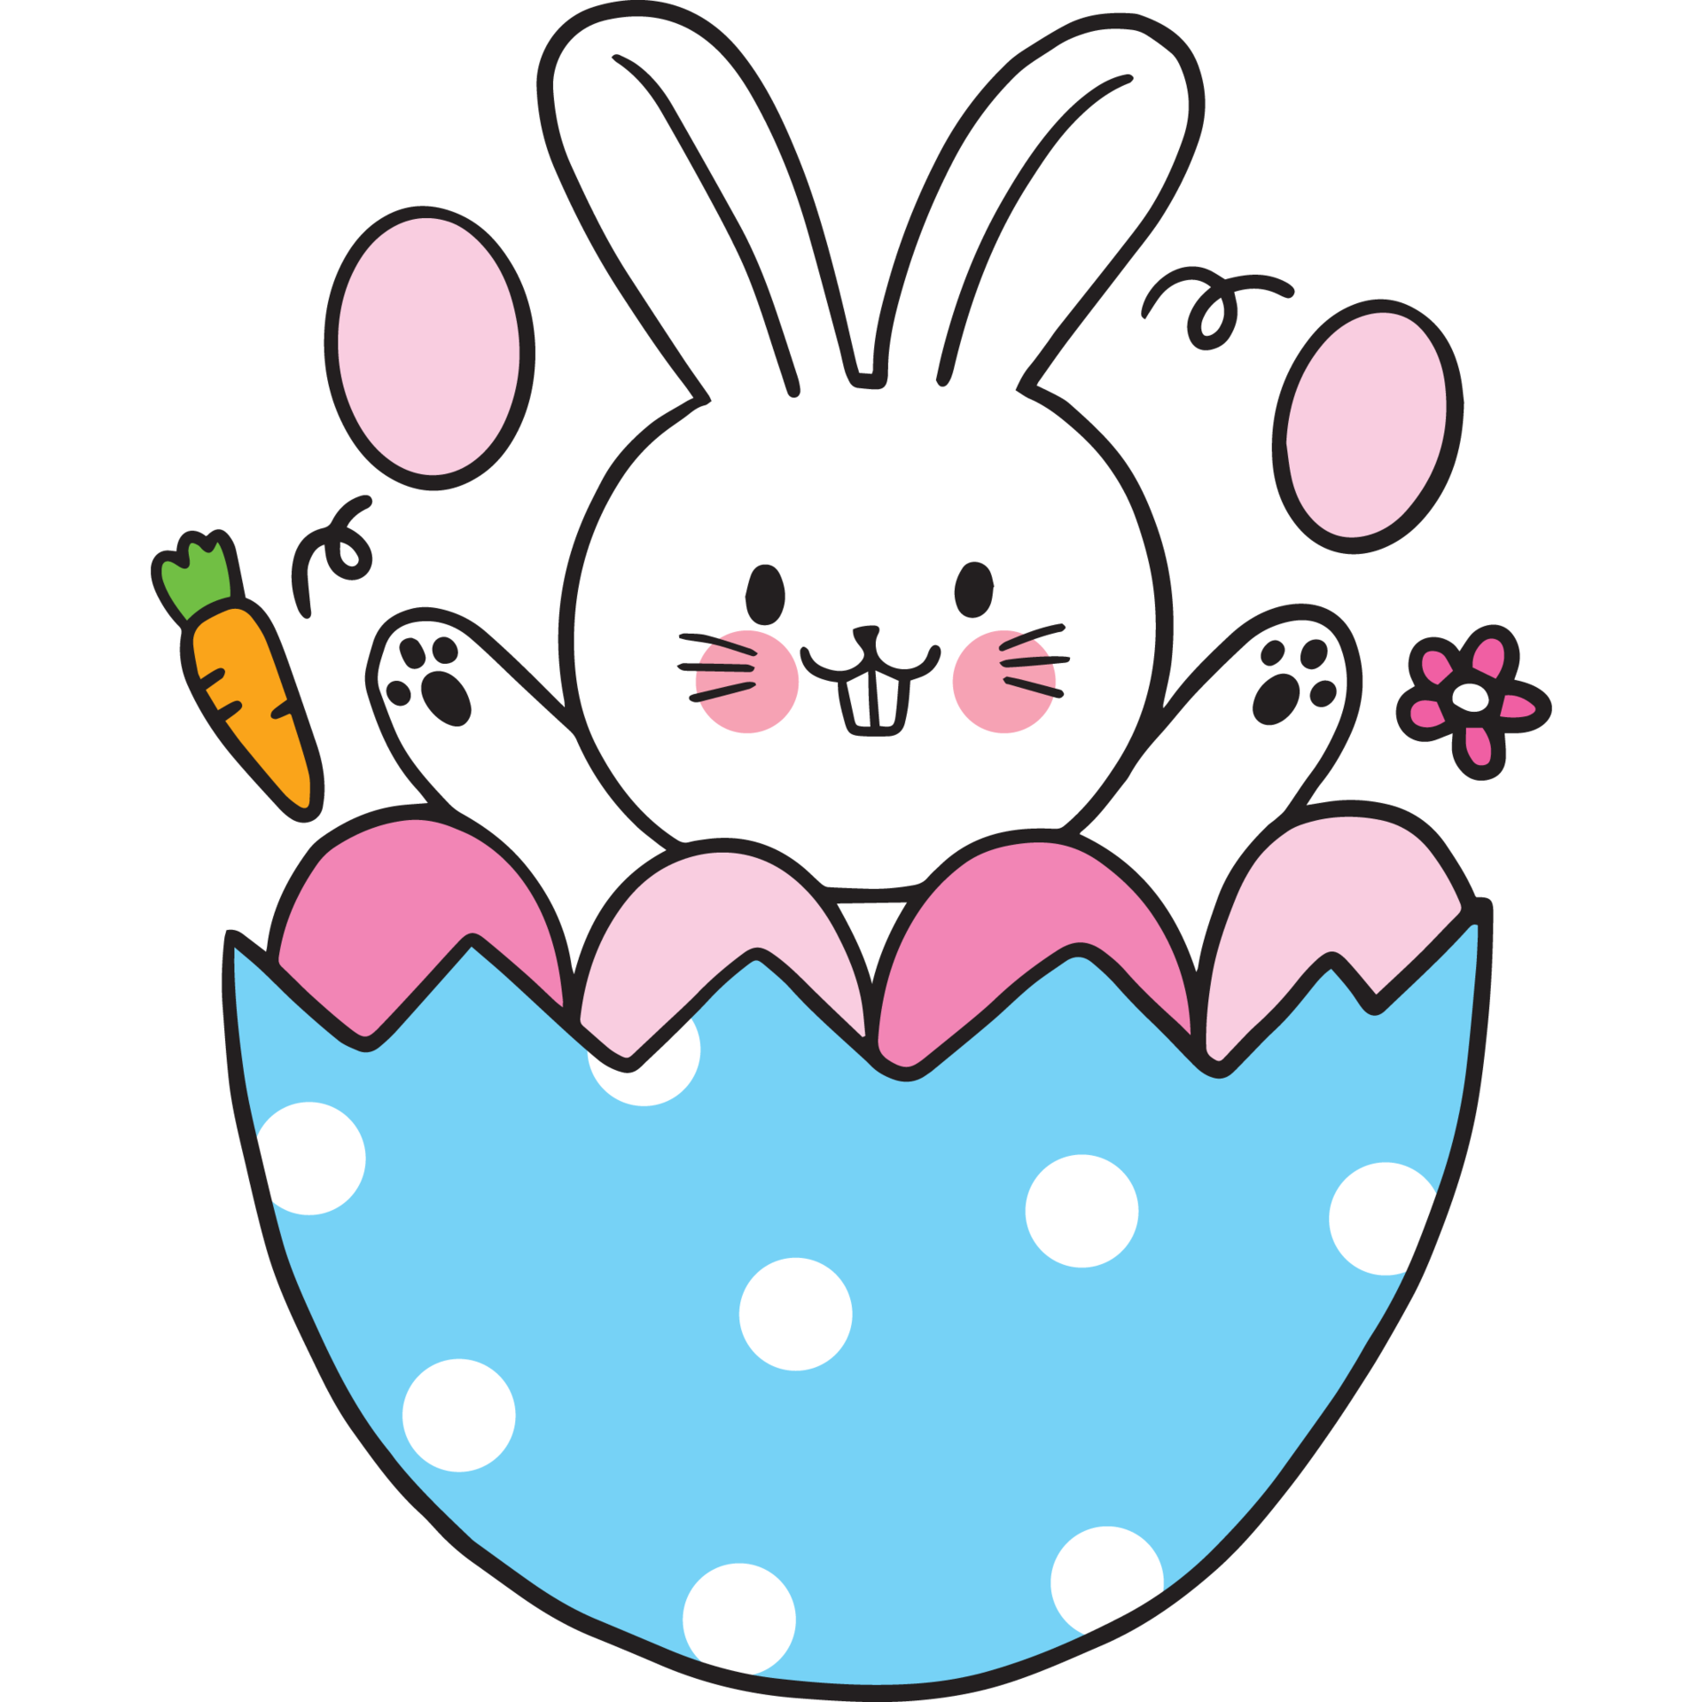
15. Dutch (n):
16. Easter (n):
/dʌtʃ/ người Hà Lan
/'i:stə(r)/
lễ Phục sinh
Lễ Phục sinh (hay còn được gọi là Easter Day, ngày Chúa sống lại, ngày Chúa phục sinh...) chính là một ngày lễ rất quan trọng đối với những người theo Kitô giáo (bao gồm Công giáo, Đạo Tin lành, Anh giáo, Chính thống giáo).

Slide 10
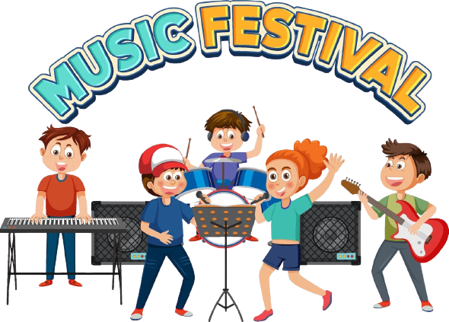
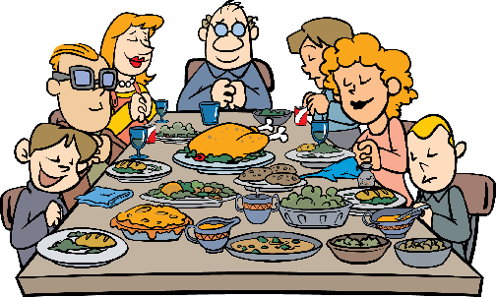
18. festival (n):
17. feast (n):
/'festivl/
lễ hội
/fi:st/
bữa tiệc lớn

Slide 11
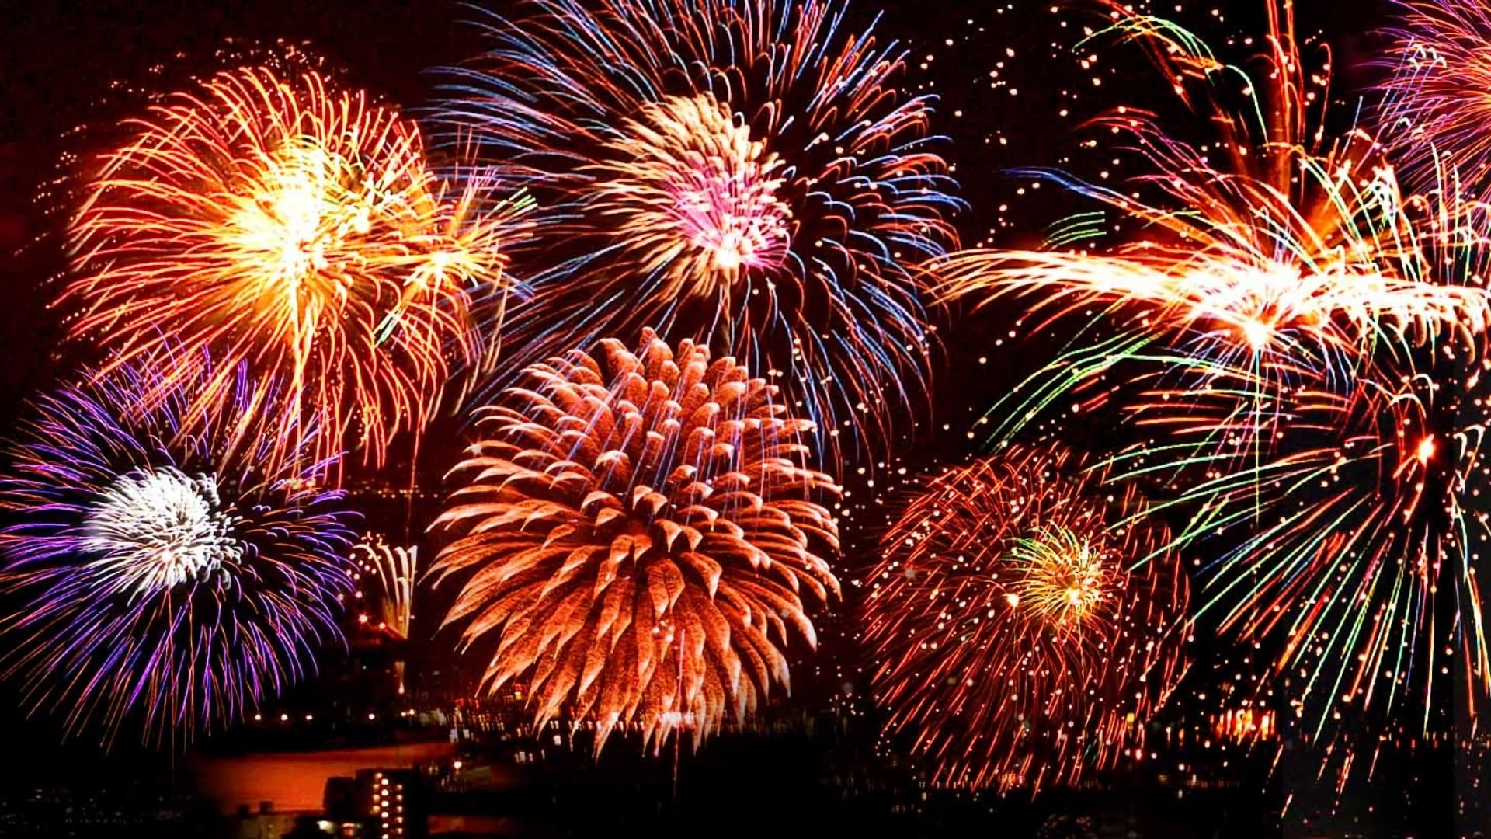
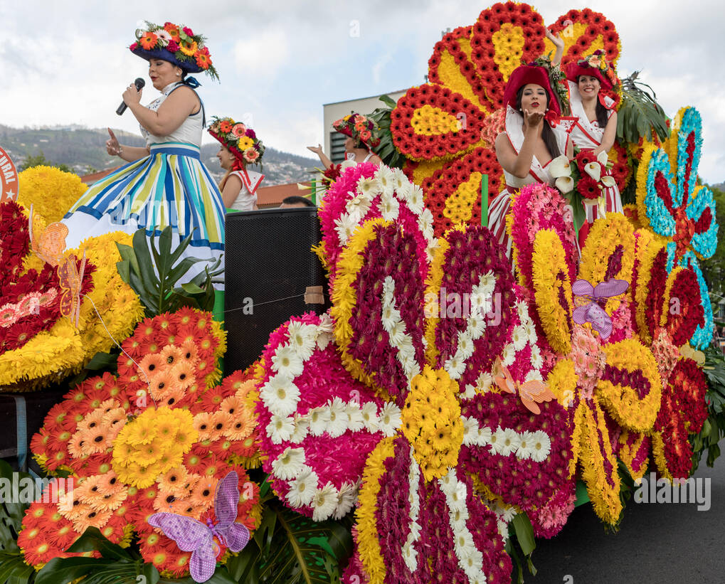
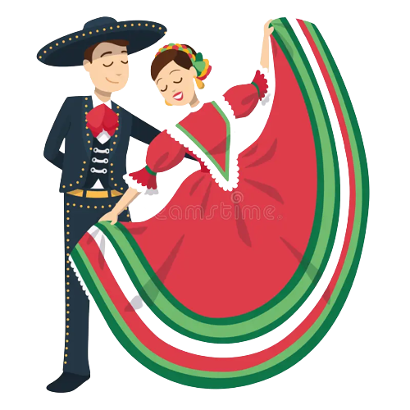
19. firework (n):
20. Flower Festival (n):
21. folk dance (n):
/'faɪəwɜ:k/ pháo hoa
/'flaʊə(r) 'festɪvl/ lễ hội Hoa
/fəʊk dæns/
điệu múa dân gian

Slide 12
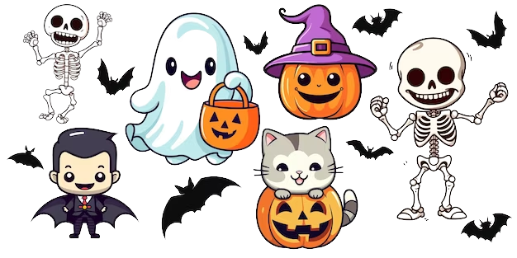
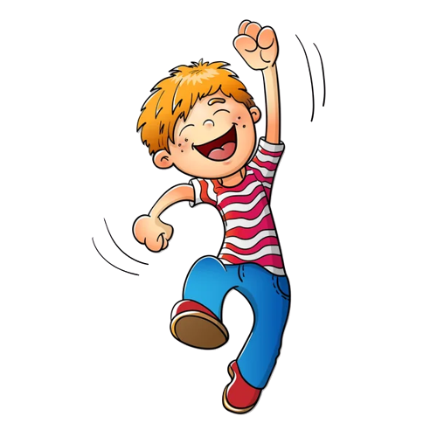
22. Halloween (n):
23. hold (V):
24. joyful (adj):
/,hæləʊ'i:n/
lễ hội hóa trang
/həʊld/
tổ chức
/'dʒɔɪfl/
Vui vẻ

Slide 13
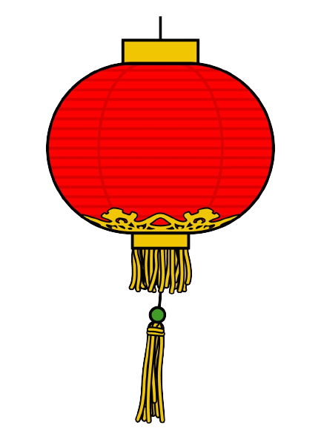

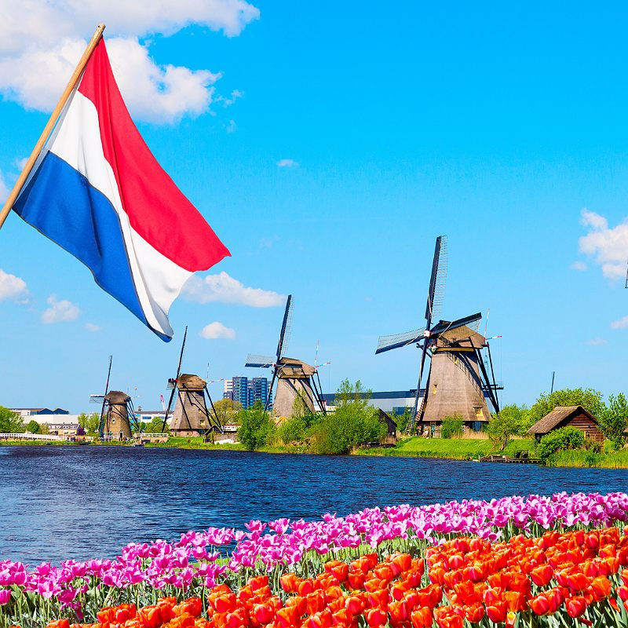

25. lantern (n):
26. Moon cake (n):
27. Netherlands (n):
28. New Year (n):
/'læntən/
đèn lồng
/mu:n keɪk/ bánh Trung thu
/nju: jɪə(r)/
năm mới
/'neðələndz/
nước Hà Lan

Slide 14
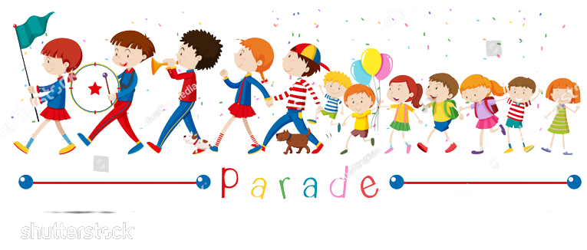
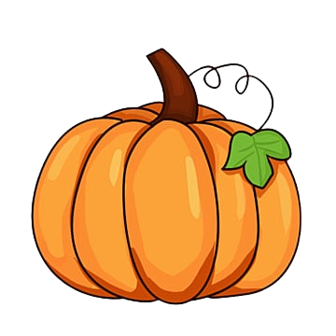

29. parade (n):
30. Performer (n):
31. photo (n):
32. Pumpkin (n):
/pə'reɪd/
cuộc diễu hành
/pə'fɔ:mə(r)/
người trình diễn, người thể hiện
/'pʌmpkɪn/
Bí ngô
/fəʊtəʊ/
ảnh

Slide 15
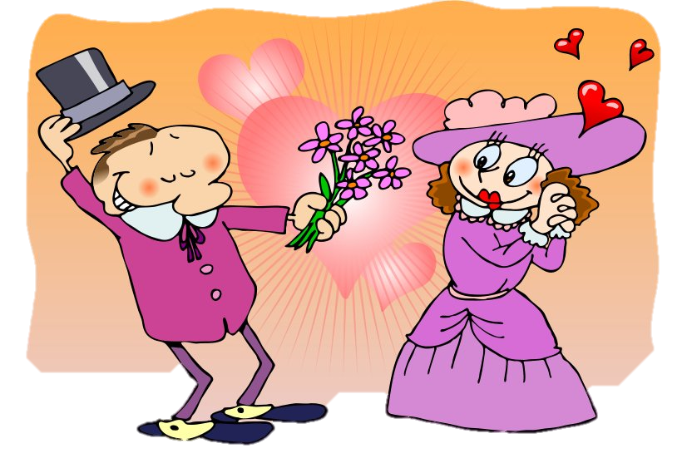
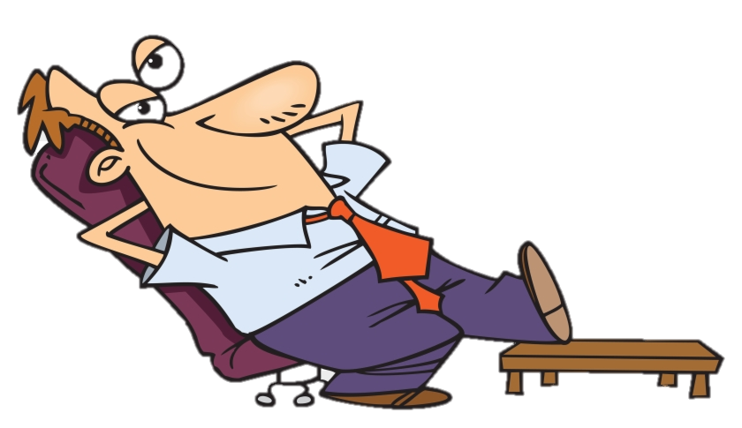
33. relax (v):
/rɪ'læks/
thư giãn
35. romantic (adj):
/rəʊ'mæntɪk/
lãng mạn
34. religious (adj):
/rɪ'hdʒəs/
mang tính tôn giáo
36. seasonal (adj):
/'si:zənl/
mang tính theo mùa

Slide 16
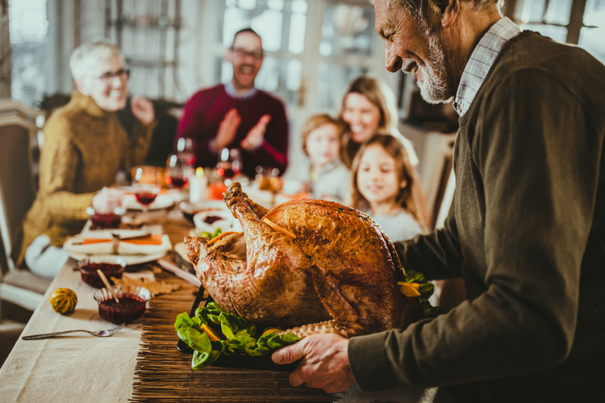
37. Thanksgiving (n):
/.θæηks'gɪvɪη/
Lễ Tạ ơn
Lễ Tạ ơn là một ngày lễ hàng năm được tổ chức chủ yếu tại Hoa Kỳ, Canada, một số đảo ở Caribe và Liberia. Ý nghĩa ban đầu là mừng thu hoạch được mùa và tạ ơn Thiên Chúa đã giúp cho cuộc sống no đủ và an lành. Đây cũng là ngày nghỉ lễ chính thức cho tất cả người lao động tại Mỹ và Canada.

Slide 17
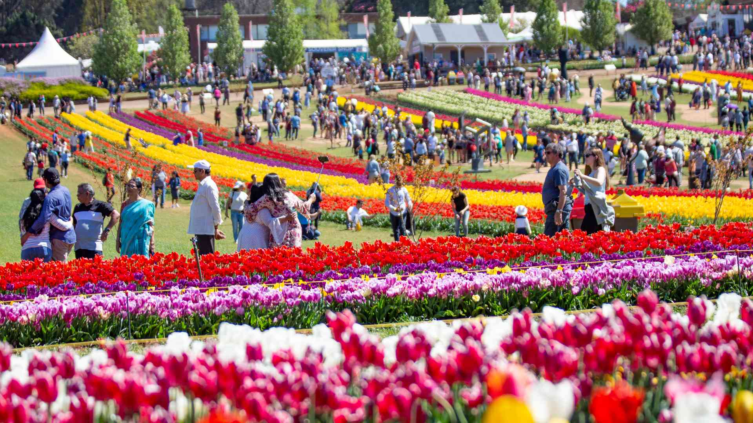
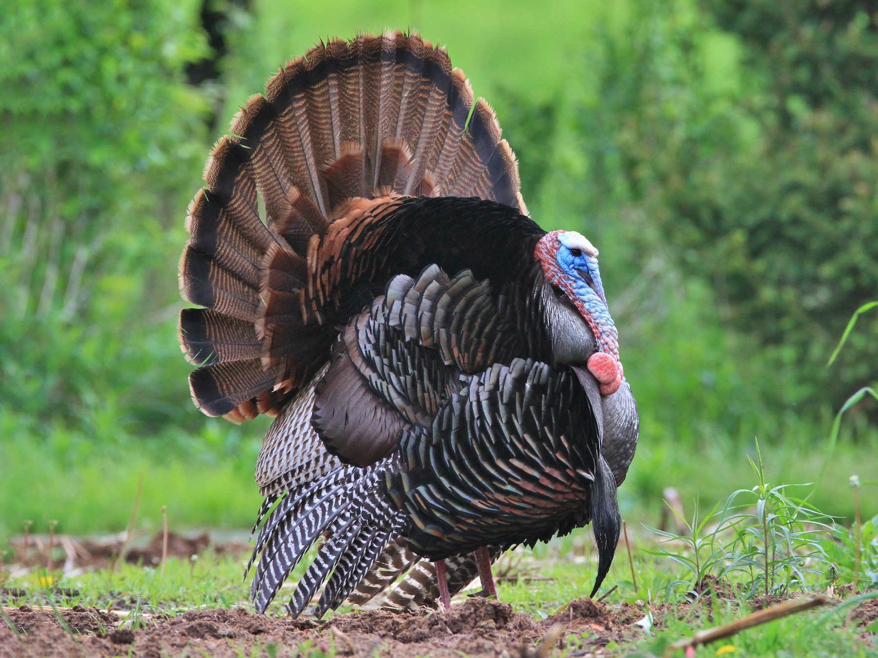
38. Tulip festival (n):
'tuləp 'festɪvəl/
lễ hội hoa Tulip
/'tɜ:kɪ/
gà tây
39. Turkey (n):

Slide 18
1 | April Fool’s Day | n
2 | balloon | n
3 | candle | n
4 | Cannes Film Festival | n
5 | carnival | n
6 | celebration | n
7 | celebratory | n
8 | Christmas | n
9 | common | adj
10 | costume | n
11 | dance | V
12 | dancer | n
13 | decorate | V
14 | Diwali | n
15 | Dutch | n
16 | Easter | n
17 | feast | n
18 | festival | n
19 | firework | n
20 | Flower Festival | n

Slide 19
21 | folk dance | n
22 | Halloween | n
23 | hold | V
24 | joyful | adj
25 | lantern | n
26 | Moon cake | n
27 | Netherlands | n
28 | New Year | n
29 | parade | n
30 | performer | n
31 | photo | n
32 | pumpkin | n
33 | relax | V
34 | religious | adj
35 | romantic | adj
36 | seasonal | adj
37 | Thanksgiving | n
38 | Tulip festival | n
39 | turkey | n

Slide 20
GAME
https://wordwall.net/resource/30946660/game-festivals-around-the-world
https://wordwall.net/resource/53317057/festivals-around-the-world
https://wordwall.net/resource/29882442/ngo%e1%ba%a1i-ng%e1%bb%af/unit-9-festivals-around-the-world

Slide 21
PART 1 THEORY
II. GRAMMAR

Slide 22
1. YES/ NO QUESTION (Dạng câu hỏi Yes/ No)
a. Định nghĩa
Câu hỏi yes - no là loại câu hỏi chỉ đưa ra cho người được hỏi hai sự lựa chọn để trả lời là “có” hoặc “không”, “đúng” hoặc “sai” thay vì được đa dạng câu trả lời như các loại câu hỏi khác. Nó là một dạng câu hỏi đóng.

Slide 23
Ex 1:
Do you like this car?
(Bạn có thích chiếc xe này không?)
Yes, I do. / No, I don’t.
(Có, tôi thích./ Không, tôi không thích.)
Ex 2:
Did you go to the zoo last week?
(Bạn đã đi sở thú tuẫn trước phải không?)
Yes, I did. / No, I didn't.
(Ừ, đúng vậy/ Không, không phải.)

Slide 24
b. Cách thành lập câu hỏi Yes/ No
Câu hỏi Yes/ No được thành lập bằng cách đưa trợ động từ (is, am, are, do, does, did ...), hoặc động từ khuyết thiêu lên trước chủ ngữ.
b.1. Với động từ to be
Ex 1:
Is he a doctor? (Anh ấy là bác sĩ phải không?)
Yes, he is. (Vâng, đúng vậy.)
Ex 2:
Are you playing chess? (Bạn đang chơi cờ à?)
No, I am not. (Không, không phải.)
Be + S + ...? - Yes, S + be. - No, S + be not.

Slide 25
b.2. Động từ thường (ordinary verbs)
Auxiliary verbs + S + V...?
- Yes, S + Auxiliary Verb.
- No, S + Auxiliary Verb + not.
Auxiliary verbs có thể là một trong các trợ động từ: do, does, did, have, has ...

Slide 26
Ex 1:
Does she play the piano well?
(Cô ấy chơi đàn piano giỏi phải không?)
Yes, she does./ No, she doesn’t.
(Vâng, đúng vậy./ Không phải.)

Slide 27
Ex 2:
Did he go to the museum yesterday?
(Anh ấy đến viện bảo tàng ngày hôm qua à?)
Yes, he did./ No, he didn’t.
(Đúng vậy. / Không, anh ấy không.)

Slide 28
Ex 3:
Have you finished your homework?
(Bạn đã làm xong bài tập về nhà rồi à?)
Yes, I have./ No, I haven’t.
(Vâng, đúng vậy. / Không.)

Slide 29
b.3. Với động từ khuyết thiếu (modal verbs)
Modal verb + s + V?
- Yes, s + Modal verb.
- No, s + Modal verb + not.
Modal verbs có thể là một trong các trợ động từ: will, can, may, should, would, could...

Slide 30
Ex 1:
May I open the book?
(Tớ có nên mở sách ra không nhỉ?)
Yes, you may. No, you may not.
(Không, cậu không nên.)

Slide 31
Ex 2:
Can you play the guitar?
(Cậu có thể chơi đàn ghita không?)
Yes, I can./ No, I can’t.
(Có, tớ có thể.)
Ex 3:
Could you swim when you were a child?
(Khi còn nhỏ, bạn có biết bơi không?)
Yes, I could./ No, I couldn’t.
(Có, tôi có thể./ Không, tôi không thể.)

Slide 32
GAME
https://wordwall.net/resource/30442834/yes-no-questions
https://wordwall.net/resource/27859049/question-yes-no
https://www.baamboozle.com/game/151655

Slide 33
PART 1 THEORY
III. PHONETICS

Slide 34
 Stress in two-syllable words (Trọng âm của từ có 2 âm tiết)
1. Với danh từ và tính từ có 2 âm tiết
Với hầu hết các danh từ hoặc tính từ có 2 âm tiết, trọng âm thường nhấn vào ầm tiết đầu.
Ex:
Words | Pronunciation | Type | Meaning
chapter | /'tʃæptər/ | n | chương (sách)
summer | /'sʌmər/ | n | mùa hè
music | /'mju'zɪk/ | n | âm nhạc
better | /'betər/ | adj | tốt hơn
active | /'æktɪv/ | adj | năng động
easy | /'i:zɪ/ | adj | dễ dàng

Slide 35
Ngoại lệ: Nếu danh từ có 2 âm tiết mà âm thứ 2 có chứa nguyên âm đôi hoặc nguyên âm dài thì trọng âm sẽ rơi vào âm số 2.
Ex:
Words | Pronunciation | Type | Meaning
design | /dɪ'zaɪn/ | n | bản phác hoạ
balloon | /bə'lu:n/ | n | bóng bay
advice | /əd'vaɪs/ | n | lời khuyên
estate | /ɪ'steɪt/ | n | tài sản, ruộng đất
alone | /ə'ləʊn/ | adj | một mình

Slide 36
2. Với động từ có 2 âm tiết
Các động từ có 2 âm tiết: trọng âm thường nhấn vào âm tiết thứ hai.
Ex:
Words | Pronunciation | Type | Meaning
invest | /ɪn'vest/ | v | đẩu tư
believe | /bɪ'li:v/ | v | tin tưởng
decide | /dɪ'saɪd/ | v | quyết định
decrease | /dɪ'kri:s/ | v | giảm xuống

Slide 37
Ngoại lệ: Nếu động từ có âm tiết thứ hai là nguyên âm ngắn hoặc kết thúc bởi 1 phụ ầm hoặc không có phụ âm. Hoặc động từ đó chứa âm đuôi nhẹ thì trọng âm thường rơi vào âm tiết thứ nhất. (Nó thường kết thúc ở dạng: er, en, ish, age, ow)

Slide 38
Ex:
Words | Pronunciation | Type | Meaning
enter | /‘entər/ | v | vào
open | /'əʊpən/ | v | mở
manage | /'mænɪdʒ/ | v | điều hành, quản lý
happen | /'hæpən/ | v | xảy ra
visit | /'vɪzɪt/ | v | thăm, tham quan
finish | /fɪnɪʃ/ | v | hoàn thành
offer | /'ɔ:fər/ | v | đề xuất
study | /'stʌdɪ/ | v | học
swallow | /'swɒləʊ/ | v | nuốt

Slide 39
✓ Listen and repeat these words.  Track 07
First syllable | answer | question | practise | visit
 | /'ænsər/ | /'kwestʃən/ | /'præktɪs/ | /’vɪzɪt/
Second syllable | account | before | believe | rely
 | /ə'kaʊnt/ | /bɪ'fɔ:r/ | /bɪ'li:v/ | /rɪ’laɪ/

Slide 40
PART 2 LANGUAGE
I. VOCABULARY

Slide 41
Exercise 1. Find the odd one out among A, B, C or D.
1. A. happy | B. funny | C. joyful | D. prefer
2.A. fascinating | B. shopping | C. exciting | D. amazing
3. A. attend | B. celebrate | C. organize | D. festival
4.A. celebration | B. performer | C. artist | D. dancer
5. A. flower | B. cultural | C. traditional | D. local

Slide 42
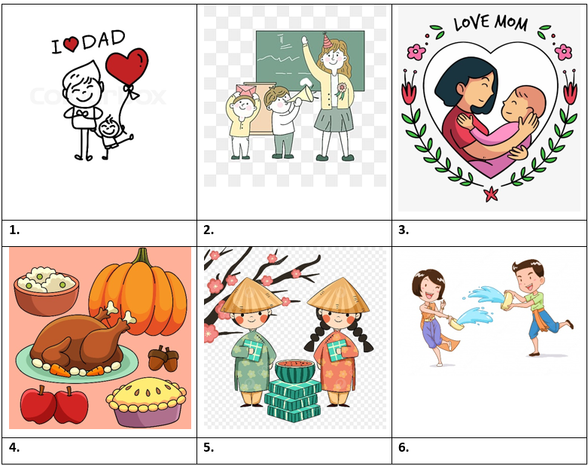
Exercise 2. Look at the pictures and complete the blanks with available names of festival.
Mother’s Day
Water Festival
Teacher’s Day
New Year
Father's Day
Thanks giving

Slide 43
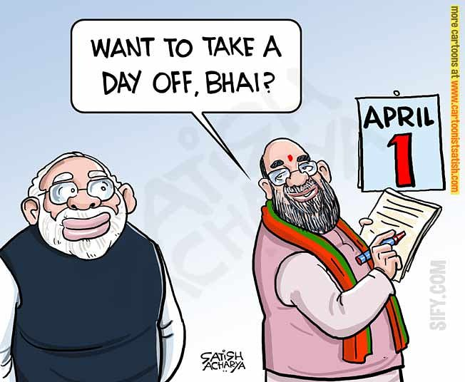
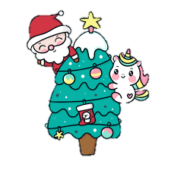

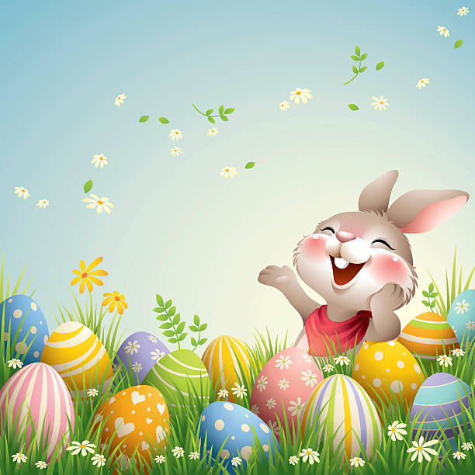
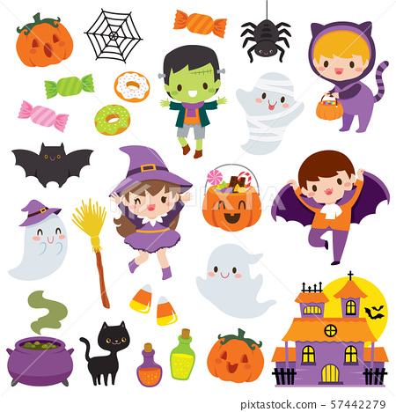
Exercise 3. Look at the pictures and complete the blanks with available names of festival.
1. | 2. | 3.
4. | 5. | 6.
Christmas
Flower Festival
Easter
Halloween
April Fool’s Pay
Cannes Film Festival

Slide 44
Exercise 4. Choose the best option to complete the sentence.
1. Carnival is a popular ____________ in many countries in South America.
A. festival B. music C. harvest D. festive
2. South American people ____________ carnival in different ways.
A. celebration B. celebrate C. celebratory D. decorate
3. At carnival, people wear costumes and ____________ through the streets, playing samba music and dancing.
A. parading B. parade C. attend D. went
4. She is going to Rio Carnival to watch ____________ dance.
A. perform B. performance C. performers D. performed
5. A lot of dancers go to Rio de Janeiro to ____________ the Rio Carnival.
A. attend B. attendance C. harvest D. perform

Slide 45
6. Cooking is a hugely important part of French ____________.
A. celebration B. performance C. culture D. music
7. We ____________ to the Flower Festival in Da Lat last year.
A. went B. arrived C. described D. watched
8. We often ____________ lucky money at Tet.
A. receives B. receive C. received D. receiving
9. I think it is a good ____________ in this circumstance.
A. choose B. chose C. choice D. chooses
10. There are a lot of cultural and ____________ activities held as part of this festival.
A. art B. artists C. arts D. artistic

Slide 46
Exercise 5. Give the correct form of the words given to complete the sentences.
1. I saw so many ____________ flowers when I attended the festival last year. (beauty)
2. The Christmas season is also called the ________ season. (festival)
3. I loved the ____________ this night. (perform)
4. There is a great ____________ for girls on March 3rd every year. (celebrate)
5. What I like about festivals is that they show the _________ values of different Communities. (culture)
beautiful
festive
performance
celebration
cultural

Slide 47
6. Hoi An is an old city with many places of ____________. (interesting)
7. The ____________ for Hue festival is taken by my group. (prepare)
8. All the streets in the city center are decorated with _______ lights and red banners. (color)
9. There has been various ____________ shows on TV recently. (entertain)
10. The New Year marks the __________ of spring and the start of the Lunar New Year. (begin)
interests
preparation
colorful
entertaining
beginning

Slide 48
PART 2 LANGUAGE
II. GRAMMAR

Slide 49
Exercise 1. Put the verbs in brackets into the correct forms of present simple.
1. Robin (play) ________ football every Sunday.
2. We (have) _________ a holiday in December every year.
3. He often (go) ________ to work late.
4. The Moon (circle) ________ around the Earth.
5. The flight (start) ________ at 6 a.m every Thursday.
plays
have
goes
circles
starts

Slide 50
6. Peter (not/ study) ______________ very hard. He never gets high scores.
7. My mother often (teach) __________ me English on Saturday evenings.
8. She (like) ______ Literature.
9. My sister (wash) _________ dishes every day.
10. They (have) _____ breakfast every morning.
doesn’t study
teaches
likes
washes
have

Slide 51
Exercise 2. Turn the sentences in exercise 1 into the interrogative form.
1. _______________________________________________________________________________
2. _______________________________________________________________________________
3. _______________________________________________________________________________
4. _______________________________________________________________________________
5. _______________________________________________________________________________
Does Robin play football every Sunday?
Do you have a holiday in December every year?
Does he often go to work late?
Does the moon circle around the earth?
Does the flight start at 6 am every Thursday?

Slide 52
6. _______________________________________________________________________________
7. _______________________________________________________________________________
8. _______________________________________________________________________________
9. _______________________________________________________________________________
10. ______________________________________________________________________________
Doesn't Peter study very hard? He never gets high scores.
Does your mother often teach you English on Saturday evenings?
Does she like Literature?
Does your sister wash dishes every day?
Do they have breakfast every morning?

Slide 53
Exercise 3. Put the verbs in brackets into the correct forms of past simple.
1. Nam (write) _____ an essay in Literature class this morning.
2. I (watch) ______________ TV yesterday morning.
3. Nam and you (be) ________ in the English club last Tuesday.
4. They (eat) ______ noodles two hours ago.
5. We always (have) _______ a nice time on Christmas holiday in the past.
wrote
watched
were
ate
had

Slide 54
Exercise 3. Put the verbs in brackets into the correct forms of past simple.
6. My father (decorate) ___________ the Christmas tree.
7. She (buy) __________ a new dress yesterday.
8. They (be) _________ late for school.
9. Mr. Tam (take) ________ his children to the museum last Sunday.
10. Hoa (make) _________ a cushion for her armchair.
decorated
bought
were
took
made

Slide 55
Exercise 4. Turn the sentences in exercise 3 into the interrogative form.
1. _______________________________________________________________________________
2. _______________________________________________________________________________
3. _______________________________________________________________________________
4. _______________________________________________________________________________
5. _______________________________________________________________________________
Did Nam write an essay in Literature class this morning?
Did you watch TV yesterday morning?
Were Nam and you in the English club last Tuesday?
Did they eat noodles two hours ago?
Did you always have a nice time on Christmas holiday in the past?

Slide 56
Exercise 4. Turn the sentences in exercise 3 into the interrogative form.
6. _______________________________________________________________________________
7. _______________________________________________________________________________
8. _______________________________________________________________________________
9. _______________________________________________________________________________
10. _______________________________________________________________________________
Did your father decorate the Christmas tree?
Did she buy a new dress yesterday?
Were they late for school?
Did Mr. Tam take his children so the museum last Sunday?
Did Hoa make a cushion for her armchair?

Slide 57
Exercise 5a. Turn the sentences into the interrogative form and answer it.
1. The dog is small
_________________________________________________
2. She is a student.
_________________________________________________
3. We are ready to get a pet.
_________________________________________________
4. This book is so boring.
_________________________________________________
5. I am a worker
_________________________________________________
Is the dog small!-Yes, it is/ No, It isn't.
Is she a student? Yes, the ls/ No, she isn't.
Are we ready to get a pet? Yes, we are. No, we aren't
Is this book so boring? Yes, it is/ No, it isn't.
Are you a worker? - Yes, I am./ No, I am not

Slide 58
Exercise 5b. Turn the sentences into the interrogative form and answer it.
1. Mary and Linda were late.
_________________________________________________
2. Emma and Betty were good friends.
_________________________________________________
3. They were in the park yesterday
_________________________________________________
4. His sister was seven years old.
_________________________________________________
5. It was hot yesterday.
_________________________________________________
Were Mary and Linda late? Yes, they were./ No, they weren't.
Were Emma and Betty good friends! Yes, they were/ No, they weren‘t.
Were they in the park yesterday? Yes, they were/ No, they weren‘t.
Was his sister seven years old? Yes, she was/ No, she wasn‘t.
Was it hot yesterday? Yes, it was/ No, it wasn‘t.

Slide 59
Exercise 6: Write short answers for the following questions. (Answers may vary)
1. Can you play the piano? ______________________________ | 6. Can you do this puzzle? ______________________________
2. Can you play the guitar? ______________________________ | 7. Should you do morning exercise? ______________________________
3. Can you sing and dance? ______________________________ | 8. Should you smoke? ______________________________
4. Can you swim? ______________________________ | 9. Will you go to the zoo with me? ______________________________
5. Can you speak English? ______________________________ | 10. Will you live in the USA in the future? ______________________________
Yes, I can./ No, I can't.
Yes, I can./ No, I can't.
Yes, I can./ No, I can't.
Yes, I should.
Yes, I can./ No, I can't.
No, I shouldn’t.
Yes, I can./ No, I can't.
Yes, I will./ No, I won't.
Yes, I can./ No, I can't.
Yes, I will./ No, I won't.

Slide 60
PART 2 LANGUAGE
III. PHONETICS

Slide 61

Divide these words into two columns as below: stress on first syllable or stress on second syllable.  Track 08
Stress on first syllable |  | Stress on second syllable
banquet schedule birthday cowboy pleasure humour cancer treatment | farmer country cover money mother borrow lecture | disease persuade reduce apply machine prepare agree tonight | enjoy reply provide decide suggest desire suppose
banquet | apply | agree | country | mother
disease | cowboy | cancer | reply | borrow
schedule | pleasure | tonight | provide | suggest
persuade | machine | treatment | cover | desire
reduce | humour | farmer | decide | lecture
birthday | prepare | enjoy | money | suppose

Slide 62
PART 3 COMMUNICATION SKILLS
I. LISTENING

Slide 63
☞ Listen and do the tasks followed.  Track 09
Exercise 1. Listen and decide if each statement is True (T), or False (F), or Not Given (NG).
1. Christmas is the most important holiday in Britain. ___________
2. People decorated their houses with balloon, paper chains, holly,…___________
3. The Christmas dinner is a feast with the main dish is Christmas pudding. ___________
4. The Queen gives Christmas speech at 3 a.m on December 25th.___________
5. The Christmas speech of the Queen is broadcast on radio and television.___________
F
T
NG
F
T

Slide 64
Exercise 2. Listen again and answer the questions.
1. When does Christmas Eve occur?
__________________________________________________________________2. What do people decorate the top of the trees with?
__________________________________________________________________
3. Where do children hang up their stocking?
__________________________________________________________________
4. What do children get on the morning of the 25th?
__________________________________________________________________
5. When does Christmas dinner take place?
__________________________________________________________________
On the 24 of December
An angle or a star
By the chimney
They get presents from Father Christmas.
At midday or early afternoon

Slide 65
PART 3 COMMUNICATION SKILLS
II. SPEAKING

Slide 66
Read the conversation and answer the questions. Then practise speaking the conversation.
Mary: Hi, Hoa.
Hoa: Hi, Mary.
Mary: What did you do last weekend?
Hoa: I went to Hoi Mua Festival with my parents.
Mary: Where is it?
Hoa: It's in Phu Yen.
Mary: What is it about?
Hoa: Ah. It's held to thank the Rice God for the crop, and to pray for better crops in the future.
Mary: Really? What do people usually do at the festival?
Hoa: People play drums, sing songs and dance. They also drink rice wine through a long thin bamboo tube. My father likes it.
Mary: Are there any other activities?
Hoa: Yes. There are cultural shows, buffalo races, and traditional games.
Mary: Oh, that sounds really interesting. How often does it take?
Hoa: Every March.
Mary: I would like to go there next year.

Slide 67
QUESTIONS:
1. What did Hoa do last weekend?
_________________________________________________________________________
2. Who did she go with?
_________________________________________________________________________
3. What is Hoi Mua held for?
_________________________________________________________________________
4. What do people usually do at the festival?
_________________________________________________________________________
_________________________________________________________________________
5. Would Mary like to go there?
_________________________________________________________________________
She went to Hol Mua Festival.
She went with her parents.
It's held to thank the Rice God for the crop, and to pray for better crops in the future.
People play drums, sing songs and dance. They also drink rice wine through a long thin bamboo tube.
Yes, she would.

Slide 68
PART 3 COMMUNICATION SKILLS
III. READING

Slide 69
Exercise 1. Read the text and then choose the best answer A, B, C, or D.
Visit the Edinburgh Festival
Every year, thousands of people come to Edinburgh, the capital city of Scotland, to be part of the Edinburgh Festival. For three weeks every August and September the city is filled with actors and artists from all over the world. They come to Edinburgh for the biggest arts festival in Britain. During this time, the streets of the city are alive with music and dance from early in the morning until late at night. You can even see artists painting pictures on the streets.
Tens of thousands of tourists come to the festival to see new films and plays and to hear music played by famous musicians. This year, you can see over five hundred performances with actors from more than forty countries.
The tickets for these performances are quite cheap, and it is usually easier to see your favourite star in Edinburgh than it is in London. So come to Edinburgh next summer!

Slide 70
1. How many people come to attend the Edinburgh Festival every year?
A. Thousand people
B. Thousands of people
C. Some people
D. Few people

Slide 71
2. How long does the Edinburgh Festival last?
A. Two months
B. Three months
C. Three weeks
D. For 3 weeks every August and September

Slide 72
3. What can you even see artists doing on the streets?
A. Playing the guitar on the streets
B. Singing songs on the streets
C. Painting pictures on the streets
D. Dancing on the streets

Slide 73

4. How many performances can people see this year?
A. Tens of thousands
B. Thousands
C. Some people
D. Over five hundred

Slide 74
5. How much are the tickets for these performances?
A. Very cheap
B. Very expensive
C. Not cheap
D. Not quite expensive

Slide 75
Exercise 2. Choose the word from the box that best fits the blank space in the following passage.
their
would
consisted
been
recent
way
explain
a lot of
which
fewer
The world’s first film was shown in 1895 by two French brothers, Louis and Auguste Lumiere. Although it only (1) ___________ of short, simple scenes, people loved it and films have (2) ________ popular ever since. The first films were silent, with titles on the screen to (3) ___________ the story.
Soon the public had (4) ___________ favorite actors and actresses and, in this (5) ___________, the first film stars appeared. In the 1927, the first “talkie”, a film with sound, was shown and from then on, the public (6) ___________ only accept this kind of film.

Slide 76
Exercise 2. Choose the word from the box that best fits the blank space in the following passage.
their
would
consisted
been
recent
way
explain
a lot of
which
fewer
Further improvements continued, particularly in America, (7) ___________ produced 95% of all films. With the arrival of television in 1950s, (8) ___________ people went to see films, but in (9) ___________ years audiences have grown again. More countries have started to produce films that influences film-making and there are currently (10) ___________ national film industries.

Slide 77
Exercise 3. Read the passage. Decide whether the statements are True (T) or False (F) then answer the questions.
My favorite movie is cartoon “Tom and Jerry”. Tom is a cat with blue and white color. He keeps the house for a normal family and has a very free life. His job is chasing Jerry day by day. Jerry is a row house mouse. He usually lives in the deep cave behind the wall. Although they hate each other so much and always find ways to hurt the opponent but when Tom or Jerry falls into really dangerous situations, then both become another savior. The film is an endless confrontation between Tom and Jerry, bring plenty of laughter for the audiences. I love this film because when I watch it I feel very glad, feeling like returned to my childhood.

Slide 78
1. What’s Tom’s color?
__________________________________________________________________2. Does Tom usually live in a cage?
__________________________________________________________________
3. When will they help each other?
__________________________________________________________________
4. How do the audiences feel when they watch “Tom and Jerry”?
__________________________________________________________________
5. Why does the writer love “Tom and Jerry”?
__________________________________________________________________
Tom is a cat with blue and white color.
No, he has a very free life.
They will help each other when they fall into really dangerous situations.
"Tom and Jerry" brings plenty of laughter for the audiences.
The writer loves "Tom and Jerry" because when he watches it, he feels very glad, feeling like returned to his childhood.

Slide 79
PART 3 COMMUNICATION SKILLS
IV. WRITING

Slide 80
Exercise 1a. Rewrite the sentences without changing the meaning of the original sentences.
1. It’s a good idea to eat a lot of fruit and vegetables every day.
→ We should
2. We couldn’t keep on cleaning the streets because of the heavy rain.
→ Because it
3. The garden party wont take place if the weather doesn’t improve.
→ Unless
4. Both students and teachers can borrow books from the library.
→ The library lends
5. Nobody plays this piece of music as beautifully as he does.
→ He plays this
eat a lot of fruit and vegetables every day.
rained heavily, we couldn't keep on cleaning the streets
the weather improves, the garden party won't take place
books to both students and teachers.
piece of music more beautifully than anybody else.

Slide 81
Exercise 1b: Use the words in brackets and rewrite the sentences without changing the meaning of the original sentences.
1. I would like six apples. (DOZEN)
________________________________________________________________________
2. What is the price of a bowl of beef noodle soup? (MUCH)
________________________________________________________________________
3. There is sugar in many kinds of food. (HAVE)
________________________________________________________________________
4. We haven’t got any tomatoes. (THERE)
________________________________________________________________________
5. My sister likes chicken very much. (FAVOURITE)
________________________________________________________________________
I would like half a dozen apples.
How much is a bowl of beef noodle soup?
Many kinds of food have (got) sugar.
There aren't any tomatoes left.
Chicken is my sister's favourite food/ meat.

Slide 82
Exercise 2. Use the words in brackets and rewrite the sentences without changing the meaning of the original sentences.
1. How much are these shoes? (How much...)
___________________________________________________________________________
2. It takes me about five minutes to go to school by bike. (spend)
___________________________________________________________________________
3. It often takes him two hours to do his homework. (He)
___________________________________________________________________________
4. She spends one hour with her housework. (It...)
___________________________________________________________________________
5. Where will she mail her letter? (send)
___________________________________________________________________________
How much do these shoes cost?
I spend five minutes going to school by bike.
He often spends two hours doing his homework.
It takes her one hour to do her housework.
Where will she send her letter?

Slide 83
Exercise 2. Use the words in brackets and rewrite the sentences without changing the meaning of the original sentences.
6. They usually walk to school. (foot)
________________________________________________________________________________
7. He usually rides to school. (bike)
________________________________________________________________________________
8. Mr. Hung sometimes travels to work by plane. (fly)
________________________________________________________________________________
9. They never go to school late. (They are...)
________________________________________________________________________________
10. Do you have a better refrigerator than this? (Is this...?)
________________________________________________________________________________
They usually go to school on foot.
He usually goes to school by bike.
Mr. Hang sometimes flies to work
They are never late for school
Is this the best refrigerator you have?

Slide 84
Exercise 3. Imagine Christmas is coming, write a letter to Santa Claus.
The answer may vary.
Dear Santa Claus,
My name is Sally and I am 8 years old. I have been a very good girl this year I help my mum wash the dishes every night, and I listen to my dad when he asks me to clean my room. I am also nice to my little brother. I sing him to sleep and play with him a lot.
Thank you for all the presents last year. They were all really nice, and I played with all of them a lot. This year I would like a jump rope and a kitten. I hope it is not difficult for you to prepare those
Please give my best regards to the reindeers. I love them a lot.
Love,
Sally

Slide 85

THANKS YOU

