Slide 1

Unit 5: Around Town
Lesson 1.3: Pronunciation & Speaking
Page 40

Slide 2
Lesson Outline
Warm-up
Pronunciation
Practice
Speaking
Consolidation
Wrap-up

Slide 3
Objectives
By the end of this lesson, students will be able to…
- use sound changes in the question: “Do you have …?”
- ask about clothes and prices when shopping.

Slide 4

WARM-UP

Slide 5

Work in pairs.
Choose the word whose main stress is placed
differently from the others.
1. A. cola B. pasta C. sandwich D. dessert
2. A. hamburger B. history C. customer D. adventure
3. A. jacket B. window C. dollar D. cartoon
/ˈkoʊlə/
/ˈpɑːstə/
/ˈsænwɪtʃ/
/dɪˈzɜ:rt/
/ˈhæmbɜ:rɡər/
/ˈhɪstəri/
/ˈkʌstəmər/
/ədˈventʃər/
/ˈdʒækɪt/
/ˈwɪndoʊ/
/ˈdɑːlər/
/kɑ:rˈtu:n/

Slide 6
Work in pairs.
Choose the word whose underlined part is
pronounced differently from that of the other words.
A. car B. large C. black D. sharp
2. A. helps B. ticks C. picks D. sounds
3. A. sizes B. colors C. windows D. sweaters
/kɑːr/
/lɑ:rdʒ/
/blæk/
/ʃɑ:rp/
/helps/
/tɪks/
/pɪks/
/saʊndz/
/ ˈsaɪziz/
/ˈkʌlərz/
/ˈwɪndoʊz/
/ˈswetərz/

Slide 7

Presentation

Slide 8
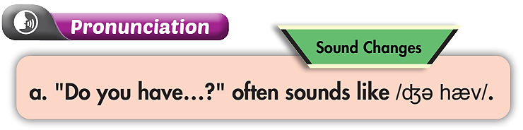

b. Listen. Notice the sound changes of the underlined words.
Do you have these pants in blue?
Do you have this jacket in green?

Slide 9
c. Listen and cross out the one with the wrong sound changes.
Do you have these socks in red?
Do you have this shirt in pink?
d. Read the sentences with the correct sound changes to a partner.

Slide 10

Practice

Slide 11
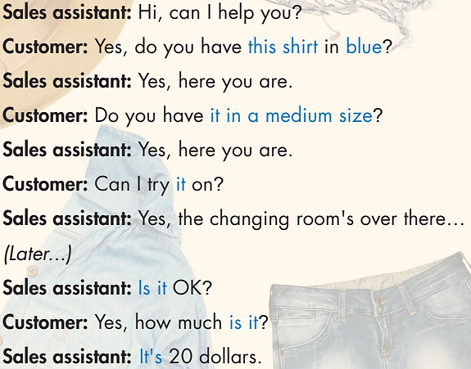
Who are there in the conversation?
→ Sales assistant and customer.
What are you going to do?
→ Practice the conversation.
And then?
→ Swap roles and repeat.

Slide 12
Sales assistant: Hi, can I help you?
Customer: Yes, do you have this shirt in blue?
Sales assistant: Yes, here you are.
Customer: Do you have it in a medium size?
Sales assistant: Yes, here you are.
Customer: Can I try it on?
Sales assistant: Yes, the changing room's over there…
(Later...)
Sales assistant: Is it OK?
Customer: Yes, how much is it?
Sales assistant: It's 20 dollars.

Slide 13

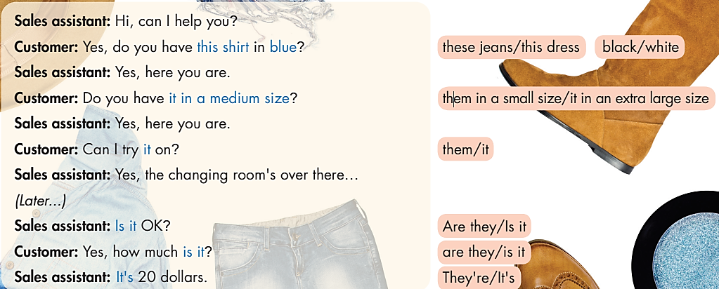
Swap roles and repeat

Slide 14

Production

Slide 15

Work in pairs.
Practice with your own ideas.

Slide 16
STUDENT A
STUDENT B
Do you have this dress in yellow?
Yes, here you are.
Can I try it on?
Yes, the changing room is over there.
How much is it?
It’s $20.

Slide 17

Speaking

Slide 18



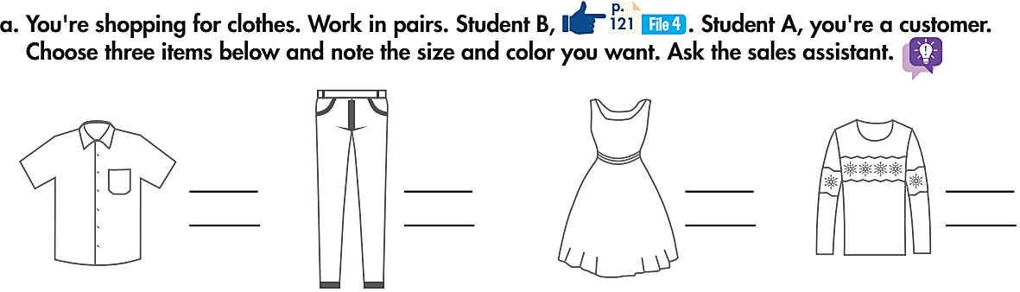
Pre-Speaking
What are you doing? How many people are there in the conversation?
→ Shopping for clothes. Two – a sales assistant and a customer.
What is the customer going to do?
→ Choose three items with size and color, then ask to buy.

Slide 19
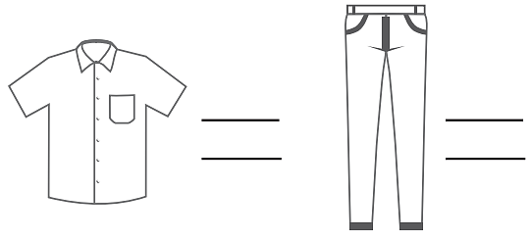
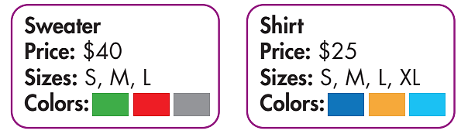
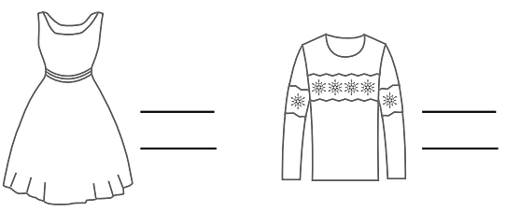
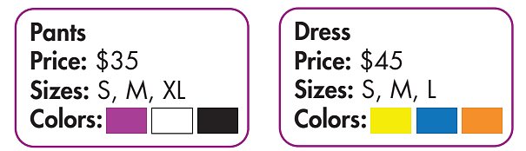
Work in pairs.
While-Speaking
Student A - customer.
Choose three items, size, and color.
Ask the sales assistant.
Student B - sales assistant at a store. You have the clothes below.

Slide 20
STUDENT A
STUDENT B
Do you have this sweater size M and green?
Yes, here you are.
Can I try it on?
Yes, the changing room is over there.
How much is it?
It’s $40.

Slide 21
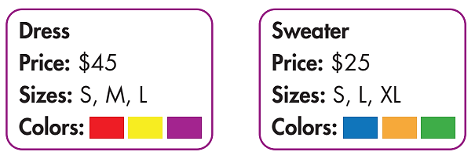
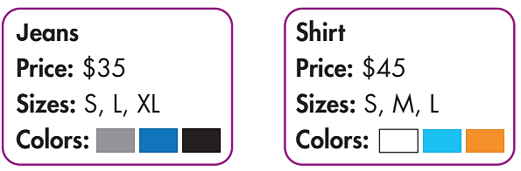
While-Speaking
Swap roles and repeat. You're a sales assistant at a store. You have the clothes below.
Student A - sales assistant at a store. You have the clothes below.
Student B - customer.
Choose three items, size, and color.

Slide 22
STUDENT A
STUDENT B
Hello. How can I help you?
Do you have this dress size S and in purple?
Here you are. The changing room’s over there.
How much is it?
It’s $45.
Ok, I’ll take it.

Slide 23
Post-Speaking
In groups, discuss the items you bought and how much you spent.
You can begin with:
Hey, yesterday I bought a shirt at a shop. It’s…..

Slide 24

CONSOLIDATION

Slide 25
Write about what items you bought.
When and where you bought.
How much you spent.
Write about 60-80 words.

Slide 26

WRAP-UP

Slide 27
Today’s lesson
- Use sound changes in the question: “Do you have …?”
- Ask about clothes and prices when shopping.

Slide 28
Homework
Practice sound changes in the question: “Do you have …?”.
Prepare the next lesson (page 41 - SB).
Play the consolidation games in Tiếng Anh 6 i-Learn Smart World DHA App on www.eduhome.com.vn.

Slide 29

Enjoy your day!

