Slide 2
Unit
8
BECOMING INDEPENDENT
Unit
FAMILY LIFE
LESSON 8
LOOKING BACK AND PROJECT

Slide 3
LESSON 8
LOOKING BACK AND PROJECT
WARM-UP
Review
- Pronunciation: review fall-rise intonation
- Vocabulary: Phrasal verbs
- Grammar: Cleft sentences
LOOKING BACK
PROJECT
How to become independent posters
CONSOLIDATION
- Wrap up
- Homework

Slide 4
WARM-UP
What have we learnt in unit 8?

Slide 5
LOOKING BACK
1
Read the sentences using fall-rise intonation. Then listen and compare. Practise saying them in pairs.
1. Shall we look for a part-time job to earn some pocket money? 2. Do you feel like doing a vegetarian cooking course? 3. Would you please give me some advice on how to set my goals? 4. Could you help me improve my communication skills?

Slide 6
LOOKING BACK
2
Choose the correct answers A, B, or C to complete the sentences.

Slide 7
LOOKING BACK
3
Complete the answers to these questions using cleft sentences focusing on the words or phrases in brackets.
1. Would you like to apply for the babysitting job? (dog walking)
No. It _________________________________ I’d like to apply for.
2. Did your dad buy you a new bicycle last week? (a new motorbike)
No. It _______________________________ he bought me last week.
3. Is Lan the best decision-maker in your class? (Tuan)
No. It __________________________________ is the best decision-maker in my class.
4. Does the presentation skills training start tomorrow? (the day after tomorrow)
No. It __________________________________ the presentation skills training starts.
is the dog-walking job that
was a new motorbike that
is Tuan that/who
is the after tomorrow that

Slide 8
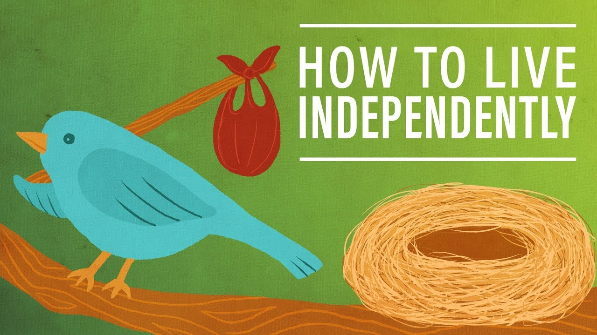
PROJECT
HOW TO LIVE INDEPENDENTLY POSTERS

Slide 9
CONSOLIDATION
1
Wrap-up
What have you learnt today?
- Review the vocabulary and grammar of Unit 8;
- Apply what you have learnt (vocabulary and grammar) into practice through a project.

Slide 10
CONSOLIDATION
2
Homework
Do exercises in the workbook.
Prepare for Unit 9.

Slide 11
Website: hoclieu.vn
Fanpage: facebook.com/sachmem.vn/

