Slide 1

Unit 3
Cities of the future

Slide 2
Unit 3
CITIES OF THE FUTURE
LESSON 2
LANGUAGE

Slide 3
LESSON 2
LANGUAGE
Cinderella
WARM-UP
Task 1: Listen and repeat.
Task 2: Listen and mark the linking sounds.
PRONUNCIATION
Task 1: Match the words with their meanings.
Task 2: Complete the sentences.
VOCABULARY
Task 1: Choose the correct forms.
Task 2. Find and correct the mistakes.
Task 3. Talk about future developments in your neighbourhood.
GRAMMAR
CONSOLIDATION
Wrap-up
Homework

Slide 4
WARM UP

Slide 5



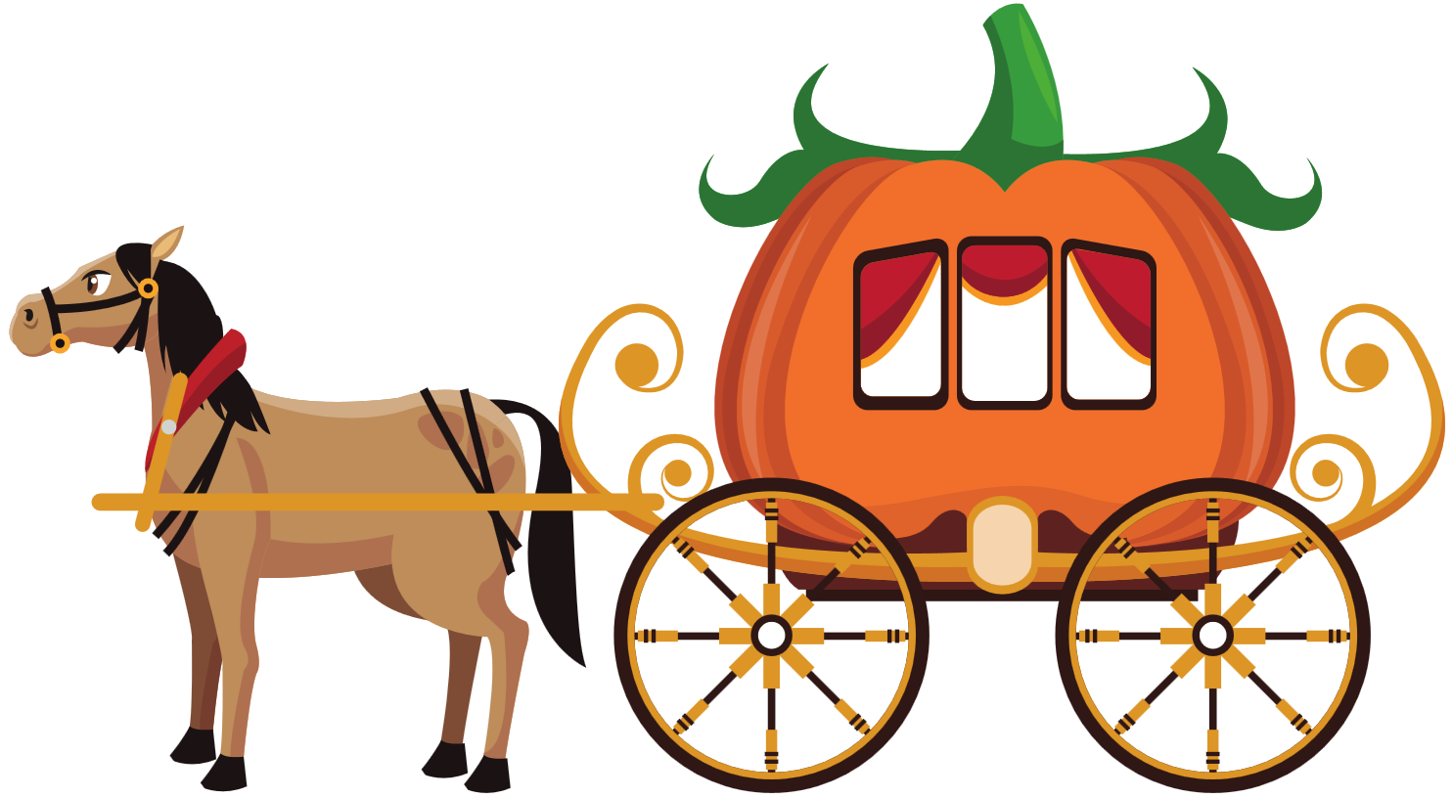
GAME CINDERELLA

Slide 6


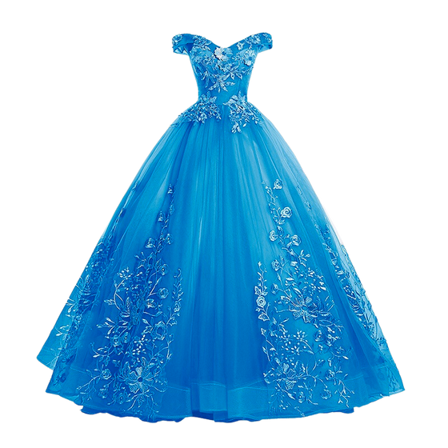

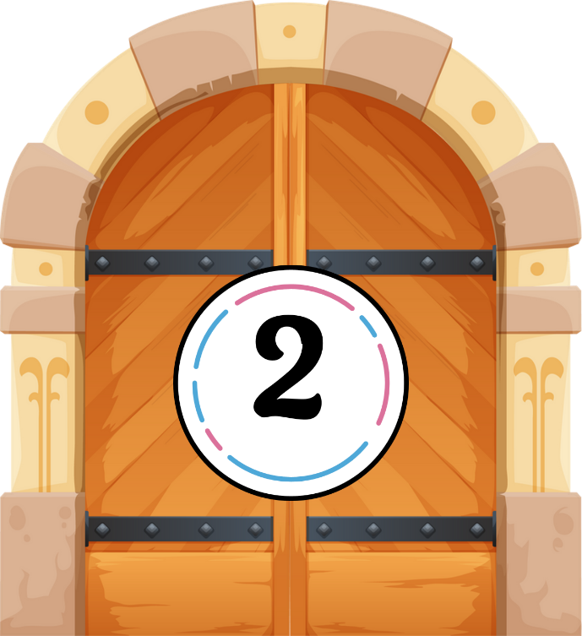






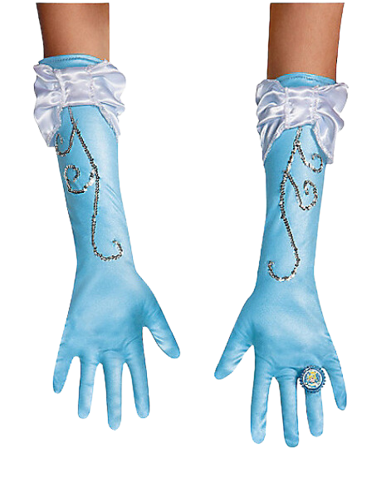



Slide 7



Social media can have a big ________ on young people’s behavior.
A. impact
B. traffic jam
C. public transport

Slide 8
Leaving early can help you avoid the morning ________.
A. carbon footprint
B. infrastructure
C. traffic jam

Slide 9
The government plans to invest more in the country’s ________.
A. impact
B. infrastructure
C. traffic jam

Slide 10
Using bikes instead of cars helps reduce your ________.
A. public transport
B. carbon footprint
C. impact

Slide 11
Many people in big cities use ________ to go to work every day.
A. public transport
B. infrastructure
C. traffic jam

Slide 12
The new policy had a positive ________ on reducing pollution in the city.
A. infrastructure
B. carbon footprint
C. impact

Slide 13
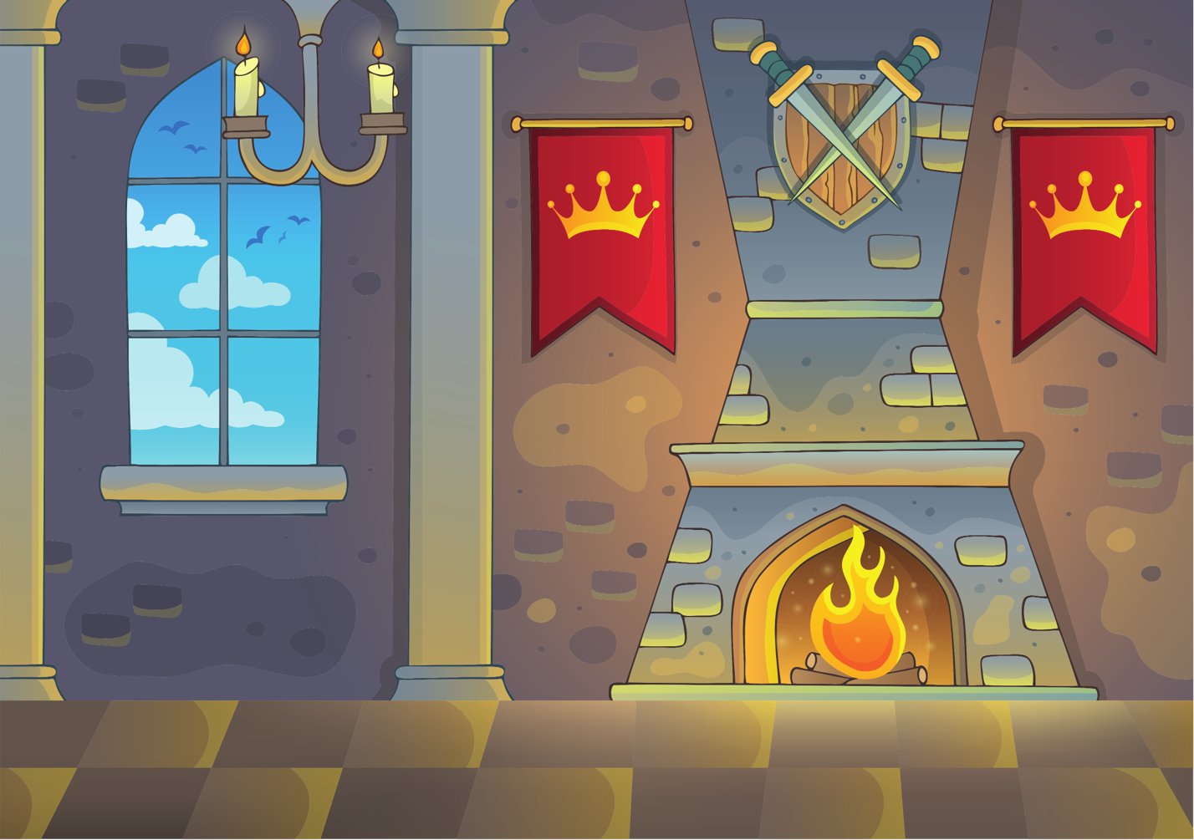


Slide 14
PRONUNCIATION

Slide 15

PRONUNCIATION
1
Listen and repeat. Pay attention to the linking between the words in the sentences.
1. He lives in the city centre.
2. Cities of the future will be more exciting.
3. The new high-rise building is in the west of the city.
4. A lot of people come to the city to walk across the famous bridge.

Slide 16

PRONUNCIATION
2
Listen and mark the consonant and vowel sounds that are linked. Then practise saying the sentences.
1. Traffic jams are the city's biggest problem, especially during rush hour.
2. This is the most beautiful city I’ve ever visited.
3. Would you like a guided tour of the city this afternoon?
4. The Fine Art Museum was built in the new urban area last year.

Slide 17
VOCABULARY

Slide 18
VOCABULARY
1
Match the words and phrases with their meanings.
c
city dweller (np) | 1 - | a garden built on the top of a building
2. traffic jam (n) | 2 - | b. a very tall, modern building, usually in a city
3. urban centre (np) | 3 - | c. a person who lives in the city
4. roof garden (n) | 4 - | d. a situation of too many vehicles on a road so that they can move only very slowly or are stopped completely
5. skyscraper (n) | 5 - | e. an area in a city where a large number of people live
d
e
a
b

Slide 19
VOCABULARY
Complete the sentences using the correct forms of the words and phrases in Task 1.
2
Traffic jam
1. ________ is a serious problem in many big cities around the world.
2. The new underground has allowed ____________ to get around more easily.
3. With the help of technology, people can now grow vegetables in the ___________ of high-rise buildings.
4. The _________ attracts people’s attention because of its unusual architecture.
5. More people are moving away from the ____________ of large cities to the suburbs.
city dwellers
roof gardens
skyscraper
urban centres

Slide 20
GRAMMAR

Slide 21
GRAMMAR
STATIVE VERBS IN THE CONTINUOUS FORM
1. Describe a state rather than an action.
- Thoughts and opinions (agree, believe, remember, think, understand)
- Feelings and emotions (hate, love, prefer)
- Senses (appear, feel, hear, look, see, seem, smell, taste)
- Possession (belong, have, own)
2. Stative verbs are not normally used in the continuous form. However, some stative verbs can be used in the continuous form to describe actions, depending on the context.
Eg: My dad has a new car.
He is having a good time.

Slide 22
GRAMMAR
1
Choose the correct forms of the verbs to complete the following sentences.
1. I think / am thinking that living in the city is good for young people.
2. We are thinking / think of moving out of the city.
3. I don’t see / am not seeing the building. It’s too far away.

Slide 23
GRAMMAR
2
Find and correct the mistakes in the following sentences.
1. The urban lifestyle seems more excitingly to young people.
2. The museum looks beauty from a distance.
3. Widening the road sounds a good solve to traffic problems in the area.
=> exciting
=> beautiful
=> solution

Slide 24
REVIEW GRAMMAR

Slide 25
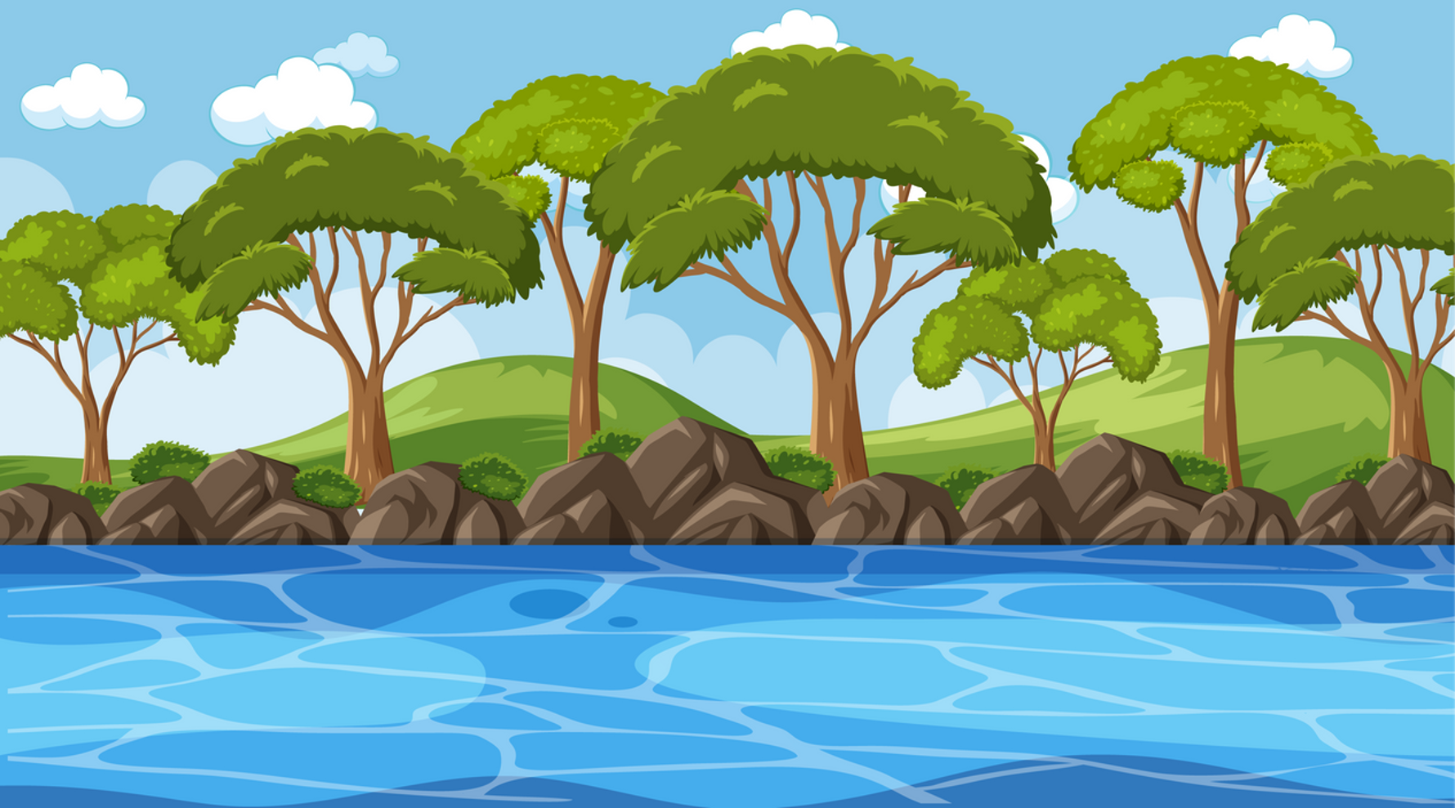


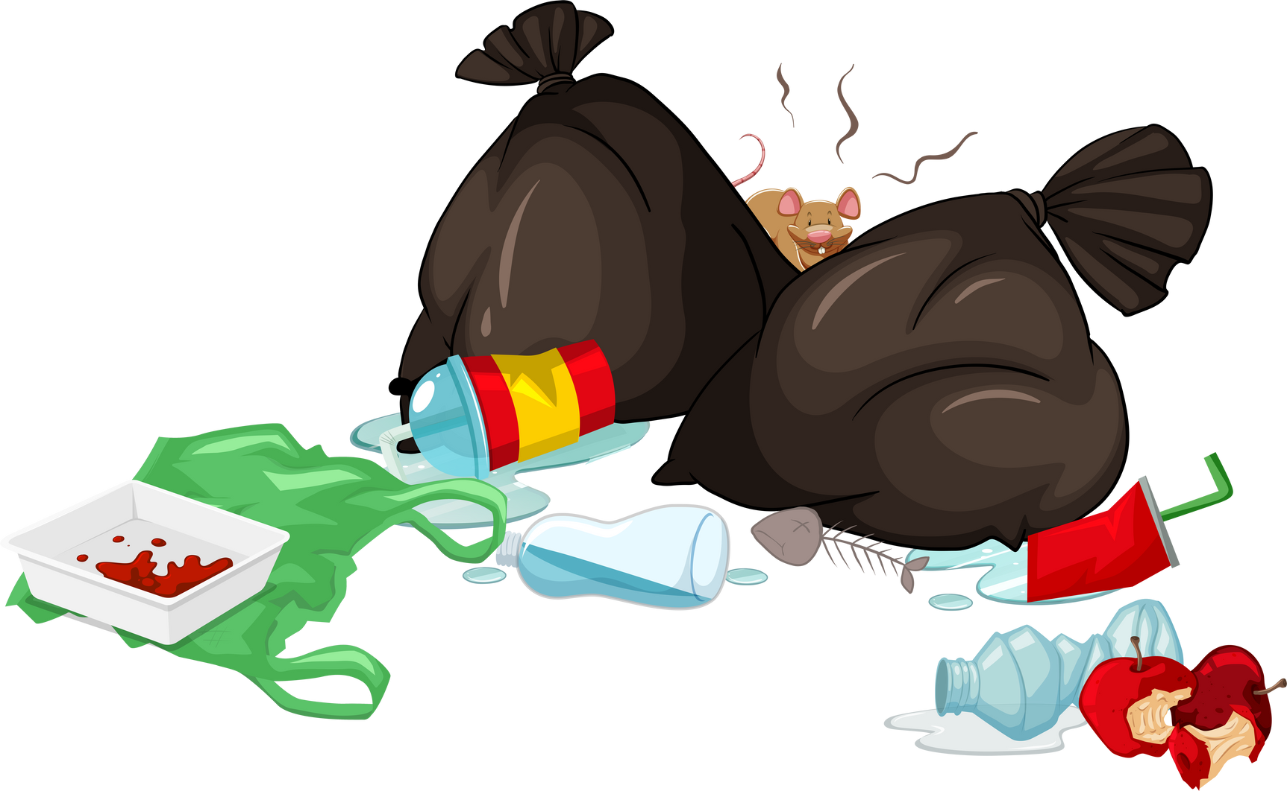
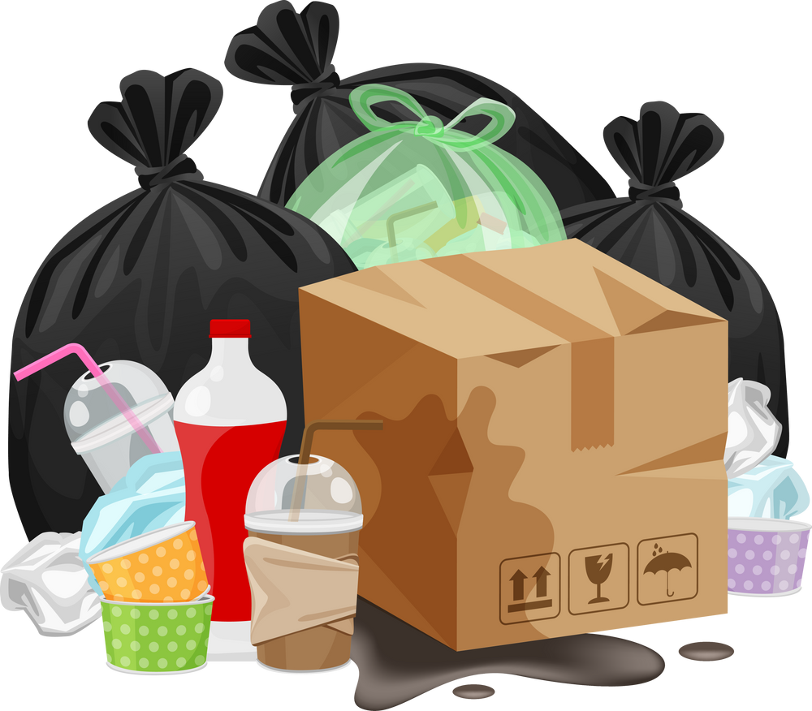

CLEAN UP TRASH IN THE RIVER

Slide 26
HOW TO PLAY
Click "PLAY" to start the game.
Click on the pieces of trash floating on the river (numbered from 1 to 9) to reveal a question.
After answering, click "BACK" to return.
Click "EXIT" to end the game.

Slide 27


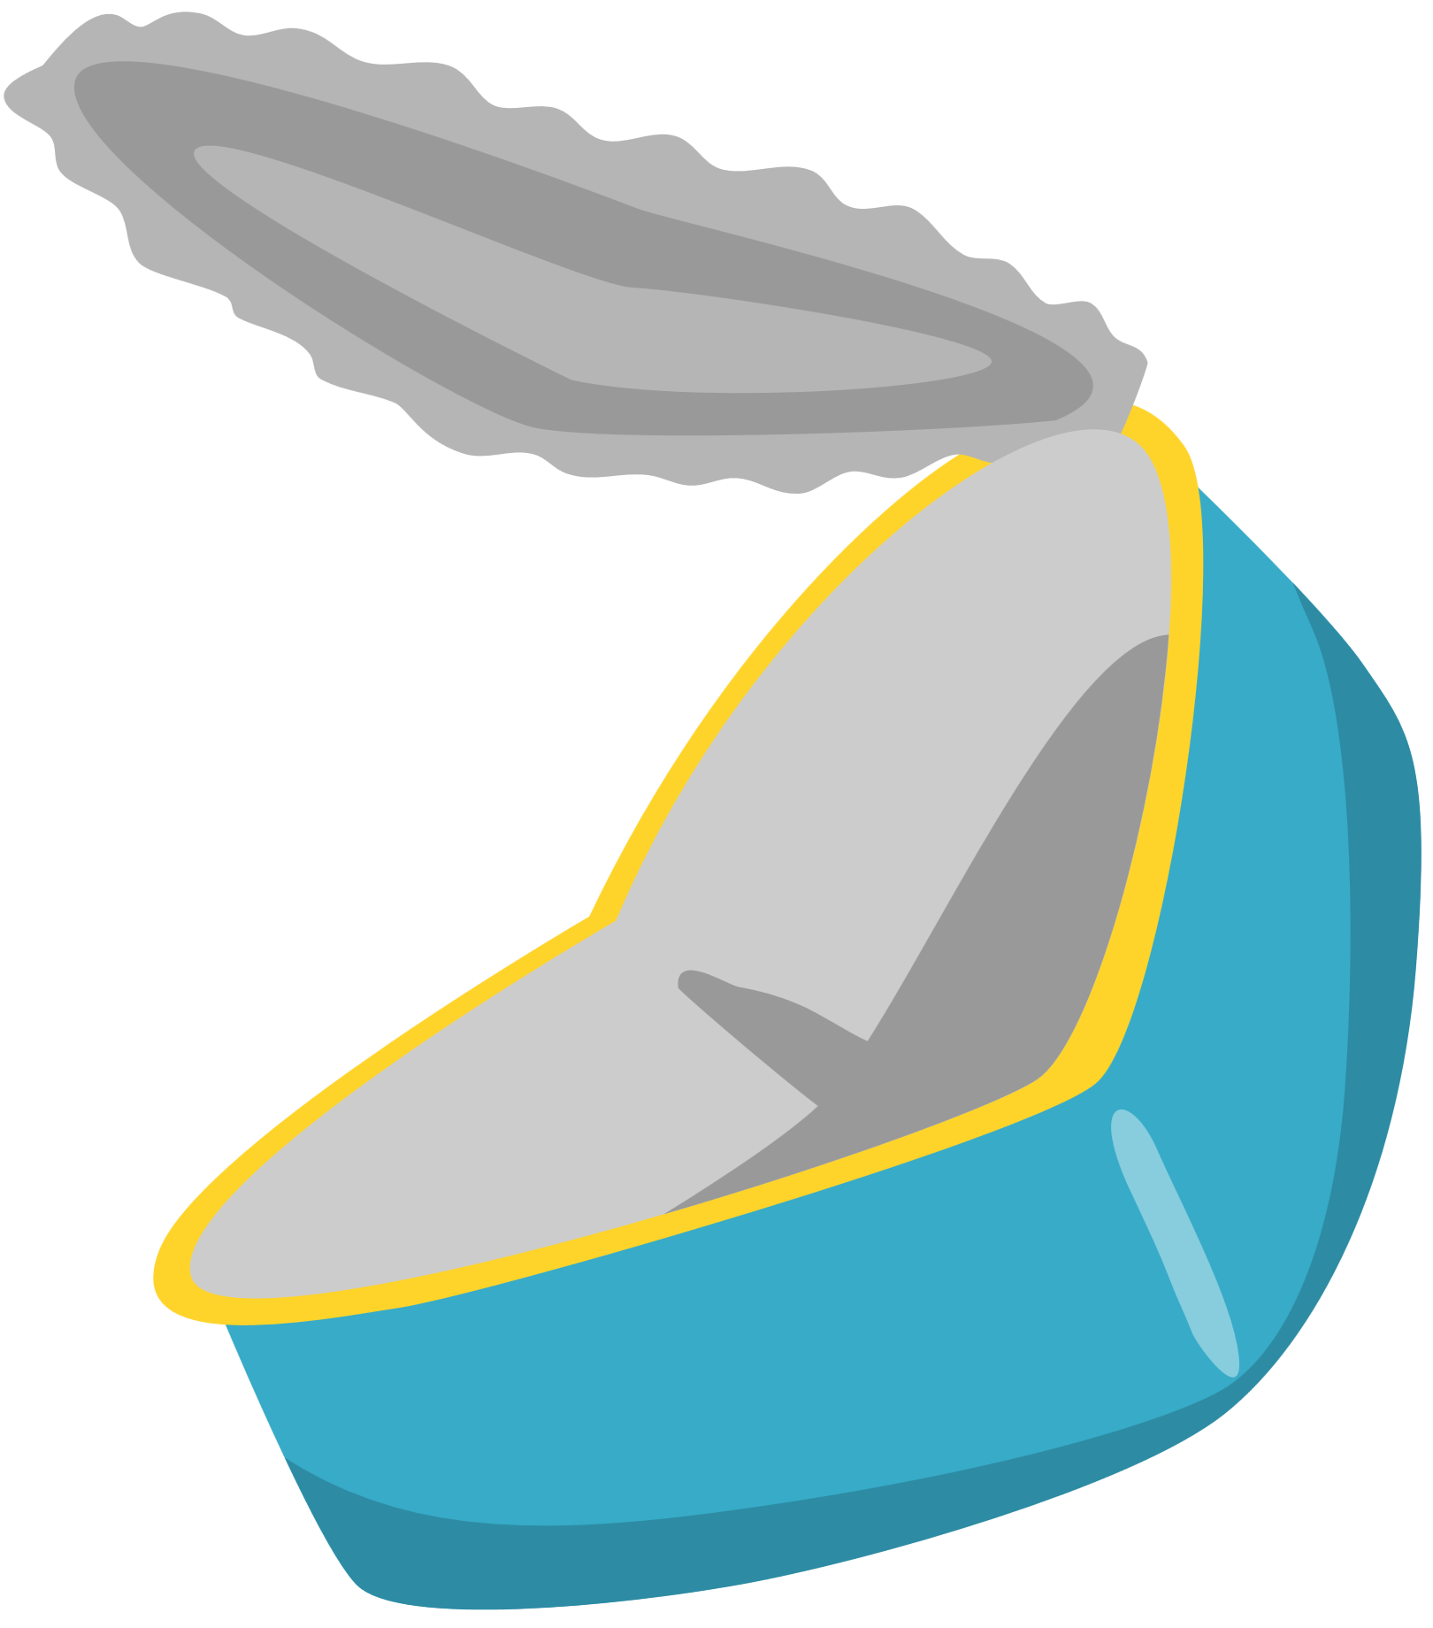








3
5
4
1
7
8
2
9
6

Slide 28
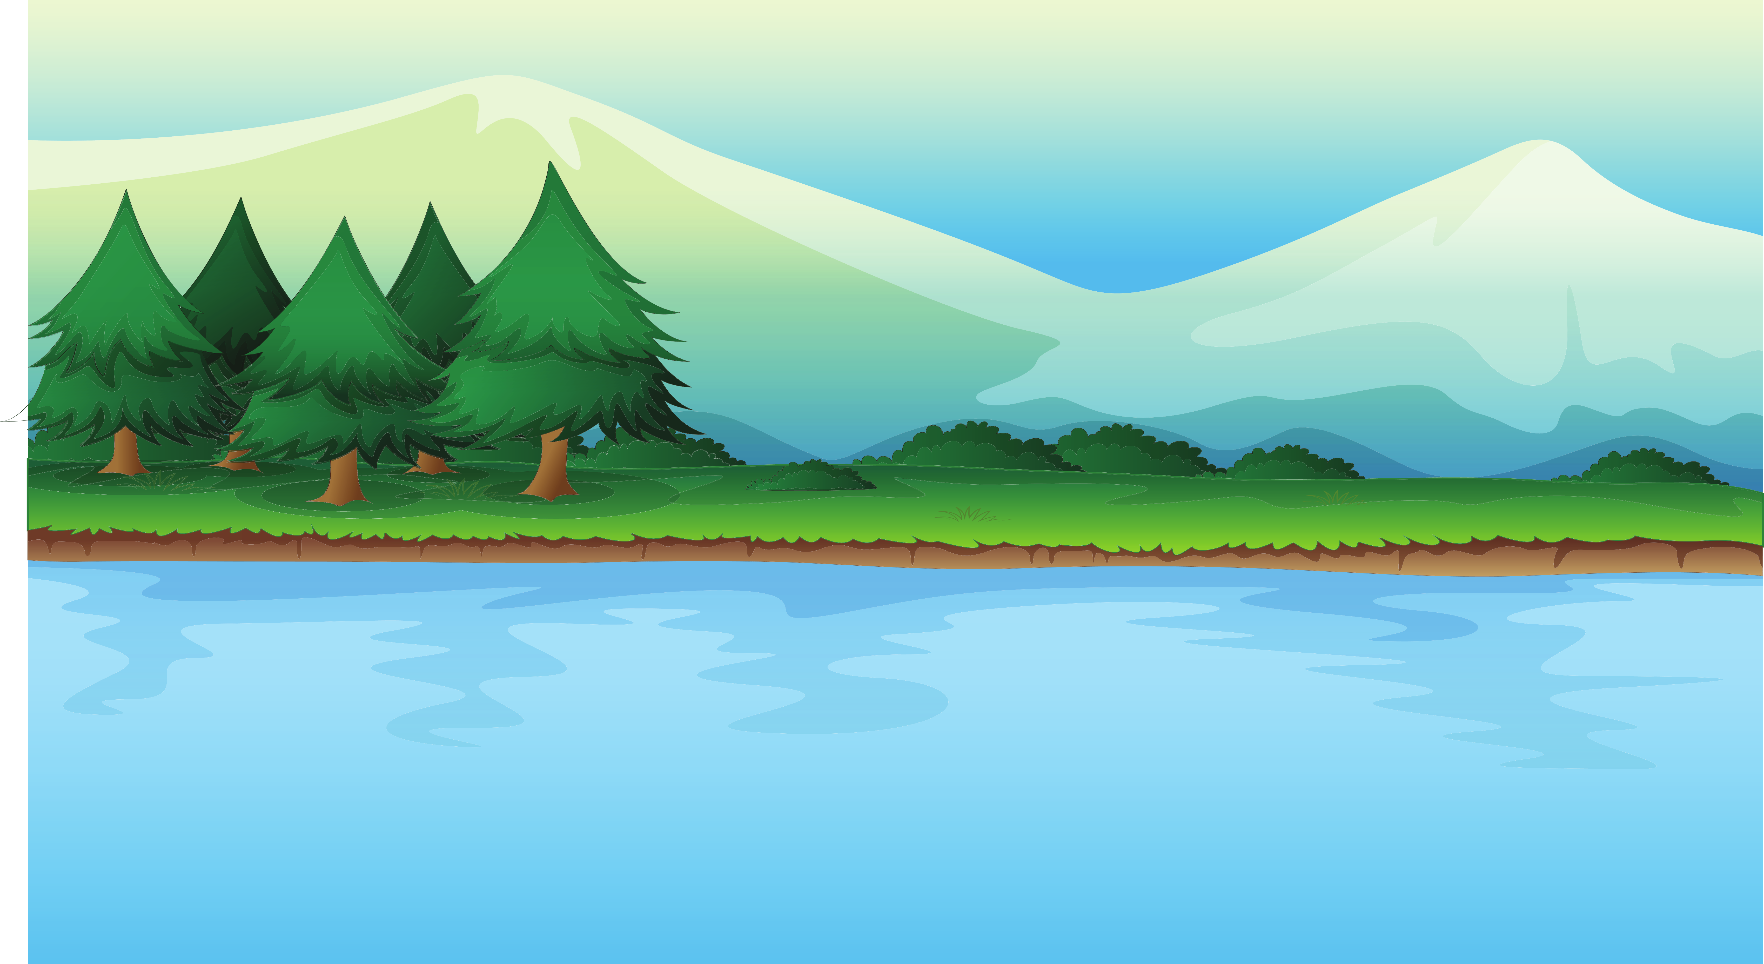
BACK
She ________ that learning a second language is very important.
A. thinks
B. is thinking
C. think
D. thinking

Slide 29
BACK
This soup ________ delicious!
A. is tasting
B. tastes
C. taste
D. is tasted

Slide 30
BACK
I ________ with you. That idea won’t work.
A. agreed
B. am agreeing
C. agree
D. have agreed

Slide 31
BACK
Find the mistake
The city sounds very noise at night.
noisy
A. The
B. sounds
C. noise
D. at

Slide 32
BACK
I ________ a party this weekend. Do you want to come?
A. have
B. was having
C. has
D. am having

Slide 33
BACK
I ________ the answer, but I can't explain it clearly.
A. know
B. knew
C. am knowing
D. was knowing

Slide 34
BACK
My parents ________ a small hotel near the beach.
A. are owning
B. own
C. owned
D. are owned

Slide 35
BACK
Find the mistake
This exercise is a good recommend for improving vocabulary.
recommendation
A. exercise
B. recommend
C. improving
D. vocabulary

Slide 36
BACK
He ________ to buy a new laptop these days.
A. thinks
B. thought
C. is thinking
D. has thought

Slide 37
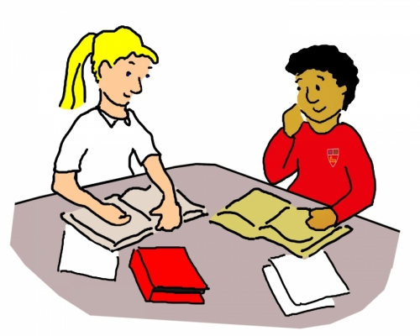
GRAMMAR
Work in pairs. Talk about future developments in your neighbourhood. Use stative verbs in continuous form and linking verbs.
3

Slide 38
I heard they’re building a new shopping mall next to the park.
Really? That sounds exciting, but I’m thinking about the traffic.

Slide 39
Yeah, I’m worried too. The roads are crowded, and we need more space for cars.
My parents are worried too. They think it’ll be too noisy.

Slide 40
Still, the area is looking better. More places to hang out might actually improve the community!
I agree! It might help local businesses too.

Slide 41
CONSOLIDATION
1
Wrap-up
What have you learnt today?
Some lexical items about cities and smart living
Linking final consonants to initial vowels
Stative verbs in the continuous form and Linking verbs

Slide 42
CONSOLIDATION
2
Homework
Do exercises in the workbook.
Prepare for Lesson 3 - Unit 3.

Slide 43
GOODBYE

