Slide 1








UNIT 9.
CITIES OF THE WORLD

Slide 2



PART 1. THEORY
I. VOCABULARY

Slide 3






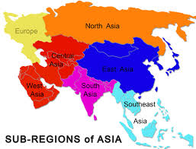



1. Africa (n):
2. architect (n):
/'ɑ:kɪtekt/
kiến trúc
/'æfrɪkə/
châu Phi
3. Asia (n):
4. award (n):
/’eɪʒə/
châu Á
/ə'wɔ:d/
phấn thưởng

Slide 4
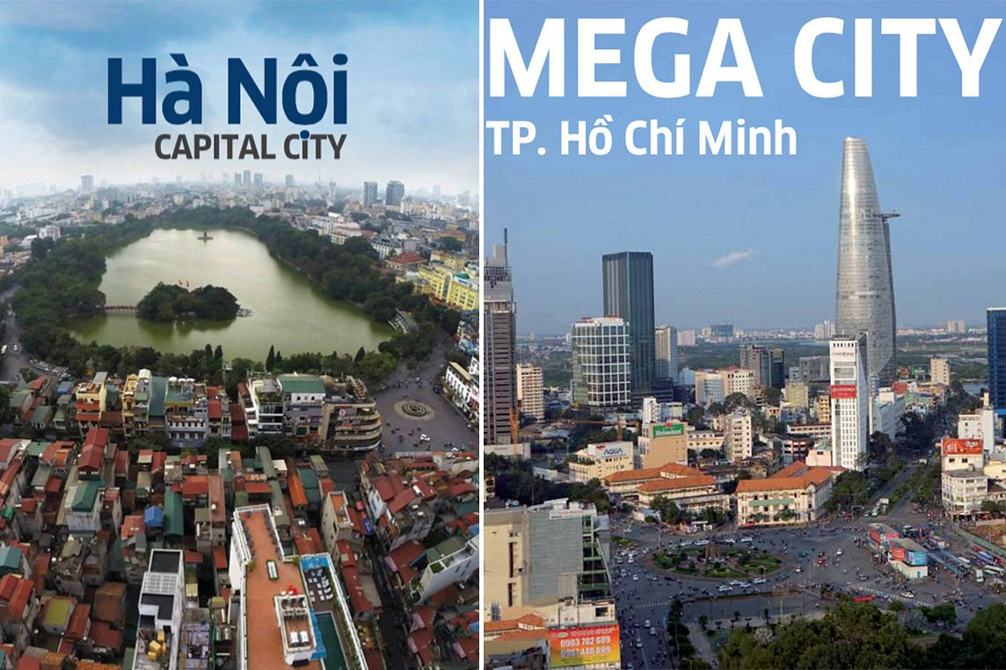
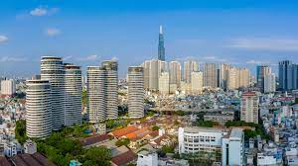

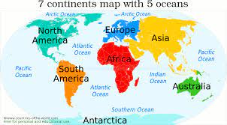
5. capital (n):
6. city (n):
/'sɪtɪ/
thành phố
/'kæpɪtəl/
thủ đô
7. common (n):
8. continent (n):
/'kɒntɪnənt/
lục địa
/'kɒmən/
thông thường

Slide 5
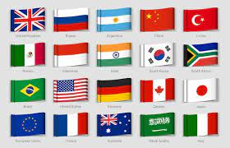
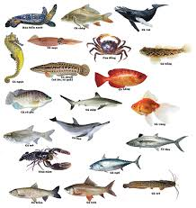

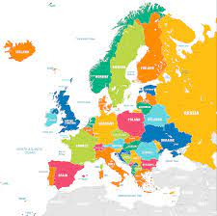
9. country (n):
10. creature (n):
/'kri:tʃər/
sinh vật
/'kʌntrɪ/
quốc gia
11. design (v):
12. Europe (n):
'jʊərəp/
châu Âu
/dɪ'zaɪn/
thiết kế

Slide 6
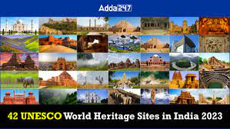

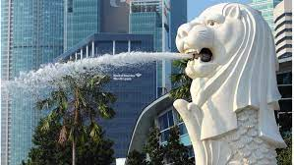
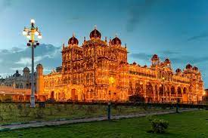
13. heritage (n):
14. journey (n):
/'dʒɜ:nɪ/
chuyến đi,
hành trình
/'herɪtɪdʒ/
di sản
15. merlion (n):
16. palace (n):
/'pæləs/
lâu đài
/'mɜ'laɪən/
sư tử cá

Slide 7
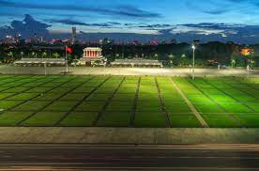


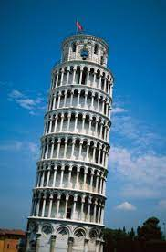
17. postcard (n):
18. square (n):
/skweər/
quảng trường
/'pəʊstkɑ:d/
bưu thiếp
19. symbol (n):
20. tower (n):
/'taʊər/
tòa tháp
/'sɪmbəl/
biểu tượng

Slide 8


21. university (n):
/ju:nɪ'vɜ:sɪtɪ/
trường đại học
22. writer (n):
/'raɪtər/
nhà văn

Slide 9

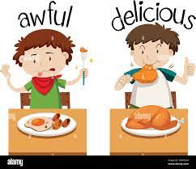
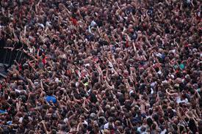


Một số tính từ thường gặp
1. awful (adj):
2. crowded (adj):
/'ɔ:fəl/
kinh khủng
/'kraʊdɪd/
đông đúc
3. dangerous (adj):
4. exciting (adj):
/ɪk’saɪtɪη/
náo nhiệt
/’de ɪndʒərəs/
nguy hiểm

Slide 10

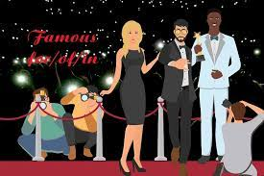
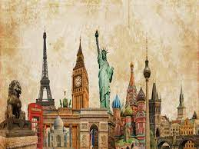
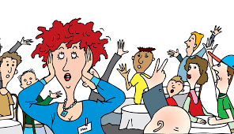
5. expensive (n):
6. famous (for) (n):
/'feɪməs fɔ:r/
nổi tiếng
/ɪk'spensɪv/
đắt đỏ
7. historic (n):
8. noisy (n):
/'nɔɪzɪ/
ầm ĩ
/hɪ'stɒrɪk/
có tính lịch sử

Slide 11
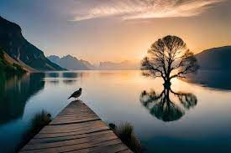
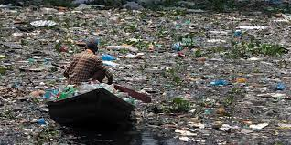

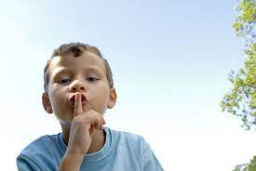
9. peaceful (n):
10. polluted (n):
/'pi:sfəl/
thanh bình
/pə'lu:tid/
bị ô nhiễm
11. popular (n):
12. quiet (n):
/kwaɪət/
yên tĩnh
/'pɒpjələr/
phổ biến

Slide 12
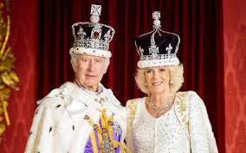

0
13. royal (n):
/'rɔɪəl/
thuộc hoàng gia
14. safe (n):
/seɪf/
an toàn

Slide 13
Africa
architect
Asia
award
capital
city
common
continent
country
creature
design
Europe
heritage
journey
merlion
palace
postcard
square
symbol
tower
University
writer

Slide 14
awful
crowded
dangerous
exciting
expensive
famous (for)
historic
noisy
peaceful
polluted
popular
quiet
royal
safe

Slide 15
VOCABULARY CHECKING
https://wordwall.net/resource/36078410
https://wordwall.net/resource/28715605

Slide 16
PART 1. THEORY
II. GRAMMAR

Slide 17




1. POSSISSIVE ADJECTIVE (TÍNH TỪ SỞ HỮU)
a. Định nghĩa
Tính từ sở hữu là những từ đứng trước danh từ để cho biết danh từ đó của ai, của cái gì. Chúng ta gọi nó là tính từ sở hữu vì nó thể hiện tính chất sở hữu của người hoặc vật với danh từ đi sau nó.
b. Bảng đại từ nhân xưng và tính từ sở hữu tương ứng
Đại từ nhân xưng (Personal pronoun) | Tính từ sở hữu (Possessive adjectives)
I (Tôi) | My (Của tôi)
You (Bạn, các bạn) | Your (Của bạn, của các bạn)
They (Họ) | Their (Của họ)
We (chúng tôi) | Our (Của chúng tôi)
She (Cô ấy) | Her (Của cô ấy)
He (Anh ấy) | His (Của anh ấy)
It (Nó) | Its (Của nó)

Slide 18
Ex:
my pencil (bút chì của tôi)
your sister (chị gái của bạn)
our country (đất nước của chúng tôi)
their idea (ý tưởng của họ)
his food (đồ ăn của anh ấy)
her hand (bàn tay của cô ấy)
its toy (đồ chơi của nó)

Slide 19
c. Vị trí trong câu
Nó luôn đứng trước danh từ mà nó sở hữu và các danh từ này không có mạo từ đi kèm.
Ex 1: They are my friends. (Họ là bạn của tôi.)
Ex 2: Her books are on the table. (Những quyển sách của cô ấy ở trên bàn.)
Ex 3: The dog wags its tail. (Con chó vẫy đuôi của nó.)

Slide 20
GRAMMAR CHECKING
https://wordwall.net/resource/38073716
https://wordwall.net/resource/32928562

Slide 21
2. POSSISSIVE PRONOUNS (ĐẠI TỪ SỞ HỮU)
a. Định nghĩa
Đại từ sở hữu là những đại từ dùng để chỉ sự sở hữu.
b. Bảng đại từ nhân xưng và tính từ sở hữu tương ứng
Đại từ nhân xưng (Personal pronoun) | Tính từ sở hữu (Possessive adjectives)
I (Tôi) | mine (...của tôi)
You (bạn, các bạn) | yours (...của bạn, của các bạn)
They (Họ) | theirs (...của họ)
We (Chúng tôi) | ours (...của chúng tôi)
She (Cô ấy) | hers (...của cô ấy)
He (Anh ấy) | his (...của anh ấy)
It (Nó) | its (...của nó)

Slide 22
c. Cách dùng đại từ sở hữu
✓ Đại từ sở hữu dùng để thay thê cho một tính từ sở hữu + một danh từ
Ex 1: Her shirt is blue, and mine is red. (mine = my shirt)
(Áo của cô ấy màu xanh và của tôi màu đỏ.)
Ex 2: This is your pencil and that is his. (his = his pencil)
(Đây là bút chì của bạn và kia là bút chì của anh ấy.)
✓ Đại từ sở hữu dùng trong cầu sở hữu kép.
Ex: She is a good friend of mine. (Cô ấy là một người bạn tốt của tôi.)

Slide 23
 Lưu ý về tính từ sở hữu và đại từ sở hữu
• Tính từ sở hữu: luôn đi cùng với danh từ.
• Đại từ sở hữu: Bản thân nó đã mang nghĩa của một cụm danh từ. Do đó đại từ sở hữu không đi kèm với bất kỳ danh từ nào khác.
Ví dụ chi tiết phân biệt cách dùng đại từ sở hữu và tính từ sở hữu.
This is my book. | This book is mine.
This is your book. | This book is yours.
This is his book. | This book is his.
This is her book. | This book is hers.
This is our book. | This book is ours.
This is their book. | This book is theirs.

Slide 24
GRAMMAR CHECKING
https://wordwall.net/resource/53582567
https://wordwall.net/resource/31688029

Slide 25
PART 1. THEORY
III. PHONETICS
 Cách phát âm âm /əʊ/ và /aʊ/.

Slide 26
1. Âm /əʊ/
a. Cách phát âm âm /əʊ/
- Âm /əʊ/ là 1 nguyên âm đôi. Để phát âm âm này, đầu tiên đặt lưỡi ở vị trí phát âm của âm /ə/, sau đó miệng tròn dần để phát âm âm /ʊ/. (Chú ý: phát âm /ə/ dài, /ʊ/ ngắn và nhanh.)
Các em tập thực hành phát âm các từ sau:
go /gəʊ/ | boat /bəʊt/ | shoulder /'ʃəʊldər/
road /rəʊd/ | phone /fəʊn/ | October /ɒk'təʊbər/
old /əʊld/ | joking /dʒəʊkɪη/ | potato /pə'teitəʊ /

Slide 27
b. Dấu hiệu nhận biết
- “o” thường được phát âm là /əʊ/ khi nó ở cuối một từ
Examples | Transcription | Meaning
go | /gəʊ/ | đi
no | /nəʊ/ | không
ago | /ə'gəʊ/ | trước đây
mosquito | /mə'ski:təʊ/ | con muỗi
potato | /pə'teɪtəʊ/ | khoai tây
tomato | /tə'mɑ:təʊ/ | cà chua

Slide 28
b. Dấu hiệu nhận biết
- "oa” được phát âm là /əʊ/ trong một từ có một âm tiết tận cùng bằng một hay hai phụ âm
Examples | Transcription | Meaning
coat | /kəʊt/ | áo choàng
road | /rəʊd/ | con đường
coal | /kəʊl/ | than đá
loan | /ləʊn/ | sự cho vay nợ
goat | /gəʊt/ | con dê

Slide 29
b. Dấu hiệu nhận biết
- “ou” có thể được phát âm là /əʊ/
Examples | Transcription | Meaning
soul | /səʊl/ | tâm hồn
dough | /dəʊ/ | bột nhão
shoulder | /ʃəʊldər/ | vai
poultry | /'pəʊltrɪ/ | gia cầm

Slide 30
b. Dấu hiệu nhận biết
- “ow” được phát âm là /əʊ/
Examples | Transcription | Meaning
know | /nəʊ/ | biết
slow | /sləʊ/ | chậm
widow | /‘wɪdəʊ/ | bà góa phụ
window | /'wɪndəʊ/ | cửa sổ
bowl | /həʊl/ | cái bát

Slide 31
2. Âm /aʊ/
a. Cách phát âm âm /aʊ/
- Âm /aʊ/ là 1 nguyên âm đôi. Để phát âm âm này, đầu tiên ta mở khẩu hình miệng như khi phát âm âm /a/. Tiếp đó ta mở miệng tròn dần để phát âm /ʊ/. (Chú ý: phát âm /a/ dài, /ʊ/ ngắn và nhanh.)
Các em hãy tập thực hành phát âm các từ sau:
how /haʊ / now /naʊ / loud /laʊd/ | mouse /maʊs/ sound /saʊnd/ about /ə'baʊt/ | accounting /ə'kaʊtɪη/ mountain /'maʊtn/ council /'kaʊnsl/

Slide 32
b. Dấu hiệu nhận biết
- “ou” được phát âm là /aʊ/ trong những từ có nhóm “ou” với một hay hai phụ âm
Examples | Transcription | Meaning
found | /faʊnd/ | tìm thấy (quá khứ của find)
cloud | /klaʊd/ | đám mây
mouth | /maʊθ/ | mồm, miệng
doubt | /daʊt/ | sự nghi ngờ, ngờ vực

Slide 33
b. Dấu hiệu nhận biết
- “ow” được phát âm là /aʊ/
Examples | Transcription | Meaning
tower | /taʊər/ | tháp
power | /paʊər/ | sức mạnh, quyền lực
powder | /'paʊdər/ | bột
crown | /kraʊn/ | vương miện
drown | /draʊn/ | chết đuối, chết chìm

Slide 34
PART 2. LANGUAGE
I. VOCABULARY

Slide 35



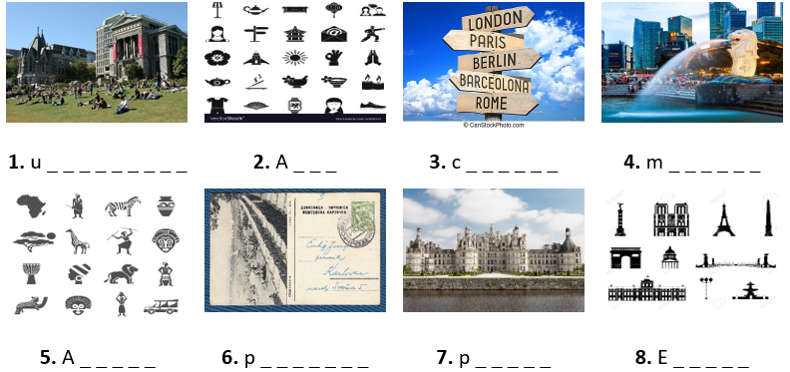


0
Exercise 1. Look at the photo and write the correct word. The first letter is a hint.
niversity
sia
apital
erlion
frica
ostcard
alace
urope

Slide 36
0
Exercise 2. Match the adjective with their opposite one.
No. | A | Opt. | B | Your anwer
1. | large | A. | poor
2. | expensive | B. | quiet
3. | rich | C. | terrible
4. | polluted | D. | clean
5. | high | E. | small
6. | noisy | E | low
7. | dangerous | G. | cheap
8. | wonderful | H. | safe
1. E
2. G 3. A
4. D
5. F
6. B
7. H
8. C

Slide 37
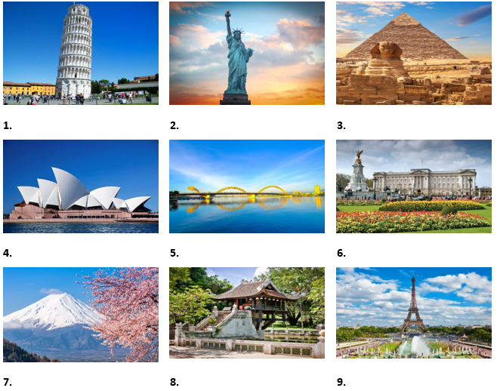
0
Exercise 3. Look at the photos and put the word under the correct photo.
Tower of Pisa
The Statue of Liberty
Great Pyramid
Sydney Opera House
Dragon Bridge
Buckingham Palace
Mount Fuji
One Pillar Pagoda
Eiffel Tower

Slide 38
0
Exercise 4. Choose the word that is opposite in meaning to the underlined word.
1. The streets were very noisy throughout the night.
A. crowded B. busy C. quiet D. empty
2. That modern building is so ugly!
A. big B. impressive C. unattractive D. beautiful
3. We didn’t go camping last weekend. The weather was awful.
A. unpleasant B. nice C. bad D. terrible
4. Rio de Janeiro is an exciting city
A. interesting B. dangerous C. boring D. expensive

Slide 39
0
Exercise 4. Choose the word that is opposite in meaning to the underlined word.
5. The beaches in Sydney are clean and beautiful.
A. clear B. dirty C. famous D. fresh
6. It’s dangerous to walk around the city at night.
A. safe B. exciting C. cold D. popular
7. The dish is delicious with cheese.
A. tasty B. pleasant C. fatty D. awful
8. York is a historic city in North Yorkshire.
A. exciting B. modern C. famous D. quiet

Slide 40
0
Ex 5. Write the adjectives in the correct column. Some can go more than one column.
new
sunny
big
beautiful
quiet
awful
ugly
huge
polluted
cloudy
dangerous
modern
historic
tall
cold
exciting
windy
safe
small
noisy
Weather | Building | City
beautiful
big
modern

Slide 41
PART 2. LANGUAGE
II. GRAMMAR

Slide 42
0
Exercise 1a. Write the possessive adjectives of the subject pronoun in brackets.
My
1. (I) __________ sister is ten years old.
5. (You) __________ bicycles are old.
2. (He) __________ eyes are blue.
6. (She) __________ house is big.
3. (They) __________ car is red.
7. (He) __________ father is doctor.
4. (We) __________ dog is white.
8. (The boy) __________ sister is Mary.
Your
His
Her
Thier
His
Our
The boy’s

Slide 43
0
Exercise 1b. Complete the sentences with a correct possessive adjective.
my
1. I have finished __________ homework tonight.
2. Linda is talking with __________ mother.
3. Tom doing homework with __________ sister.
4. In the morning, Lyly water __________ plants and feed __________ dog.
5. She is wearing shoes. __________ shoes are very lovely.
6. The cat wagged __________ tail.
7. On next weekend, she is going to visit __________ parents and __________ grandmother.
8. Every morning, Tom often takes __________ dog for a walk.
9. Lyly is sick. I will bring her __________ homework.
10. Jack just gave me a tree in __________ garden.
her
his
her
her
Her
its
her
her
his
my
his

Slide 44
0
Exercise 2. Choose the best option to complete the sentence.
1. These toys are __________.
A. you B. your C. yours
2. I love __________ grandparents.
A. mine B. me C. my
3. __________ children are young.
A. They’re B. They C. Their
4. That CD is __________.
A. mine B. my C. me
5. These clothes aren’t __________.
A. our B. ours C. We

Slide 45
0
Exercise 2. Choose the best option to complete the sentence.
6. Your bike is a lot faster than __________.
A. my B. its C. mine
7. The book is __________ but you’re welcome to read it.
A. mine B. yours C. my
8. __________ dog is always so friendly.
A. There B. They C. Their
9. My sister gets along well with __________.
A. yours B. my C. your
10. I looked everywhere for my keys but I could only find __________.
A. your B. yours C. them

Slide 46
0
Exercise 3. Read the email. Choose the correct option to fill in the blank.
Dear Christian,
My name is Emily and I want to be (1) __________ e-pal. I am seven years old and I am from England. My parents are doctors. I (2) __________ two brothers. They are students at the University of London. Have (3) __________ got any brothers or sisters? In my free time, I go to the cinema with my brothers or hang out with my friends. My best friend (4) __________ Selma. (5) __________ mother is from India and her father is from Germany. Please write soon and tell (6) __________ all about your family and friends.
Best wishes,
Emily
1. A. yours | B. your | C. you
2. A. be | B. can | C. have got
3. A. you | B. your | C. yours
4. A. am | B. is | C. are
5. A. She | B. Hers | C. Her
6. A. I | B. me | C. my

Slide 47
0
Exercise 4. Choose the best option to complete the sentence.
1. This isn’t her skirt. __________ is blue.
A. Hers B. Her C. She D. He
2. __________ daughter is a teacher.
A. Our B. Ours C. Us D. We
3. Look at __________!
A. I B. mine C. me D. my
4. Linda is __________ cousin.
A. him B. he C. he’s D. his
5. This craft isn’t mine. It’s __________.
A. him B. she C. hers D. them

Slide 48
0
Exercise 5. Complete the sentences. Use the correct possessive adjective or possessive pronoun. Number 1 is an example for you.
1. The coat belongs to me. It is mine.
2. Peter has got a kite. The kite is __________.
3. My friends and I have got sweets. The sweets are_________.
4. I have a new book. It is __________.
5. My brothers have got bikes. The bikes are __________.
6. Karen has got a dog. That’s __________ dog.
7. I’ve got a watch. This is __________ watch.
his
our
mine
theirs
her
my
1. mine 2. his 3. ours 4. mine 5. theirs 6. her 7. my 8. hers 9. hers 10. her 11. hers 12. yours 13. ours 14. his

Slide 49
0
Exercise 5. Complete the sentences. Use the correct possessive adjective or possessive pronoun. Number 1 is an example for you.
8. Mary has new pillows. They are __________.
9. The chair belongs to Mary. It is __________.
10. Mum has got a new bag. That’s __________ bag.
11. She has a new cat. It is __________.
12. You have a new toy. It is __________.
13. We have new shoes. They are __________.
14. Peter has some books. They are __________.
hers
hers
her
hers
your
our
his

Slide 50
0
Exercise 6. Complete the sentences. Use the correct possessive adjective or possessive pronoun.
your
1. Is it __________ book? (you)
2. It’s __________ question, not __________. (they, we)
3. Is this camera __________? (you)
4. Are these __________ shoes? (you)
5. That’s not __________ key. __________ is yellow. (I)
6. They know __________ address but they don’t know __________. (we, they)
7. _______ room is bigger than ________ but ________ is nicer. (I, she, she)
8. I can see __________ children at the school gate but where are __________? (you, I)
9. I want to change _________ bike. I want to buy one like _________. (I, you)
10. __________ car is cheap but __________ is expensive. (I/ he)
their
ours
yours
your
my
mine
ours
theirs
My
hers
hers
your
mine
my
yours
My
his

Slide 51
0
Exercise 6. Complete the sentences. Use the correct possessive adjective or possessive pronoun.
yours
11. “Whose camera is it?” - “It’s __________. (you)
12. Excuse me, those are __________ seat. (we)
13. Is it __________ suitcase or __________? (you/he)
14. Has the dog had __________ food? (it)
15. They’re not __________ keys. They’re __________. (I/she)
16. I don’t think it’s ________ room. I think it’s _________. (you/ they)
17. The police asked me for __________ address. (I)
18. I think this is __________ book. Oh no, it’s __________. (I/ you)
19. ________ brother hasn’t got a phone, so he uses ________. (I/ we)
20. __________ garden is bigger than __________. (they/we)
our
your
his
its
my
hers
your
theirs
my
my
yours
My
ours
Theirs
ours

Slide 52
PART 2. LANGUAGE
III. PHONETICS

Slide 53
0
Exercise 1. Put the words in the correct column according to the pronunciation.
cow
stole
now
coat
allow
house
bowl
roll
boat
out
load
home
bow
foul
cold
brow
about
most
go
how
old
flower
pole
though
comb
grouse
slow
plough
ouch
/aʊ/ |  | /əʊ/

Slide 54
0
Exercise 2. Underline the word containing sound /aʊ/ and double underline the word containing sound /əʊ/ then read aloud these sentences.
1. We found our gowns downtown.
2. Shower the flower for an hour.
3. She phoned me in October.
4. They showed us their home.
5. Is the window open?
6. How’s the loud vowel sound?

Slide 55
PART 3. COMMUNICATION SKILLS
I. LISTENING

Slide 56
0
Exercise 1. Listen and decide if each statement is True (T) or False (F).  Track 05
T
1. The speaker went on holiday in Paris in May. __________
2. They visited nowhere except for the Eiffel Tower and Notre Dame.
__________
3. Her friend took lots of photos, but she did not. __________
4. The market was full of little stalls. __________
5. They bought few souvenirs. __________
F
F
T
F

Slide 57
0
Exercise 2. Listen and answer the question.  Track 06
1. Who did she go on holiday with?
→ Her friend
2. What did they do first?
→ They did a lot of sightseeing
3. What are some beautiful places in Paris?
→ The Eiffel Tower, Notre Dame...
4. Where did they get lost?
→ On their way back to the hotel.
5. What were sold at the market?
→ Everything from apples to antiques.

Slide 58
PART 3. COMMUNICATION SKILLS
II. SPEAKING

Slide 59
0
Exercise 1. Complete the conversation then practise speaking it.
tourists
world
beautiful
height
city
history
- Where are you from, Nick?
- I’m from Toronto.
- I heard it is a very big (1) __________, isn’t it?
- Yes, you’re right. It is a very (2) __________ city. I like it very much.
- What’s interesting in your country?
- There are a lot of places which (3) __________ like to visit. But I like CN Tower. It is one of the tallest building in the (4) __________.
- Really? Do you know its (5) __________?
- Yes, of course. It was completed in 1976 and it is used for TV and radio broadcasting.
- What’s the (6) __________?
- It is 553 meters high.
- Great!

Slide 60
0
Ex 2. Complete the dialogue with the sentences from the box then practise speaking it.
Beth: Hi Dad!
Dad: Hi Beth. (1) _____________________________
Beth: Yes, thanks. This holiday isn’t long enough!
Dad: (2) ____________________________________
Beth: We were in London. I saw the River Thames and I went to a souvenir shop.
Dad: (3) ____________________________________
Beth: Yes, we visited the Natural History Museum. It’s the best museum in London!
Dad: (4) _____________________________________
Beth: A diplodocus. It was the tallest dinosaur in the world - it was bigger than three buses!
Dad: (5) _____________________________________
Beth: Yes, I did and Ben did too!
Are you having a good time?
• What did you see?
• Did you have fun?
• Are you having a good time?
• Did you visit any famous places?
• What did you do yesterday?
What did you do yesterday
Did you visit any famous places?
What did you see?
Did you have fun?

Slide 61
PART 3. COMMUNICATION SKILLS
III. READING

Slide 62
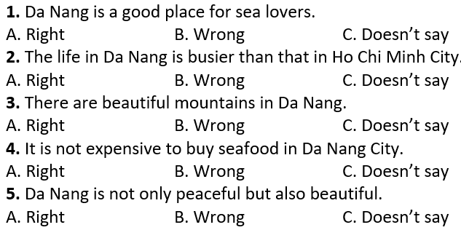
0
Exercise 1. Read the text and choose the best answer (A, B, or C) to each statement.
Da Nang is one of the most peaceful cities in Viet Nam with a lot of beautiful beaches. This is a wonderful place for those who love the sea and enjoy fresh air.
Life here is not so busy as that in Ho Chi Minh City. It is not only a beautiful city but also a safe place to live in. Every evening, after work, you can easily catch the sight of families riding to the beach, leaving their motorbikes. They believe that their vehicles will still be there when they come back. There is no beggar here and the air is fresh. Another good thing is the food. If you love seafood, Da Nang will be the right choice. The food here is very fresh and the price is not expensive.

Slide 63
0
Ex2. Read the following text and decide which answer best fits each numbered blank.
Hoi An is one of the (1) ___ towns in Vietnam. It (2) ___ on the lower section of the Thu Bon River. It is a very beautiful town with a lot of colour (3) ____ which are hung (4) ______ the town. Hoi An is famous (5) _____ one week tailoring. Customers order clothes (6) ______ the morning and get them (7) _____ the evening. The price is not very (8) ______. If you want to find the place of the (9) ________ time, Hoi An is a (10) _______ choice.
1. A. newer | B. newest | C. oldest
2. A. are | B. is | C. are being
3. A. lanterns | B. stars | C. balloons
4. A. on | B. around | C. up
5. A. of | B. for | C. with
6. A. at | B. in | C. on
7. A. with | B. on | C. in
8. A. expensive | B. cheap | C. more expensive
9. A. modern | B. old | C. new
10. A. best | B. worst | C. good

Slide 64
0
Exercise 3. Read the following text and use the words given in the box to fill the blanks. There are 2 extra words you don't need to use.
foreigners
country
among
more
modern
of
islands
The unique beauty of Ha Long Bay with its karst makes it a natural to be added to UNESCO’s World heritage listing. But, it seems the opinions are divided (1) __________ travelers.
There are (2) __________ than 1600 islets in the bay, their limestone worn down by 500 million years of tropical downpours, and topped by thick jungle growth. Some of the islands are hollow, creating majestic caves. Some of the larger (3) __________ have their own lakes.
At the centre (4) __________ the bay there are 775 of the formations in an area of just 330 square kilometres - an invitation for (5) __________ to board a traditional Vietnamese junk-boat and explore the bay, its island, caves, and floating villages.

Slide 65
PART 3. COMMUNICATION SKILLS
IV. WRITING

Slide 66
0
Exercise 1a. Use the given words to write the complete sentences.
1. Nha Trang/ attract/ lots/ tourists/ because/ it/ most beautiful/ beaches/ Viet Nam.
→ Nha Trang attracts lots of tourists because it is one of the most beautiful beaches in Viet Nam.
2. Ha Noi/ crowded/ than/ any other cities/ Viet Nam.
→ Ha Noi is more crowded than any other cities in Viet Nam.
3. The Eiffel Tower/ is/ visited/ landmark/ world.
→ he Eiffel Tower is the most visited landmark in the world.
4. I/ be/ Sa Pa/ many times/ with/ family.
→ I have been to Sa Pa many times with my family.
5. Most people/ Tokyo/ travel/ work/ train.
→ Most people in Tokyo travel to work by train.

Slide 67
0
Exercise 1b. Rearrange the words to make meaningful sentences.
1. Sydney/ the/ cleanest/ the/ is/ and/ the/ most/ in/ city/ world/ beautiful/./
→ Sydney is the cleanest and the most beautiful city in the world.
2. I/ cannot/ because/ my/ sleep/ neighborhood/ very/ noisy/ is/./
→ I cannot sleep because my neighborhood is very noisy.
3. After/ John/ clean/ has/ his/ washed/ car/,/ looks/ it/ very/./
→ After John has washed his car, it looks very clean.
4. Tea/ is/ in/ most/ drink/ the/ London/ popular/./
→ Tea is the most popular drink in London.
5. most/ populous/ city/ Ha Noi/ of the/ in Viet Nam/./ is/ one/
→ Ha Noi is one of the most populous cities in Viet Nam.

Slide 68
0
Exercise 2. There is ONE mistake in each sentence. Let's underline the mistake and rewrite the correct sentence.
1. The Royal Palace is one of the largest palace in Europe.
→ The Royal Palace is one of the largest palaces in Europe.
2. “Have you ever eat Ha Noi Pho, Steven?”
→ "Have you ever eaten Ha Noi Pho, Steven?"
3. Up to now, I have visited Da Lat third times.
→ Up to now, I have visited Da Lat three times
4. Do you think the most popular Vietnamese writer of children is To Hoai?
→ Do you think the most popular Vietnamese writer for children is To Hoai?
5. Sydney Opera House is an UNESCO World Heritage building.
→ Sydney Opera House is a UNESCO World Heritage building.

Slide 69
0
Exercise 2. There is ONE mistake in each sentence. Let's underline the mistake and rewrite the correct sentence.
6. The Merlion is a creature with the head of a lion so the body of a fish.
→ The Merlion is a creature with the head of a lion and the body of a fish.
7. New York is an excited city with many skyscrapers.
→ New York is an exciting city with many skyscrapers.
8. You can play boating on the West Lake and it is very nice.
→ You can go boating on the West Lake and it is very nice.
9. I have been to the beaches in Nha Trang many times to my family.
→ I have been to the beaches in Nha Trang many times with my family.
10. Is Chicago or Los Angeles the two biggest city in the United States?
→ Is Chicago or Los Angeles the second biggest city in the United States?

Slide 70
0
Exercise 3a. Put the words in the correct order to have correct sentences.
1. from/ vacation/ come/ Phu Quoc Island/1/ just/ have/ a/ back/ in.
→ I have just come back from a vacation in Phu Quoc Island.
2. university/ Viet Nam/ the/ was/ Quoc Tu Giam/ first/ in.
→ Quoc Tu Giam was the first university in Viet Nam.
3. world/ six/ in/ are/ continents/ there/ the.
→ There are six continents in the world.
4. Viet Nam I tower/ it/ famous/ in/ the/ is/ most.
→ It is the most famous tower in Viet Nam.
5. years/ new/ building/ is/ but/ looks/100/ more than/ old/ the/ it.
→ The building is new but it looks more than 100 years old.

Slide 71
0
Exercise 3b. Write in complete sentences using the words or phrases given.
1. Da Nang/ attract/ lots/ tourists/ because/ it/ most beautiful/ beaches/ Viet Nam./
→ Da Nang attracts lots of tourists because it has the most beautiful beaches in Viet Nam
2. Hoi An/ famous/ old houses/ building/ traditional crafts.
→ Hoi An is famous for old houses and building traditional crafts.
3. We/ visit/ New York/ one day/ the future.
→ We will visit New York one day in the future.
4. Temple of Literature/ one/ Ha Noi’s/ most/ picturesque / tourist attractions./
→ Temple of Literature is one of Ha Noi's most picturesque tourist attractions.
5. Merlion/ lion’s head/ fish’s body/ symbol/ Singapore./
→ Merlion with a lion's head and a fish's body is the symbol of Singapore.

Slide 72






THANK YOU

