Slide 1

Unit 4: All things high-tech
Lesson 4b: Grammar (Cont.)
Page 67

Slide 2
Lesson Outline
Warm-up
Grammar
Consolidation
Wrap-up

Slide 3
Objectives
By the end of this lesson, students will be able to…
- use modals correctly.
- talk about rules at home and at school.

Slide 4

WARM UP

Slide 5

Work in pairs.
MATCHING
Match the verbs in column A with correct uses in column B.
A | B
1. can | a. permission
2. must | b. advice
3. should | c. necessity
4. have to | d. obligation

Slide 6

It’s time to learn …

Slide 7

Presentation

Slide 8
Examples
1. I advise you to see the doctor.
2. Is it OK if I open the windows?
1.1 → You should see the doctor.
1.2 → Can I open the windows?

Slide 9
Lead in
1. What are sentences 1.1 and 1.2?
They are rewritten using modals without changing meaning from sentences 1 and 2.

Slide 10
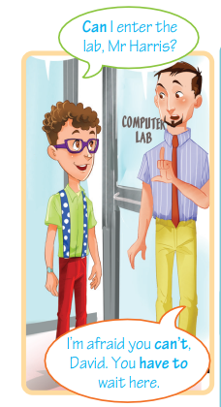

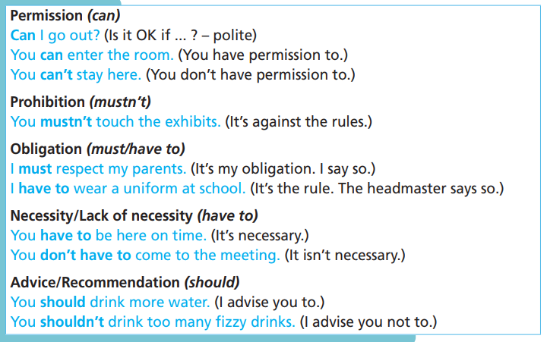

Slide 11

Practice

Slide 12
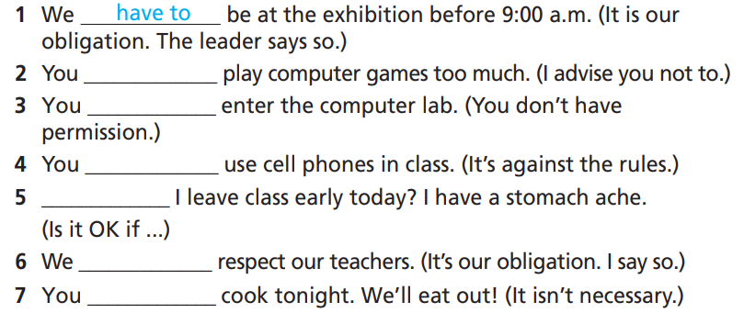
Practice
3 Rewrite the sentences using the correct modal verbs.
How many sentences are there?
→ There are 7.
What are you going to do?
Rewrite using the correct modals.

Slide 13
Practice
3 Rewrite the sentences using the correct modal verbs.
1. You have permission to go.
2. It’s against the rules to eat in the computer lab.
3. Is it OK if I take some pictures?
4. It’s our obligation to respect the rules.
You can go.
You mustn’t eat in the computer lab.
Can I take some pictures?
We must respect the rules.

Slide 14
Practice
3 Rewrite the sentences using the correct modal verbs.
5. I advise you not to eat too much fast food.
6. It’s not necessary to call Mark.
7. It’s the rule to wear gloves in the lab.
8. I advise you to go jogging every day.
You shouldn’t eat too much fast food.
You don’t have to call Mark.
We have to wear gloves in the lab.
You should go jogging every day.

Slide 15
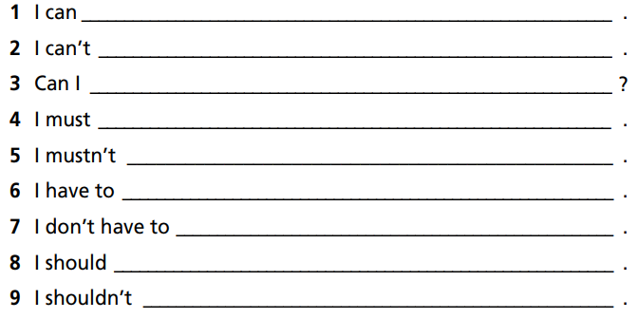
Practice
4 Complete the sentences. Then practise with your partner.
How many sentences are there?
→ There are 9.
What will you do?
Complete and practice.

Slide 16
Practice
4 Complete the sentences. Then practise with your partner.
1. I can ____________________________________________ .
2. I can’t ___________________________________________ .
3. Can I ____________________________________________ ?
4. I must ___________________________________________ .
watch TV after dinner
stay out after 11 p.m
use your tablet
practise hard to become a better volleyball player

Slide 17
Practice
4 Complete the sentences. Then practise with your partner.
5. I mustn’t _____________________________________________ .
6. I have to _____________________________________________ .
7. I don’t have to _________________________________________.
8. I should ______________________________________________ .
9. I shouldn’t ____________________________________________ .
use my mobile phone in class
help with the household chores at home
walk to school. My dad gives me a lift
exercise every day
eat a lot of junk food

Slide 18
Extra Practice
WB, page 33
Rewrite the sentences using the correct modal verbs.
1. Is It OK if I use the games console?
_________________________________________ ?
2. It’s necessary for me to buy a digital camera.
I ________________________________________ .
3. I advise you not to click on that link.
You ______________________________________ .
4. We don’t have permission to use Dad’s drone.
We ______________________________________ .
5. I advise you to take part in the game contest.
You ______________________________________ .
Can I use the games console
have to buy a digital camera
shouldn’t click on that link
can’t use Dad’s drone
should take part in the game contest

Slide 19
Extra Practice
WB, page 33
Rewrite the sentences using the correct modal verbs.
6. It’s against the rules to enter the room.
You ______________________________________ .
7. We have permission to take our tablets to school.
We ______________________________________ .
8. It’s not necessary for you to copy the files.
You ______________________________________ .
9. It’s my obligation to hand in my work by Friday. The teacher said so.
I ________________________________________ .
10. It’s our obligation to improve our English.
We ______________________________________ .
mustn’t enter the room
can take our tablets to school
don’t have to copy the files
have to hand in my work by Friday
must improve our English

Slide 20
Extra Practice
Grammar bank, page 71
Rewrite the sentences using the correct modal verbs.
1. You are not allowed to drink or eat in the library. (mustn’t)
____________________________________
2. Is it OK if I use the computer? (can)
____________________________________
3. I advise you to use a strong password. (should)
____________________________________
4. It’s our obligation to be on time at the concert. (must)
____________________________________
5. Do we have permission to go out? (can)
____________________________________
You mustn’t drink or eat in the library.
Can I use the computer?
You should use a strong password.
We must be on time at the concert.
Can we go out?

Slide 21

Production

Slide 22

5 Talk about rules at your home and school. Use can/can’t, should/shouldn’t, must/mustn’t or have to/don’t have to.

Slide 23
STUDENT A
STUDENT B
I have to go to bed before 10 p.m.
I can go to bed a bit late at the weekend.
We mustn’t talk when the teacher is giving lessons.
We can ask questions when we don’t understand something.
I mustn’t eat in class.
I have to take off my shoes when I get in the house.

Slide 24

CONSOLIDATION

Slide 25
Write 5 rules at school.
Suggested answer
1. You must go to school on time.
2. You must complete all homework assignments.
3. You must respect teachers and friends.
4. You mustn’t litter.
5. You mustn’t cheat in the exams.

Slide 26

WRAP-UP

Slide 27
Today’s lesson
Grammar: Practice and use modals correctly.
Speaking: Talk about rules at home and at school.

Slide 28
Homework
Practise the structure and make sentences using them.
Do the exercises in TA 7 Right on WB (page 33).
Prepare the next lesson (page 68 SB).
Complete the grammar notes in TA 7 Right on Notebook (pages 30).

Slide 29

Enjoy your day!

