Slide 1

Unit 6: Be green
Lesson 6c: Vocabulary
Page 100

Slide 2
Lesson Outline
Warm-up
Vocabulary
Listening
Consolidation
Wrap-up

Slide 3
Objectives
By the end of this lesson, students will be able to…
- develop vocabulary related to recycling (a yoghurt pot, an apple core, newspapers, a jam jar, a banana skin, a can of cola, batteries, magazines).
- listen for details.
- talk about recycling.

Slide 4

WARM-UP

Slide 5












Extra-task
Choose the word whose main stress is placed
differently from the others.
Work in pairs.
1. A. curtain B. behave C. rescue D. padlock
2. A. celebration B. photographer C. mausoleum D. exhibition
3. A. talkative B. generous C. rollerblades D. performance

Slide 6
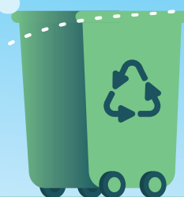
Work in groups of 3-4
Let’s guess Who I am?
RECYCLING BIN
I live in every building.
I eat waste.
I am a container.
Waste in my body will be recycled.

Slide 7
Answer the Questions
1. What kinds of rubbish can be recycled?
2. Is rubbish sorted in households in Vietnam?

Slide 8

New words
a yoghurt pot
an apple core
a jam jar
a banana skin
a can of cola
batteries
magazines

Slide 9
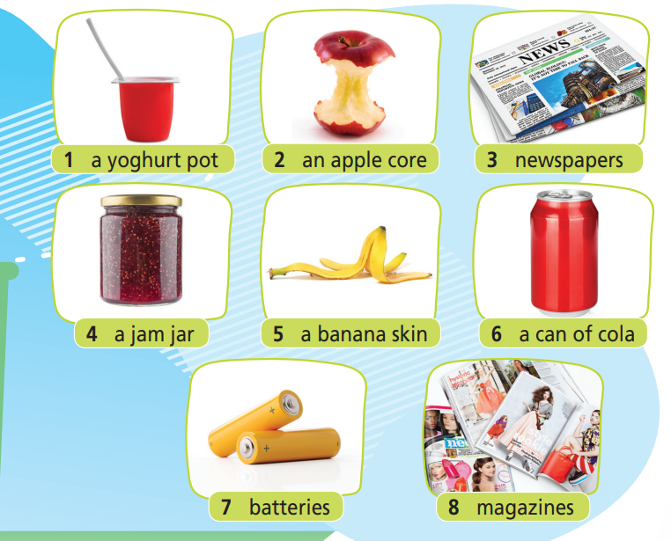
Work in pairs. Match each picture with the correct word or phrase.
a jam jar
a banana skin
a yoghurt pot
a jam jar
batteries
magazines
an apple core
newspapers
a can of cola

Slide 10

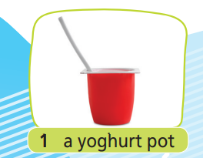
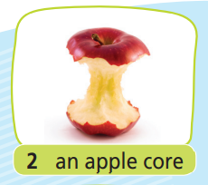

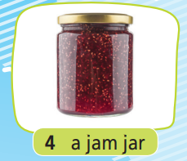



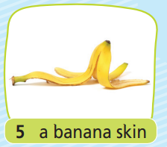
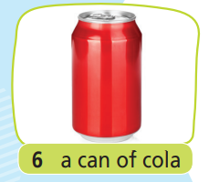
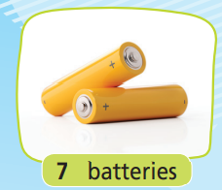




Click on each picture to hear the sound. Listen and repeat.

Slide 11
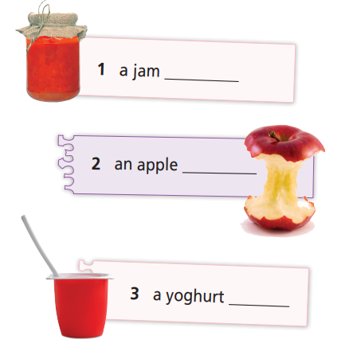
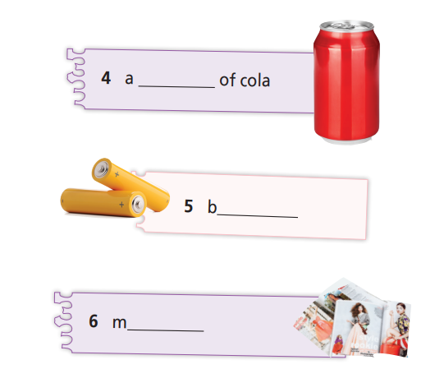
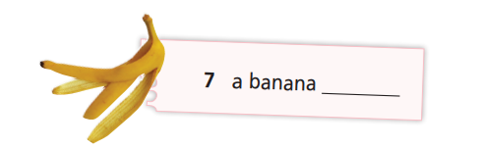
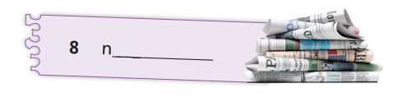
WB p. 50
jar
can
core
atteries
pot
agazines
skin
ewspapers

Slide 12
NB p. 47
Match each word/phrase with the suitable definition.
a jam jar
a banana skin
a yoghurt pot
batteries
magazine
an apple core
newspapers
a can of cola
things that give electricity for toy, radio or cars to make them work
a deep, round container for yoghurt
the outer part that covers the banana
the middle part of an apple, where the seeds are
a kind of thin book with a paper cover and many different stories and pictures inside that you can buy every week or every month
a glass container for jam
a large piece of paper with news or other things people print on them
a metal container for cola

Slide 13
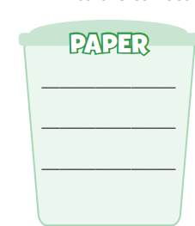

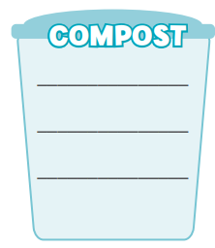
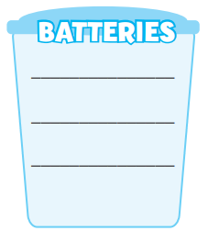
WB p. 50
Work in groups of 3-4. Put the items in Exercise 1 into the correct recycling bins. Say sentences as in the example.
E.g. We can put yoghurt pots, jam jars and cans of cola into the plastic, metal & glass recycling bin.
a jam jar
a banana skin
a yoghurt pot
a jam jar
batteries
magazines
an apple core
newspapers
a can of cola
newspapers
A banana skin
batteries
magazines
A can of cola
An apple core
A yoghurt pot
A jam jar

Slide 14

Listening

Slide 15
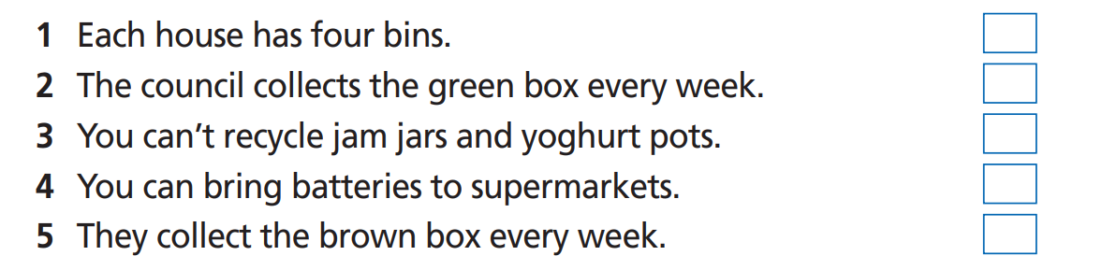
Pre-Listening
Read the instruction quickly. Underline the key words. What are we going to do?
Listen and decide if the statements (1-5) are R (right) or W (wrong)

Slide 16

While-Listening
Now listen and choose R or W.  FIRST TIME
☞ YOUR ANSWER?
☞ WHY?

Slide 17
While - listening
Now listen again and check.  SECOND TIME
While you are listening, focus on what the speaker explains.
I’m here to explain how our recycling system works. Each house has four bins: a big grey one, a big blue one and two boxes, one brown and one green.
☞ THE ANSWER IS …
R

Slide 18
While - listening
Now listen again and check.  SECOND TIME
While you are listening, focus on what the speaker explains.
Put all your paper in the green box: newspapers and magazines. We collect the green box every two weeks.
☞ THE ANSWER IS …
W

Slide 19
While - listening
Now listen again and check.  SECOND TIME
While you are listening, focus on what the speaker explains.
Make sure you wash these items, please! We don’t want dirty jam jars and yoghurt pots at our recycling centres!
☞ THE ANSWER IS …
W

Slide 20
While - listening
Now listen again and check.  SECOND TIME
While you are listening, focus on what the speaker explains.
Unfortunately, you can’t put batteries into the blue bin; you can take them to any supermarket.
☞ THE ANSWER IS …
R

Slide 21
While - listening
Now listen again and check.  SECOND TIME
While you are listening, focus on what the speaker explains.
The brown box is a compost bin. We pick this up once a month. Finally, we collect the grey bin every week.
☞ THE ANSWER IS …
W

Slide 22
Extra-Practice
Pre-Listening
Read the instruction and questions quickly. Underline the key words. What are we going to do?
Listen and choose the correct answer.
3. Where can you put your jam jars?
a. The blue bin
The green bin
The brown bin
The grey bin
4. What should you do with dirty yoghurt pots?
Bring them to the recycling centres
Put them in the white bin
Wash them
5. The rubbish which can’t be recycled is collected
Every day
Once a week
Once a month
What are the colors of the recycling bins?
green, blue, grey, brown
Grey, black, blue, green
Grey, blue, brown, white
2. Where can you put your newspapers?
The blue bin
The green bin
The brown bin

Slide 23
While - listening
Now listen and choose the correct answer.  FIRST TIME
3. Where can you put your jam jars?
The blue bin
The green bin
The brown bin
The grey bin
4. What should you do with dirty yoghurt pots?
Bring them to the recycling centres
Put them in the white bin
Wash them
5. The rubbish which can’t be recycled is collected
Every day
Once a week
Once a month
☞ YOUR ANSWER?
What are the colors of the recycling bins?
green, blue, grey, brown
Grey, black, blue, green
Grey, blue, brown, white
2. Where can you put your newspapers?
The blue bin
The green bin
The brown bin

Slide 24
While - listening
Now listen again and check.  SECOND TIME
While you are listening, focus on what the speaker explains.
Each house has four bins: a big grey one, a big blue one and two boxes, one brown and one green.
What are the colors of the recycling bins?
green, blue, grey, brown
Grey, black, blue, green
Grey, blue, brown, white
☞ WHY?

Slide 25
While - listening
Now listen again and check.  SECOND TIME
While you are listening, focus on what the speaker explains.
Put all your paper in the green box: newspapers and magazines.
2. Where can you put your newspapers?
a. The blue bin
b. The green bin
c. The brown bin
☞ WHY?

Slide 26
While - listening
Now listen again and check.  SECOND TIME
While you are listening, focus on what the speaker explains.
We also collect the big blue bin on the same day. That one is for plastic, metal and glass. Make sure you wash these items, please! We don’t want dirty jam jars and yoghurt pots at our recycling centres!
3. Where can you put your jam jars?
a. The blue bin
b. The green bin
c. The brown bin
d. The grey bin
☞ WHY?

Slide 27
While - listening
Now listen again and check.  SECOND TIME
While you are listening, focus on what the speaker explains.
Make sure you wash these items, please! We don’t want dirty jam jars and yoghurt pots at our recycling centres!
4. What should you do with dirty yoghurt pots?
a. Bring them to the recycling centres
b. Put them in the white bin
c. Wash them
☞ WHY?

Slide 28
While - listening
Now listen again and check.  SECOND TIME
While you are listening, focus on what the speaker explains.
Finally, we collect the grey bin every week. It’s for the rubbish you can’t recycle.
5. The rubbish which can’t be recycled is collected
a. Every day
b. Once a week
c. Once a month
☞ WHY?

Slide 29
Post-Listening
Work in groups of 3 – 4.
Design a poster to encourage people to recycle the rubbish.
Present and display your poster around the class
Students vote the best one.
REQUIREMENTS
At least 6 words/phrases from the lesson included
At least 30 words
Effective use of illustrations

Slide 30

CONSOLIDATION

Slide 31
Write at least 4 sentences to describe how you are going to recycle the rubbish. Write at least 40 words
Remember to include:
1. What kinds of rubbish are you going to recycle?
2. How are you going to set up the recycling bins at home?
3. How are you going to encourage others to recycle?

Slide 32

WRAP-UP

Slide 33
Today’s lesson
Vocabulary
a jam jar
a banana skin
a yoghurt pot
a jam jar
batteries
magazines
an apple core
newspapers
a can of cola
Language skills
Listening: listen for details.
Speaking: talk about recycling.
Writing: design a poster.

Slide 34
Homework
Practice the vocabularies and make sentences using them.
Prepare the next lesson (page 101 SB).
Do the exercise in TA 7 Right On Notebook (page 47).
Do the exercise in TA 7 Right On Workbook (page 50).

Slide 35

Enjoy your day!

