Slide 1

Unit 6: Be green
Lesson 6d: Everyday English
Page 101

Slide 2
Lesson Outline
Warm-up
Pronunciation
Practice
Speaking
Consolidation
Wrap-up

Slide 3
Objectives
By the end of this lesson, students will be able to…
- learn and practise word stress.
- act out a dialogue asking for suggestions, agreeing/disagreeing.

Slide 4

WARM-UP

Slide 5
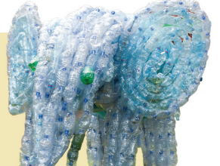
WARM UP
Tell the exact word for each picture.
5
4
3
2
1
Time is up
plastic

Slide 6

WARM UP
Tell the exact word for each picture.
5
4
3
2
1
Time is up
cola

Slide 7
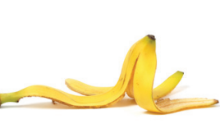
WARM UP
Tell the exact word for each picture.
5
4
3
2
1
Time is up
banana

Slide 8
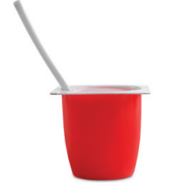
WARM UP
Tell the exact word for each picture.
yoghurt
5
4
3
2
1
Time is up

Slide 9
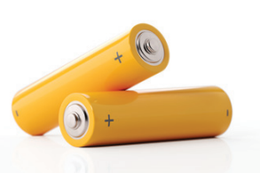
WARM UP
Tell the exact word for each picture.
batteries
5
4
3
2
1
Time is up

Slide 10

WARM UP
Tell the exact word for each picture.
5
4
3
2
1
Time is up
magazine

Slide 11
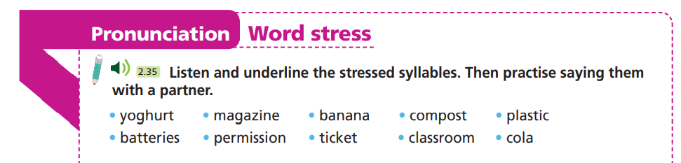


Slide 12












Extra-task
Choose the word whose main stress is placed
differently from the others.
Work in pairs.
A. ancient B. display C. damage D. statue
A. preserve B. support C. fortress D. reduce
A. monument B. ambulance C. pollution D. celebrate

Slide 13

Speaking

Slide 14
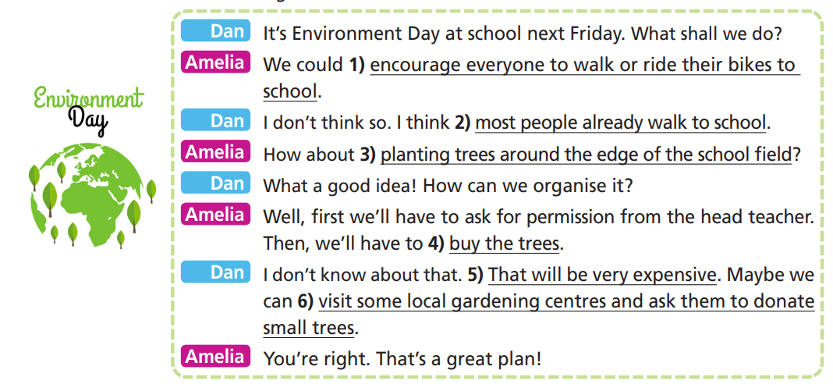
Listen and read the dialogue. What are Amelia’s suggestions?
To walk or ride their bikes to school and to plant trees around the edge of the school field.

Slide 15
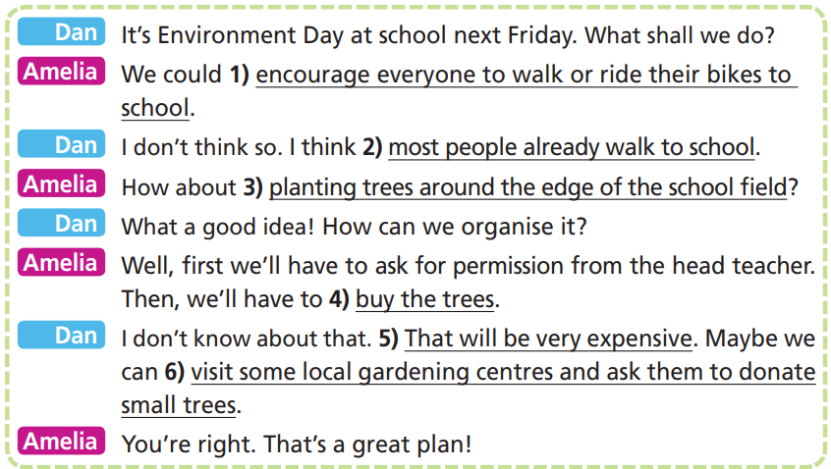
Pre-Speaking
Which phrases/sentences do we use to ask for suggestions? Make suggestions? to agree? to disagree?

Slide 16
Pre-Speaking
Asking for suggestions
Making suggestions
Agreeing
Disagreeing
What shall we do?
Do you have any ideas?
We could + V…
How about + V-ing…?
What about + Ving…?
Maybe we can + V…
What a good idea! You’re right.
I don’t think so.
I don’t know about that

Slide 17
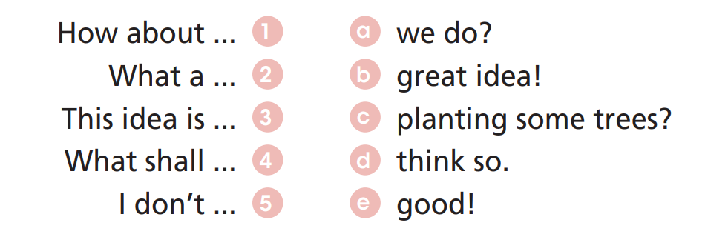
Pre-Speaking
Extra Practice – wb p. 51
Match to form complete sentences.

Slide 18
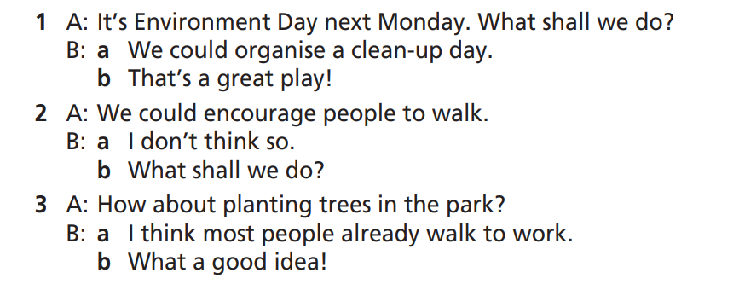
Pre-Speaking
Extra Practice – WB p. 51
Choose the correct response.

Slide 19
Pre-Speaking
Listen to the dialogue again. Underline the sentence stress,
mark the intonation and word stress as the given example.

Slide 20
While-Speaking
Work in pairs. Read the dialogue aloud.

Slide 21

While-Speaking
Act out a dialogue similar to the one in Exercise 1. Use the
prompts below. Mind the sentence stress and intonation.
Dan: It’s Environment Day at school next Friday. What shall we do?
Amelia: We could ______________________.
Dan: I don’t think so. I think ______________.
Amelia: How about _____________________?
Dan: What a good idea! How can we organise it?
Amelia: Well, first we’ll have to ask for permission from the head teacher. Then, we’ll have to _______.
Dan: I don’t know about that. _____________.
Maybe we can _________________________.
Amelia: You’re right. That’s a great plan!
1. encourage everyone to recycle at home
2. most people already recycle at home
3. putting recycling bins around the school
4. buy big bins to put outside the school
5. people won’t use them
6. put small bins in each classroom for paper and big bins for plastic and metal around the school
1
2
3
6
4
5

Slide 22
While-Speaking
Imagine it’s Recycling Week at our school next week. Work with your partner to discuss what you can do together. Remember to use the Expressions.
Making suggestions
Agreeing
Disagreeing
Asking for suggestions
What shall we do?
Do you have any ideas?
We could + V…
How about/What about+ V-ing…?
What about + Ving…?
Maybe we can + V…
What a good idea!
You’re right.
I don’t think so.
I don’t know about that
It’s Recycling Week at school next week. What shall we do?
We could….
I don’t think so. I think….
How about…..?
What a good idea!

Slide 23

CONSOLIDATION

Slide 24
It’s Recycling Week at our school next week. Do you have any ideas? Each pair share the idea that you have discussed. The class vote the best one.
Remember to include the expressions for making your suggestions, agreeing and disagreeing.

Slide 25

WRAP-UP

Slide 26
Today’s lesson
Pronunciation
Practice word stress.
Speaking
Practise asking for/making suggestions, agreeing and disagreeing.

Slide 27
Homework
Learn by hearts vocabularies and make sentences using them.
Do the exercises on page 51 WB.
Prepare the next lesson (page 102 SB).

Slide 28
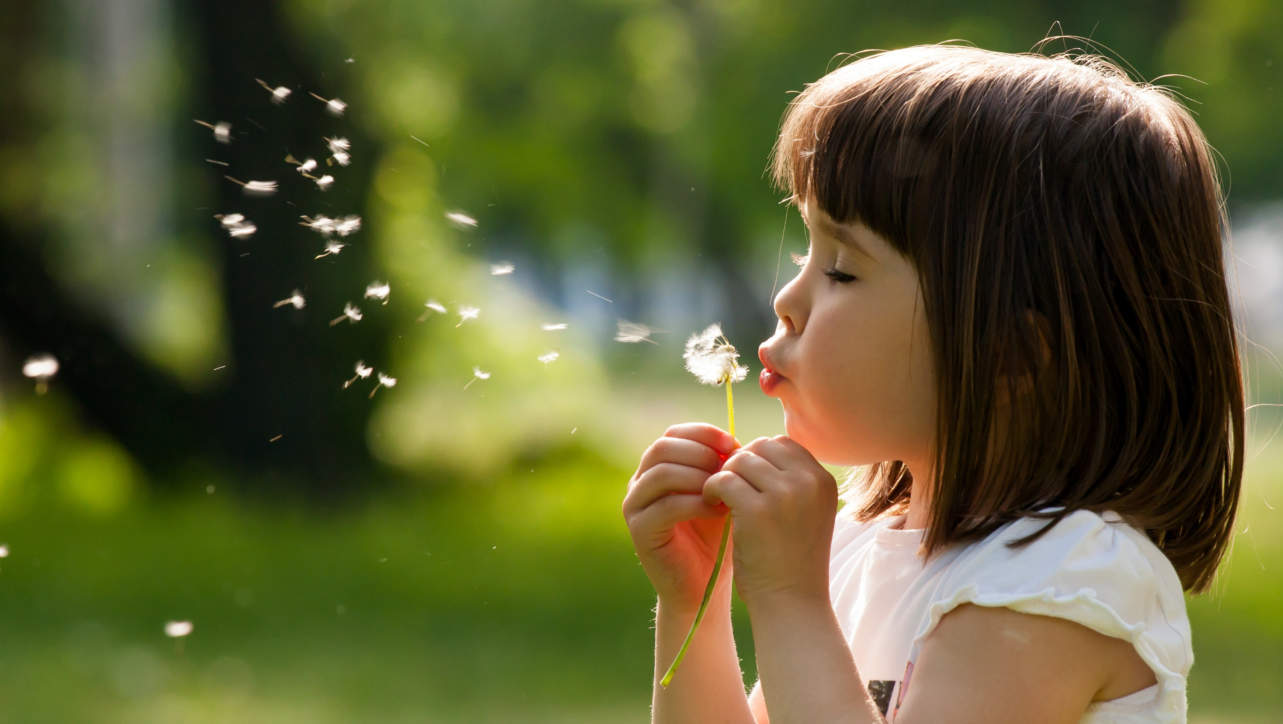
Enjoy your day!

