Slide 1

Unit 5: Around Town
Lesson 3.2: Reading, Speaking, & Writing
Page 45

Slide 2
Lesson Outline
Warm-up
Pre-Writing: Reading
Pre-Writing: Speaking
Writing
Consolidation
Wrap-up

Slide 3
Objectives
By the end of this lesson, students will be able to…
- read an article about Vietnamese food.
- talk about food around the world.
- write a paragraph about famous dishes.

Slide 4

WARM-UP

Slide 5

Work in pairs.
Pick out one redundant letter in each word to make the correct words
1. dishwes
2. herubs
3. riceo
4. seatfood
5. powrk

Slide 6
Work in pairs.
Answers
1. dishwes
2. herubs
3. riceo
4. seatfood
5. powrk
1. dishes
2. herbs
3. rice
4. seafood
5. pork
ANSWER

Slide 7

Presentation

Slide 8

Reading

Slide 9
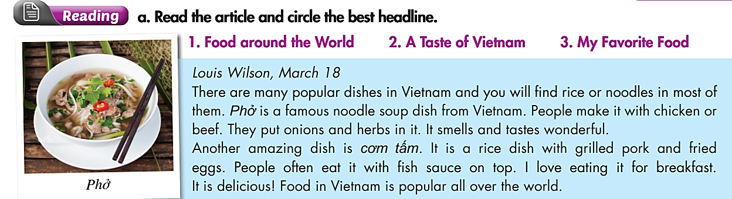
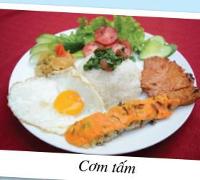
Pre-Reading
What dishes are they?
- Phở and cơm tấm.
What are you going to do?
- Read the article and circle the best headline.

Slide 10
Pre-Reading
Underline the key words and guess what the best headline is.
a. Read the article and circle the best headline.
Food around the World
A Taste of Vietnam
My Favorite Food

Slide 11
While-Reading
Skim the article and underline the key words.
Louis Wilson, March 18
There are many popular dishes in Vietnam and you will find rice or noodles in most of them. Phở is a famous noodle soup dish from Vietnam. People make it with chicken or beef. They put onions and herbs in it. It smells and tastes wonderful.
Another amazing dish is cơm tấm. It is a rice dish with grilled pork and fried eggs. People often eat it with fish sauce on top. I love eating it for breakfast.
It is delicious! Food in Vietnam is popular all over the world.

Slide 12
The best headline is
While-Reading
Food around the World
2. A Taste of Vietnam
3. My Favorite Food

Slide 13
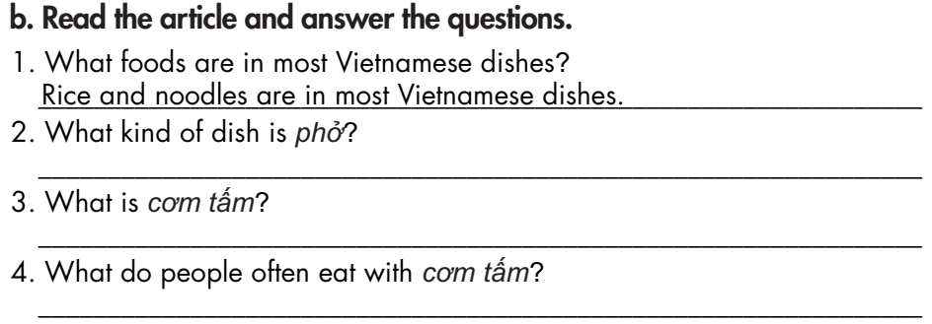
Pre-Reading
How many questions are there?
- Four.
What are you going to do?
- Read the article and answer the questions.

Slide 14
Pre-Reading
Skim the article again and underline the key words.
(1)
Louis Wilson, March 18
There are many popular dishes in Vietnam and you will find rice or noodles in most of them. Phở is a famous noodle soup dish from Vietnam. People make it with chicken or beef. They put onions and herbs in it. It smells and tastes wonderful.
Another amazing dish is cơm tấm. It is a rice dish with grilled pork and fried eggs. People often eat it with fish sauce on top. I love eating it for breakfast.
It is delicious! Food in Vietnam is popular all over the world.
(2)
(3)
(4)

Slide 15
While-Reading
Read the article and answer the questions.
1. What foods are in most Vietnamese dishes?
_________________________________________________ .
2. What kind of dish is phở?
_________________________________________________.
3. What is cơm tấm?
_________________________________________________ .
4. What do people often eat with cơm tấm?
_________________________________________________ .
Rice and noodles are in most Vietnamese dishes.
It is a noodle soup dish.
It is a rice dish with grilled pork and fried eggs.
People often eat it with fish sauce on top.

Slide 16

Practice

Slide 17

Speaking

Slide 18

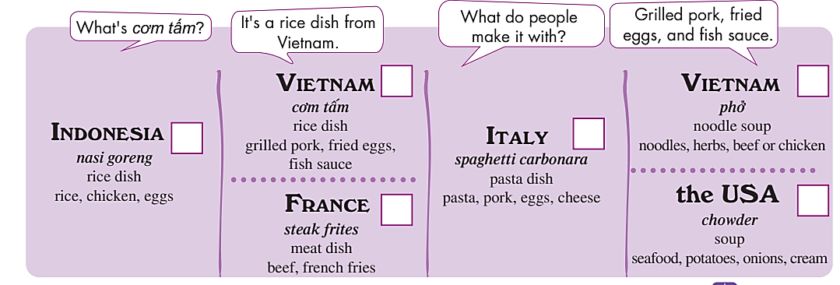
Pre-Speaking
Work in pairs.
Food around the World
You're visiting an international food festival. Work in pairs. Student A,
ask Student B about four of the dishes below and tick (✓) the ones you
would like to try. Student B, answer the questions.
Where are you?
→ At an international food festival.
What are you going to do?
→ A: asks about four of the dishes – B: answers.

Slide 19

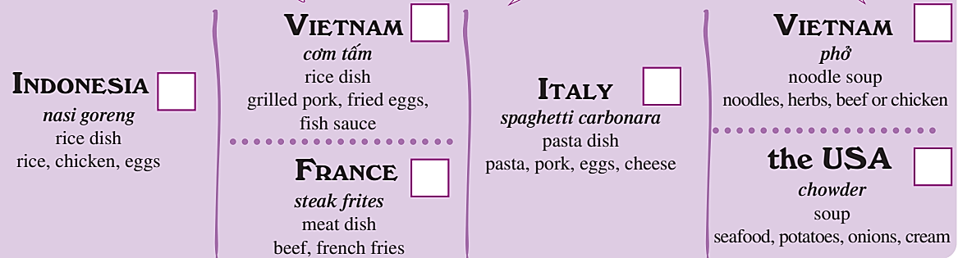
Work in pairs.
While-Speaking
Student A - asks about the dishes
Student B - answers

Slide 20
STUDENT A
STUDENT B
What’s cơm tấm?
It’s a rice dish from Vietnam.
What do people make it with?
Grilled pork, fried eggs, and fish sauce.
Thank you very much.
You’re welcome.

Slide 21

Work in pairs.
While-Speaking
Swap roles and repeat. How many dishes would you like to try? Which is your favorite?
Student A - answers about the dish
Student B - asks about the dish

Slide 22
STUDENT A
STUDENT B
What do you want to know?
Yes, what’s nasi goreng?
It’s a rice dish.
What do people make it with?
Rice, chicken, and eggs.
Thank you very much.

Slide 23

Production

Slide 24

Writing

Slide 25
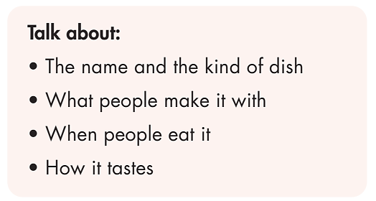
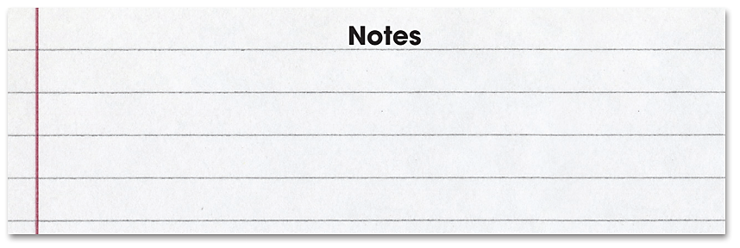
Work in pairs.
Pre- writing
Choose two of the dishes from your country and make notes.

Slide 26
Pre-writing
Make notes.
Talk about:
• The name and the kind of dish
• What people make it with
• When people eat it
• How it tastes
Note
___________________
___________________
___________________
___________________
Cơm hến
Rice, vegetables, mussels.
all meals
delicious

Slide 27
Post - writing
Make notes.
Talk about:
• The name and the kind of dish
• What people make it with
• When people eat it
• How it tastes
Note
____
___________________
___________________
___________________
Bánh Mì
Bread, vegetables, pork sausage
all meals
tasty

Slide 28
Model paragraph
While-writing
Vietnam has many famous dishes and my favorite one is Cơm hến. Cơm hến is the specialty of Hue. People make it with rice, vegetables, and mussels. They also put some crispy fried pork fat, a little roasted peanuts, a little chili pepper, and herbs in it. It smells and tastes delicious.

Slide 29

CONSOLIDATION

Slide 30
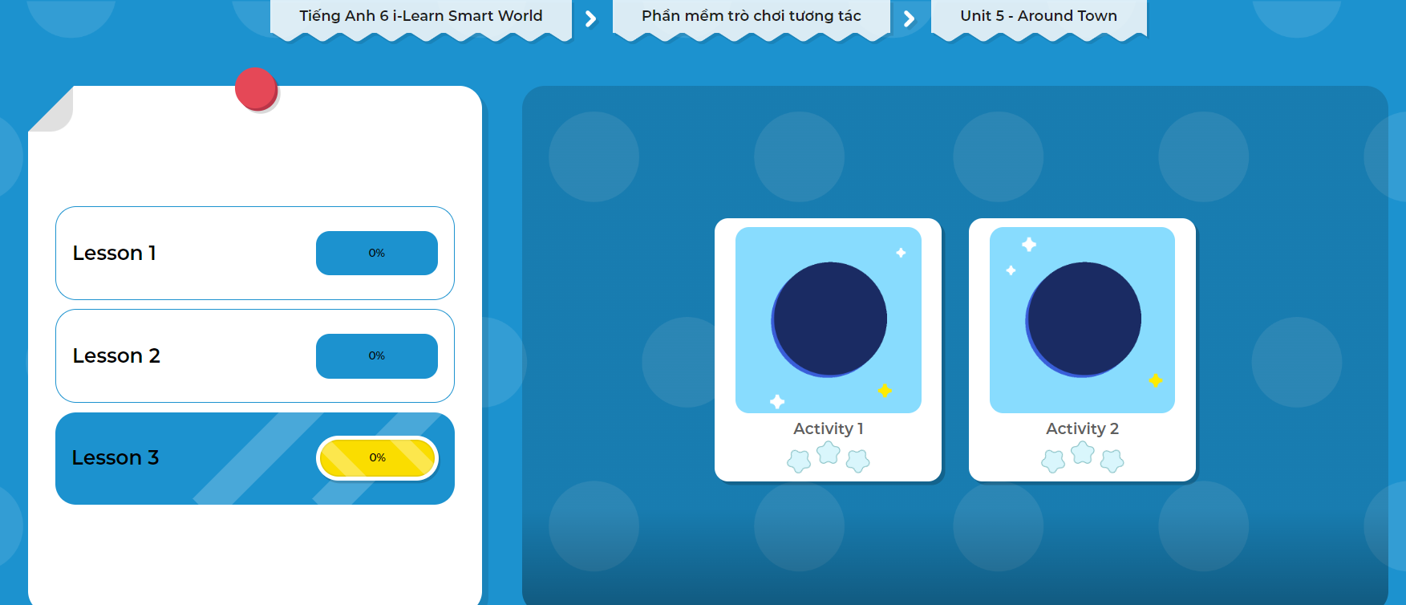
LET’S PLAY!
Click on the picture below to play the games!

Slide 31
Extra Practice
WB, page 31
Work in pairs.
Write a paragraph about a famous dish from Italy. Use the information below to help you. Write 50 to 60 words.
• Spaghetti Bolognese – Italy
• tomatoes, herbs, beef, onions – cheese on top

Slide 32

WRAP-UP

Slide 33
Today’s lesson
Reading: an article about Vietnamese food.
Speaking: talk about food around the world.
Writing: write a paragraph about famous dishes.

Slide 34
Homework
Practice asking and answering about food around the world.
Do the exercises in Tiếng Anh 6 i-Learn Smart World Notebook on page 31.
Prepare the next lesson (pages 94 & 95 - SB).
Play the consolidation games in Tiếng Anh 6 i-Learn Smart World DHA App on www.eduhome.com.vn.

Slide 35

Enjoy your day!

