Slide 2

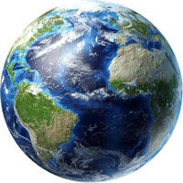
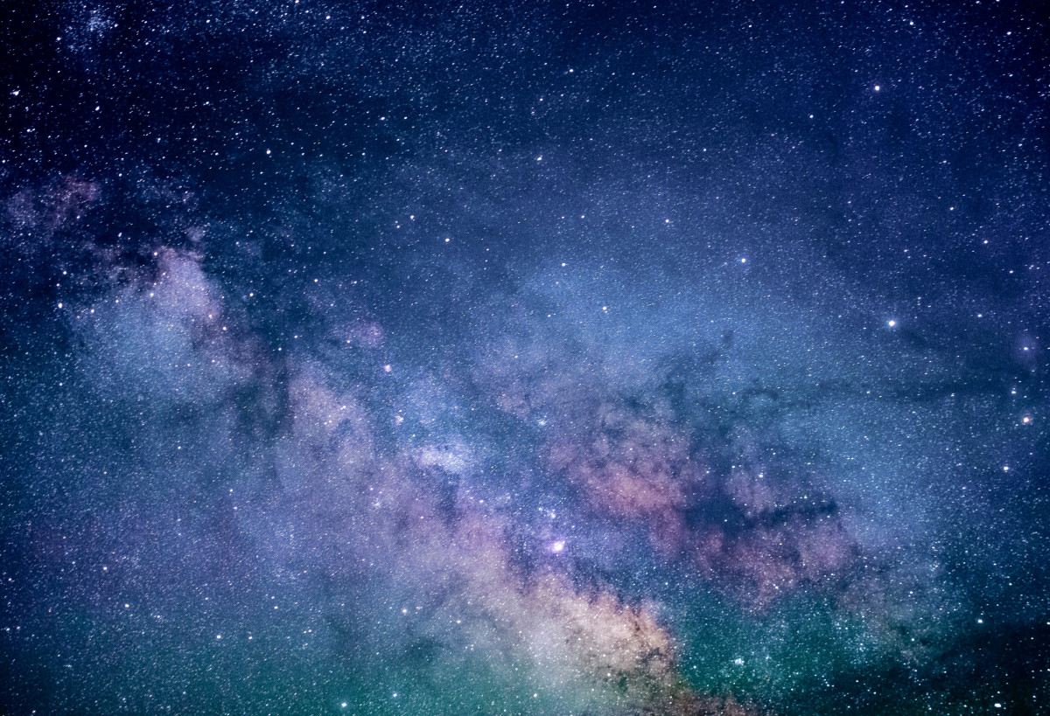



Unit
10
PLANET EARTH
LESSON 4: COMMUNICATION

Slide 3
Unit
10
PLANET EARTH
LESSON 4: COMMUNICATION

Slide 4

OBJECTIVES
By the end of the lesson, students will be able to:
Persuade someone to do something and responding to persuasions;
Read for general and specific information about flora and fauna.

Slide 5
LESSON 4: COMMUNICATION
LESSON 1: GETTING STARTED
Option 1: Brain storming
Option 2: Headline Hysteria
WARM-UP
Task 1: Listen and read the conversations. Pay attention to the highlighted parts.
Task 2: Work in pairs. Make similar conversations with the following situations.
EVERYDAY ENGLISH
Task 3: Read the short descriptions of various habitats and match them with their features.
Task 4: Work in pairs. Choose two habitats and compare them.
Task 5: Report the results of your comparison to the class.
EARTH’S HABITATS
CONSOLIDATION
Wrap-up
Homework

Slide 6
WARM-UP
OPTION 1
BRAIN STORMING
Ss work in groups to take turns adding appropriate
non-defining relative clause to each sentence on the
board.
The group that has the most sentences with correct
non-defining relative clause embedded wins.

Slide 7
WARM-UP
OPTION 1
Example:
The Mekong River, which is the longest river in Southeast Asia, has a length of about 4900km.

Slide 8

WARM-UP
OPTION 2
Headline Hysteria

Slide 9
WARM-UP
OPTION 2
How to play:
There is a hot-button issue or a controversial
statement on the board.
Work in groups to create compelling headlines
that take opposing stances on the issue.
Use strong verbs, evocative language, and
attention-grabbing wordplay.

Slide 10
WARM-UP
OPTION 2
Topic: Should homework be banned?
Example:
Homework: Friend or Foe? The Amazing Tale You've Never Heard.

Slide 11
LESSON 4: COMMUNICATION
LESSON 1: GETTING STARTED
Option 1: Brain storming
Option 2: Headline Hysteria
WARM-UP
Task 1: Listen and read the conversations. Pay attention to the highlighted parts.
Task 2: Work in pairs. Make similar conversations with the following situations.
EVERYDAY ENGLISH
Task 3: Read the short descriptions of various habitats and match them with their features.
Task 4: Work in pairs. Choose two habitats and compare them.
Task 5: Report the results of your comparison to the class.
EARTH’S HABITATS

Slide 12

EVERYDAY ENGLISH
1
Listen and read the conversations. Pay attention to the highlighted parts.
1
Mi: Have you read this book about the Solar System?
Tom: Not yet. I don’t feel like reading it.
Mi: Why don’t you give it a go? You will like it.
Tom: OK, I’ll think about that.
2
Lan: How would you feel about contributing to the fund to protect our wildlife?
Local resident: Contribute to a fund?
Lan: Yes, your contribution would really help us out.
Local resident: Alright. I’ll make a contribution.

Slide 13
EVERYDAY ENGLISH
Structures
Persuade someone to do something:
Why don’t you give it a go?
Respond:
Ok, I’ll think about that.
When the persuasion is more specific with a specific verb like contributing in
How would you feel about contributing …
Respond:
Alright. I’ll contribute some.

Slide 14
EVERYDAY ENGLISH
2
Work in pairs. Make similar conversations with the following situations.
- Work in pairs to make similar dialogues, using the
language you have learnt.
- Then, swap roles.
1. You ask your friend for permission to borrow a book on the Galápagos Islands
2. You ask your teacher for permission to submit your project after the deadline.

Slide 15
You: Hey, heard of "Planet Earth"? It's this insane doc about our crazy planet.
Friend: Scoffs Pfff, sounds more like "Animal Planet After Dark." Not really my scene.
You: No, trust me! It's like an extreme nature travel program. Why don't you give it a go?
Friend: Hmm, you got me curious. Okay, I'll think about it.
EVERYDAY ENGLISH
2
Work in pairs. Make similar conversations with the following situations.
1
1. You persuade your friend to watch a
movie about planet Earth.
2. You persuade local people to contribute
to a fund to build a nature reserve.

Slide 16
EVERYDAY ENGLISH
Example:
1
A: Have you watched ‘Blue Planet” yet?
B: Not yet. I don’t like watching it much.
A: Why don’t you give it a go? You will like it.
B: OK, I’ll think about that.
You: Hi, B! Have you heard about the plans for a new nature reserve? Imagine we could have hiking trails, a butterfly garden... wouldn't that be lovely?
B: It sounds peaceful, dear. But these things cost money, and times are tight.
You: True, but how would you feel about contributing to the plans to make our lives better?
B: Alright, I'll contribute some.

Slide 17
EVERYDAY ENGLISH
Example:
2
A: How would you feel about contributing to the fund
to build a nature reserve?
B: Contribute to a fund?
A: Yes, your contribution would really help us out.
B: Alright. I’ll make a contribution.

Slide 18
Transition from Everyday English to Earth’s habitats.
Situation:
You persuade your peer to read about the Earth’s habitats.
Dialogue:
Mi: Have you read this book about the Earth’s habitats?
Tom: Not yet. I don’t feel like reading it.
Mi: Why don’t you give it a go? You will like it.
Tom: Ok, I’ll think about that.
We will have a chance to read about some of the Earth’s habitats.

Slide 19
EARTH’S HABITATS
3
Read the short descriptions of various habitats and match them with their features.
include the North Pole and the South Pole. These habitats are covered in ice and extremely cold and dry. Animals here include small fish, polar bears, penguins, leopard seals, etc.
Polar habitats
- Work in pairs to read the posts to match the main idea of each post with the name of the habitat.
include tropical forests, temperate forests, and boreal forests. They are considered the Earth’s lungs because they produce oxygen. They also provide homes to bats, owls, deer, squirrels, foxes, lizards, etc.
Forest habitats

Slide 20
EARTH’S HABITATS
include the Pacific, Atlantic, Indian, Southern, and Arctic Oceans. They produce more than 50 per cent of Earth’s oxygen and help adjust the climate. They provide living places for plants like sea grasses, microscopic algae, and fish, etc.
Polar habitats
include the North Pole and the South Pole. These habitats are covered in ice and extremely cold and dry. Animals here include small fish, polar bears, penguins, leopard seals, etc.
Ocean habitats
3
include tropical and temperate ones. The main plants are grasses. They are crucial for grazing livestock. Grassland animals include giraffes, zebras, lions, elephants, etc.
include tropical forests, temperate forests, and boreal forests. They are considered the Earth’s lungs because they produce oxygen. They also provide homes to bats, owls, deer, squirrels, foxes, lizards, etc.
Grasslands
Forest habitats

Slide 21
EARTH’S HABITATS
Ocean habitats
include the Pacific, Atlantic, Indian, Southern, and Arctic Oceans. They produce more than 50 per cent of Earth’s oxygen and help adjust the climate. They provide living places for plants like sea grasses, microscopic algae, and fish, etc.
include the North Pole and the South Pole. These habitats are covered in ice and extremely cold and dry. Animals here include small fish, polar bears, penguins, leopard seals, etc.
Polar habitats
3
include tropical forests, temperate forests, and boreal forests. They are considered the Earth’s lungs because they produce oxygen. They also provide homes to bats, owls, deer, squirrels, foxes, lizards, etc.
Forest habitats
include tropical and temperate ones. The main plants are grasses. They are crucial for grazing livestock. Grassland animals include giraffes, zebras, lions, elephants, etc.
Grasslands

Slide 22
EARTH’S HABITATS
1. Polar regions | a. two main types and are crucial for livestock grazing | 1.
2. Forests | b. largest, produce oxygen and adjust the climate | 2.
3. Oceans | c. extremely cold, dry, covered in snow and ice | 3.
4. Grasslands | d. the lungs of Earth, home to many species | 4.
c
d
b
a

Slide 23
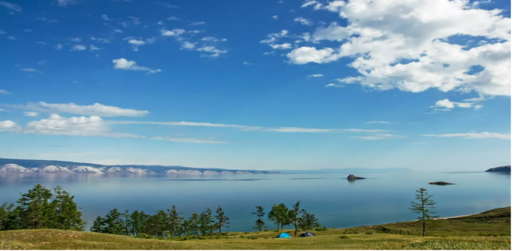
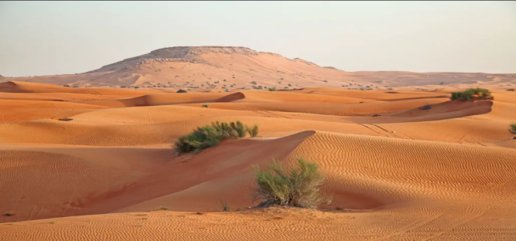
EXTRA ACTIVITY:
- There are two pictures of two other types of
habitats.
- Name them.
Then, ask and answer questions about additional
habitats, the types of flora and fauna, the special
features and roles of them.
SAHARA | BAIKAL
-largest one in the world -located in northern Africa -few plants and animals -little rain fall (<25 cm per year) -very hot and dry average temperature: 36o C, highest in summer: 56oC | - largest, oldest and deepest freshwater - located in Russia - home to approximately 1,700 to 1,800 plant and animal species - holds 20% of world fresh water. - cold (-21o C in winter and 11oC in summer)

Slide 24
EARTH’S HABITATS
SAHARA | BAIKAL
- largest one in the world - located in northern Africa - few plants and animals - little rain fall (<25 cm per year) - very hot and dry average temperature: 36º C, highest in summer: 56ºC | - largest, oldest and deepest freshwater - located in Russia - home to approximately 1,700 to 1,800 plant and animal species - holds 20% of world fresh water. - cold (-21º C in winter and 11ºC in summer)

Slide 25
EARTH’S HABITATS
4
Work in pairs. Choose two habitats and compare them.
- Suggested features:
- their specific types / examples
- their importance
- plants / animals living there
- other special features
 | HA LONG BAY | DA LAT HIGHLANDS
Specific types / examples | Limestone cliffs, turquoise waters, schools of fish, playful dolphins, coral reefs. | Lush tea plantations, crisp mountain air, wild orchids, colorful birds, misty valleys.
Importance | Cleans air, shields coast, cradles marine life. | Purifies water, offers respite from heat, contributes to scenic beauty.
Plants /animals living there | Coral reefs, fish, dolphins. | Tea plants, orchids, birds.
Other special features | Mist, ancient legends, sun-dappled depths. | Cool temperature, vibrant colors, bird songs.

Slide 26
Example:
 | HA LONG BAY | DA LAT HIGHLANDS
Specific types / examples | limestone cliffs, turquoise waters, schools of fish, playful dolphins, coral reefs | lush tea plantations, crisp mountain air, wild orchids, colorful birds, misty valleys
Importance | cleans air, shields coast, cradles marine life | purifies water, offers respite from heat, contributes to scenic beauty
Plants /animals living there | coral reefs, fish, dolphins | tea plants, orchids, birds
Other special features | Mist, ancient legends, sun-dappled depths. | Cool temperature, vibrant colors, bird songs.

Slide 27
EARTH’S HABITATS
5
Report the results of your comparison to the class.
- The representatives of some pairs report the comparison of the two habitats you have chosen.
- You can read the notes or talk to the class using the suggested features in 4.
- Use ideas from the posts in 3.
Imagine two colorful regions of our dear Vietnam: Da Lat and Ha Long Bay. In Ha Long Bay, limestone giants rise from turquoise waters, shrouded in mist and whispering ancient legends. while schools of silver fish dance in the sun-dappled depths. This watery wonderland cleans the air, shields the coast, and cradles a symphony of life, from playful dolphins to coral castles hidden beneath the waves. In stark contrast, Da Lat's highlands burst with vibrant life. Lush tea plantations blanket the hills, their scent mingling with the crisp mountain air. Wild orchids cling to ancient trees, while colorful birds flit through the canopy, their songs echoing through the valleys. This misty paradise purifies the water we drink, offers refuge from the scorching sun, and paints Vietnam's canvas with a touch of cool magic. Though worlds apart, both Ha Long Bay and Da Lat, with their unique beauty and ecological roles, remind us of Vietnam's rich tapestry of life and the importance of protecting it.

Slide 28
Example:
Imagine two colourful regions of our dear Vietnam: Da Lat and Ha Long Bay.
In Ha Long Bay, limestone giants rise from turquoise waters, shrouded in mist and whispering ancient legends while schools of silver fish dance in the sun-dappled depths. This watery wonderland cleans the air, shields the coast, and cradles a symphony of life, from playful dolphins to coral castles hidden beneath the waves. In stark contrast, Da Lat's highlands burst with vibrant life. Lush tea plantations blanket the hills, their scent mingling with the crisp mountain air. Wild orchids cling to ancient trees, while colourful birds flit through the canopy, their songs echoing through the valleys. This misty paradise purifies the water we drink, offers refuge from the scorching sun, and paints Vietnam's canvas with a touch of cool magic. Though worlds apart, both Ha Long Bay and Da Lat, with their unique beauty and ecological roles, remind us of Viet Nam's rich tapestry of life and the importance of protecting it.

Slide 29
LESSON 4: COMMUNICATION
LESSON 1: GETTING STARTED
Option 1: Brain storming
Option 2: Headline Hysteria
WARM-UP
Task 1: Listen and read the conversations. Pay attention to the highlighted parts.
Task 2: Work in pairs. Make similar conversations with the following situations.
EVERYDAY ENGLISH
Task 3: Read the short descriptions of various habitats and match them with their features.
Task 4: Work in pairs. Choose two habitats and compare them.
Task 5: Report the results of your comparison to the class.
EARTH’S HABITATS
CONSOLIDATION
Wrap-up
Homework

Slide 30

CONSOLIDATION
1
Wrap-up
What have we learnt in this lesson?
Persuade someone to do something and responding to persuasions.
Read for general and specific information about flora and fauna.

Slide 31

CONSOLIDATION
2
Homework
- Do exercises in the workbook.

Slide 32
Website: hoclieu.vn
Fanpage: facebook.com/www.tienganhglobalsuccess.vn/

