Slide 1


Slide 2


Unit
8
SHOPPING
LESSON 3: A closer look 2
1

Slide 3
LESSON 3: A CLOSER LOOK 2
WARM-UP
Brainstorming
PRESENTATION
- Adverbs of frequency
- Present simple for future events
Task 1: Complete the sentences.
Task 2: Underline the verbs. Answer the questions.
Task 3: Write A: a timetable, schedule or plan; and B: unplanned future action.
Task 4: Choose the correct answer.
PRACTICE
PRODUCTION
Task 5: Work in pairs. Ask and answer to check planned events for the community fair next month
CONSOLIDATION
Wrap-up
Homework

Slide 4
WARM-UP
BRAINSTORMING
List as many adverbs of frequency as possible

Slide 5
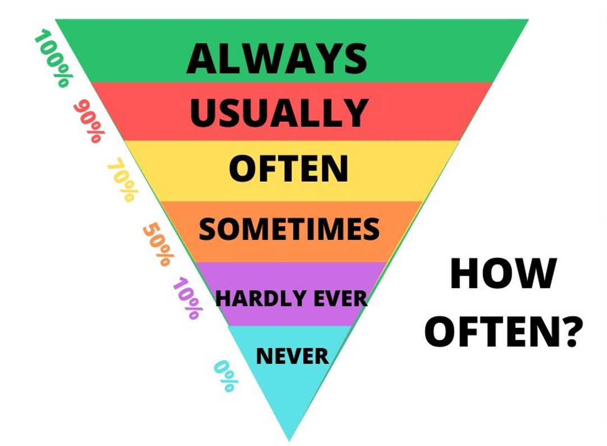
PRESENTATION
ADVERBS OF FREQUENCY

Slide 6
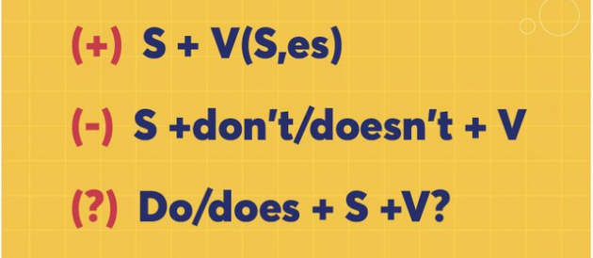
PRESENTATION
SIMPLE PRESENT FOR FUTURE EVENTS
USES
- Facts
- Habitual actions
- Future events

Slide 7
PRACTICE
1
Complete the sentences with the adverbs of frequency from the box.
always
often
sometimes
rarely
never
1. My mother________ shops at the supermarket. She never shops anywhere else.
2. I ________ buy things online, just once or twice a year. I prefer to shop at the shopping mall.
3. You can _______ bargain at a supermarket because the prices are fixed.
4. How ______ do you return things you buy online?
5. I don’t often buy things at the dollar store. My mother only takes me there __________.

Slide 8
PRACTICE
2
Read the schedule for the grade 8 field trip tomorrow, and underline the verbs in the sentences. Then answer the questions.
Field trip to the Double Dragon Chocolate Factory. 30 February
9:00 | The bus leaves.
10:00 | Students arrive at the factory
10:10 | Students watch a documentary introducing the factory.
10:30 | The tour of the factory starts.
12:10 | Students return to school to write the trip reports.
Present simple
What tense are the verbs in the sentences?
Are the sentences about habits or future activities?
Future activities

Slide 9
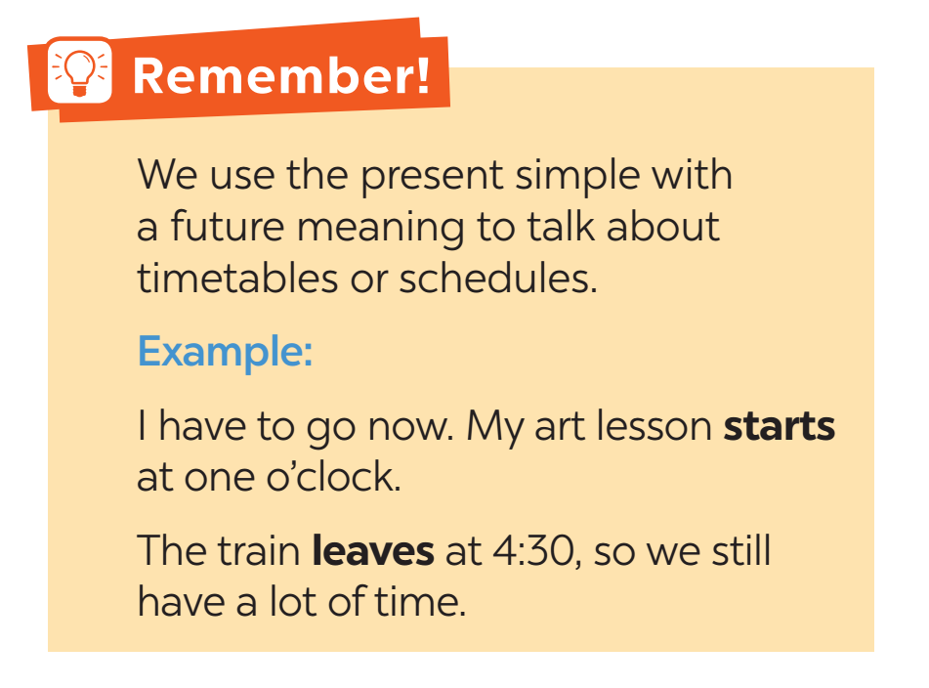
PRACTICE

Slide 10
PRACTICE
3
Write A next to a sentence if it relates to a timetable, schedule or plan, and B if it is an unplanned future action.
1. We’ll go to Costco to return this suitcase.
2. Look! We have a whole afternoon for shopping on the second day of our tour.
3. The summer sales end next Sunday.
4. Listen to the announcement. The train doesn’t leave till 12:00.
5. I’m too busy today, so we’ll go shopping on Tuesday.
B
A
A
A
B

Slide 11
PRACTICE
4
Choose the correct answer to complete each sentence.
1. The supermarket in my neighbourhood opens / will open longer hours than the one in yours.
2. Don’t worry. I make / will make a shopping list, and you just give it to the shop owner.
3. We don’t buy / won’t buy a birthday cake this year. We can bake one at home.
4. The bus schedule says that there is / will be a bus to Aeon at 10:05.
5. Look at the advertisement. Does / Will the big sale start next Friday?

Slide 12
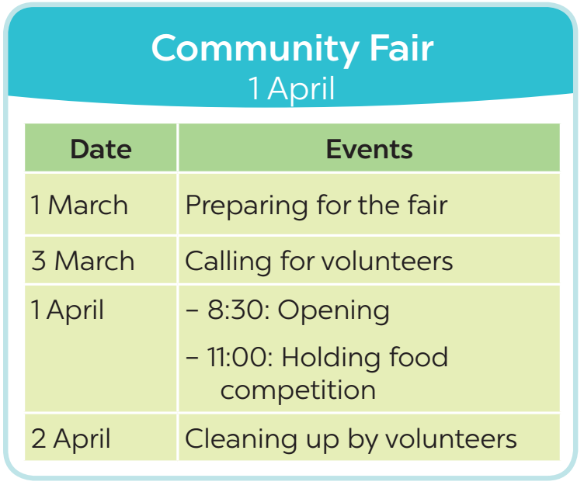
PRACTICE
5
Work in pairs. Ask and answer to check planned events for the community fair next month.
Example:
A: When do we start preparing for the fair?
B: We start on the first of March.

Slide 13
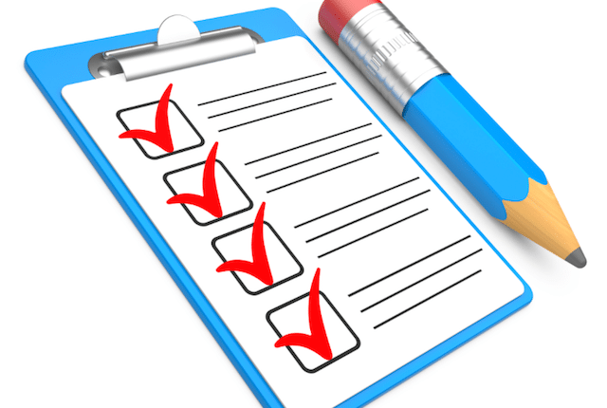
CONSOLIDATION
1
Wrap-up
What have we learnt in this lesson?
Recall adverbs of frequency
Present simple for future uses

Slide 14
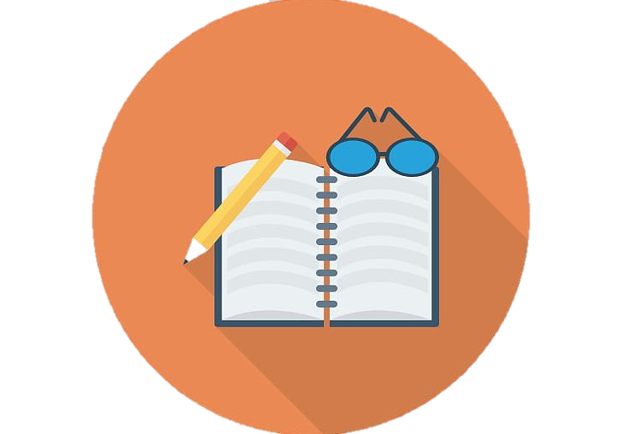
CONSOLIDATION
2
Homework
Learn the use of adverbs of frequency by heart.
Make 5 sentences of the simple present for future meaning
Do exercise in the Workbook

Slide 15

Website: hoclieu.vn
Fanpage: facebook.com/tienganhglobalsuccess.vn/

