Slide 1


Slide 2



Unit
6
A VISIT TO A SCHOOL
LESSON 2: A CLOSER LOOK 1
VOCABULARY
PRONUNCIATION
Unit
HOBBIES

Slide 3

OBJECTIVES
By the end of the lesson, students will be able to:
use the lexical items related to the topic School activities
correctly pronounce words that contain the sounds: /tʃ/ and /dʒ/

Slide 4
LESSON 2: A CLOSER LOOK 1
WARM-UP
Game: Pass the secret
Task 1: Match the words in columns A and B to form phrases. Then say them aloud.
Task 2: Complete the sentences with the phrases in 1. Task 3: Work in pairs. Answer the questions about your school.
VOCABULARY
Task 4: Listen and repeat the words. What letters can we use to make the /dʒ/ sound?
Task 5: Listen and repeat the chant. Pay attention to the sounds /tʃ/ and /dʒ/.
PRONUNCIATION
PRODUCTION
Game: Up and down
CONSOLIDATION
Wrap-up
Homework

Slide 5

LESSON 2: A CLOSER LOOK 1
WARM-UP
Game: Pass the secret
Aims of the stage:
to activate students’ knowledge

Slide 6
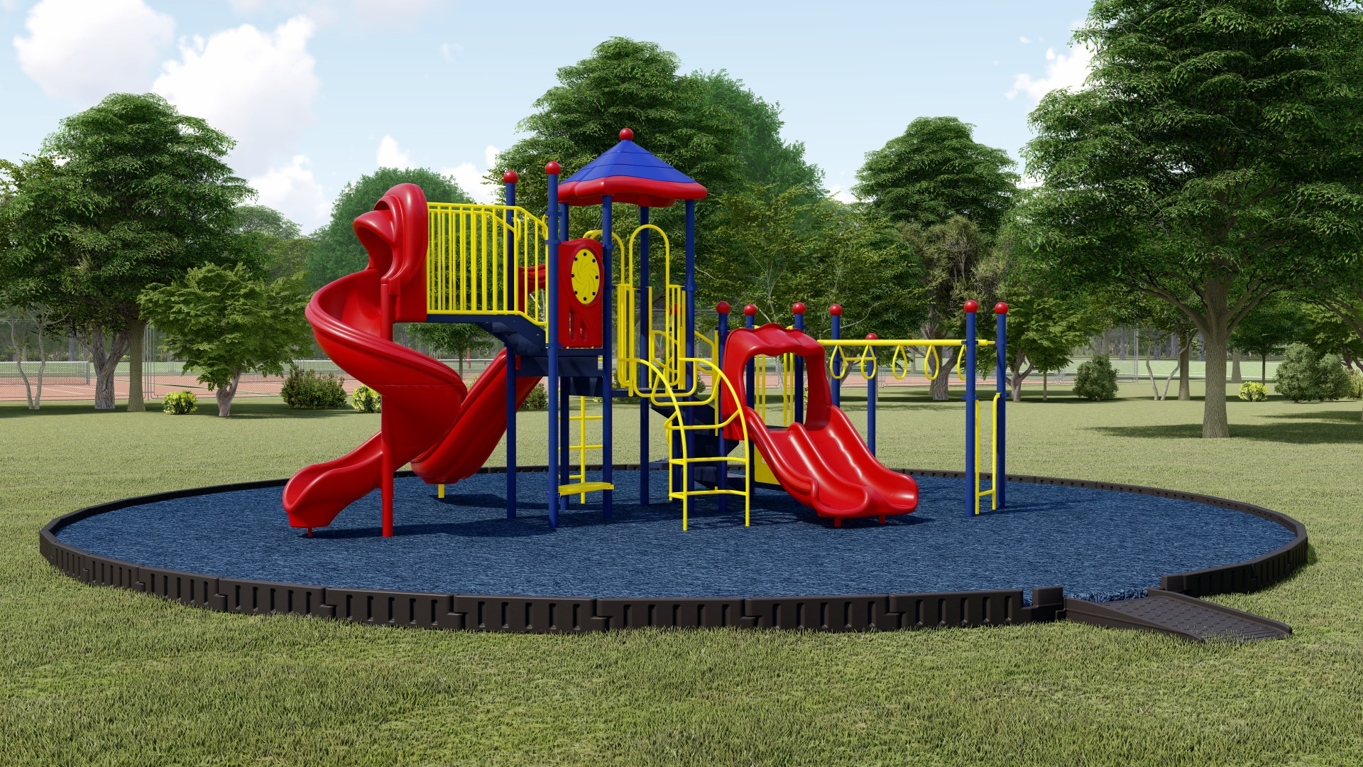
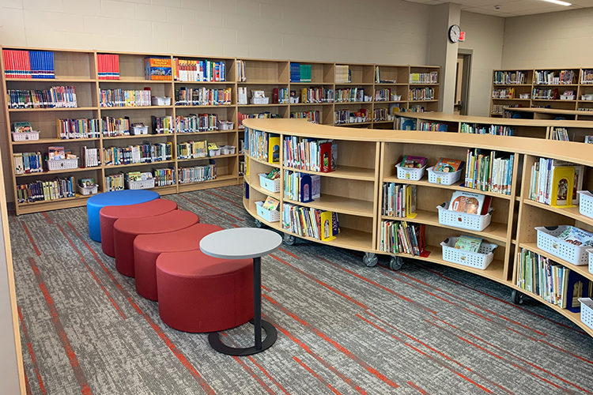
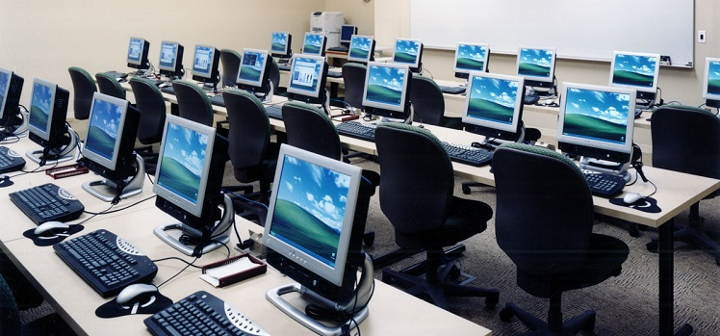
WARM-UP
school playground
school library
computer room

Slide 7
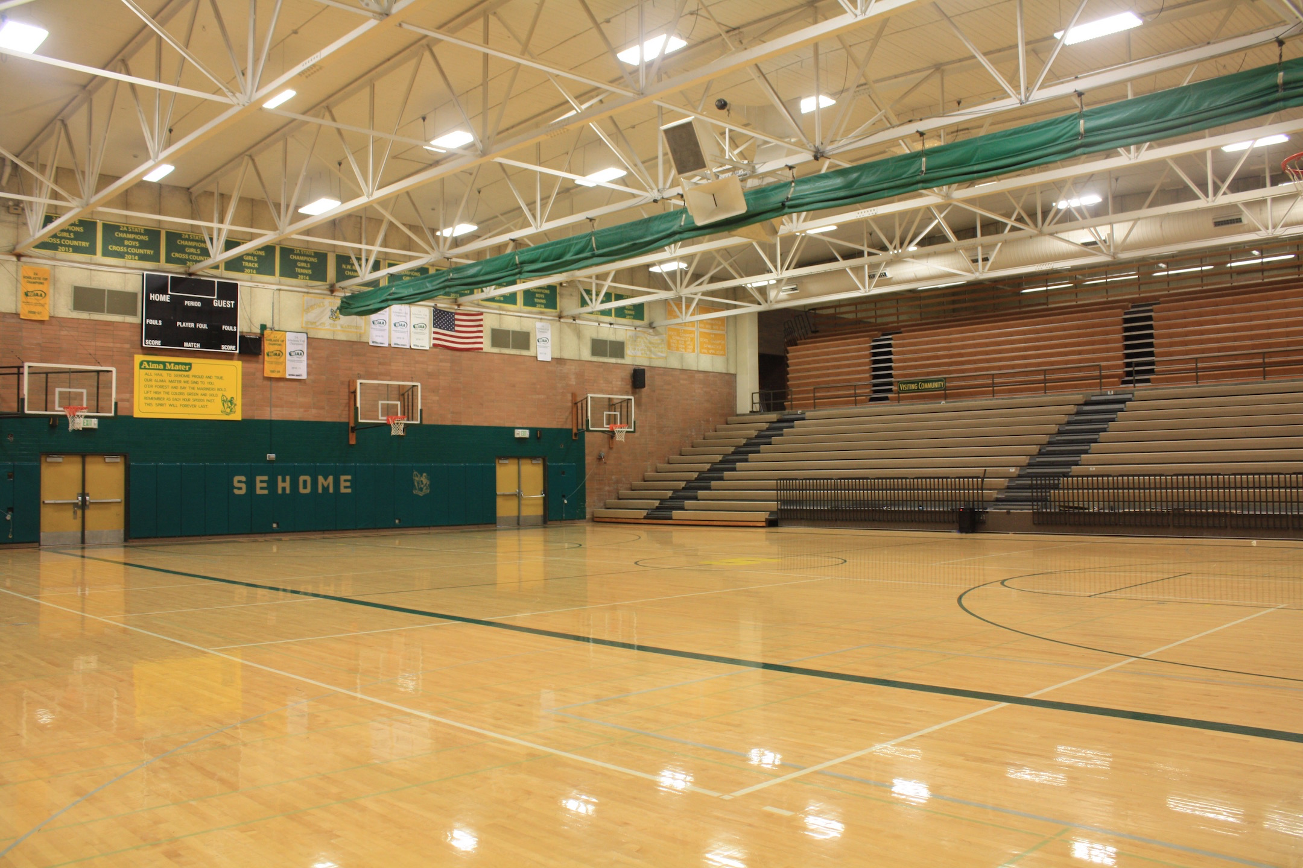

WARM-UP
gym
science lab

Slide 8
LESSON 2: A CLOSER LOOK 1
WARM-UP
Game: Pass the secret
Task 1: Match the words in columns A and B to form phrases. Then say them aloud.
Task 2: Complete the sentences with the phrases in 1. Task 3: Work in pairs. Answer the questions about your school.
VOCABULARY

Slide 9
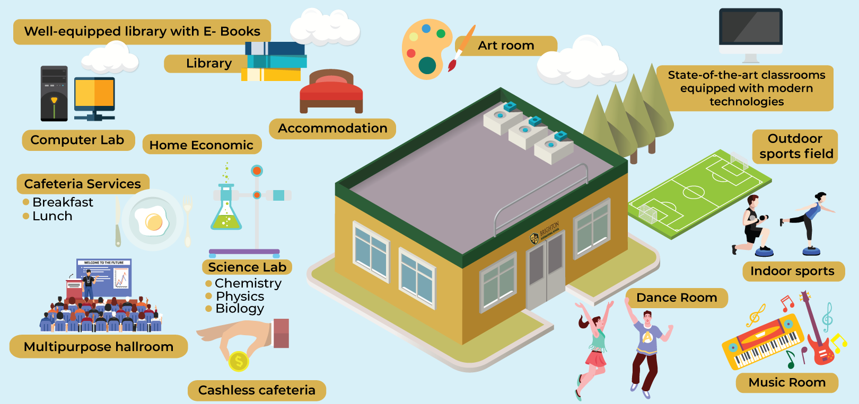
VOCABULARY
facility (n)
/fəˈsɪləti/
thiết bị / cơ sở vật chất

Slide 10
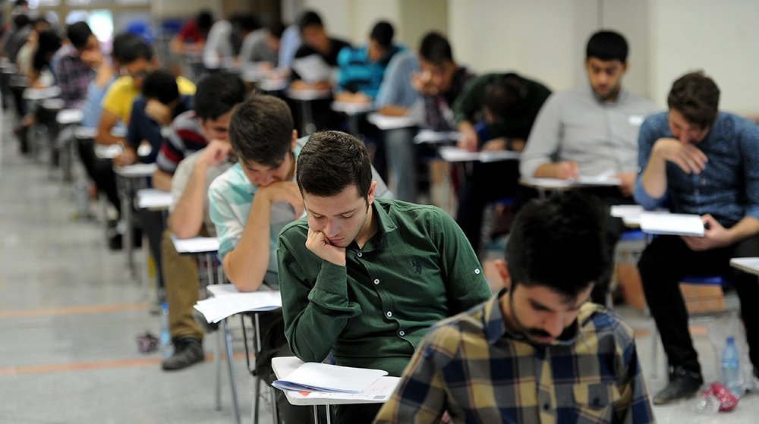
VOCABULARY
entrance exam (n. phr.)
/ˈentrəns ɪɡˌzæm/
kỳ thi đầu vào

Slide 11

VOCABULARY
midterm (n)
/ˈmɪdtɜːm/
giữa học kì

Slide 12
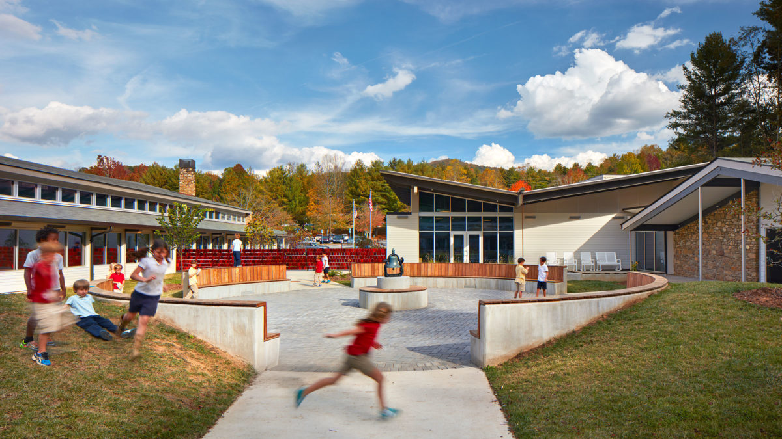
VOCABULARY
outdoor (adj)
/ˈaʊtˌdɔːr/
ngoài trời

Slide 13
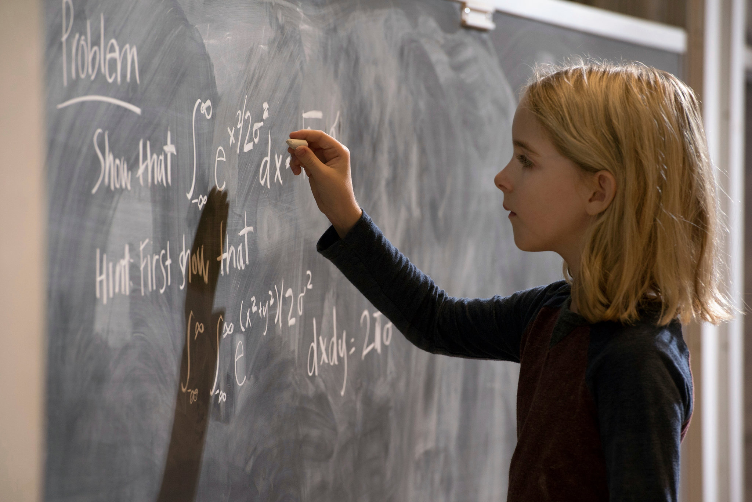
VOCABULARY
gifted (adj)
/ˈɡɪftɪd/
năng khiếu

Slide 14
VOCABULARY
Form | Pronunciation | Meaning
1. entrance exam (n. phr.) | /ˈentrəns ɪɡˈzæm/ | kì thi đầu vào
2. facility (n) | /fəˈsɪləti/ | thiết bị / tiện nghi
3. midterm (n) | /ˈmɪdtɜːm/ | giữa học kÌ
4. outdoor (adj) | /ˈaʊtˌdɔːr/ | ngoài trời
5. gifted (adj) | /ˈɡɪftɪd/ | năng khiếu

Slide 15
VOCABULARY
1
Match the words in columns A and B to form phrases. Then say them aloud.
A | B
1. entrance | a. students
2. school | b. activities
3. outdoor | c. facilities
4. midterm | d. examination
5. gifted | e. test
1. d
2. c
3. b
4. e
5. a

Slide 16
VOCABULARY
2
Complete the sentences with the phrases in Task 1.
gifted students
1. Binh Minh Lower Secondary School is for _____________ in the city.
2. Our ____________ usually covers the first three units.
3. Students in my school take part in many _______________ during the school year.
4. Our school has a lot of modern _____________.
5. In order to study in Quoc Hoc – Hue you have to pass a(n) __________________.
midterm test
outdoor activities
school facilities
entrance examination

Slide 17
VOCABULARY
3
Work in pairs. Answer the questions about your school.
Can you name some gifted student in your school?
When does the first-term test take place?
Do you have to take an entrance examination to study at your school?
What kind of facilities does your school have?
What types of outdoor activities do you like to take part in?

Slide 18
LESSON 2: A CLOSER LOOK 1
WARM-UP
Game: Pass the secret
Task 1: Match the words in columns A and B to form phrases. Then say them aloud.
Task 2: Complete the sentences with the phrases in 1. Task 3: Work in pairs. Answer the questions about your school.
VOCABULARY
Task 4: Listen and repeat the words. What letters can we use to make the /dʒ/ sound?
Task 5: Listen and repeat the chant. Pay attention to the sounds /tʃ/ and /dʒ/.
PRONUNCIATION

Slide 19

PRONUNCIATION
/tʃ/ and /dʒ/
Aims of the stage:
to let students listen and notice the targeted sounds in individual words
to let students practice pronouncing the targeted sounds in sentences

Slide 20

PRONUNCIATION
4
Listen and repeat the words. What letters can we use to make the /dʒ/ sound?
/tʃ/ | /dʒ/
cherry cheaper children lunch teacher | jam gym juice large project intelligent
Notes:
Link video hướng dẫn phát âm: https://www.youtube.com/watch?v=Oq_9Hq-U8W0&t=2s

Slide 21
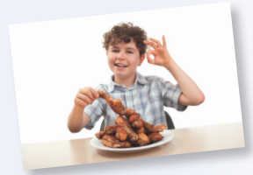

PRONUNCIATION
5
Listen and repeat the chant. Pay attention to the sounds /tʃ/ and /dʒ/.
Orange juice, orange juice,
Who likes orange juice?
Children do, children do.
Children like orange juice.
Chicken chop, chicken chop,
Who likes chicken chop?
John does, John does.
John likes chicken chop.
Notes:
Link video hướng dẫn phát âm: https://www.youtube.com/watch?v=Oq_9Hq-U8W0&t=2s

Slide 22
LESSON 2: A CLOSER LOOK 1
WARM-UP
Game: Pass the secret
Task 1: Match the words in columns A and B to form phrases. Then say them aloud.
Task 2: Complete the sentences with the phrases in 1. Task 3: Work in pairs. Answer the questions about your school.
VOCABULARY
Task 4: Listen and repeat the words. What letters can we use to make the /dʒ/ sound?
Task 5: Listen and repeat the chant. Pay attention to the sounds /tʃ/ and /dʒ/.
PRONUNCIATION
PRODUCTION
Game: Up and down

Slide 23

PRODUCTION
Game: Up and down
/tʃ/ | /dʒ/
maturity
teenager
exchange
project
chapped
jogging
kitchen
originate
picture
jeep

Slide 24
LESSON 2: A CLOSER LOOK 1
WARM-UP
Game: Pass the secret
Task 1: Match the words in columns A and B to form phrases. Then say them aloud.
Task 2: Complete the sentences with the phrases in 1. Task 3: Work in pairs. Answer the questions about your school.
VOCABULARY
Task 4: Listen and repeat the words. What letters can we use to make the /dʒ/ sound?
Task 5: Listen and repeat the chant. Pay attention to the sounds /tʃ/ and /dʒ/.
PRONUNCIATION
PRODUCTION
Game: Up and down
CONSOLIDATION
Wrap-up
Homework

Slide 25
CONSOLIDATION
1
WRAP-UP
VOCABULARY
PRONUNCIATION

Slide 26

CONSOLIDATION
2
HOMEWORK
Find some more words having the sounds /tʃ/ and /dʒ/.

Slide 27

Website: hoclieu.vn
Fanpage: facebook.com/www.tienganhglobalsuccess.vn/

