Slide 1
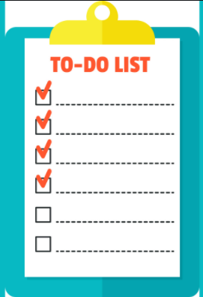
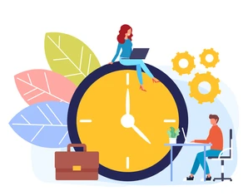
BÉ HỌC TIẾNG ANH QUA “TIMELINE DAILY”
DAILY ROUTINES

Slide 2
have breakfast
wake up
go to bed
6:00
I usually __________
at _______________
half-past six
wake up
twenty to six
six o’clock
Six o’clock

Slide 3
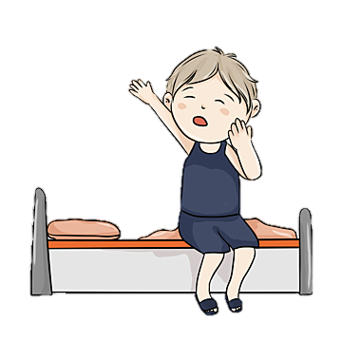
wake up
go to bed
get up
6:05
quarter past eight
I __________
at _______________
get up
six past five
six past five
twenty to nine

Slide 4
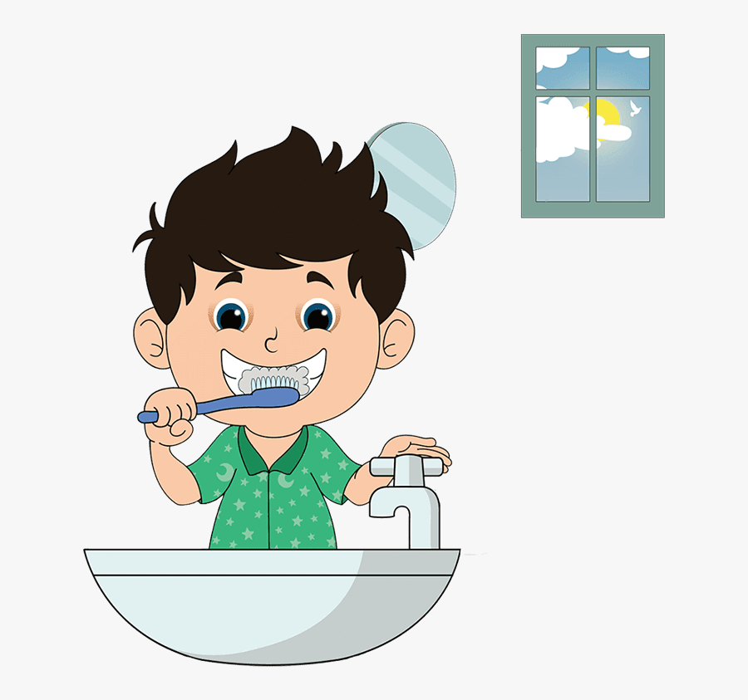
brush my teeth
wash my face
6:10
comb my hair
I ______________
at _____________
six past ten
brush my teeth
six past ten
nine o’clock
quarter to eight

Slide 5
make my bed
get dressed
6:15
go to bed
half-past nine
I usually __________
at _______________
get dressed
quarter to six
quarter past six
quarter past six

Slide 6
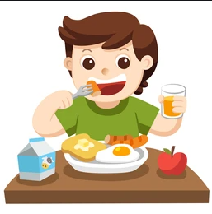
6:20
have dinner
have lunch
have breakfast
I usually ____________
with bread and milk
at _______________
quarter to eight
have breakfast
twenty past six
twenty past six
quarter to nine

Slide 7
go to school
6:30
go home
take a walk
ten to eight
I ____________
at ____________
go to school
quarter to nine
half past six
half past six

Slide 8
brush my teeth
wash my face
wash my hands
19:00
three o’clock
I sometimes
____________
at _______________
wash my face
six o’clock
nineteen o’clock
nine o’clock

Slide 9
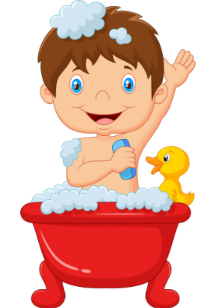
wash my face
have a bath
19:05
have a shower
eight o’clock
I ______________
at _____________
have a shower
nineteen past eight
nineteen past eight
five to eight

Slide 10
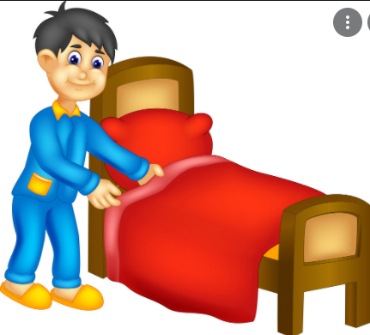
get up
22:30
wake up
go to bed
half-past six
I sometimes ________
at _______________
go to bed
half-past twenty
half-past twenty
six o’clock
EXIT

