Slide 1
50:50
15 120,000
14 80,000
13 50,000
12 35,000
11 25,000
10 15,000
9 9,000
8 6,000
7 3,600
6 2,000
5 1,000
4 500
3 300
2 200
1 100

Slide 2
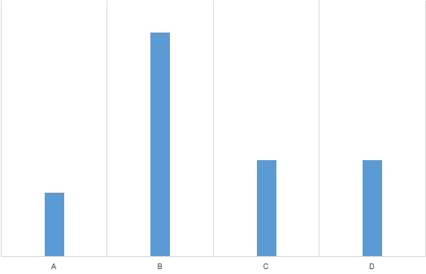
Key
50:50
1. _______ raiding for camels was a significant part of Bedouin life hasbeen documented in Wilfed Thesiger’s Arabian Sands.
A: Which
B: That
C: What
D: Where
CALLING!

Slide 3
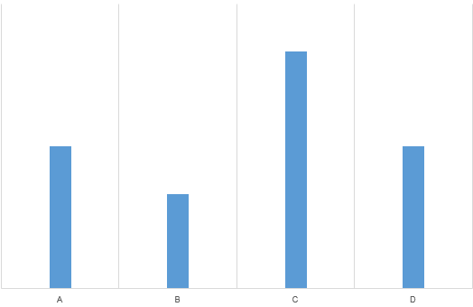
Key
50:50
Question 2:The little boy pleaded _____ not to leave him alone in the dark.
A. on his mother
B. his mother
C. with his mother
D. at his mother
CALLING!

Slide 4
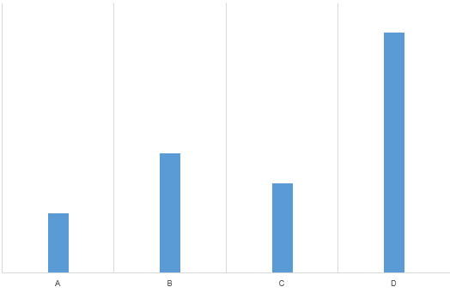
Key
50:50
Question 3:_____, the people who come to this club are in their twenties and
thirties.
A. Virtually
B. Altogether
C. To a degree
D. By and large
CALLING!

Slide 5
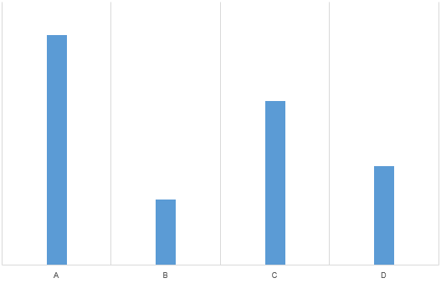
Key
50:50
Question 4.The TV station, in _______ to massive popular demand, decided not to discontinue the soap
A. response
B. reaction
C. answer
D. rely
CALLING!

Slide 6
Key
50:50
Question 5.Last week, when John arrived at the airport, the plane __________.
A. took off.
B. had taken off.
C. will take off.
D. takes off.
CALLING!

Slide 7
Key
50:50
Question 6: The salary of a bus driver is much higher ................
A . than that of a teacher
B. than a teacher
C .In comparison with the salary of a teacher
D . to compare as a teacher
CALLING!

Slide 8
Key
50:50
Question 7. Is was a difficult time, but we never gave up hope
A. had
B. continued
C. offered
D:stopped
CALLING!

Slide 9
Key
50:50
Question 8. He failed in the election just because he ___________ his opponent.
A: underestimated
B:overestimated
C. understated
D. undercharged
CALLING!

Slide 10
Key
50:50
Question 9. They ________because it is a national holiday.
A: A. don’t
B: aren’t working
C:. haven’t worked
D: won’t work
CALLING!

Slide 11
Key
50:50
Question 10 .She’s finished the course, ____________?
A. isn’t she
B. doesn’t she
C. hasn’t she
D. didn’t she
CALLING!

Slide 12
Key
50:50
Question 11:“Would you like a beer?” “ Not while I’m ___________”
A. in the act
B. in order
CALLING!
C. under control
D.on duty

Slide 13
Key
50:50
Question 12. Some friends of mine are really fashion-conscious, while __________ are quite simple.
A. some others
B. some other
C. anothers
D. the other
CALLING!

Slide 14
Key
50:50
Question 13: Janet has left home and is ______ of her parents.
A. dependently
B:dependent
C. independent
D. depend
CALLING!

Slide 15
Key
50:50
Question 14: When I last ______ Jane, she ______ to find a job.
A. saw/ was trying
B. saw/ tried
C. have seen/ tried
D. see/ is trying
CALLING!

Slide 16
Key
50:50
Question 15: ______ he did not attend the English class, he knew the lesson quite well.
A. In spite of
B. However
C . Despite
CALLING!
D. Although

