Slide 2
Unit
2
1
Unit
FAMILY LIFE
HUMANS AND THE ENVIRONMENT
LESSON 5
LISTENING
A green event

Slide 3
Unit
1
1
FAMILY LIFE
Family Life
Unit
OBJECTIVES
By the end of this lesson, students will be able to:
1. Knowledge
- Listen for specific information in a text about green living;
- Talk about a plan to organise a green event in their area.
2. Core competence
- Be collaborative and supportive in pair work and team work;
- Actively join in class activities;
- Develop presentation skills.
3. Personal qualities
- Be more responsible for the environment and be able to propose plans to solve environmental issues in their residential areas;
- Be ready to make a plan to organize a green event in their area.

Slide 4
LESSON 5
LISTENING
Unit
GETTING STARTED
WARM-UP
Game: Taboo
PRE-LISTENING
Vocabulary
Task 1: Look at the picture and answer the questions.
WHILE-LISTENING
Task 2: True or False.
Task 3: Listen and complete the table.
POST-LISTENING
Task 4: Discussion
CONSOLIDATION
Wrap-up
Home work

Slide 5
LESSON 5
LISTENING
Unit
GETTING STARTED
WARM-UP
Game: Taboo

Slide 6
WARM-UP
GAME: TABOO
Rules:
There are 2 teams, each team chooses 5 representatives.
Each group of representatives is given a set of words.
In 2 minutes, the representatives must explain the words for the teams to guess.
Do not use the words in the set and do not use your mother tongue.
The winners are the ones whose team can guess the most words.

Slide 7
WARM-UP
GAME: TABOO

Slide 8
WARM-UP
GAME: TABOO
Set 1: adopt, carbon footprint, litter, method, eco-friendly

Slide 9
WARM-UP
GAME: TABOO
Set 2: sort, awareness, organic, household appliances, cut down on

Slide 10
LESSON 5
LISTENING
Unit
GETTING STARTED
WARM-UP
Game: Taboo
PRE-LISTENING
Vocabulary
Task 1: Look at the picture and answer the questions.

Slide 11
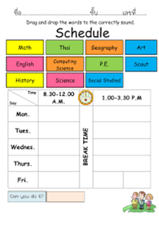
VOCABULARY
schedule (n)
/ˈʃedjuːl/
a plan that lists all the work that you have to do and when you must do each thing
E.g. They have a very flexible work schedule.

Slide 12
VOCABULARY
specific (adj)
/spəˈsɪfɪk/
connected with one particular thing only
E.g. The money was collected for a specific purpose.

Slide 13
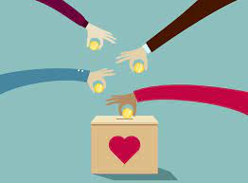
VOCABULARY
donation (n)
/dəʊˈneɪʃn/
money or goods that are given to help a person or organization, or the act of giving them

Slide 14
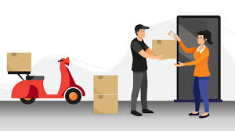
VOCABULARY
delivery (n)
/dɪˈlɪvəri/
the act of taking goods, letters, parcels, etc. to people's houses or places of work

Slide 15
VOCABULARY
New words | Pronunciation | Meaning
schedule (n) | /ˈʃedjuːl/ | a plan that lists all the work that you have to do and when you must do each thing E.g. They have a very flexible work schedule.
specific (adj) | /spəˈsɪfɪk/ | connected with one particular thing only E.g. The money was collected for a specific purpose.
donation (n) | /dəʊˈneɪʃn/ | money or goods that are given to help a person or organisation, or the act of giving them
delivery (n) | /dɪˈlɪvəri/ | The act of taking goods, letters, parcels, etc. to people's houses or places of work.

Slide 16
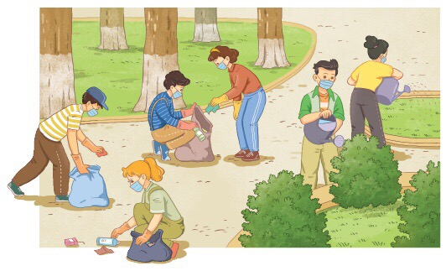
PRE-LISTENING
1
Work in pairs. Look at the picture and answer the questions.
What are they doing? Why?
Are the students wearing school uniforms?
Are they at school?
What day of the week do you think it is?
Do you think this is an organised event?
What kind of event is it?

Slide 17
LESSON 5
LISTENING
Unit
GETTING STARTED
WARM-UP
Game: Taboo
PRE-LISTENING
Vocabulary
Task 1: Look at the picture and answer the questions.
WHILE-LISTENING
Task 2: True or False.
Task 3: Listen and complete the table.

Slide 18
WHILE-LISTENING
2
True or False.
 | T | F
1. At the club meeting, the speaker only talks about the teams and activities.
2. The Clean-up Team will pick up rubbish in the central market.
3. Both students and local people will take part in the event.
4. A report of the event will be produced by the Media Team.
✔
✔
park
✔
✔

Slide 19
WHILE-LISTENING
3
ONE
Listen and complete the table with ONE word from the recording.
Clean-up Team | Clean the central (1) _______ Pick up rubbish, bottles, and (2) _______ bags Water small trees and flowers
Donation Team | Collect used items (3) _______ the items and put them into the correct bags
Media Team | (4) _______ photos of the event on the club’s website Make (5) __________ for the club’s future activities
park
plastic
Sort
Post
suggestions

Slide 20
LESSON 5
LISTENING
Unit
GETTING STARTED
WARM-UP
Game: Taboo
PRE-LISTENING
Vocabulary
Task 1: Look at the picture and answer the questions.
WHILE-LISTENING
Task 2: True or False.
Task 3: Listen and complete the table.
POST-LISTENING
Task 4: Discussion

Slide 21
POST-LISTENING
4
Work in groups. Discuss the following question.
If you have to organise a green event in your area, what will you do?
Have you ever taken part in an environmental activity or event?
How many times have you participated in such activities or events?
What did you do there?
How did you feel?

Slide 22
LESSON 5
LISTENING
Unit
GETTING STARTED
WARM-UP
Game: Taboo
PRE-LISTENING
Vocabulary
Task 1: Look at the picture and answer the questions.
WHILE-LISTENING
Task 2: True or False.
Task 3: Listen and complete the table.
POST-LISTENING
Task 4: Discussion
CONSOLIDATION
Wrap-up
Home work

Slide 23
CONSOLIDATION
1
Wrap-up
Listen for specific information in a text about green living
Talk about a plan to organise a green event in their area
2
Homework
Do exercises in the workbook
Prepare for Writing lesson

Slide 24
Website: hoclieu.vn
Fanpage: facebook.com/www.tienganhglobalsuccess.vn

