Slide 1
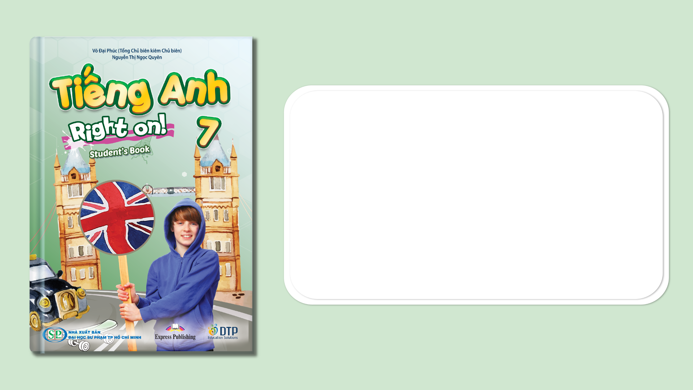
Unit 3: Arts and Music
Progress Check
Page 58

Slide 2
Lesson Outline
Warm-up
Vocabulary
Grammar
Listening
Consolidation
Wrap-up

Slide 3
Objectives
By the end of this lesson, students will be able to…
- test/consolidate vocabulary and grammar learnt throughout the unit.
- practise test-taking skills (Speaking).

Slide 4

WARM-UP

Slide 5
Choose the word whose main stress is placed differently
from the others.
1. A. finish B. vibrate C. visit D. listen
2. A. poster B. woodwind C. curtain D. display
3. A. fantastic B. amazing C. wonderful D. exciting
/ˈfɪnɪʃ/
/vaɪˈbreɪt/
/ˈvɪzɪt/
/ˈlɪsən/
/ ˈpəʊstər/
/ˈwʊdwɪnd/
/ˈkɜːtən/
/dɪˈspleɪ/
/fænˈtæstɪk/
/əˈmeɪzɪŋ/
/ˈwʌndəfəl/
/ɪkˈsaɪtɪŋ/

Slide 6
Choose the word whose underlined part is pronounced differently
from that of the other words.
A. slide B. strike C. die D. fix
2. A. face B. hand C. sack D. fat
3. A. band B. play C. game D. phrase
/slaɪd/
/straɪk/
/daɪ/
/fɪks/
/feɪs/
/hænd/
/sæk/
/fæt/
/ˈbænd/
/pleɪ/
/ɡeɪm/
/freɪz/

Slide 7
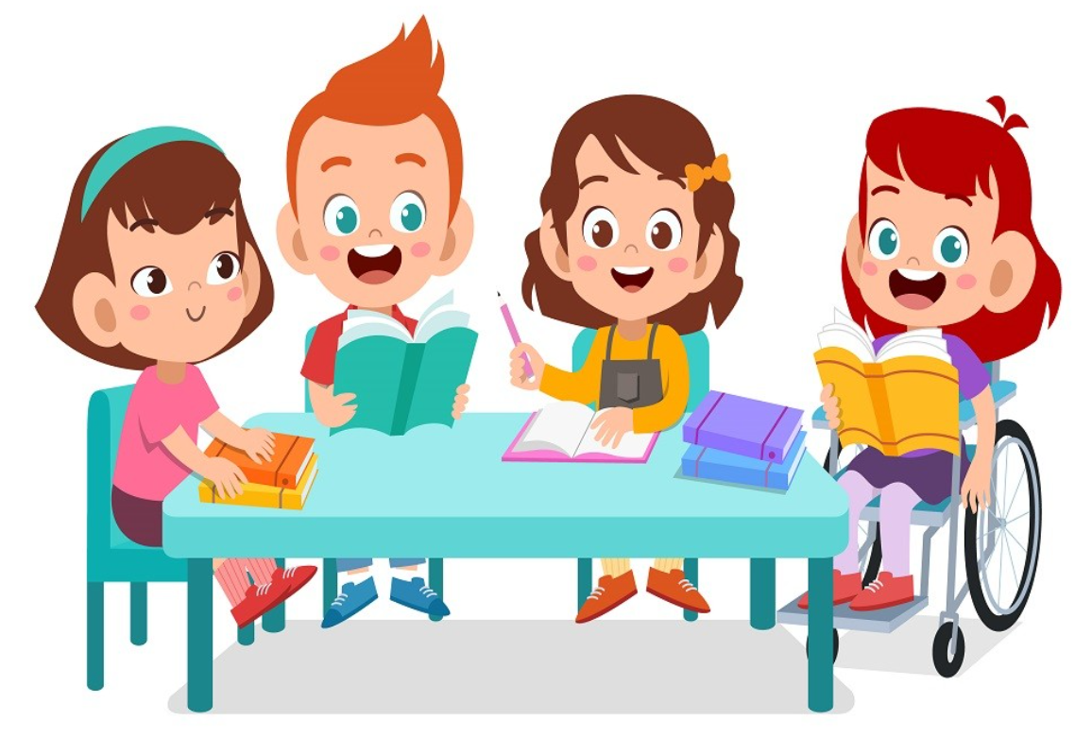
It’s time to learn …

Slide 8
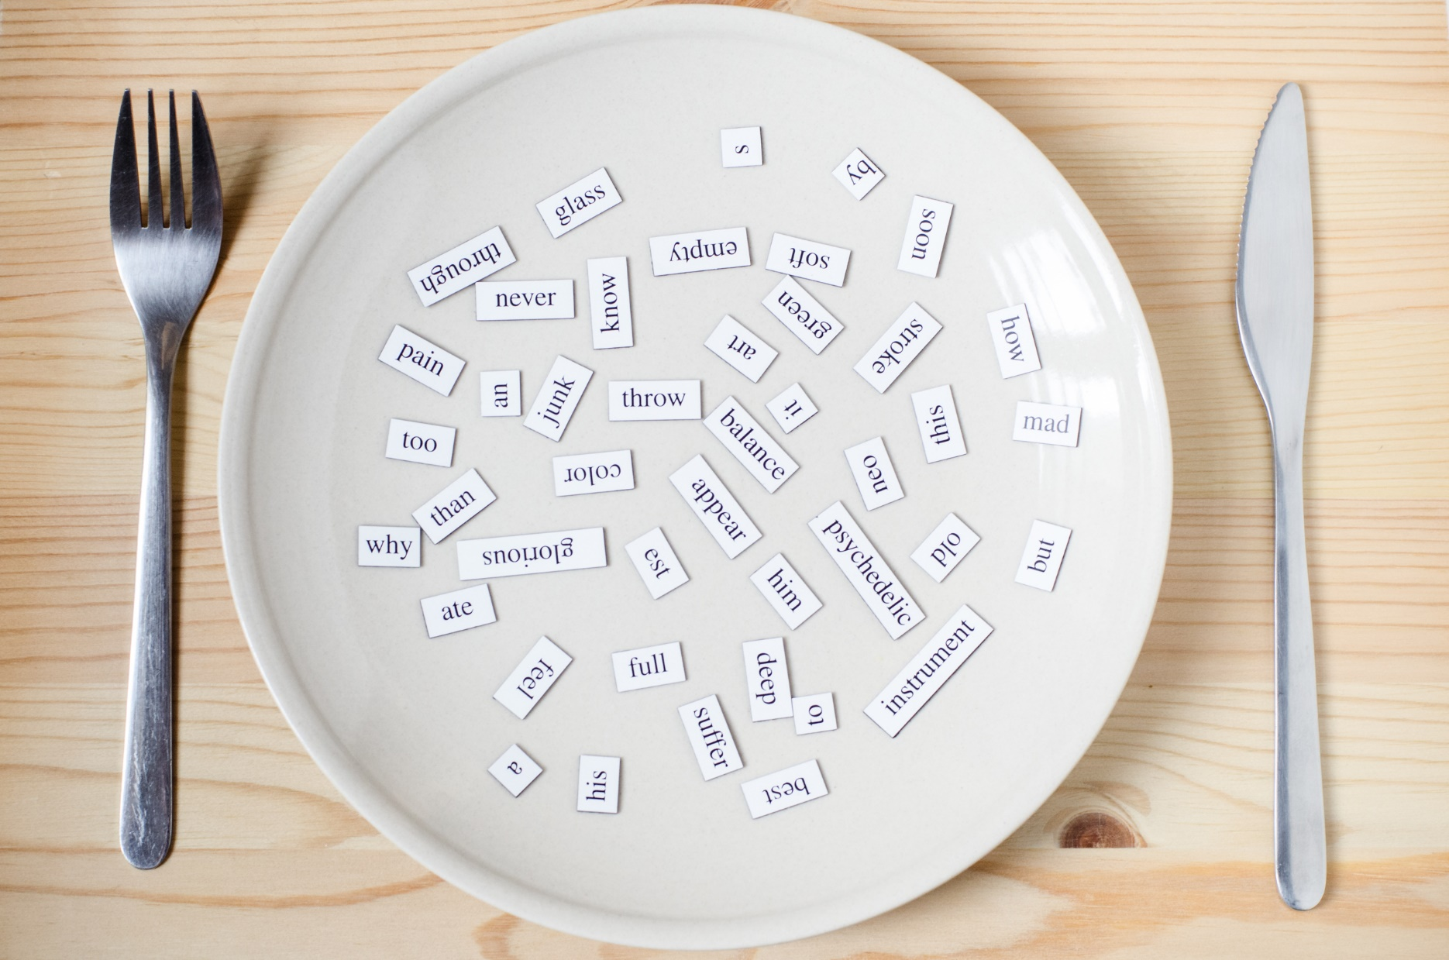
VOCABULARY

Slide 9
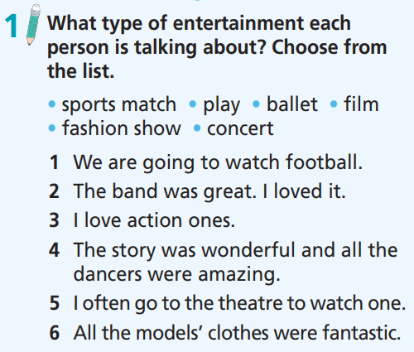
How many sentences are there?
Six.
What are you going to do?
Match the words with the correct sentences.

Slide 10
What type of entertainment each person is talking about?
Choose from the list.
• sports match • play • ballet • film
• fashion show • concert
1. We are going to watch football.
2. The band was great. I loved it.
3. I love action ones.
4. The story was wonderful and all the dancers were amazing.
5. I often go to the theatre to watch one.
6. All the models’ clothes were fantastic.

Slide 11
What type of entertainment each person is talking about?
Choose from the list.
1. We are going to watch football.
2. The band was great. I loved it.
3. I love action ones.
4. The story was wonderful and all the dancers were amazing.
5. I often go to the theatre to watch one.
6. All the models’ clothes were fantastic.
sports match
concert
film
ballet
play
fashion show

Slide 12
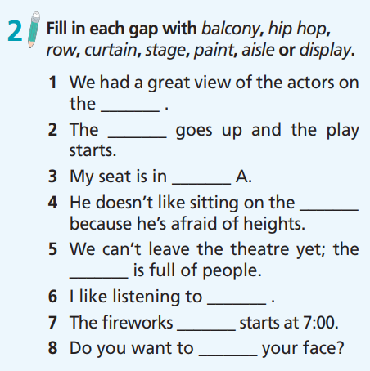
How many sentences are there?
Eight.
What are you going to do?
Fill in each gap.

Slide 13
Fill in each gap with balcony, hip hop, row, curtain, stage, paint, aisle or display.
1. We had a great view of the actors on the _______ .
2. The _______ goes up and the play starts.
3. My seat is in _______ A.
4. He doesn’t like sitting on the _______ because he’s afraid of heights.
5. We can’t leave the theatre yet; the _______ is full of people.
6. I like listening to _______ .
7. The fireworks _______ starts at 7:00.
8. Do you want to _______ your face?
stage
curtain
row
balcony
aisle
hip hop
display
paint

Slide 14
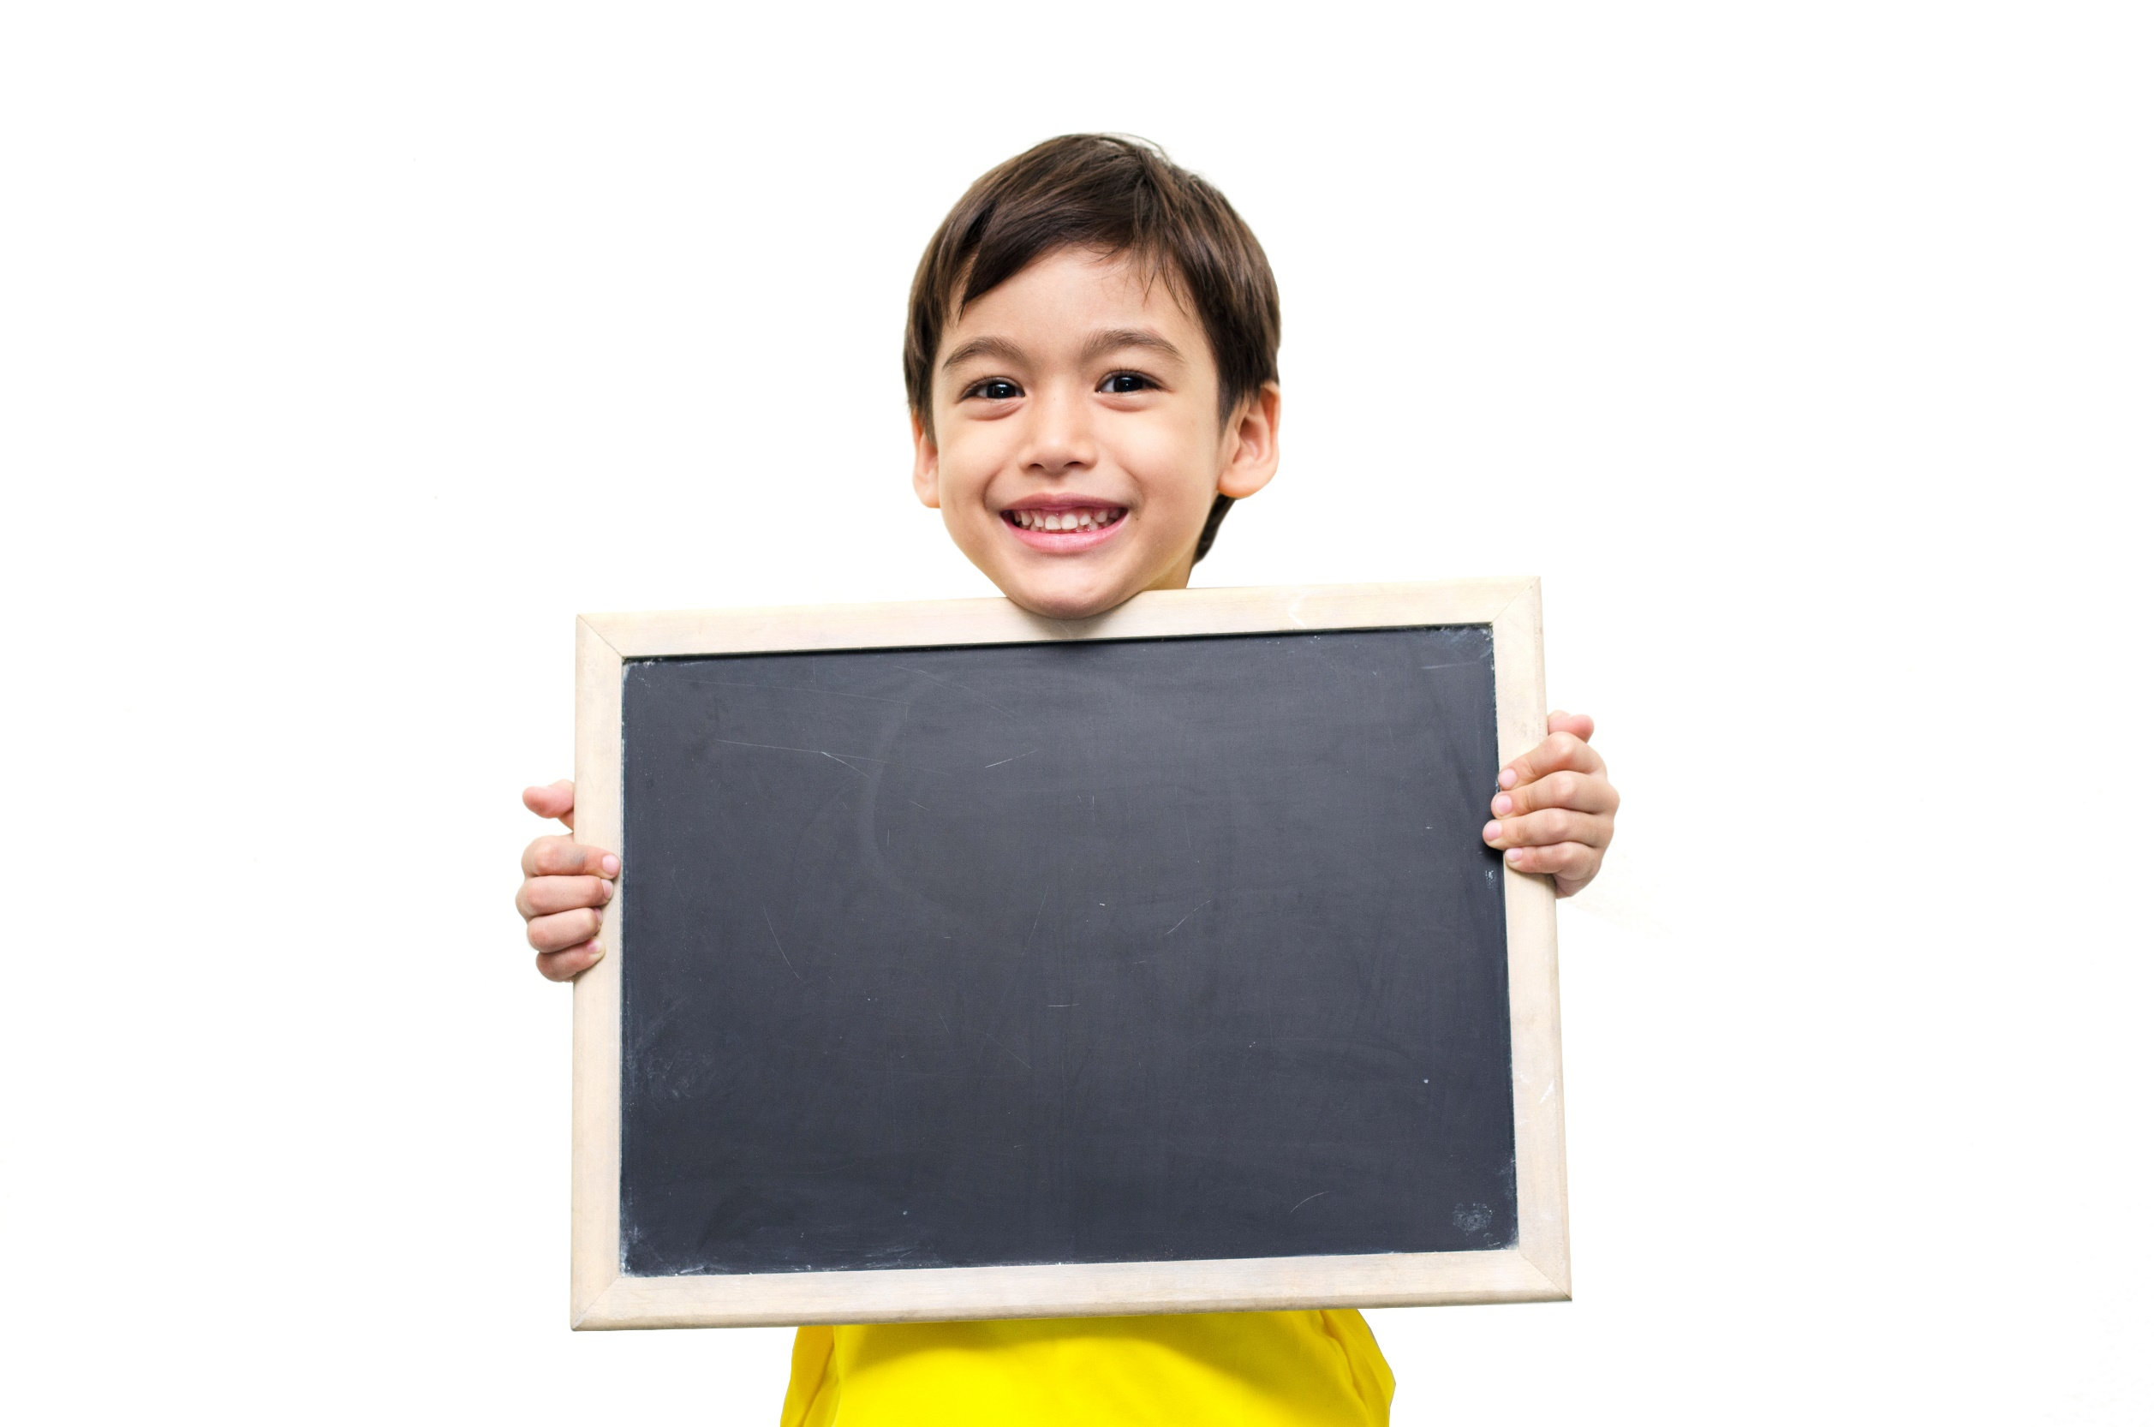
Grammar

Slide 15
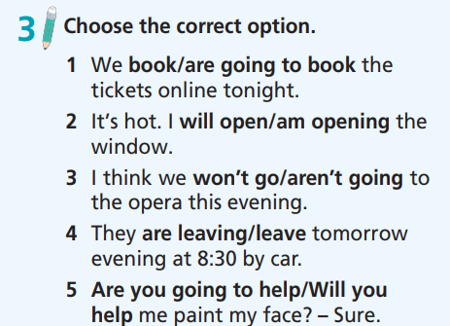
How many sentences are there?
Five.
What are you going to do?
Choose the correct option.

Slide 16
Choose the correct option.
1. We book/are going to book the tickets online tonight.
2. It’s hot. I will open/am opening the window.
3. I think we won’t go/aren’t going to the opera this evening.
4. They are leaving/leave tomorrow evening at 8:30 by car.
5. Are you going to help/Will you help me paint my face? – Sure.

Slide 17
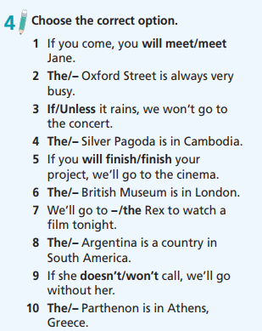
How many sentences are there?
Ten.
What are you going to do?
Choose the correct option.

Slide 18
Choose the correct option.
1. If you come, you will meet/meet Jane.
2. The/– Oxford Street is always very busy.
3. If/Unless it rains, we won’t go to the concert.
4. The/– Silver Pagoda is in Cambodia.
5. If you will finish/finish your project, we’ll go to the cinema.

Slide 19
Choose the correct option.
6. The/– British Museum is in London.
7. We’ll go to –/the Rex to watch a film tonight.
8. The/– Argentina is a country in South America.
9. If she doesn’t/won’t call, we’ll go without her.
10. The/– Parthenon is in Athens, Greece.

Slide 20
Extra Practice
Grammar Bank, p.70
Read the email and put the verbs in brackets in the correct future form.
Hi Becky!
Sorry, I 1) ___________ (go) shopping with you tomorrow. I’ve got the temperature and I think I 2) _________ (stay) in bed all day to get better quickly! You see, I’ve got tickets for a theatre performance next weekend and my mum and I are planning a great day out.
We 3) _______________ (catch) the train to London early in the morning. We 4) _______________ (not/eat) breakfast at home because we 5) _______________ (have) brunch in Soho. Then, we 6) ______________ (visit) Oxford Street for some shopping before we go to the theatre in the afternoon. I can’t wait!
I hope you and Jenny 7) _________ (find) some great bargains tomorrow.
Love,
Katie
am not going
will stay
are going to catch
aren’t going to eat
are going to have
are going to visit
will find

Slide 21

Everyday
English

Slide 22
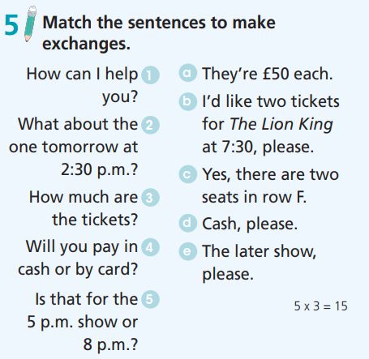
How many sentences are there?
Five.
What are you going to do?
Match the sentences.

Slide 23
Match the sentences to make exchanges.
1. How can I help you?
2. What about the one tomorrow at 2:30 p.m.?
3. How much are the tickets?
4. Will you pay in cash or by card?
5. Is that for the 5 p.m. show or
8 p.m.?
a. They’re £50 each.
b. I’d like two tickets for The Lion King at 7:30, please.
c. Yes, there are two seats in row F.
d. Cash, please.
e. The later show, please.

Slide 24

CONSOLIDATION

Slide 25

Work in pairs.
Practise the conversation.
A: How can I help you?
B: I’d like two tickets for The Lion King at 7:30, please.
A: Is that for the 5 p.m. show or 8 p.m.?
B: The later show, please.
A: How much are the tickets?
B: They’re £50 each.
A: Will you pay in cash or by card?
B: Cash, please.

Slide 26
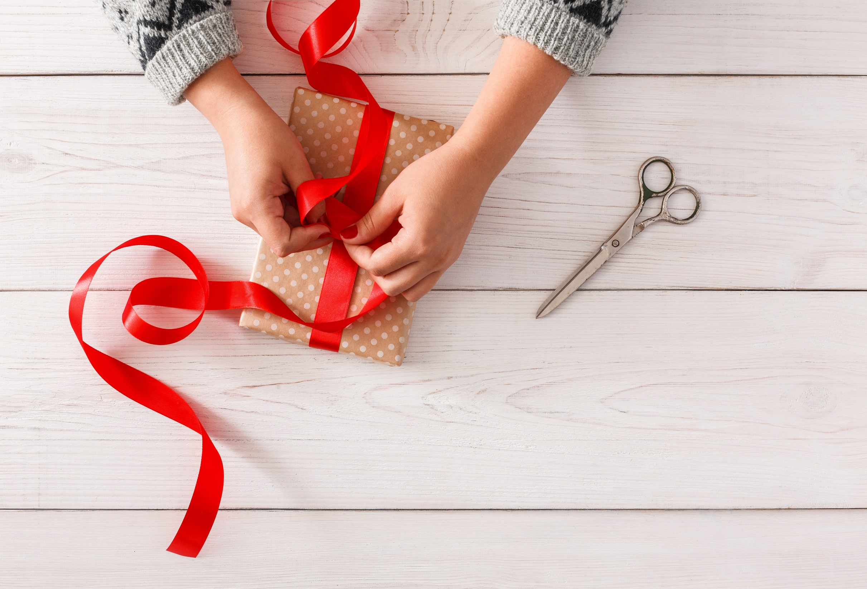
WRAP-UP

Slide 27
Today’s lesson
Vocabularies
- test/consolidate vocabulary
Grammar
- test/consolidate grammar points learnt throughout the unit.
Listening: for specific information.

Slide 28
Homework
Prepare the next lesson (page 59 SB).
Do Test 2 of Unit 3 in Bài Tập Bổ Trợ TA 7 Right on
(pages 30 & 31).
Do the Speaking Test – Test 1 of Unit 3 in Bài Tập Bổ Trợ TA 7 Right on (page 78).

Slide 29
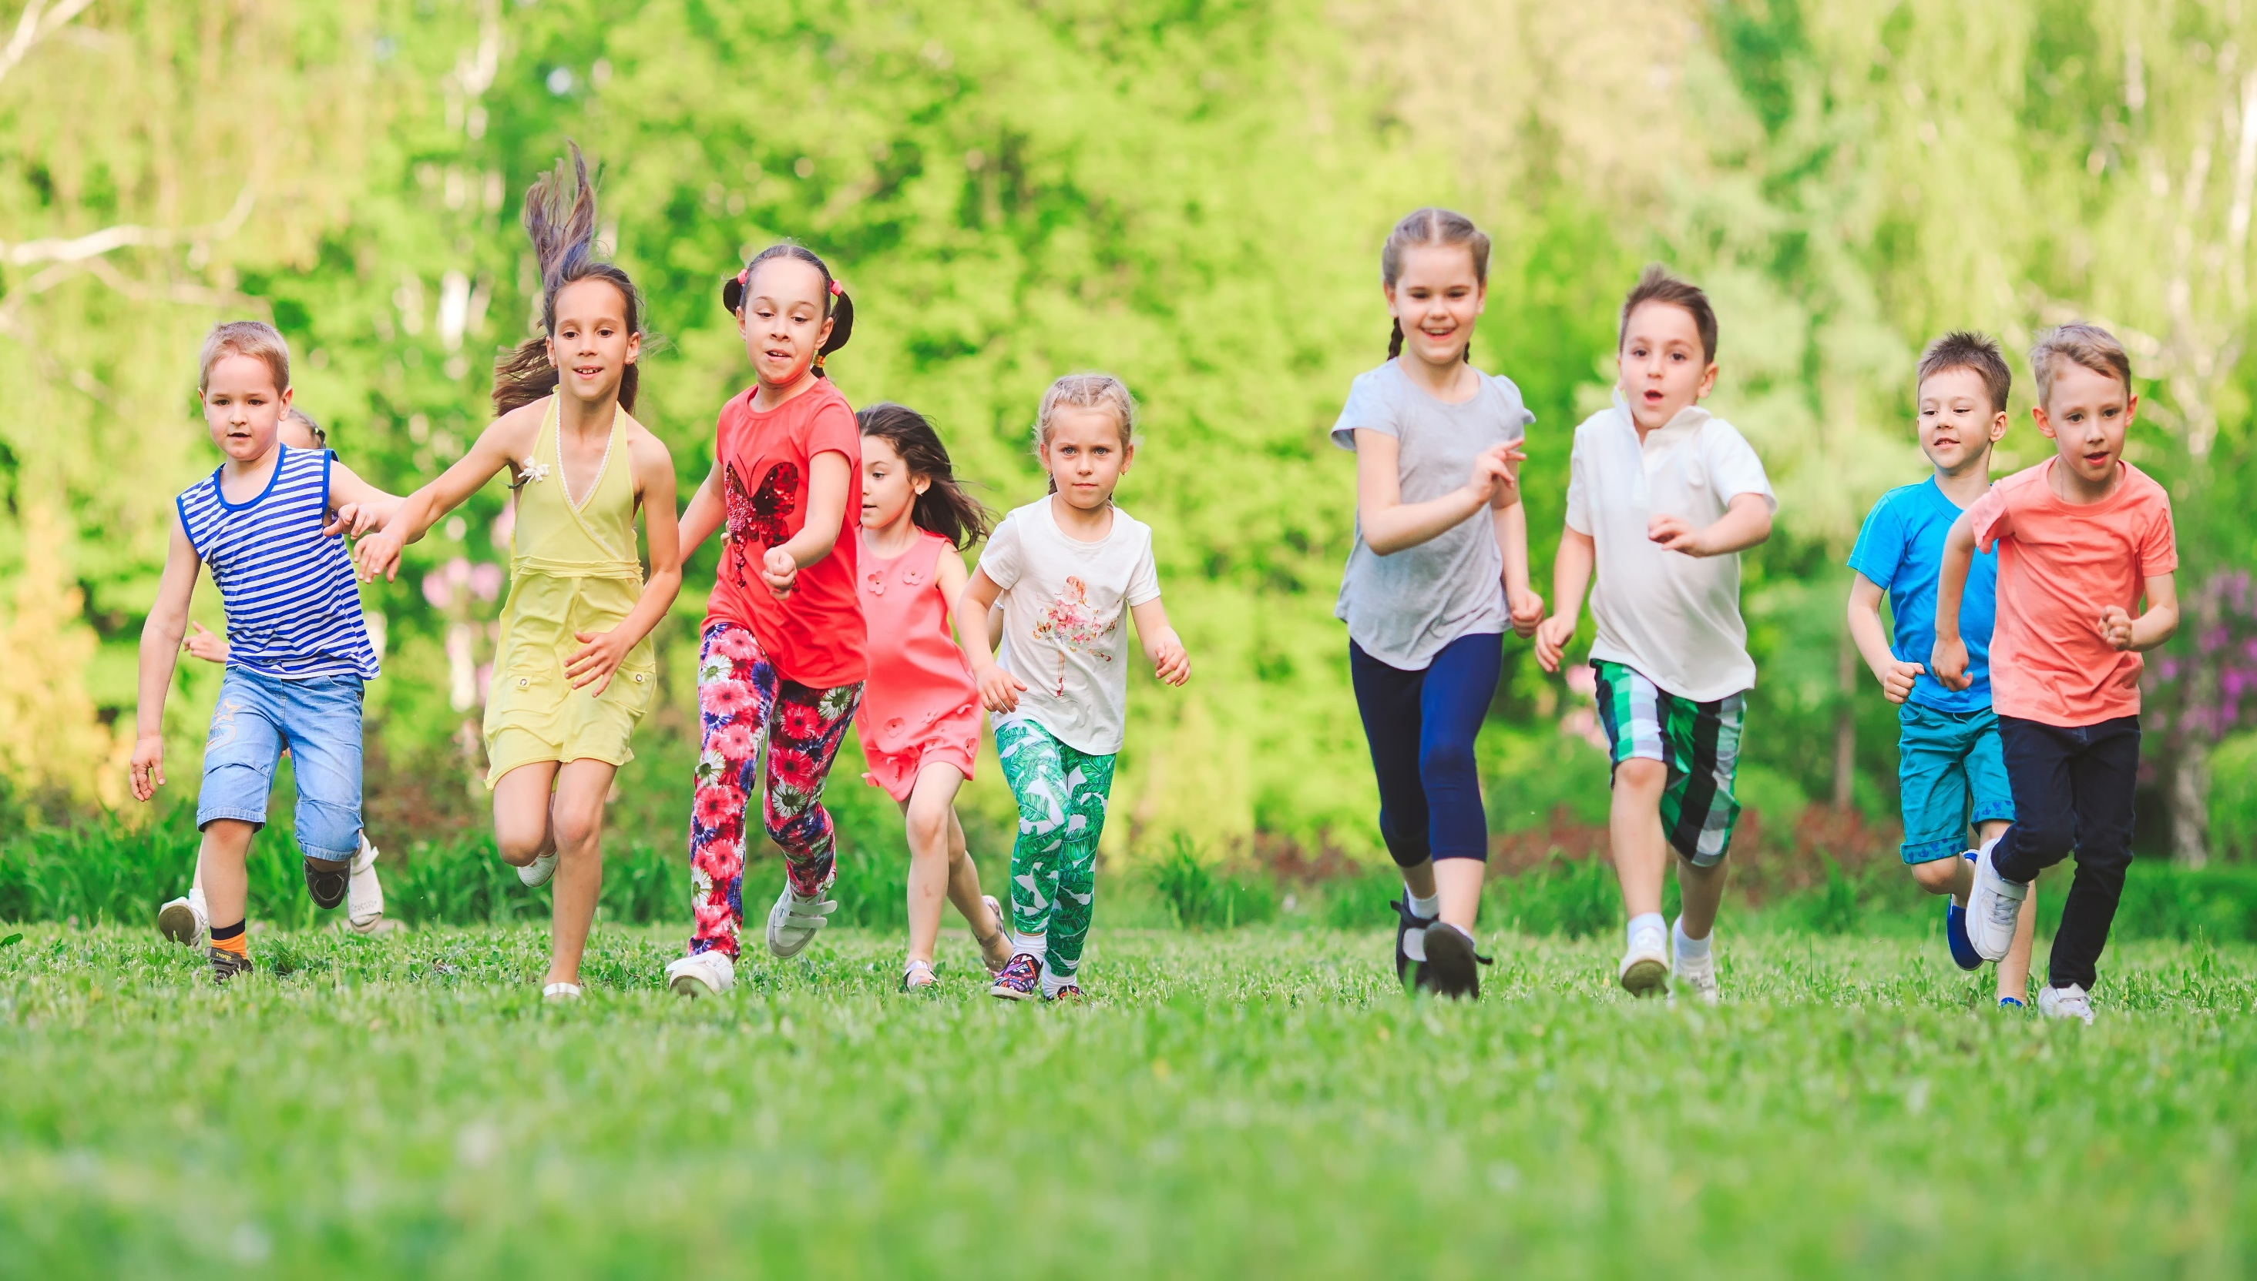
Have a nice day!

