Slide 1
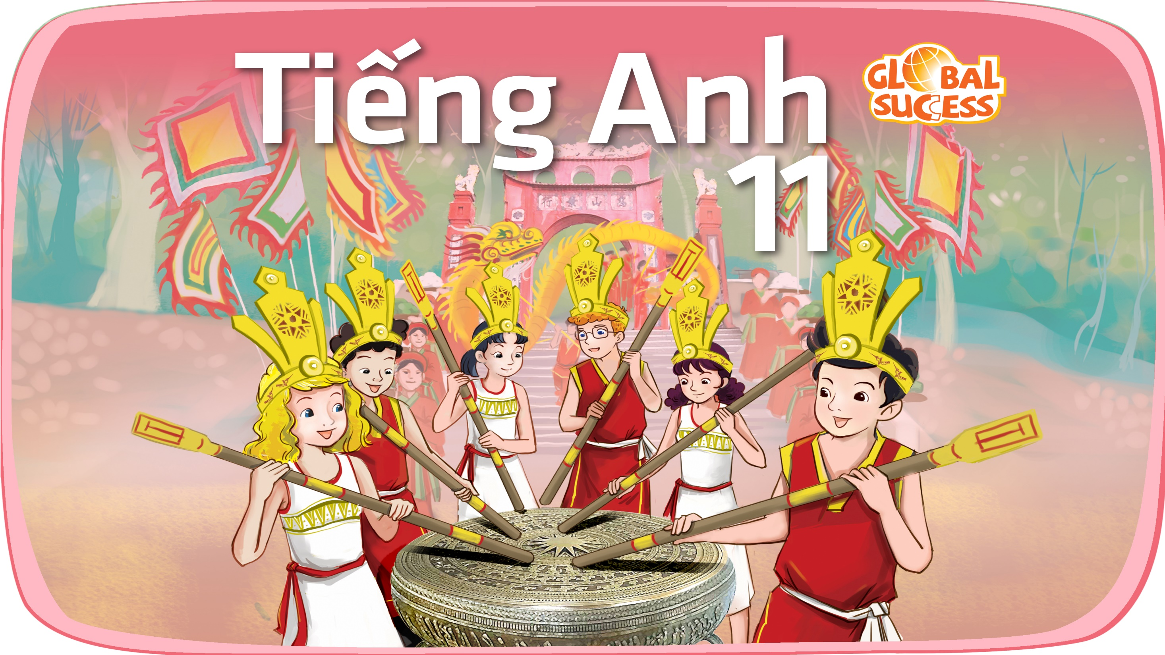

Slide 2
Unit
6
Preserving our heritage
Unit
FAMILY LIFE
COMMUNICATION AND CULTURE / CLIL
LESSON 7

Slide 3
LESSON 7
COMMUNICATION AND CULTURE / CLIL
WARM-UP
Lucky number
Task 1: Listen and complete the conversation.
Task 2: Make similar conversations.
EVERYDAY ENGLISH
CULTURE
Task 1: Read the text and answer the questions.
Task 2: Discussion.
CONSOLIDATION
Wrap-up
Homework

Slide 4
WARM-UP
LUCKY NUMBER
- Ss work in 4 groups.
- There are 8 numbers, including 3 lucky numbers and 5 numbers corresponding to 5 questions.
- Pick a lucky number ➔ get one point without having to answer the question.
- Pick a question ➔ answer “Where is it?”
- One point for a correct answer.

Slide 5
WARM-UP
Answer the question in each number.
1
2
3
4
5
6
7
8

Slide 6
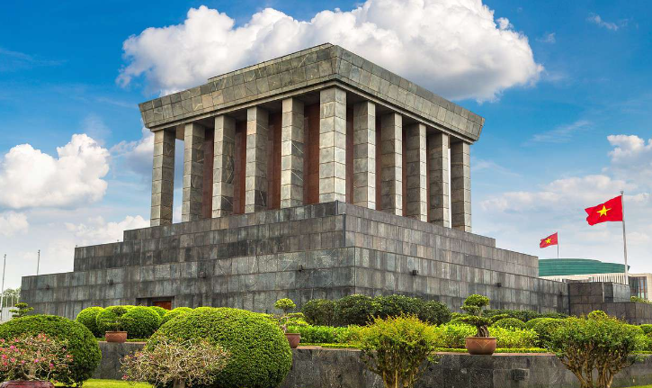
WARM-UP
Question 1
➔ HO CHI MINH MAUSOLEUM
BACK

Slide 7
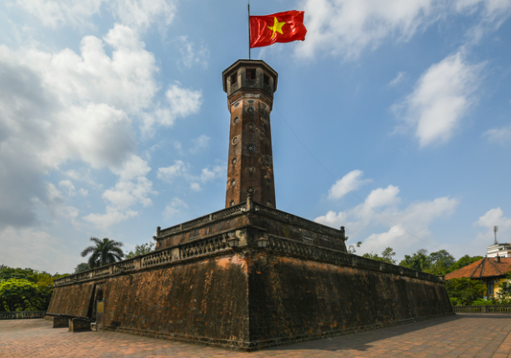
WARM-UP
Question 2
➔ HANOI FLAG TOWER
BACK

Slide 8
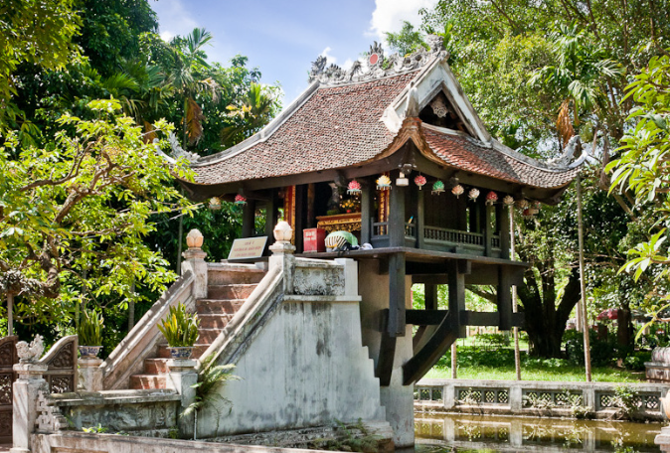
WARM-UP
Question 3
➔ ONE-PILLAR PAGODA
BACK

Slide 9
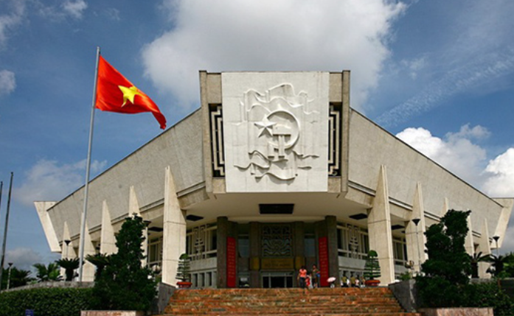
WARM-UP
Question 4
➔ HO CHI MINH MUSEUM
BACK

Slide 10
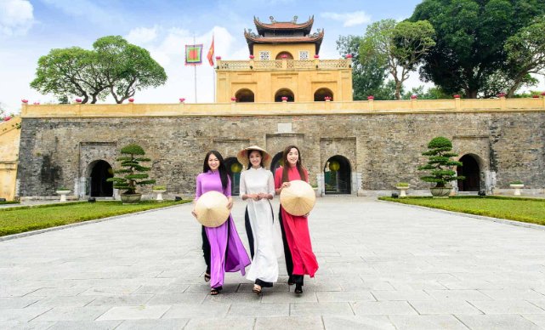
WARM-UP
Question 5
➔ IMPERIAL CITADEL OF THANG LONG
BACK

Slide 11

WARM-UP
BACK

Slide 12

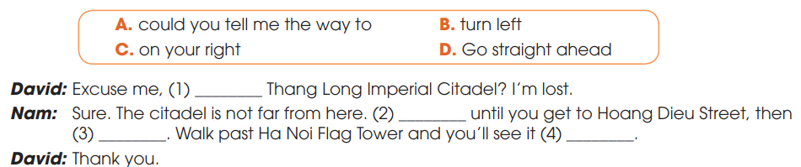
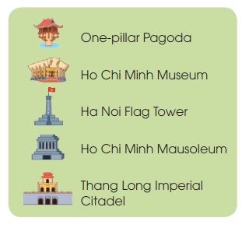
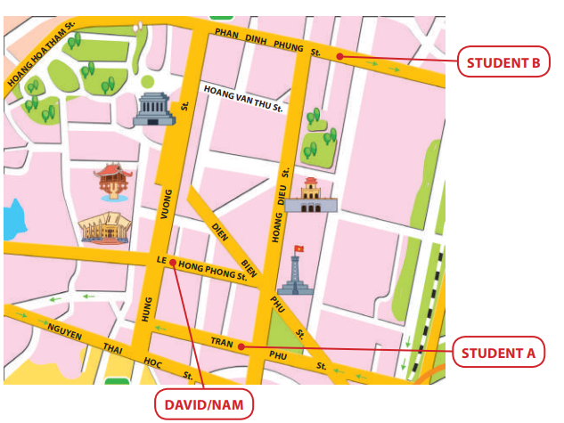
EVERYDAY ENGLISH
1
Listen and complete the conversation.
A
D
B
C

Slide 13
EVERYDAY ENGLISH
Useful expressions
Asking for directions | Give directions
+ Can you tell me the way to …? + Excuse me, is … near here? + How do/can I get to …? + What is the best/easiest way to …? + Could you show me how to get to …? | + Go straight ahead/on. + Walk along … street/road. + Walk past the (post office/bank). + Turn left/right at the traffic lights/into Star Street. + Take the first/second road/turning on the left. + It’s on your left/right. + It’s next to/opposite/between/at the end of/behind/in front of… + It’s (just) around the corner.

Slide 14
EVERYDAY ENGLISH
2
Make similar conversation for these situations.
1. Student A asking for directions to Ho Chi Minh Mausoleum.
2. Student B asking for directions to Ha Noi Flag Tower.

Slide 15
EVERYDAY ENGLISH
2
Work in pairs. Make similar conversation for these situations.
Situation 1.
A: Could you tell me the way to Ho Chi Minh Mausoleum?
B: Sure. Go straight ahead until you get to Hung Vuong Street. Turn left and walk straight on for a few minutes. You’ll see it on your left.

Slide 16
EVERYDAY ENGLISH
2
Work in pairs. Make similar conversation for these situations.
Situation 2
B: Excuse me, is Ha Noi Flag Tower near here?
A: Yes. It’s quite near. Turn left into Hoang Dieu Street and walk along the street. You’ll see it on your left, at the corner of Hoang Dieu and Dien Bien Phu Street.

Slide 17

CULTURE
crowdfunding (n)
/ˈkraʊdfʌndɪŋ/
the practice of funding a project or an activity by raising many small amounts of money from a large number of people, usually using the internet

Slide 18

CULTURE
non-profit (adj)
/ˌnɒn ˈprɒfɪt/
without the aim of making a profit

Slide 19

CULTURE
regardless of (prep.)
/rɪˈɡɑːdləs əv/
paying no attention to something/somebody; treating something/somebody as not being important

Slide 20
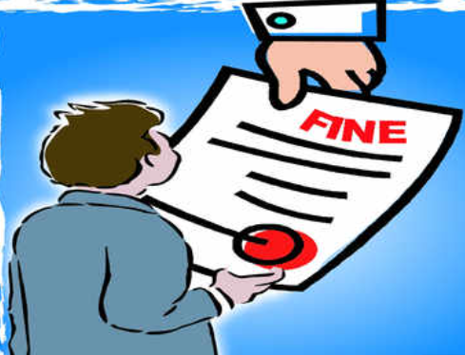
CULTURE
fine (n)
/faɪn/
a sum of money that must be paid as punishment for breaking a law or rule

Slide 21

CULTURE
unique (adj)
/juˈniːk/
being the only one of its kind

Slide 22
Form | Pronunciation | Meaning
1. crowdfunding (n) | /ˈkraʊdfʌndɪŋ/ | the practice of funding a project or an activity by raising many small amounts of money from a large number of people, usually using the internet
2. non-profit (adj) | /ˌnɒn ˈprɒfɪt/ | without the aim of making a profit
3. regardless of (prep) | /rɪˈɡɑːdləs əv/ | paying no attention to something/somebody; treating something/somebody as not being important
4. fine (n) | /faɪn/ | a sum of money that must be paid as punishment for breaking a law or rule
5. unique (adj) | /juˈniːk/ | being the only one of its kind

Slide 23



CULTURE
1
Read the text and answer the questions.
Which country …
1. raises money from the public for restoring its heritage?
2. organises successful festivals that attract visitors from around the world?
3. fines people heavily if they damage its heritage?
1
2
3
Italy
Spain
Australia

Slide 24
CULTURE
2
Work in groups. Discuss the following questions
Are the methods of preserving heritage in the text used in Viet Nam?
Which one do you think works best in Viet Nam?

Slide 25
CONSOLIDATION
1
Wrap-up
What have you learnt today?
How heritage is preserved around the world;
Review expressions for asking for and giving directions.

Slide 26
CONSOLIDATION
2
Homework
Do exercises in the workbook.
Prepare for Lesson 8 - Unit 6.

Slide 27

Website: hoclieu.vn
Fanpage: facebook.com/tienganhglobalsuccess.vn/
Website: hoclieu.vn
Fanpage: facebook.com/sachmem.vn/

