Slide 1

Unit 9: Houses in the Future
Lesson 2.2: Grammar
Page 74

Slide 2
Lesson Outline
Warm-up
Grammar
Consolidation
Wrap-up

Slide 3
Objectives
By the end of this lesson, students will be able to…
- Use "might" to say that something is possible in the future.

Slide 4

WARM-UP

Slide 5
PAIR WORK
Tell your partner as many home appliances as possible.
For example:
- TV
- washing machine
- …
- …

Slide 6



Slide 7

Presentation

Slide 8


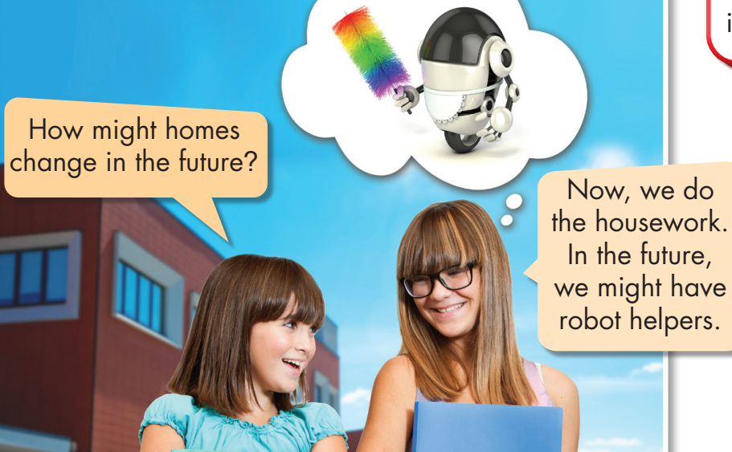



Slide 9

We use "might" to say that something is possible
in the future.
Look and read the sentences:
We might have robot helpers.
They might not have robot pets.
He might have robot helpers.
How might homes change in the future?
Do you think we will have automatic food machines?
We might do.
We might have robot helpers.
They might not have robot pets.
He might have robot helpers.
How might homes change in the future?
Do you think we will have automatic food machines?
We might do.

Slide 10

1. Automatic food machines _______________ all our food.
2. We _______________ in smart homes.
3. We _______________ smart doors.
4. We _____________ online and drones will deliver our food.
5. How ____________ homes ______________ in the future?
might make
might live
might have
might shop
might change

Slide 11

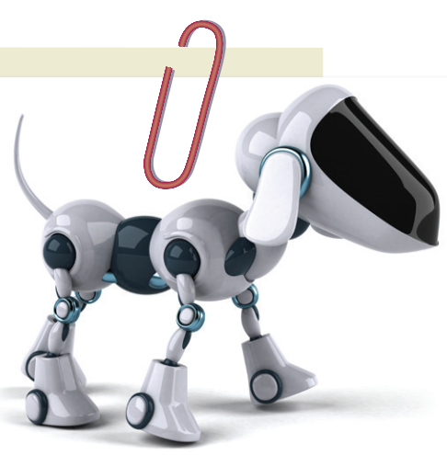
1. robot helpers./might/we/have/the future,/In
___________________________________________________
2. homes/change/How/in/future?/might/the
___________________________________________________
3. pets./In/robot/might/we/future,/the/have
___________________________________________________
4. have/doors/might/future,/In/cameras./the
___________________________________________________
5. devices/have/In/smart/not/screens./might/the/future,
___________________________________________________
In the future, we might have robot helpers.
How might homes change in the future?
In the future, we might have robot pets.
In the future, doors might have cameras.
In the future, smart devices might not have screens.

Slide 12
1.
2.
3.
4.
5.
In the future, we might have robot helpers.
How might homes change in the future?
In the future, we might have robot pets.
In the future, doors might have cameras.
In the future, smart devices might not have screens.

Slide 13

Practice

Slide 14

Extra Practice
WB page 53
1. Now, we do/might do our own housework. In the future, we have/might have robot helpers.
2. Now, we have/might have ovens and fridges. In the future, we have/might have automatic food machines.
3. Now, we have/might have computers. In the future, we have/might have smart walls.

Slide 15

Extra Practice
WB page 53
1. we/our/housework./Now,/do/own
____________________________________________________
2. we/have/In/might/future,/robot/the/helpers.
____________________________________________________
3. change/in/future?/How/homes/might/the
____________________________________________________
4. Now,/a computer./use/you
____________________________________________________
5. In/you/have/the/might/future,/walls./smart
____________________________________________________
Now, we do our own housework.
In the future, we might have robot helpers.
How might homes change in the future?
Now, you use a computer.
In the future, you might have smart walls.

Slide 16
cook deliver watch do make have
1. In the future, automatic food machines ________________ all our food.
2. In the future, robots _________________ all our housework.
3. In the future, we _________________ movies on smart walls.
4. In the future, 3D printers _________________ all kinds of things.
5. In the future, we _________________ many smart devices.
6. In the future, robot drones _________________ all our groceries.
might cook
might do
might watch
might make
might have
might deliver

Slide 17

CONSOLIDATION

Slide 18

Be creative!
1. Now, we _____________________________________________. In the future, we might ___________________________________.
2. Now, ________________________________________________. In the future, ___________________________________________.
3. Now, ________________________________________________. In the future, ___________________________________________.

Slide 19

WRAP-UP

Slide 20
Today’s lesson
Structures/ Sentence patterns
- We use "might" to say that something is possible in the future.

Slide 21
Homework
Make sentences using "might" to say that something is possible in the future.
Complete the grammar notes in Tiếng Anh 6 i-Learn Smart World Notebook on page 55
Prepare the next lesson (page 75, SB)
Play the consolidation games in Tiếng Anh 6 i-Learn Smart World DHA App on www.eduhome.com.vn

Slide 22

Enjoy your day!

