Slide 1

Unit 2: Health
Lesson 2.1: Vocabulary & Listening
Page 15

Slide 2



LESSSON OUTLINE
Consolidation
Wrap up

Slide 3

By the end of this lesson, students will be able to…
- learn and use vocabularies related to health problems.
- practice listening for gist and for details.
- practice functional English -offering help.

Slide 4

New words
feel weak
have a sore throat
get some rest
take vitamins
have a fever
take medicine
stay up late
keep warm

Slide 5

WARM-UP

Slide 6

Work in pairs.
Tell your partner about the last time you got sick.
1. What happened to your body? How did you feel?
2. What did you do to feel better?

Slide 7



Slide 8
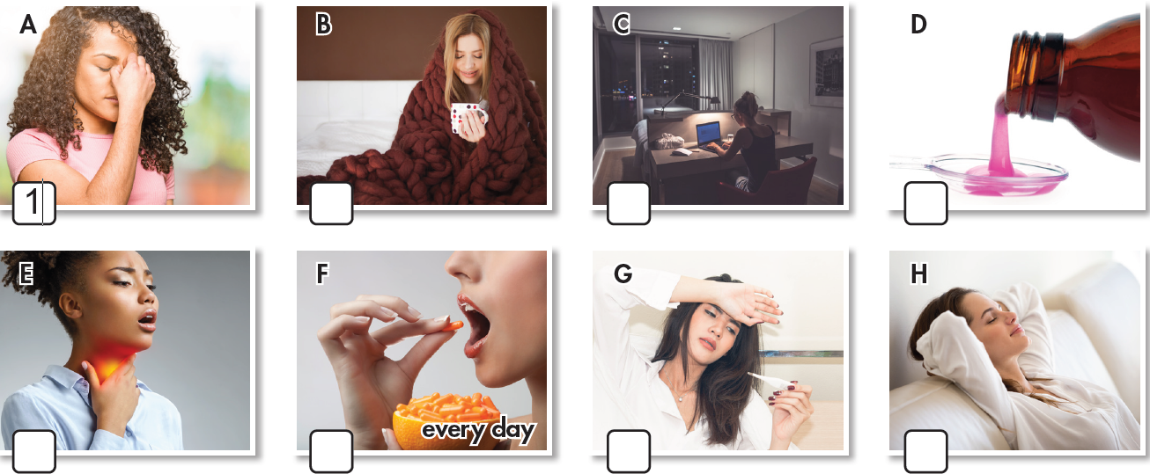
Work in pairs. What can you see in each picture?

Slide 9
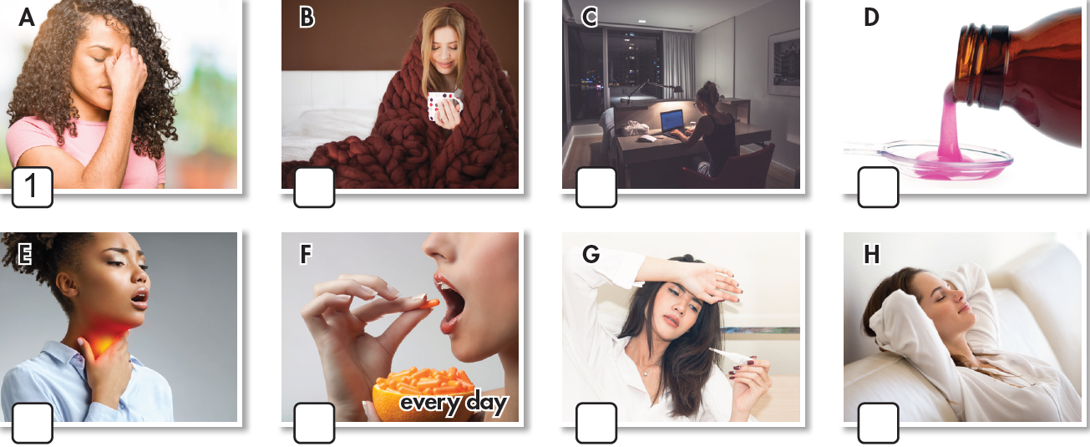
(Work in pairs) a. Match each phrase to each picture.
1. feel weak
2. have a sore throat
3. get some rest
4. take vitamins
5. have a fever
6. take medicine
7. stay up late
8. keep warm
8
7
6
2
4
5
3
Click here to show the answers.

Slide 10

Listen and repeat. Click each phrase to hear the sound.
feel weak (v. phr) /fiːl wiːk/: có cảm giác yếu
have a sore throat (v. phr) /hæv ə ˌsɔːr ˈrəʊt/: bị đau họng
get some rest (v. phr) /ɡet sʌm rest/: nghỉ ngơi
take vitamins (v. phr) /teɪk ˈvaɪtəmɪnz/: uống vitamin
have a fever (v. phr) /hæv ə ˈfiːvər/: bị sốt
take medicine (v. phr) /teɪk ˈmedɪsn/: uống thuốc
stay up late (v phr) /steɪ ʌp leɪt/: thức khuya
keep warm (v phr) /kiːp wɔːrm/: giữ ấm

Slide 11
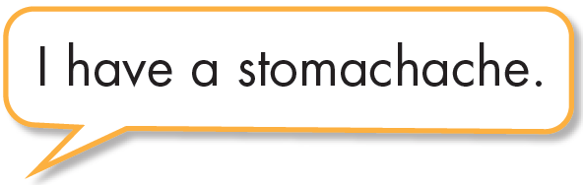
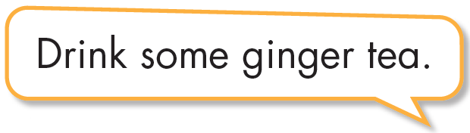

Work in pairs.
b. Discuss more health problems and give advice.

Slide 12
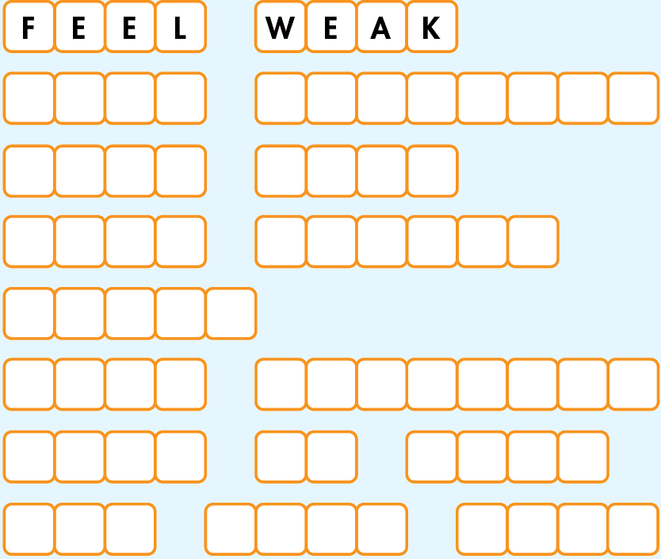
Workbook page 10
a. Unscramble the words and phrases.
1. E E L F E A W K
2. K A T E A V I T N I S M
3. P E E K M R W A
4. E O R S T A T O H R
5. R F V E E
6. K E T A C M E N D E I I
7. A Y S T P U L E A T
8. E G T O E S M S T E R
T A K E
V I T A M I N S
K E E P
W A R M
S O R E
T H R O A T
F E V E R
T A K E
M E D I C I N E
S T A Y
U P
L A T E
Click here for the answers.
G E T
S O M E
R E S T

Slide 13
Workbook p. 10
b. Fill in the blanks using the words from Task a.
1. I have no energy and can't do any work. I _____ _____.
2. I feel very hot and sick. I think I have a ______.
3. The doctor told me to _____ ________ after eating, three times a day.
4. If you eat a healthy diet, you don't need to _______ _______.
feel weak
fever
take medicine
take vitamins
Click here for the answers.

Slide 14
Workbook p. 10
b. Fill in the blanks using the words from Task a.
5. You should wear a thick jacket and scarf to ______ _____ in winter.
6. I have a cough and a _____ _____ . It hurts when I drink.
7. Many teens ____ ____ ____ to do homework or watch TV. That's bad for their health because they won't get enough sleep.
8. You look tired. You should ____ ____ ____.
keep warm
sore throat
stay up late
get some rest
Click here for the answers.

Slide 15
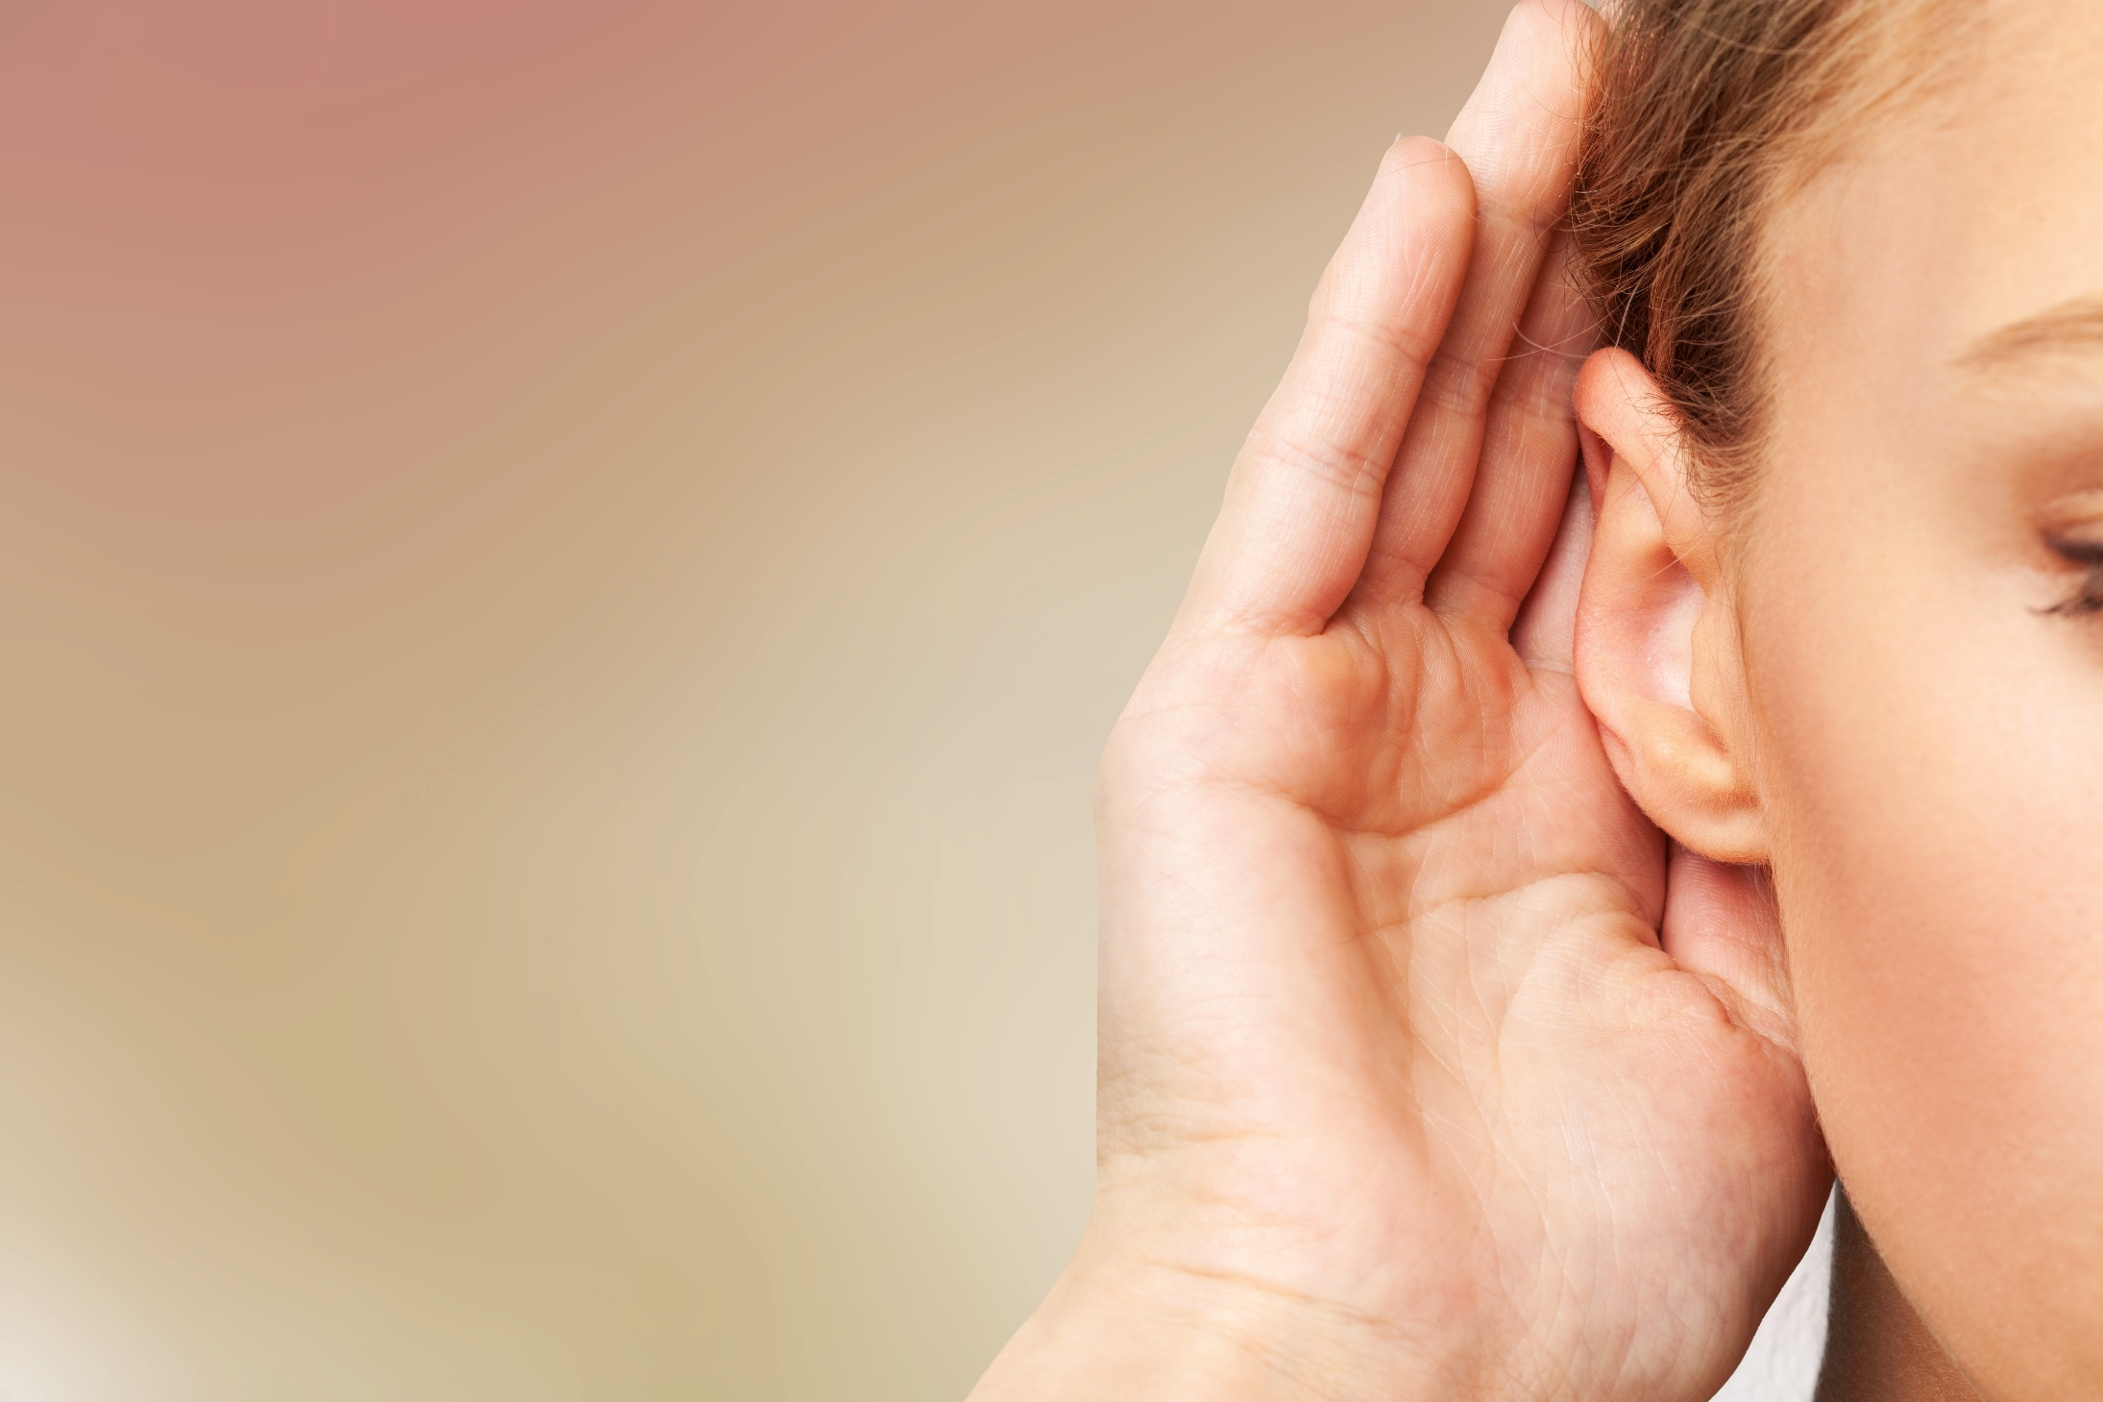


Slide 16
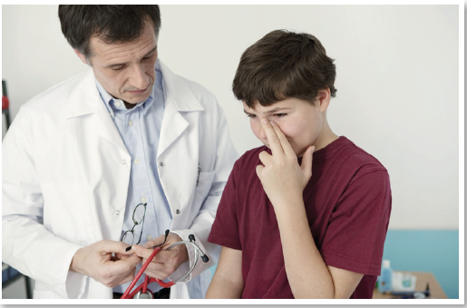
Work in pairs.
What’s wrong with the boy?

Slide 17
a. Listen to Jacob visiting the doctor. Circle the reason for Jacob's visit.
1. He wants a health check. 2. He is sick.
Keywords: a sore throat, feel very tired
Click here to show the answers.

Slide 18
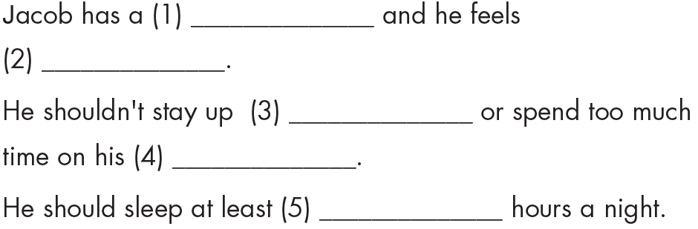
b. Listen and fill in the blanks.
sore throat
very tired
late
laptop
7 / seven
Click here to show the answers.

Slide 19
SCRIPTS
Jacob: Good morning, Doctor.
Doctor: Good morning, Jacob. What can I do for you today?
Jacob: I'm not feeling very well.
Doctor: How are you feeling?
Jacob: I have a sore throat and I feel very tired.
Doctor: I see. Are you getting enough sleep every night?
Jacob: Hmm…Not really. I often stay up late because I have a lot of homework.
Doctor: Do you use a computer for your homework?
Jacob: Yes. I use a laptop all the time.
Doctor: Well, you shouldn't stay up late or spend too much time on your laptop.
Jacob: OK, I'll try.
Doctor: And you should get at least seven hours of sleep
every night. Eight or nine hours would be better.
Jacob: OK.
Doctor: Here's some medicine for your throat. Take it every morning and night.
Jacob: Thanks, Doctor.
Doctor: You're welcome.

Slide 20
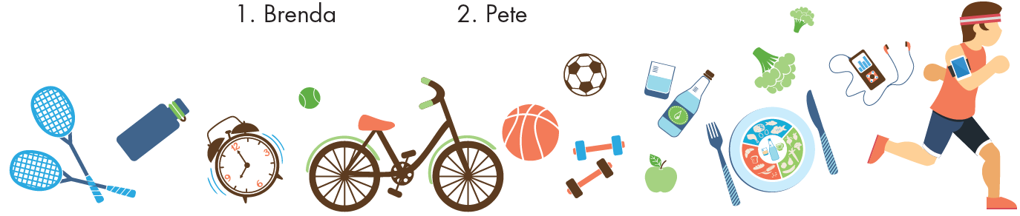
Workbook page 10-11. (WB track 3)
a. Listen to two children talking at school. Who has a healthier lifestyle?
1. Brenda 2. Pete
Click here to show the answers.

Slide 21
Workbook page 10-11. (WB track 3)
b. Listen and circle A, B, or C.
Click here for the answers.
1. Pete has...
A. a headache. B. a sore throat. C. a stomachache.
2. Pete does...
A. a lot of exercise. B. a little exercise. C. no exercise.
3. Brenda eats...
A. some junk food. B. no fresh fruit. C. a lot of salad.
4. Pete eats...
A. a lot of salad. B. a little salad. C. no salad.
5. Pete should...
A. do more exercise. B. eat more junk food. C. watch less TV.

Slide 22
SCRIPT
G: Hey Pete. You don't look well today. Are you OK?
B: No. I feel sick. I didn't really want to come to school today.
G: What's wrong with you?
B: I had a headache last night, and now I have a sore throat. My mom says my lifestyle is unhealthy.
G: Do you eat healthy food and do any exercise?
B: Not really. I love fast food and I'm too lazy to do any exercise.
G: You know I stay healthy by doing exercise every day and I always eat healthy food.
B: What do you eat?
G: Well, things like salad and fresh fruit. And I don't eat junk food.
B: Salad? Urgh! I hate salad!
G: Well, you should eat less junk food and you should definitely try to exercise more.

Slide 23
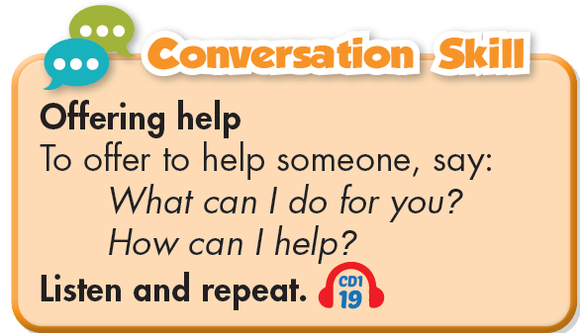
Student’s book page 15
c. What do you do when you're sick? Why?

Slide 24

CONSOLIDATION

Slide 25
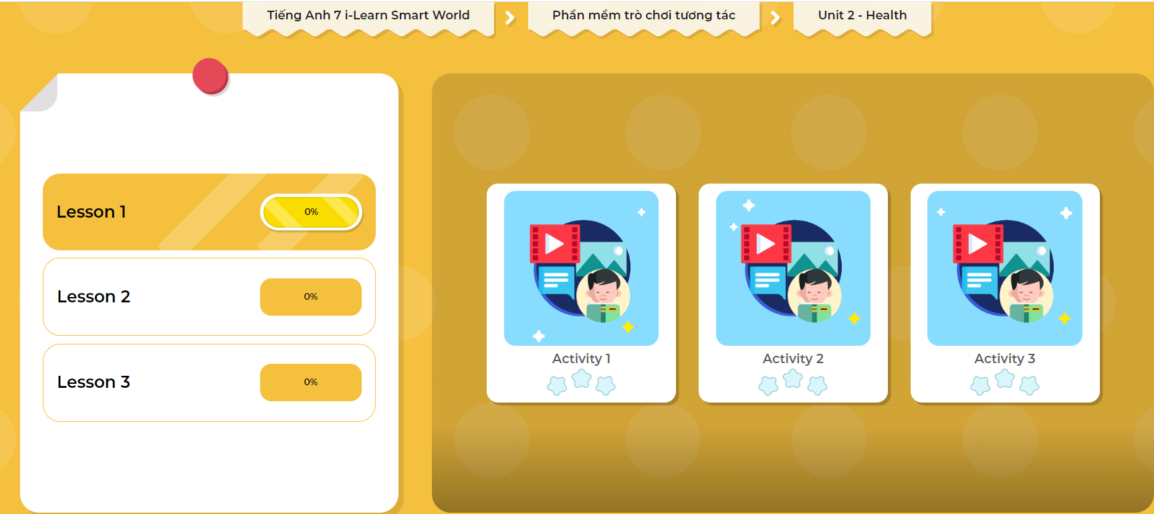
LET’S PLAY!
Click here to play the games

Slide 26
Write three examples about what you should do when you have a sore throat or when you are tired. (about 25 words)
Ex: When I have a sore throat, I always drink warm water.

Slide 27

WRAP-UP

Slide 28
Today’s lesson
Vocabularies
feel weak
have a sore throat
get some rest
take vitamins
have a fever
take medicine
stay up late
keep warm
Listening
Listening for gist and for details about health problems.
Conversation skill
To offer to help someone, say:
What can I do for you?
How can I help?

Slide 29
Homework
Practice vocabulary and make sentences using them.
Do the exercises on page 10 WB.
Do the exercises in Tiếng Anh 7 i-Learn Smart World Notebook on page 10.
Prepare the next lesson (page 16, SB).
Do the exercises in Tiếng Anh 7 i-Learn Smart World DHA App on www.eduhome.com.vn

Slide 30

Lesson 3
Stay positive and have a nice day!

