Slide 1

Unit 2: School
Lesson 1.3: Pronunciation & Speaking
Student’s Book - Page 16

Slide 2



LESSSON OUTLINE
Consolidation

Slide 3
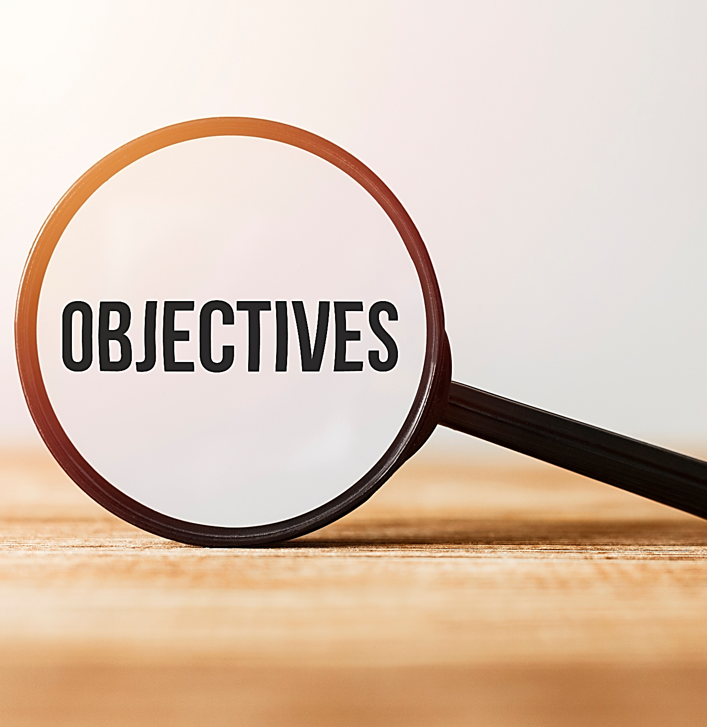
By the end of this lesson, students will be able to…
use intonation for lists goes up, up, then down;
talk about their favorite school subjects.

Slide 4

WARM-UP

Slide 5

Speaking. Interview a partner.
What’s your name?
What subjects do you study today?
Which one is your favorite?
What is your favorite subject’s teacher’s name?

Slide 6
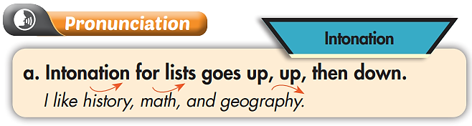

Slide 7


Listen to the sentences and focus on how the intonation goes up then down.
Practice
- I like history, math, and geography.
- I like biology, physics, and literature.

Slide 8

Listen and cross out the one with the wrong intonation.
- I like math, science, and history.
- I like art, music, and physics.

Slide 9
Read the sentences with the correct intonation to a partner.
- I like math, science, and history.
- I like art, music, and physics.

Slide 10




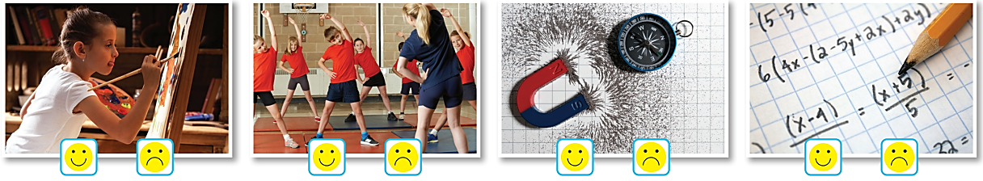

Circle or

Slide 11
Ask and answer. Swap roles and repeat.
I like art, physics, and P.E.
What subjects do you like?
Notes:
https://www.shutterstock.com/image-vector/cute-girl-kid-boy-talking-each-1905081079

Slide 12

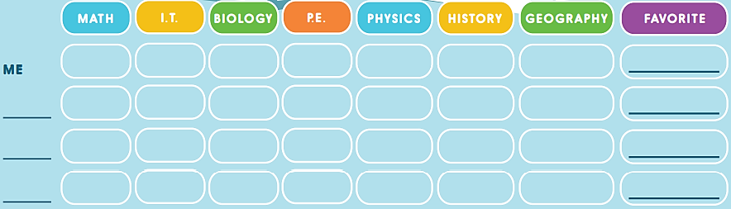
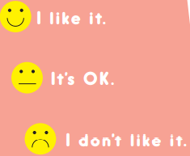
You’re doing a survey about school subjects. Fill in a survey for yourself.

Slide 13
Ask three friends about school subjects and draw faces on the table.

Slide 14
After doing the survey, answer the question ‘Which three favorite subjects are the most popular in your group?’.
In our group, our three favorite subjects are … .
Notes:
https://www.shutterstock.com/image-vector/woman-headhunter-icon-cartoon-vector-web-1853283415

Slide 15

CONSOLIDATION

Slide 16
Pronunciation Intonation
Intonation for lists goes up, up, then down.
Ex. I like history, math, and geography.

Slide 17
Pronunciation
Read the below sentences using intonation to a partner.
Swap roles and check your partner’s pronunciation.
She doesn’t like math, physics, or literature.
They like art, music, and biology.
I don’t like geography, history, or art.

Slide 18

WRAP-UP

Slide 19
Today’s lesson
Pronunciation
Using intonation for lists goes up, up, then down.

Slide 20
Homework
Review the vocabulary and grammar notes in Tiếng Anh 6 i-Learn Smart World Notebook (pages 8 & 9).
Play the consolation games in Tiếng Anh 6 i-Learn Smart World DHA App on www.eduhome.com.vn.
Prepare the next lesson (page 17 - SB).

Slide 21

Lesson 3
Stay positive and have a nice day!

