Slide 1

Unit 1 – Hello
Lesson 3 – Part 4,5,6

Slide 2
Warm
Up

Slide 3

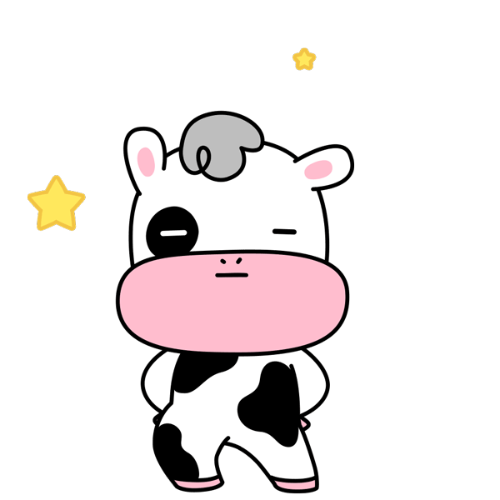









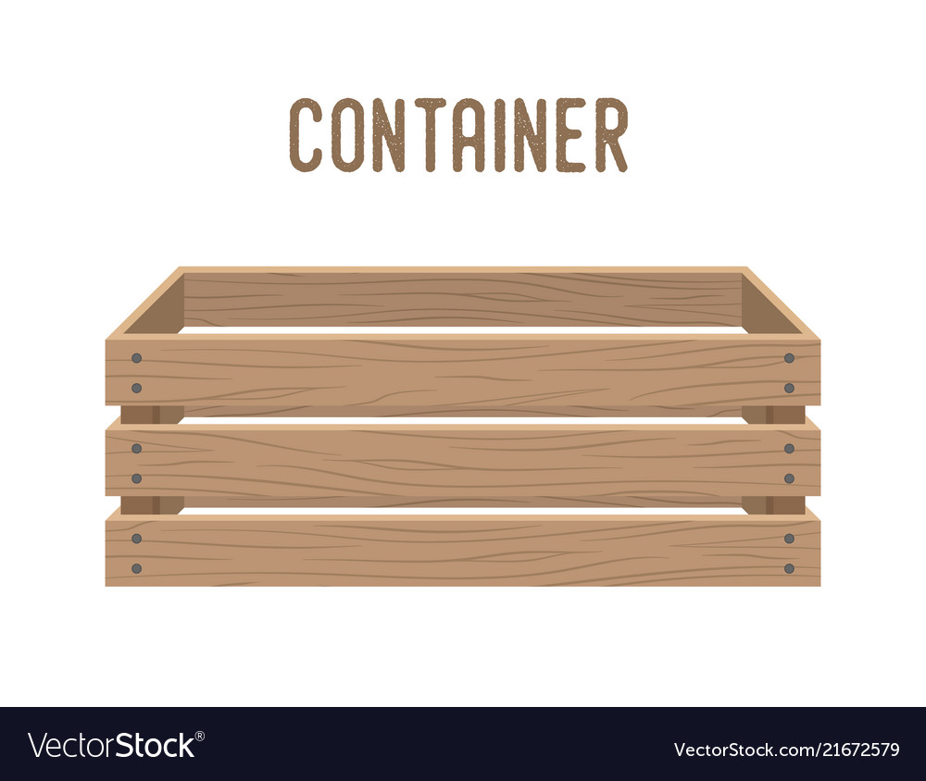
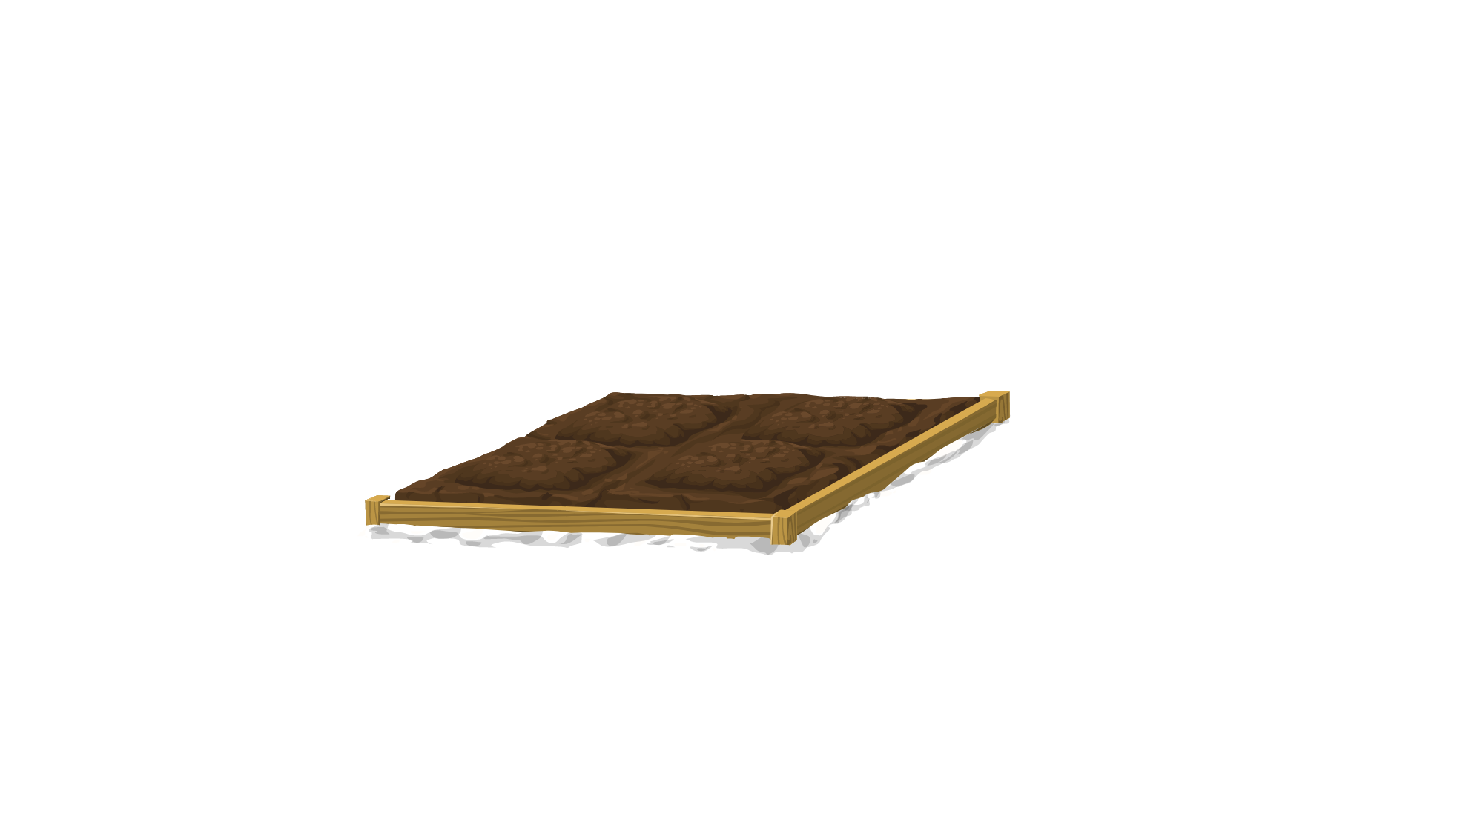
Vegetables Collecting
Game

Slide 4










Slide 5




b
Reorder:
I – Lucy – Hello, - am
A. Hello, I am Lucy
C. Hello, Lucy I am
B. Lucy, Hello I am
D. I am hello, Lucy.

Slide 6
C
Ben: Goodbye, Minh
Minh: ……………….
A. Hello, Ben
C. Bye, Ben
C. Hi, Ben
D. Fine, Ben

Slide 7
…..,How .…you?
A. Hello - are
C. Hi - fine
B. Bye - are
D. Hi - Ben

Slide 8

Hello Linh, I’m ………
A. Lycu
C. Linh
C. Lucy
D. Luck

Slide 9




Hello, Lucy

Slide 10
How are you?
………………
Fine
Fine, bye
Thank you
Fine, thank you

Slide 11
Hi, I’m Linh
Hi, how are you?
Hello, how are you?
Goodbye, Ben

Slide 12
Reorder : ogodyeb
godbyeo
goobdye
goodbye
boeoby

Slide 13
Reading and writing

Slide 14


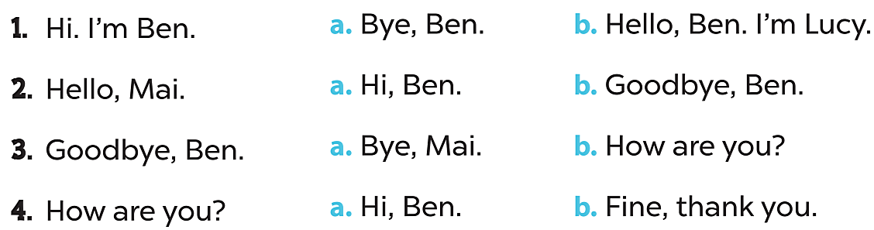

Slide 15

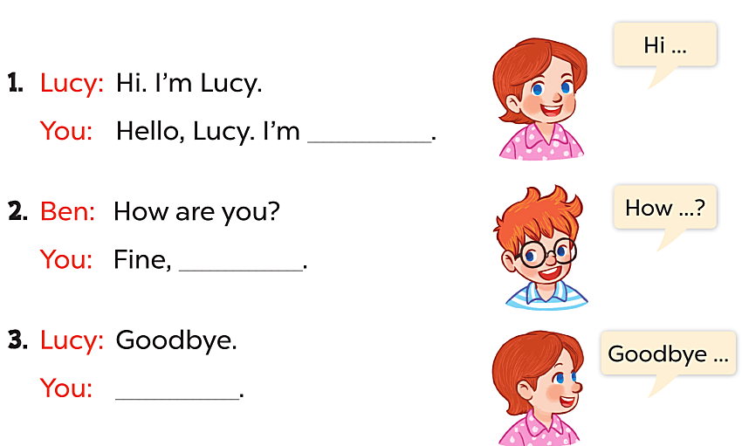
Linda
thank you.
Bye, Lucy

Slide 16

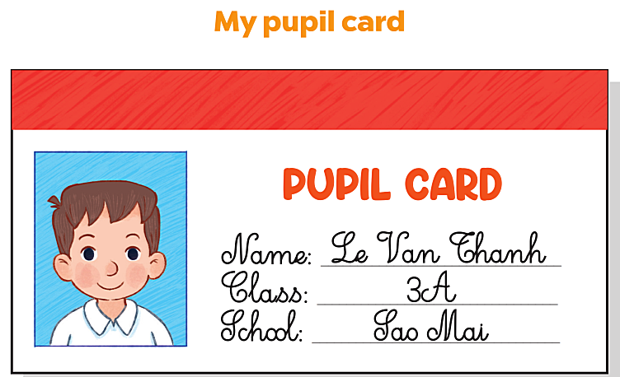

Slide 17
Good Bye

