Slide 1
Ngữ pháp Tiếng Anh
THÌ HIỆN TẠI TIẾP DIỄN
Start

Slide 2
USE
Dùng để diễn tả những sự việc xảy ra ngay lúc chúng ta nói hay xung quanh thời điểm nói.
Example: She is playing chess at the moment.
Next

Slide 3
Examples
He is
skat
e
ing
They are
swim
m
ing
She is
run
n
ing
Next

Slide 4

Practice
Is he running?
No, he isn’t
What is he doing?
He is clapping.
Next

Slide 5

Practice
Are they eating?
No, they aren’t
What are they doing?
They are talking.
Next

Slide 6

Practice
Is he driving?
No, he isn’t
What is he doing?
He is running.
Next

Slide 7

Practice
Is he skiing?
No, he isn’t.
What is he doing?
He is pushing a snowball.
Next

Slide 8

Practice
Is she speaking?
No, she isn’t
What is she doing?
She is listening to music.
Next

Slide 9

Practice
Is he studying?
No, he isn’t
What is he doing?
He is singing.
Next

Slide 10
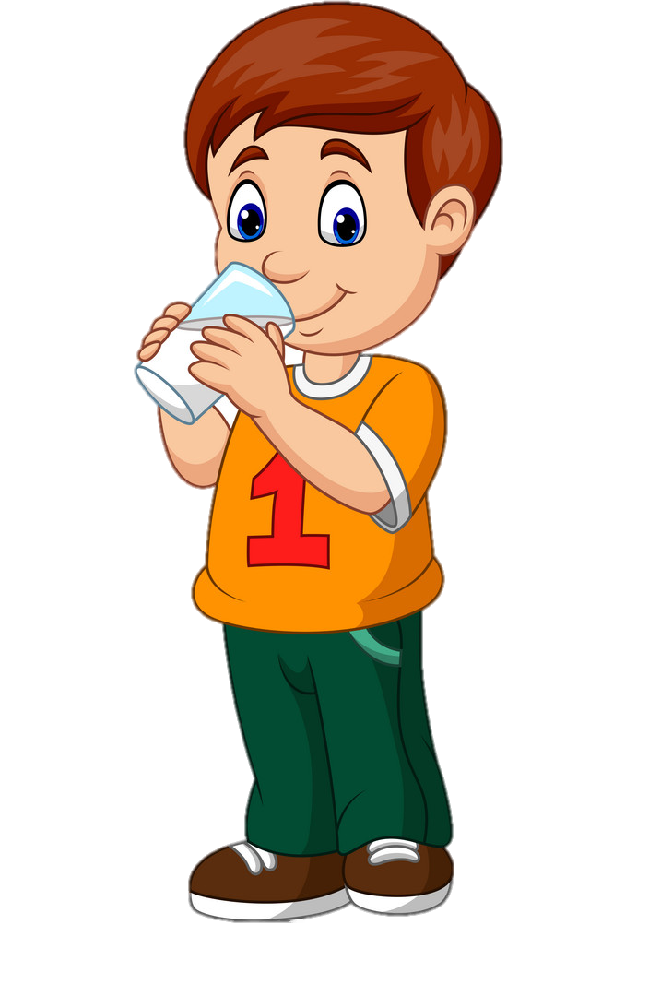
Practice
Is he eating?
No, he isn’t
What is he doing?
He is drinking.
Next

Slide 11

Practice
Is he writing?
No, he isn’t.
What is he doing?
He is driving.
Next

Slide 12
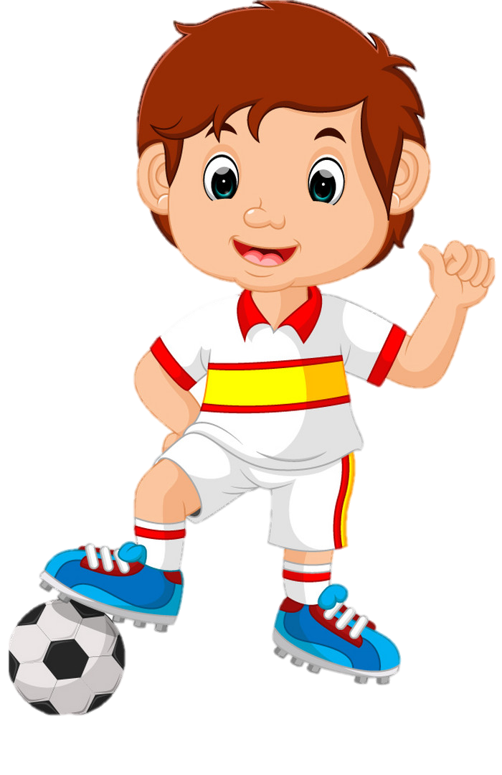
Practice
Is he reading?
No, he isn’t
What is he doing?
He is playing football.
Next

Slide 13

Practice
Is he sleeping?
No, he isn’t
What is he doing?
He is swimming.
End

