Slide 1

Unit 7: Movies
Lesson: Review
Pages 98 & 99

Slide 2
Lesson Outline
Warm-up
Listening
Reading
Vocabulary
Grammar
Pronunciation
Consolidation
Wrap-up

Slide 3
Objectives
By the end of this lesson, students will be able to…
Vocabulary: Review vocabularies related to movies.
Structure: Review prepositions: on/at/in and Past Simple with “be”.
Pronunciation: Identify words with different stress.
Reading: Practice reading for specific information.
Listening: Practice listening for details.

Slide 4

WARM-UP

Slide 5
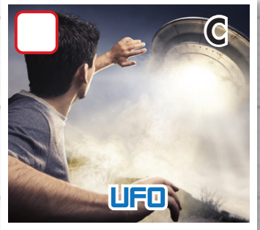
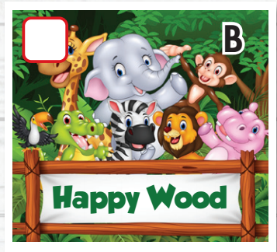
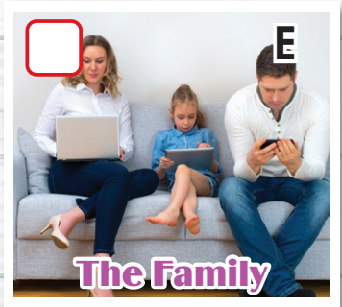
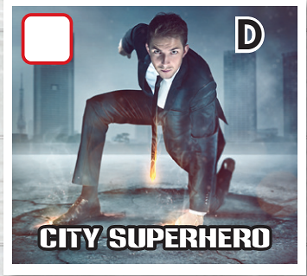
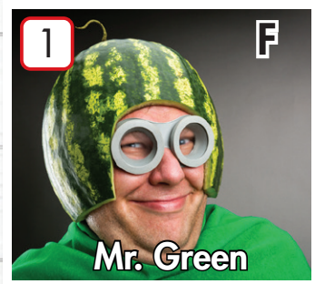
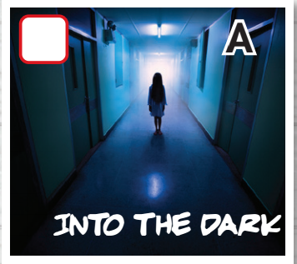
What kind of movie? List down kind of movie you can remember in the order
Notes:
6 clicks- 6 kinds of movie

Slide 6
Go around your class. Ask and find out kinds of movie that your friend likes
What kind of movie do you like?
I like…..
Kind of movie | Name
Comedy
Science fiction
Horror
Action
Animated
Drama

Slide 7

Listening

Slide 8
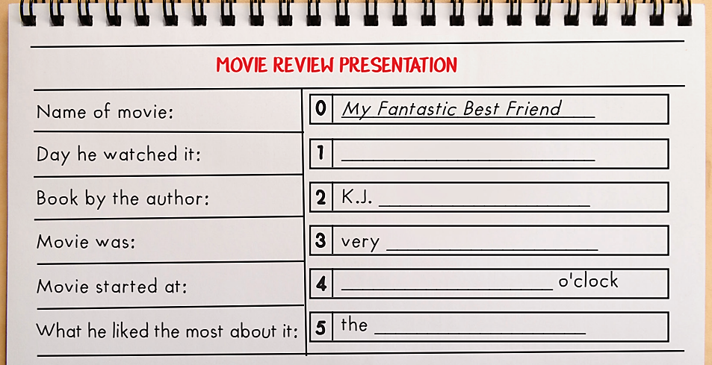
Pre-Listening

Slide 9
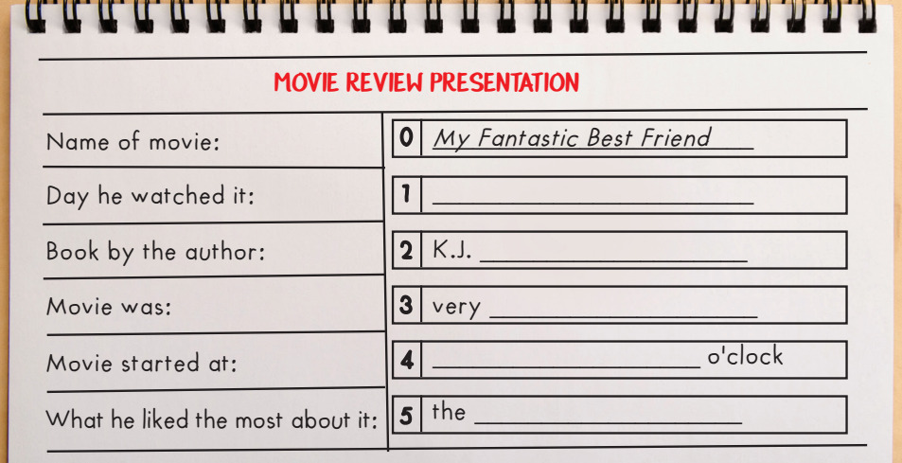
Pre-Listening
Guess what you need to fill in?
Day of week?
A name? Spelling of name.
An adjective?
Time?
Noun?

Slide 10

B: Hi, everyone. I'm Harry, and my presentation is about a movie I like. The movie is called My Fantastic Best Friend.

Slide 11
Thursday
I watched it on Thursday with my sister.

Slide 12
Birch
The movie is a comedy based on a book by the American
author K.J. Birch, that's B-I-R-C-H.

Slide 13
funny
I really liked the movie because it was very funny.

Slide 14
Seven/7
The movie started at seven o'clock and was pretty short, only ninety minutes long.

Slide 15
music
The thing I liked the most about My Fantastic Best Friend was the music. It was fantastic!

Slide 16

Reading

Slide 17
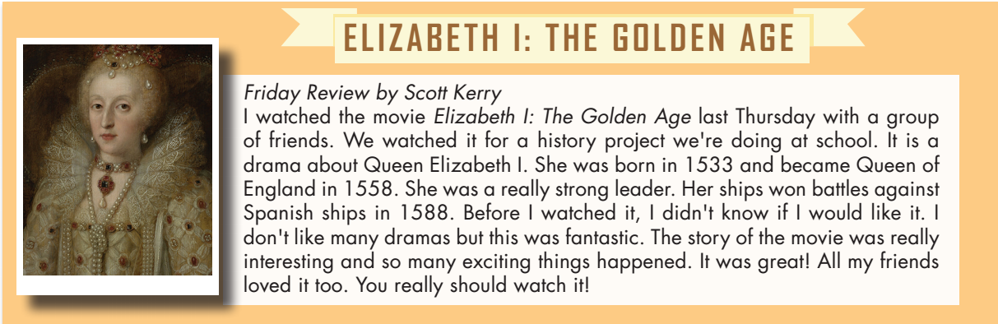

Slide 18
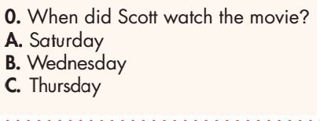
Pre-Reading
Underline key words.

Slide 19
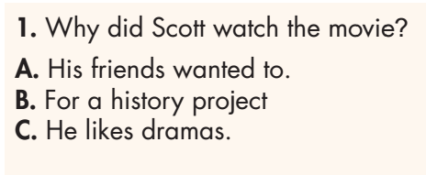
Pre-Reading
Underline key words.

Slide 20
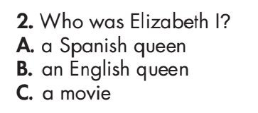
Pre-Reading
Underline key words.

Slide 21
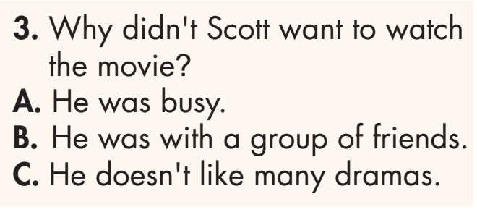
Pre-Reading
Underline key words.

Slide 22
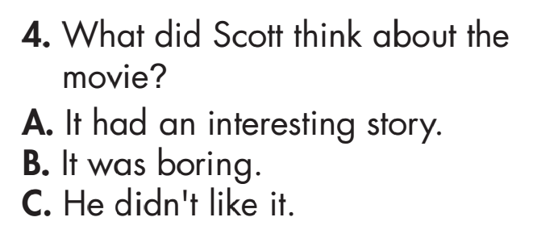
Pre-Reading
Underline key words.

Slide 23
While-Reading

Slide 24
While-Reading

Slide 25
While-Reading

Slide 26
While-Reading

Slide 27
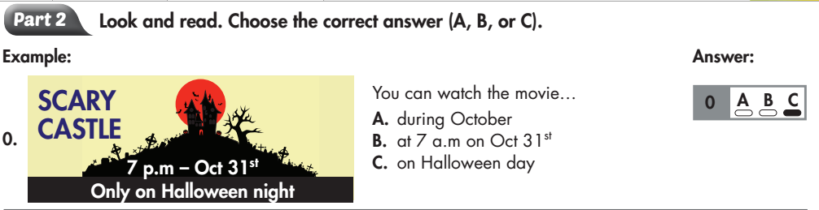
Extra Practice
WB page 68

Slide 28
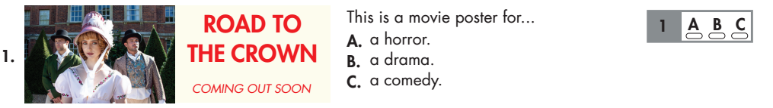
Extra Practice
WB page 68

Slide 29
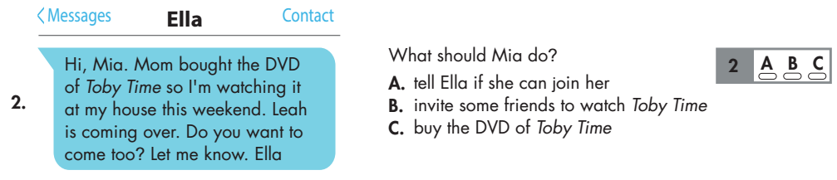
Extra Practice
WB page 68

Slide 30
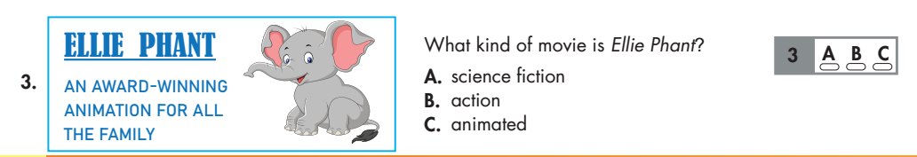
Extra Practice
WB page 68

Slide 31
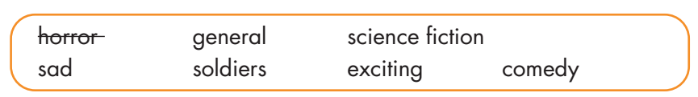
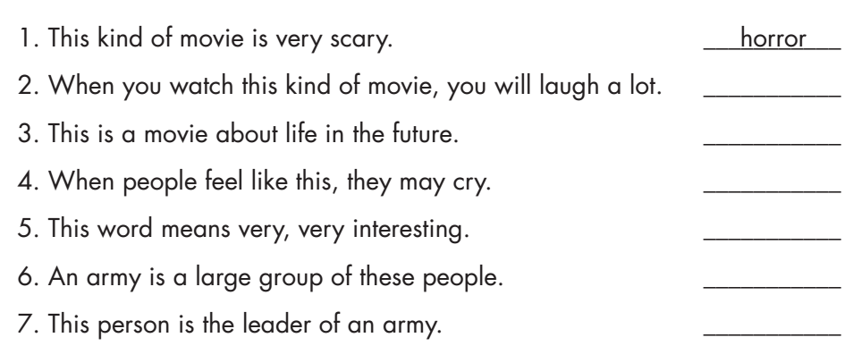
comedy
science fiction
sad
exciting
soldiers
general

Slide 32

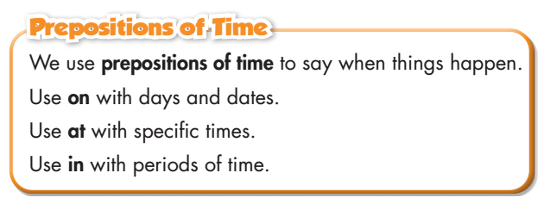
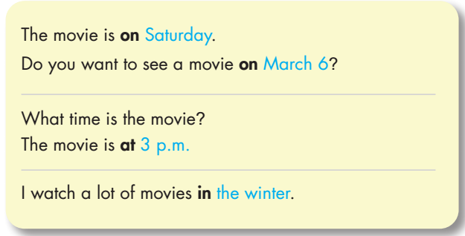

Slide 33
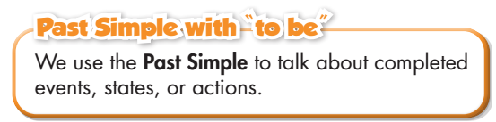
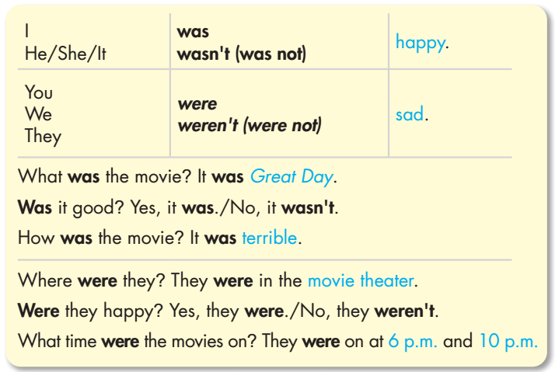

Slide 34

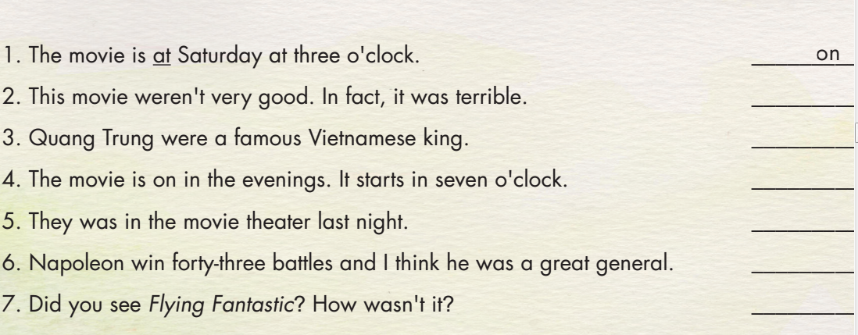
Underline the mistake in each sentence. Write the correct word on the line.
wasn’t
was
at
were
won
was

Slide 35

Where is the stress in each of these words?
against boring action fantasy exciting become adventure
horror comic between soldier movie author title animation
wonderful mystery amazing musical terrible animated
1st syllable | Second syllable | Third syllable

Slide 36
Where is the stress in each of these words?
against boring action fantasy exciting become adventure
horror comic between soldier movie author title animation
wonderful mystery amazing musical terrible animated
FIRST SYLLABLE
Boring Action
Fantasy Horror
Comic Soldier
Movie Author
Title Terrible
Wonderful Mystery
Musical Animated

Slide 37
Where is the stress in each of these words?
against boring action fantasy exciting become adventure
horror comic between soldier movie author title animation
wonderful mystery amazing musical terrible animated
SECOND SYLLABLE
Against
Exciting
Become
Adventure
Between
Amazing

Slide 38
Where is the stress in each of these words?
against boring action fantasy exciting become adventure
horror comic between soldier movie author title animation
wonderful mystery amazing musical terrible animated
THIRD SYLLABLE
animation

Slide 39
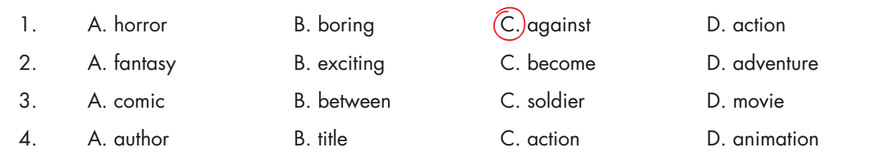
Stress on the first syllable. The rest are on the second syllable.
Stress on the third syllable. The rest are on the first syllable.
Stress on the second syllable. The rest are on the first syllable.

Slide 40
Stress on the second syllable. The rest are on the first syllable.
Stress on the second syllable. The rest are on the first syllable.

Slide 41

CONSOLIDATION

Slide 42

Answer the following questions in pairs.
- What kinds of movies do you like? Use some adjectives to describe those kinds of movie.
- What kind of movie do you dislike? Use an adjective to describe that kind of movie.
- What are you doing on Saturday?
- List down a historical movie you watched. How was the movie? Who was it about?

Slide 43

WRAP-UP

Slide 44
Today’s lesson
Vocabulary: Review vocabularies related to movies.
Structure: Review prepositions: on/at/in and Past Simple with “be”.
Pronunciation: Identify words with different stress.
Reading: Practice reading for specific information.
Listening: Practice listening for details.

Slide 45
Homework
Review all the vocabularies, pronunciation and grammar points in the unit.
Prepare the next lesson (page 62 - SB).
Play the consolidation games in Tiếng Anh 6 i-Learn Smart World DHA App on www.eduhome.com.vn.

Slide 46
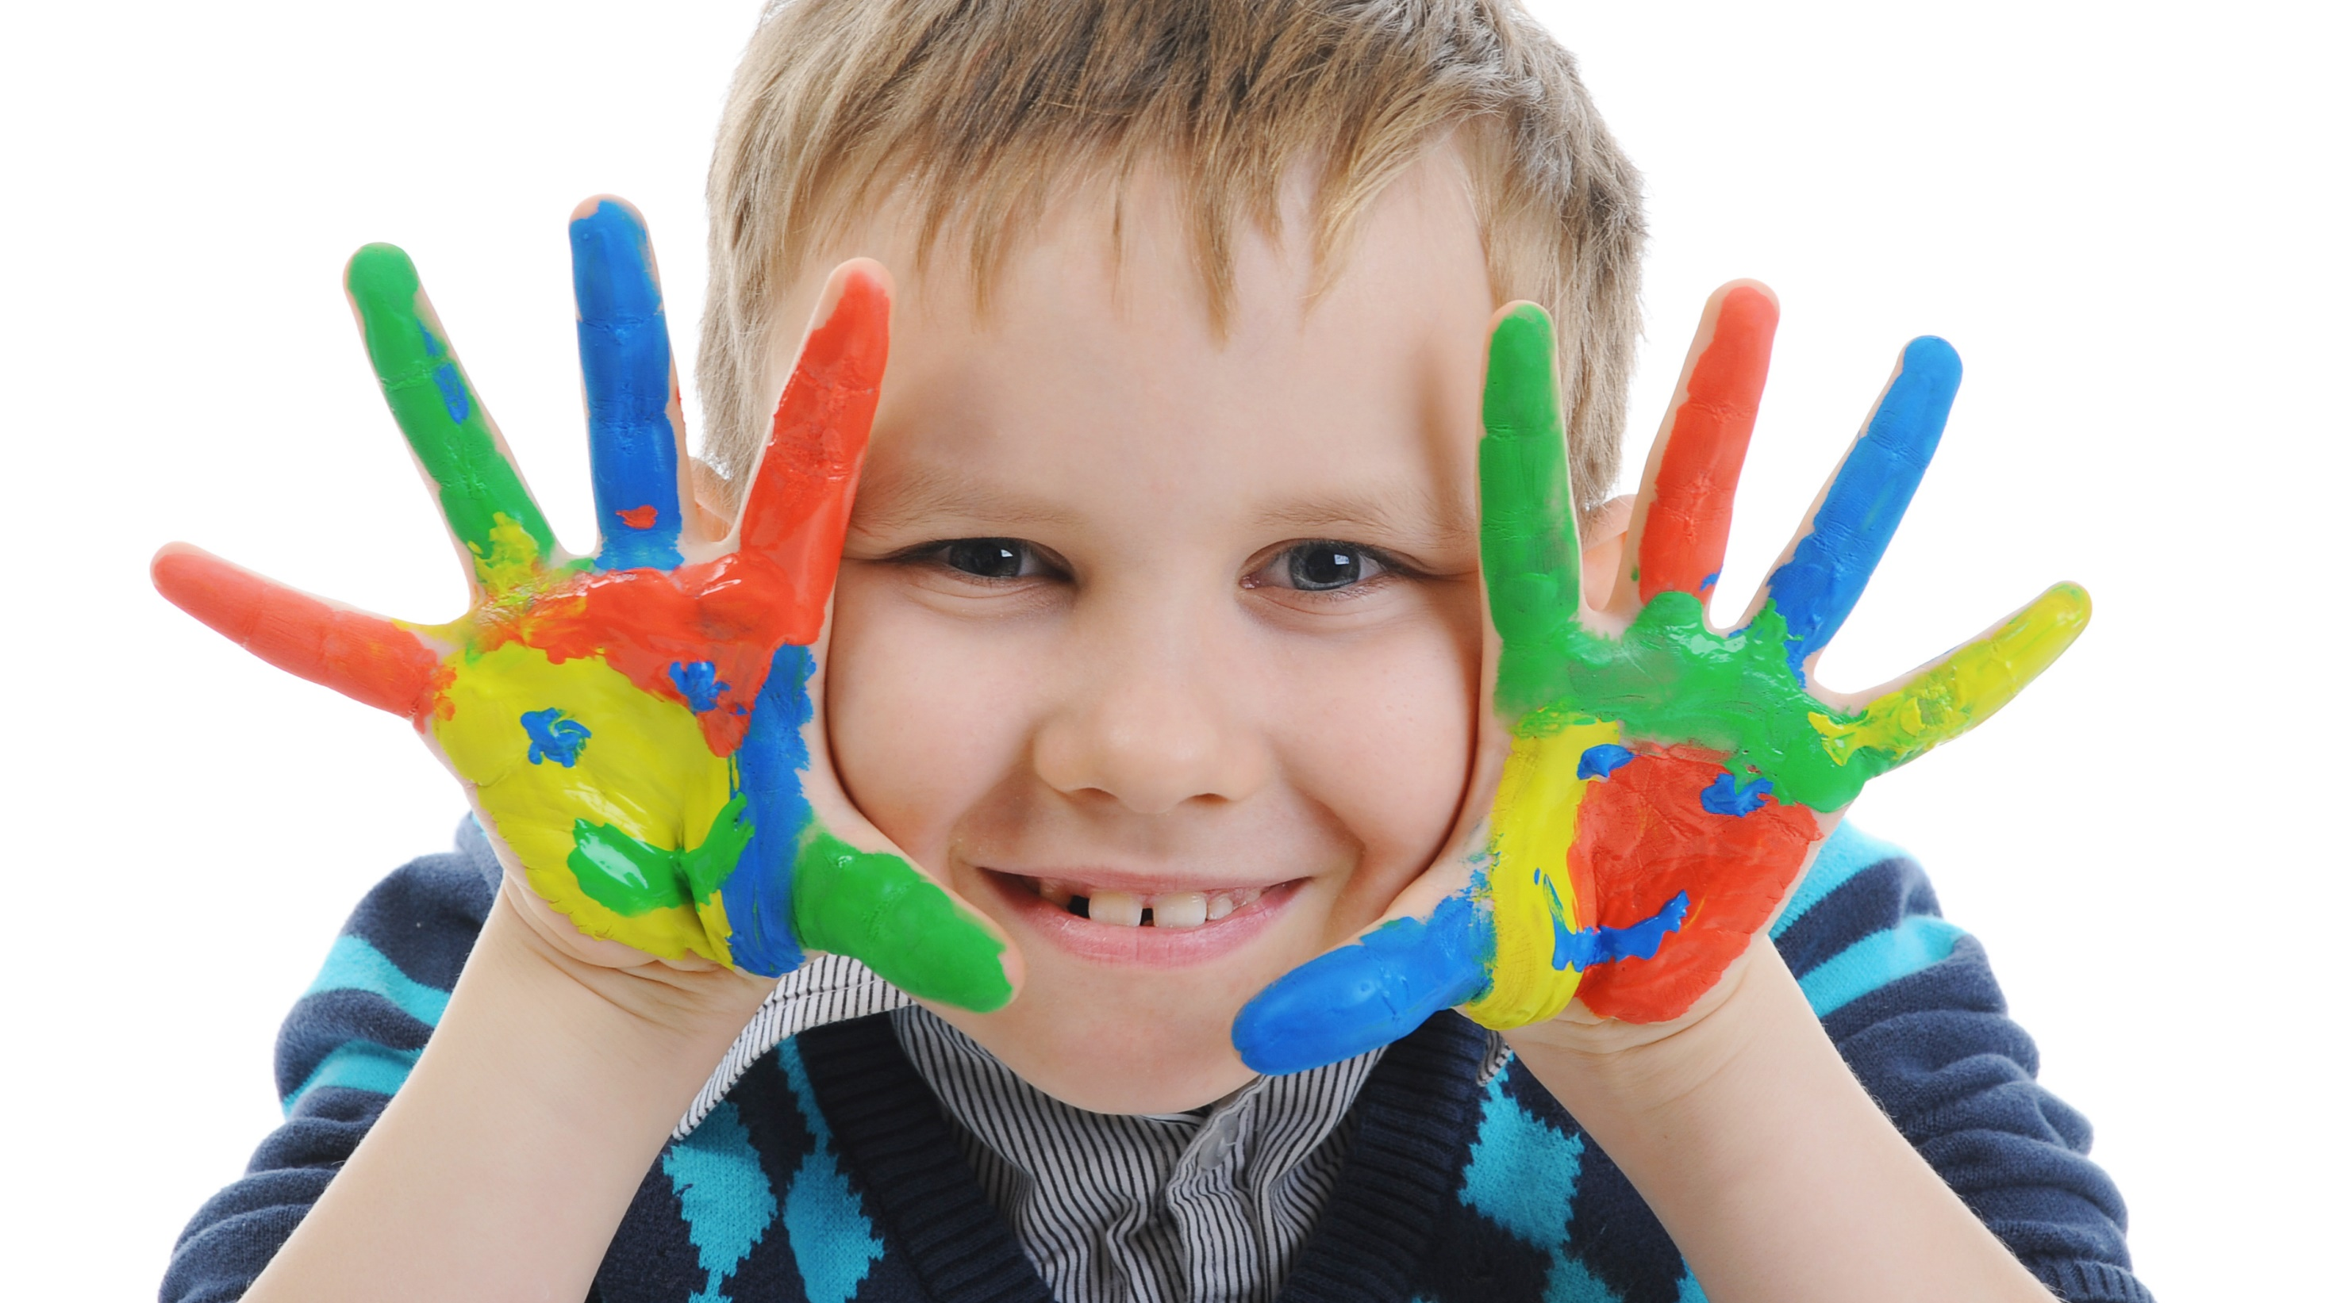
Enjoy your day!

