Slide 2


Unit
8
SPORTS AND GAMES
LESSON 6: SKILLS 2
Listening
Writing
1

Slide 3
LESSON 6: SKILLS 2
LESSON 1: GETTING STARTED
WARM-UP
Game: Choose the numbers
Task 1: Listen to the passages. Who are they about?
Task 2: Listen to the passages again. Tick T or F.
Task 3: Listen again and complete each sentence.
LISTENING
Task 4: Work in pairs. Talk about the sport/ game you like. Use the following questions as cues
Task 5: Write a paragraph of 40-50 words about the sport/game you talked about in Task 4.
WRITING
CONSOLIDATION
Wrap-up
Homework

Slide 4
Game: Choose the number
WARM-UP

Slide 5
WARM-UP
Choose the numbers
1
2
3
4
5
END GAME

Slide 6

WARM-UP
Question 1:
Give the correct name of sport which he plays
1. Football (David Beckham)
GO BACK

Slide 7
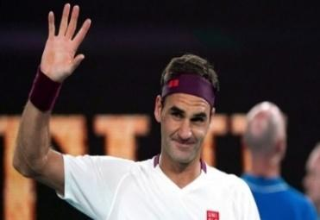
WARM-UP
Question 2:
Give the correct name of sport which he plays
→ Tennis (Roger Federer)
GO BACK

Slide 8
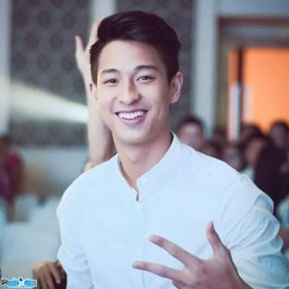
WARM-UP
Question 3:
Give the correct name of sport which he plays
Badminton
(Phạm Hồng Nam)
GO BACK

Slide 9
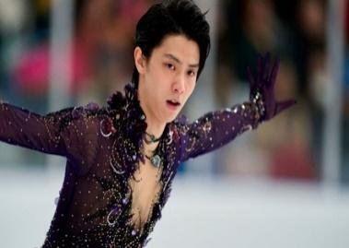
WARM-UP
Lucky numbers
Question 4:
Give the correct name of sport which he plays
→ Ice skating (Yuzuru Hanyu)
GO BACK

Slide 10
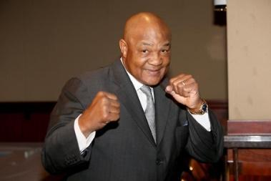
WARM-UP
Question 5:
Give the correct name of sport which he plays
→ Boxing (George Foreman)
GO BACK

Slide 11
I. LISTENING
LISTENING

Slide 12


LISTENING
1
Listen to the passages. Who are they about?
→ They are talking about Hai and Alice.

Slide 13
LISTENING
2
Listen to the passages again. Then tick (✔) T (True) or F (False) for each sentence.
 | T | F
1. The passages are about two sportsmen.
2. Hai goes cycling at the weekend.
3. Hai's favourite sport is karate.
4. Alice doesn't like doing sport very much.
5. Alice plays computer games every day.
✓
students.
✓
✓
✓
✓
sometimes

Slide 14
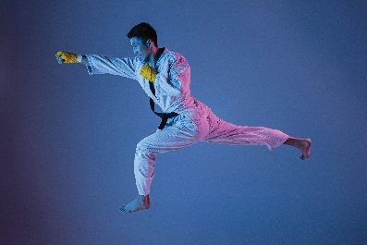

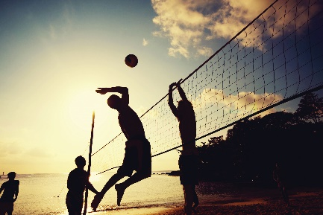
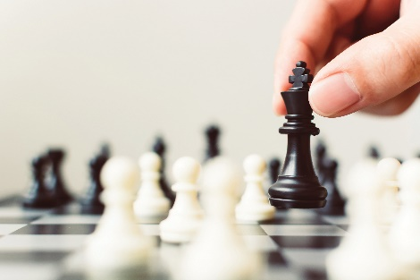
LISTENING
3
Listen again and fill each blank with a word to complete each sentence.
1. Hai plays __________ at school.
2. Hai practises karate at the club __________ times a week.
3. __________ likes watching sport on TV.
4. Alice plays __________ every Saturday.
volleyball
a sport/ game
three
number
Alice
person
chess
a sport/ game

Slide 15
II. WRITING
WRITING

Slide 16
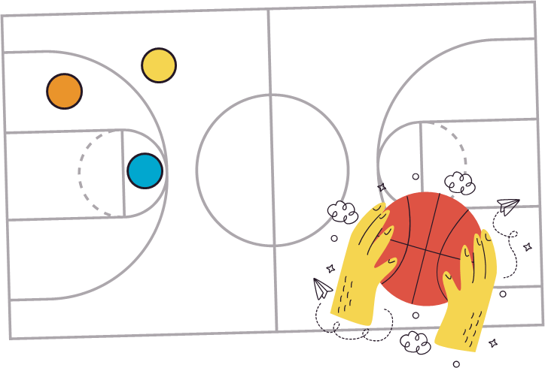
WRITING
4
Work in pairs. Talk about the sport/ game you like. Use the following questions as cues.
What is the name of the sport / game?
How many players are there?
How often do you play it?
What equipment does it need?
Why do you like it?

Slide 17


WRITING
Write a paragraph of 40-50 words about the sport/ game you talked about in Task 4. You can also refer to listening passages.
5

Slide 18

CONSOLIDATION
1
Wrap-up
What have we learnt in this lesson?
listen for general and specific information about sport(s) / game(s)
write a paragraph about a sport / game

Slide 19

CONSOLIDATION
2
Homework
Rewrite the paragraph in the notebook.
Do exercises in the workbook.

Slide 20






Website: hoclieu.vn
Fanpage: facebook.com/www.tienganhglobalsuccess.vn/

