Slide 2
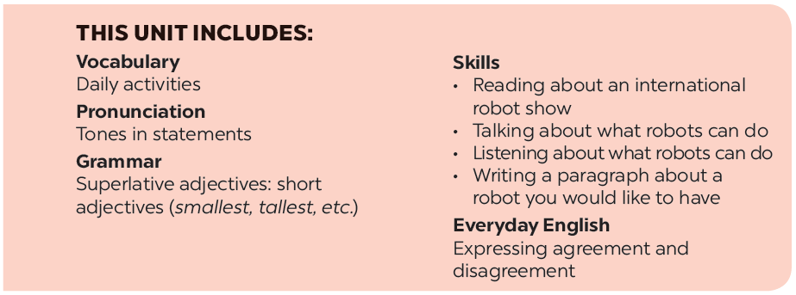

Slide 3
Listening
Writing
Listen to the conversation between Khang and Dr Adams and tick () the phrases you hear.
Imagine a robot you would like to have. Make notes about it.
Listen to the conversation again and tick () T (True) or F (False).
Now write a paragraph of 50-60 words about the robot you would like to have. Use the information in 3 to help you.

Slide 4
Listening

Slide 5
Listen to the conversation between Khang and Dr Adams and tick () the phrases you hear.
- look after sick people

- understand what we say

- build the very high buildings

- teach many subjects

- move heavy things
Audio script

Slide 6
AUDIO SCRIPT
Khang: Dr Adams, please tell me something about robots.
Dr Adams: Sure. Robots can do quite a lot today. Home robots can do housework. Doctor robots can look after sick people. And...
Khang: Can robots build houses?
Dr Adams: Yes. Worker robots can even build the very high buildings.
Khang: Can they teach?
Dr Adams: Yes. Teacher robots can teach many subjects in a classroom or online.
Khang: Can they understand what we say?
Dr Adams: Yes, they do. They can even speak to us.
Khang: Robots can do everything like humans?
Dr Adams: No, not everything. They can't understand our feelings or play football.

Slide 7
Listen to the conversation again and tick () T (True) or F (False).
 | T | F
1. Robots can’t do many things today.
2. Worker robots can build the very high buildings.
3. Teacher robots can teach on the internet.
4. Robots can talk to humans.
5. Robots can do everything like humans.





Audio script

Slide 8
AUDIO SCRIPT
Khang: Dr Adams, please tell me something about robots.
Dr Adams: Sure. Robots can do quite a lot today. Home robots can do housework. Doctor robots can look after sick people. And...
Khang: Can robots build houses?
Dr Adams: Yes. Worker robots can even build the very high buildings.
Khang: Can they teach?
Dr Adams: Yes. Teacher robots can teach many subjects in a classroom or online.
Khang: Can they understand what we say?
Dr Adams: Yes, they do. They can even speak to us.
Khang: Robots can do everything like humans?
Dr Adams: No, not everything. They can't understand our feelings or play football.

Slide 9
Writing

Slide 10
Imagine a robot you would like to have.
Make notes about it.
1. Name of your robot | _______________________________
2. Type of robot | _______________________________
3. Where it can work | _______________________________
4. What it can do for you | _______________________________

Slide 11
Now write a paragraph of 50-60 words about the robot you would like to have. Use the information in 3 to help you.
My robot’s name is ____________________.
It is a ________________________________. _____________________________________ _____________________________________ _____________________________________ _____________________________________ _____________________________________

Slide 12
Website: hoclieu.vn
Fanpage: facebook.com/www.tienganhglobalsuccess.vn/

