Slide 1

Unit 5: Food and Drinks
Review
Pages 94 & 95

Slide 2






LESSON OUTLINE
Consolidation

Slide 3
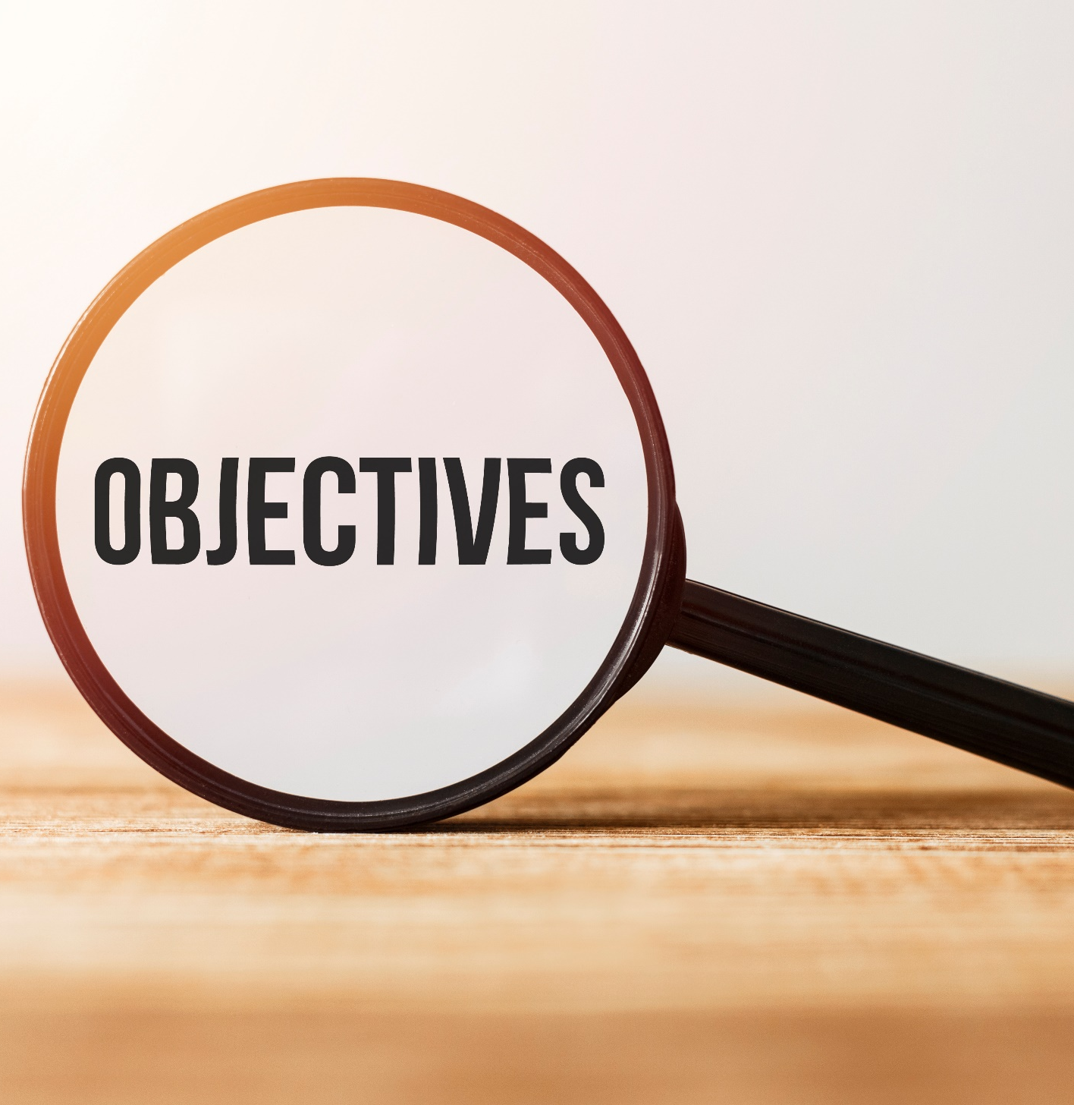
By the end of this lesson, students will be able to…
- review vocabularies and grammar points.
- talk about
• quantities and containers of food and drinks.
• what we have in our kitchen and where to put things.
- practice listening, reading and speaking.

Slide 4
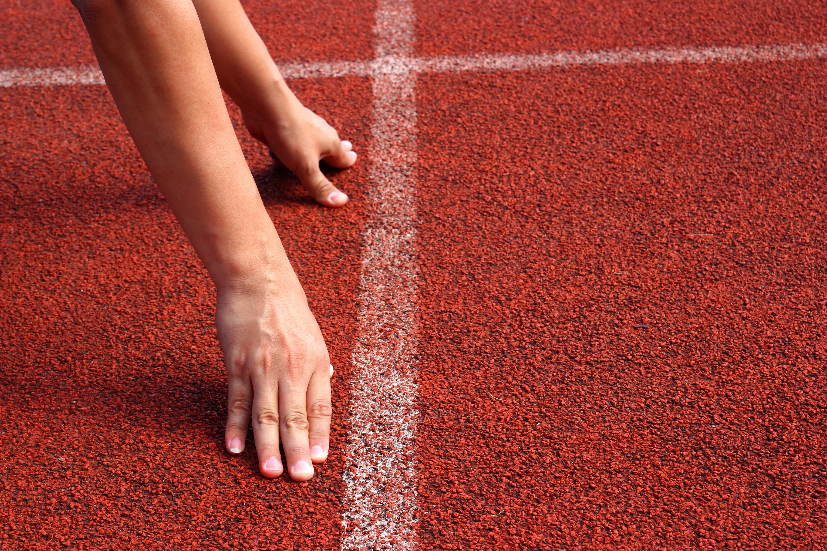
WARM UP

Slide 5
Work in groups: Complete the diagram.
A bunch of….
A bag of….
A bottle of…
Containers of food and drinks
A box of…
A can of…
A carton of…
A stick of..

Slide 6
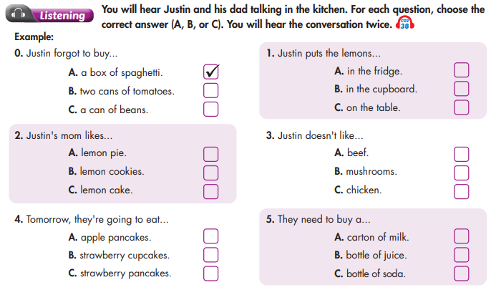

Slide 7
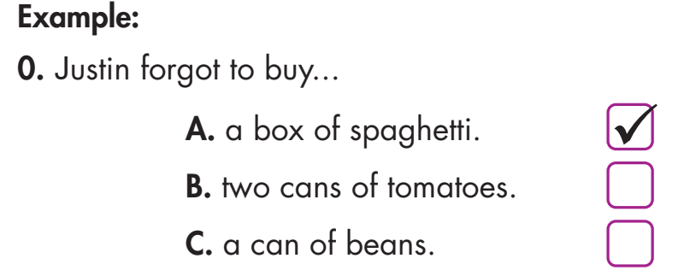
PRE-LISTENING
Underline key words and phrases

Slide 8
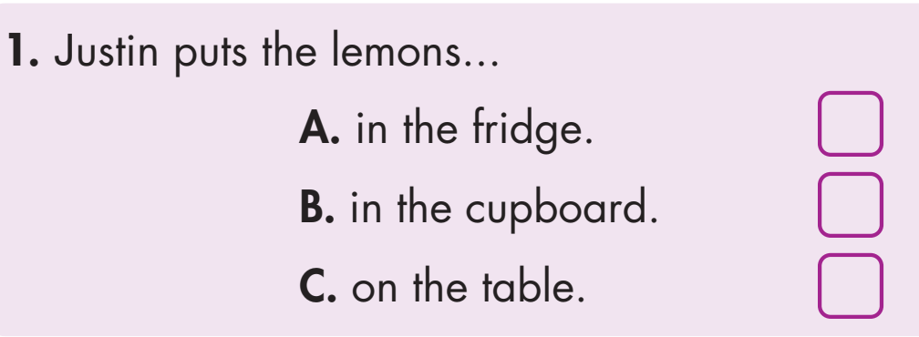

Slide 9
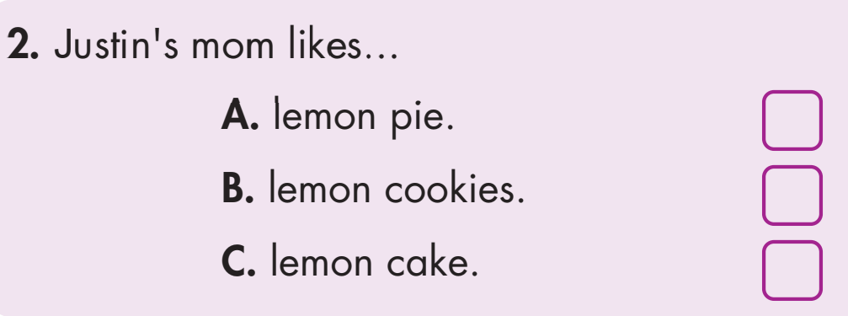

Slide 10
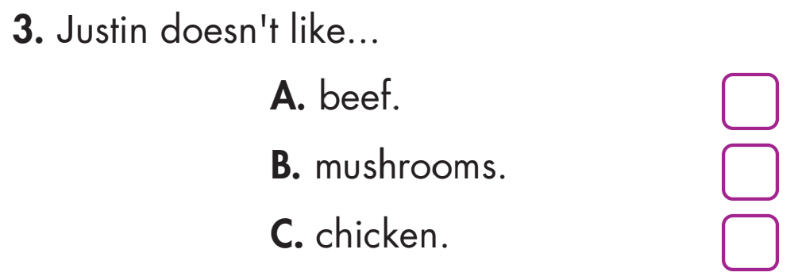

Slide 11
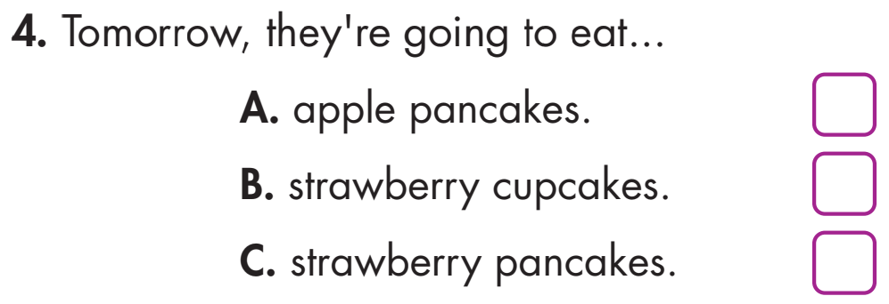

Slide 12
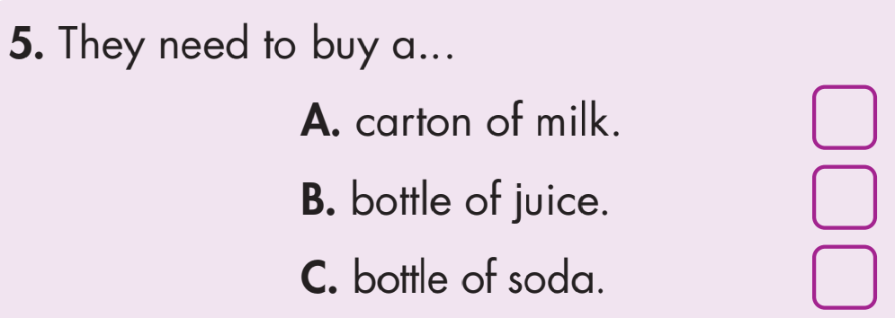

Slide 13

WHILE-LISTENING
Listen and choose the correct answer (A, B, or C). You will hear the conversation twice.
1. Justin puts the lemons...
A. in the fridge.
B. in the cupboard.
C. on the table.
Justin: What about the strawberries, apples, and lemons? Put them in the fridge?
Dad: No, put the lemons on the table.

Slide 14
2. Justin's mom likes...
A. lemon pie.
B. lemon cookies.
C. lemon cake
Justin: OK! Are you making lemon cake or lemon pie?
Dad: No, lemon cookies. Your mom loves them.

Slide 15
3. Justin doesn't like...
A. beef.
B. mushrooms.
C. chicken.
Justin: So do I! And what's for dinner?
Dad: Beef and mushroom stew.
Justin: But I don't like mushrooms.

Slide 16
4. Tomorrow, they're going to eat...
A. apple pancakes.
B. strawberry cupcakes.
C. strawberry pancakes.
Justin: Great! Can we make pancakes tomorrow? Apple…
No, let's have strawberry pancakes.
Dad: OK. We need to buy some milk first.

Slide 17
5. They need to buy a...
A. carton of milk.
B. bottle of juice.
C. bottle of soda
Dad: OK. We need to buy some milk first.
Justin: Here's a carton in the fridge. It's behind the soda.

Slide 18
Audio scripts
Dad: Justin, did you get all the shopping?
Justin: Yes, I bought two cans of tomatoes and a can of beans.
Dad: What's about the box of spaghetti?
Justin: Spaghetti? Oh, sorry. I forgot.
Dad: It's OK. Put the things away in the cupboard.
Justin: What about the strawberries, apples, and lemons? Put them in the fridge?

Slide 19
Dad: No, put the lemons on the table.
Justin: OK! Are you making lemon cake or lemon pie?
Dad: No, lemon cookies. Your mom loves them.
Justin: So do I! And what's for dinner?
Dad: Beef and mushroom stew.
Justin: But I don't like mushrooms.

Slide 20
Dad: I'm making chicken salad, too.
Justin: Great! Can we make pancakes tomorrow? Apple… No, let's have strawberry pancakes.
Dad: OK. We need to buy some milk first.
Justin: Here's a carton in the fridge. It's behind the soda.
Dad: No, that's orange juice.
Justin: Oh, OK.

Slide 21
Dad: Justin, did you get all the shopping?
Justin: Yes, I bought two cans of tomatoes and a can of beans.
Dad: What's about the box of spaghetti?
Justin: Spaghetti? Oh, sorry. I forgot.
Dad: It's OK. Put the things away in the cupboard.
Role play. Student A : Dad; student B: Justin.
You can replace some information with your own .

Slide 22
Justin: What about the strawberries, apples, and lemons? Put them in the fridge?
Dad: No, put the lemons on the table.
Justin: OK! Are you making lemon cake or lemon pie?
Dad: No, lemon cookies. Your mom loves them.
Justin: So do I! And what's for dinner?
Dad: Beef and mushroom stew.

Slide 23
Justin: But I don't like mushrooms.
Dad: I'm making chicken salad, too.
Justin: Great! Can we make pancakes tomorrow? Apple… No, let's have strawberry pancakes.
Dad: OK. We need to buy some milk first.
Justin: Here's a carton in the fridge. It's behind the soda.
Dad: No, that's orange juice.
Justin: Oh, OK.

Slide 24
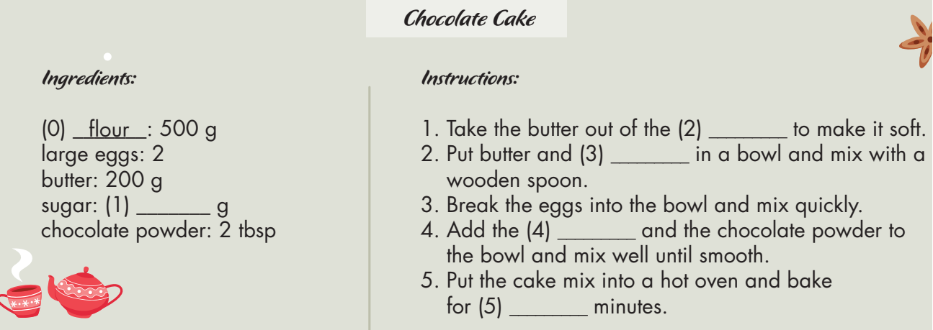
Extra Practice
WB, page 66
You will hear a woman on the radio talking about how to make a cake. Listen and fill in the blanks. You will hear the information twice.
F

Slide 25
Work in pairs. Look at the information, discuss how to make a cake, focus on the blanks to guess the answer.

Slide 26
ANSWER
1. 200
2. fridge
3. sugar
4. flour
5. twenty/20

Slide 27
Audio Scripts
W: Today we're making a chocolate cake. We need five hundred grams of flour, two large eggs, two hundred grams of butter, two hundred grams of sugar and two tablespoons of chocolate powder. Take the butter out of the fridge and leave it to make it soft. Then put it into a bowl with the sugar and mix with a wooden spoon. Break the eggs into the bowl and mix it with the butter and sugar. Mix it very quickly with a wooden spoon. Then add the flour and the chocolate powder and mix well until you have a smooth mixture. Put the cake mix into your hot oven and bake for twenty minutes. When it’s finished, take the cake out and leave it to cool. You can then serve your chocolate cake. It's really delicious!

Slide 28

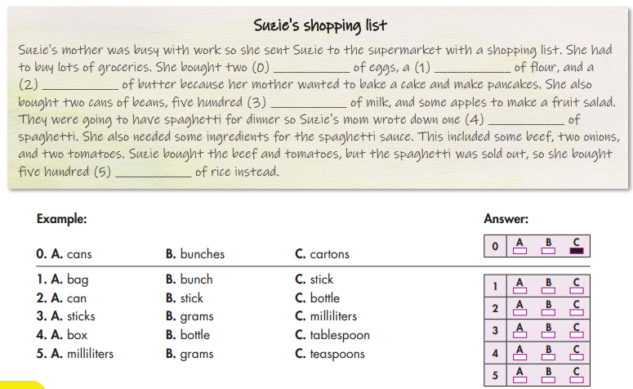
Read the text. Choose the best word (A, B, or C) for each space.

Slide 29

Suzie's shopping list
Suzie's mother was busy with work so she sent Suzie to the supermarket with a shopping list. She had to buy lots of groceries. She bought two (0) ____________ of eggs ,
CARTONS OF EGGS

Slide 30
Suzie's shopping list
Suzie's mother was busy with work so she sent Suzie to the supermarket with a shopping list. She had to buy lots of groceries. She bought two (0) ____________ of eggs, a (1) ____________ of flour,
A BAG OF FLOUR

Slide 31
and a (2) ____________ of butter because her mother wanted to bake a cake and make pancakes.
A STICK OF BUTTER

Slide 32
Read the text. Choose the best word (A, B, or C) for each space.
Suzie's shopping list
She also bought two cans of beans, five hundred (3) ____________ of milk, and some apples to make a fruit salad.
MILLILITER OF MILK

Slide 33
Read the text..
They were going to have spaghetti for dinner so Suzie's mom wrote down one (4) ____________ of
spaghetti.
A BOX OF SPAGHETTI

Slide 34
Suzie bought the beef and tomatoes, but the spaghetti was sold out, so she bought five hundred (5) ____________ of rice instead.
500 GRAMS OF RICE

Slide 35
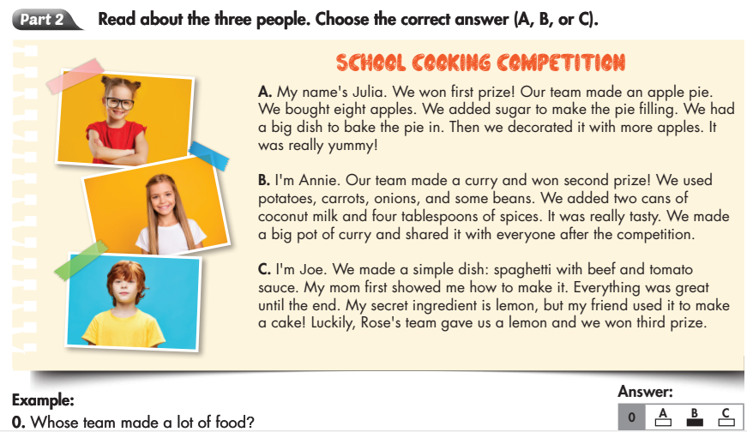
Extra Practice
WB, page 66
Read about the three people. Choose the correct answer (A, B, or C).

Slide 36

A. My name's Julia. We won first prize! Our team made an apple pie. We bought eight apples. We added sugar to make the pie filling. We had a big dish to bake the pie in. Then we decorated it with more apples. It was really yummy!
A
Summarize main ideas of the text for A
Name: Julie
Won first prize
Made an apple pie with 8 apples, sugar
Baked the pie in a big dish
Decorated with more apples
It tasted yummy

Slide 37

B. I'm Annie. Our team made a curry and won second prize! We used potatoes, carrots, onions, and some beans. We added two cans of coconut milk and four tablespoons of spices. It was really tasty. We made a big pot of curry and shared it with everyone after the competition.
B
Summarize main ideas of the text for B
Name: Annie
Won second prize
Made a curry with potatoes, carrots, onions, beans, 2 cans of coconut milk, 4 tbsp of spices
A big pot of curry
Shared the curry with everyone
It was tasty

Slide 38

C. I'm Joe. We made a simple dish: spaghetti with beef and tomato sauce. My mom first showed me how to make it. Everything was great until the end. My secret ingredient is lemon, but my friend used it to make a cake! Luckily, Rose's team gave us a lemon and we won third prize.
Summarize main ideas of the text for C
Name: Joe
Won third prize
Made spaghetti with beef, tomato sauce, lemon
His mom showed him how to make it
Needed help from Rose’s team with a lemon
C

Slide 39
Summarize the whole text
TEXT | A | B | C
Name | Julia | Annie | Joe
Prize | 1st prize | 2nd prize | 3rd prize
Dish | an apple pie | a curry | spaghetti
Ingredients | 8 apples, sugar | potatoes, carrots, onions, beans, 2 cans of coconut milk, 4 tbsp of spices | beef, tomato sauce, lemon
Taste | yummy | tasty
Other details | baked the pie in a big dish; decorated with more apples | a big pot of curry shared the curry with everyone | his mom showed him how to make it; needed help from Rose’s team with a lemon

Slide 40
Underline key words and phrases
1. Whose team made a dessert?
2. Whose team used spices in their dish?
3. Whose team got help from another team?
4. Whose team learned how to make the dish from a member's family?
5. Whose team made a dish with lots of vegetables and no meat?

Slide 41
TEXT | A | B | C
NAME | JULIA | ANNIE | JOE
WON | 1ST PRIZE | 2ND PRIZE | 3RD PRIZE
DISH | AN APPLIE PIE | A CURRY | SPAGHETTI
INGREDIENTS | 8 APPLES, SUGAR | POTATOES, CARROTS, ONIONS, BEANS, 2 CANS OF COCONUT MILK, 4 TBSP OF SPICES | BEEF, TOMATO SAUCE, LEMON
TASTE | YUMMY | TASTY
OTHER DETAILS | BAKED THE PIE IN A BIG DISH DECORATED WITH MORE APPLES | A BIG POT OF CURRY SHARED THE CURRY WITH EVERYONE | HIS MOM SHOWED HIM HOW TO MAKE IT NEEDED HELP FROM ROSE’S TEAM WITH A LEMON

Slide 42
A
B
C
C
B
Answer

Slide 43
Vocabulary. Match the words with the descriptions
1. bunch
2. carton
3. flour
4. butter
5. fridge
6. supermarket
7. spaghetti
8. tablespoon
a. container for milk, juice, or eggs
b. a place to keep butter and milk cold
c. an ingredient in pancakes and bread
d. a type of noodle from Italy
e. a place to buy all your groceries
f. It's like a teaspoon but bigger.
g. You can buy it in sticks.
h. some fruit growing together, like bananas or grapes

Slide 44

Review: Articles: a, an, the
We use a/an with singular nouns when we talk about something for the first time.
After that, we use the.
We use an before nouns beginning with the vowel letters a, e, i, o, and u

Slide 45
Much, many
Much + Uncountable Nouns
In Negative sentences and Questions
Many + Countable Nouns
Affirmative, Negative sentences and Questions

Slide 46

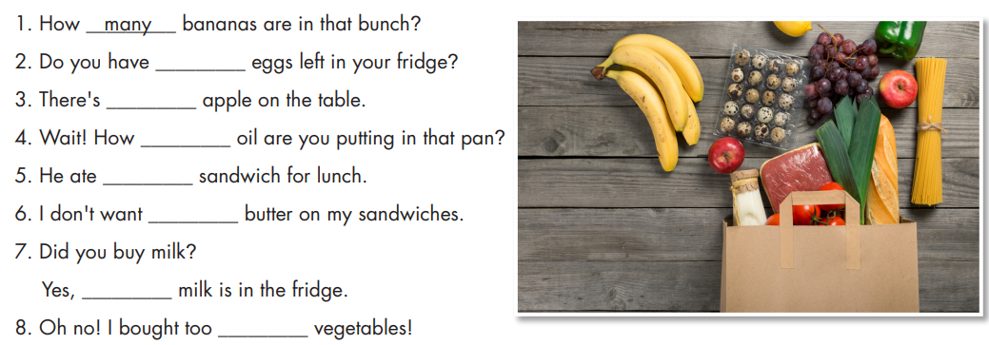
Fill in the blanks with a, an, the, much, or many

Slide 47
Countable noun
many

Slide 48
Singular countable noun, begins with vowel letter a
an

Slide 49
Uncountable noun
much

Slide 50

Countable nouns, begins with consonant letter s
a

Slide 51
Uncountable noun
much

Slide 52

Uncountable noun, already mentioned in the previous question.
the

Slide 53
Plural countable nouns
many

Slide 54

a. Circle the word that has the underlined part pronounced differently from the others.
A. pancakes B. tomatoes C. potatoes D. tablespoons
/ˈpænˌkeɪks/ / təˈmɑːtəʊz / /pəˈteɪtəʊz / /ˈteɪb(ə)lˌspuːnz /
2. A. ingredients B. apples C. lists D. supermarkets
/ ɪnˈɡriːdiənts / /ˈæpəlz/ / lɪsts/ /ˈsuːpərˌmɑːrkɪts/
A. tablespoon B. hamburger C. sandwich D. pancake /ˈteɪbəlˌspuːn / /ˈhæmˌbɜːɡər/ /ˈsæn(d)wɪdʒ/ /ˈpænˌkeɪks /

Slide 55
b. Circle the word that differs from the other three in the position of primary stress in each of the following questions.
4. A. pancake B. sandwich C. cupboard D. dessert
/ ˈpænˌkeɪk / /ˈsændwɪdʒ/ / ˈkʌbərd / / dɪˈzɜːrt /
5. A. banana B. tomato C. hamburger D. spaghetti / bəˈnɑːnə / / təˈmɑːtəʊ / /ˈ hæmbɜːrɡər/ /spəˈɡeti /
6. A. vegetable B. tablespoon C. hamburger D. potato /ˈvedʒtəbəl / /ˈteɪbəlspuːn / /ˈhæmbɜːrɡər / /pəˈteɪtəʊ/

Slide 56

CONSOLIDATION

Slide 57
Imagine you join a school cooking competition, present your dish and the prize you get. Use the mind map for brainstorming ideas.
Name
Prize
Name of dish
School cooking competition
Ingredients
How to make the dish
Taste
Decoration
Spices

Slide 58
Sample answer
My name’s Hoa. We won first prize! Our team made an apple pie.
We bought eight apples. We added sugar to make the pie filling. We had
a big dish to bake the pie in. Then we decorated it with more apples. It
was really yummy!

Slide 59
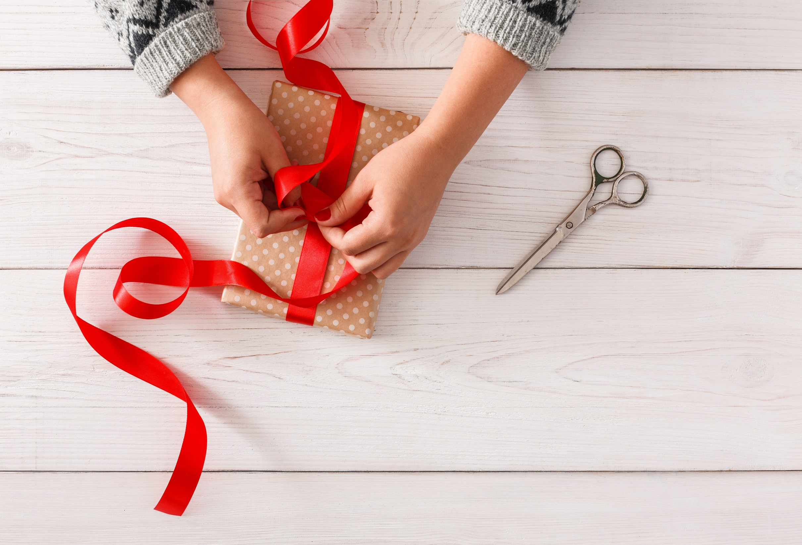
WRAP-UP

Slide 60
Today’s lesson
Reading & Listening:
- Practice reading and listening for general and specific information.
Speaking:
- Present a dish at a school cooking competition.

Slide 61
Homework
Review all vocabularies and grammar points in Unit 5.
Play the consolidation games in Tiếng Anh 7 i-Learn Smart World DHA App on www.eduhome.com.vn.
Prepare the next lesson (page 44).

Slide 62
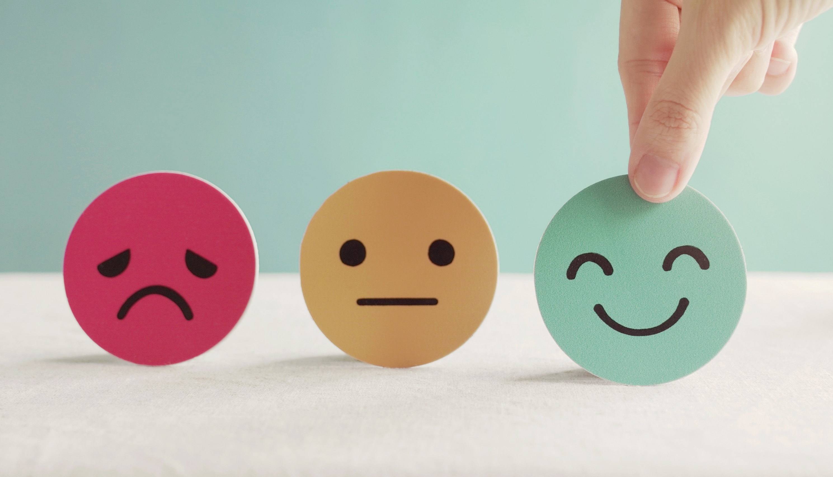
Lesson 3
Stay positive and have a nice day!

