Slide 1
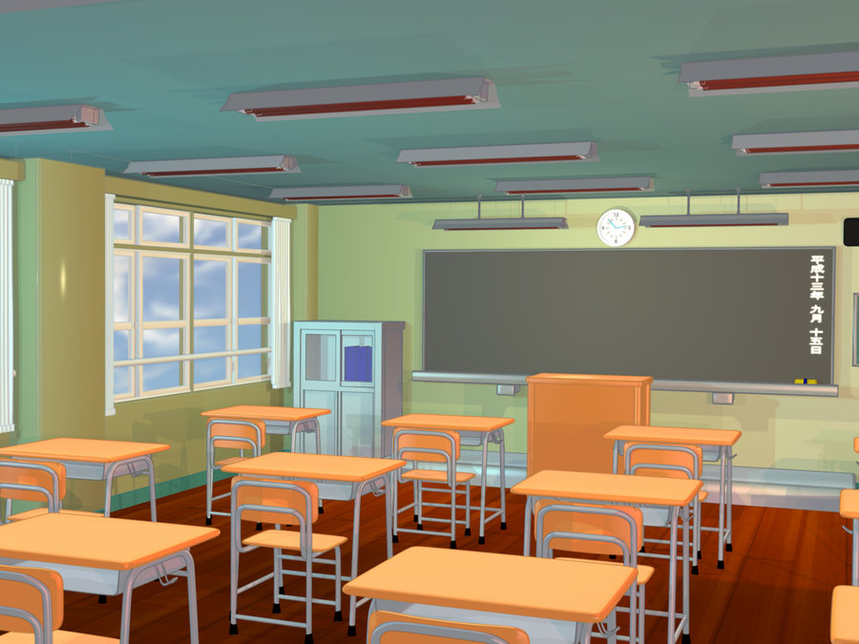


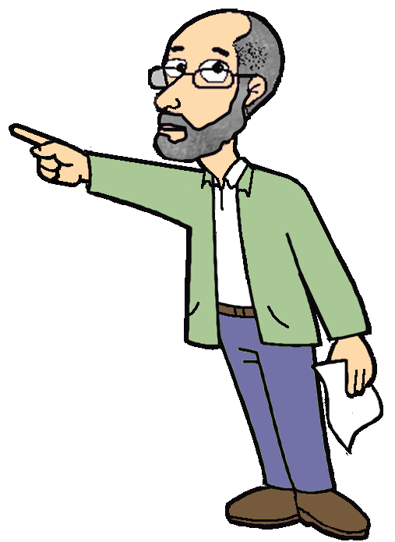
BY HERBER

Slide 2
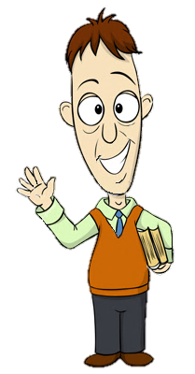

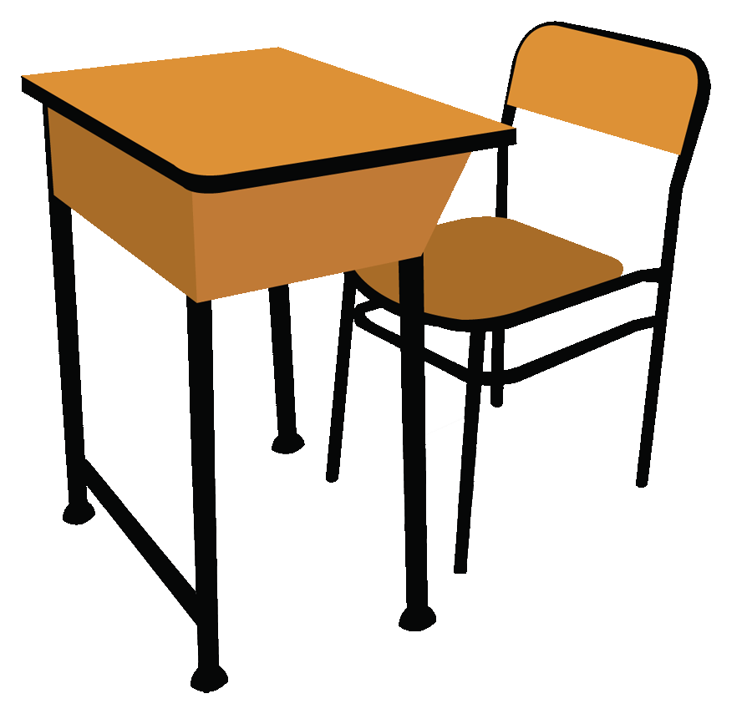
teachers
Good morning everybody!

Slide 3
teachers
Sit down, please!

Slide 4

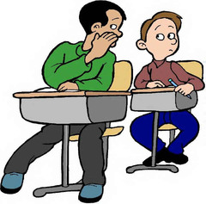
teachers
Be quiet, please!

Slide 5

teachers
Listen to me, please!

Slide 6

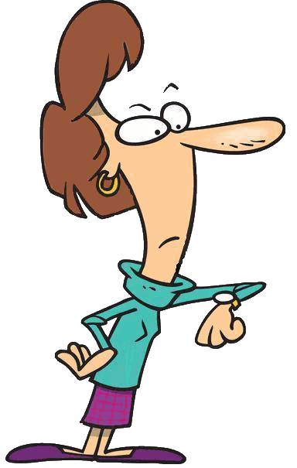
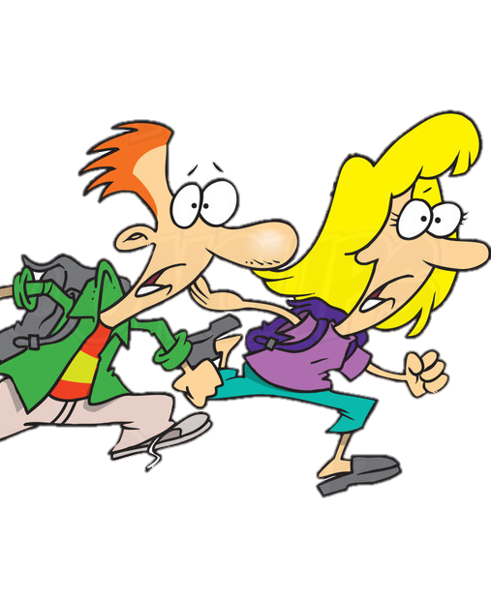
students
I’m sorry, I’m late

Slide 7

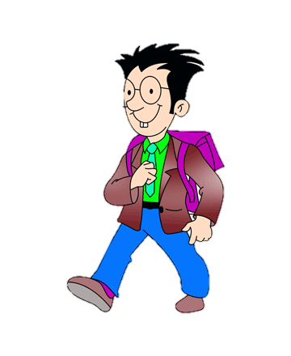
students
May I come in?

Slide 8
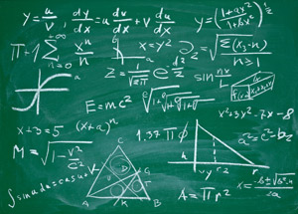
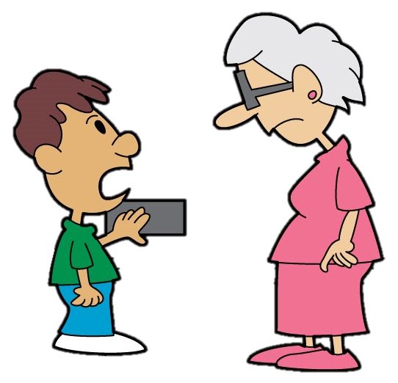
students
Can I clean the blackboard, please?

Slide 9

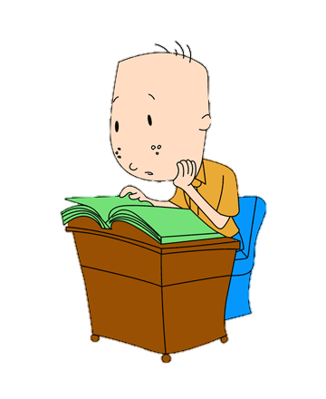
students
What page are we on?

Slide 10

teachers
Open your books at page 10.

Slide 11
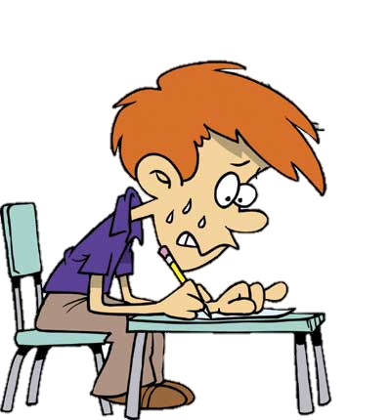
teachers
Do the exercise.

Slide 12
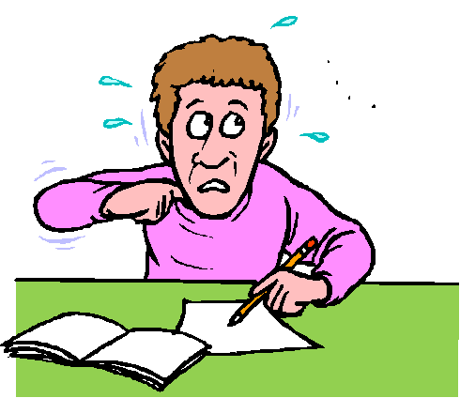
students
Can I open the window, please?

Slide 13
students
Can I sharpen my pencil, please?

Slide 14
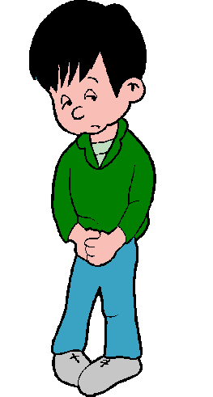
students
Can I go to the toilet, please?

Slide 15
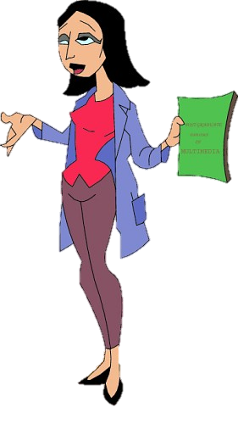
Students & teachers
What’s the matter?
I don’t understand.

Slide 16
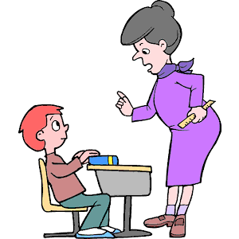
teachers
Pay attention, please.

Slide 17

students
Can you help me, please?

Slide 18


students
How do you say this in English?

Slide 19

students
Can I go to the blackboard, please?

Slide 20
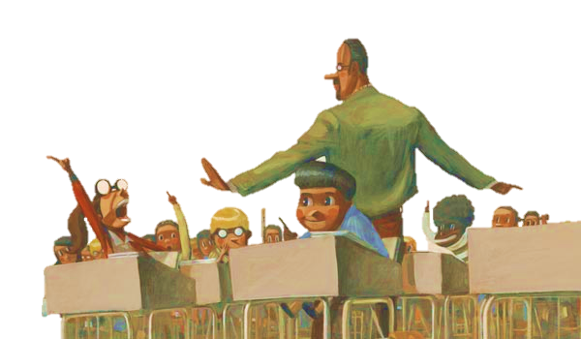
Students & teachers
Wait a moment, please?

Slide 21
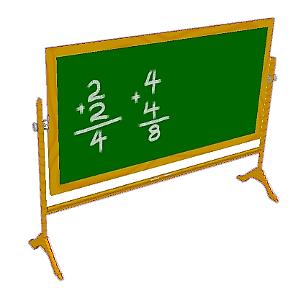
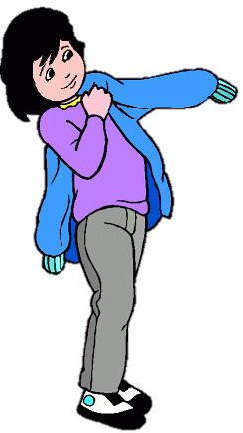
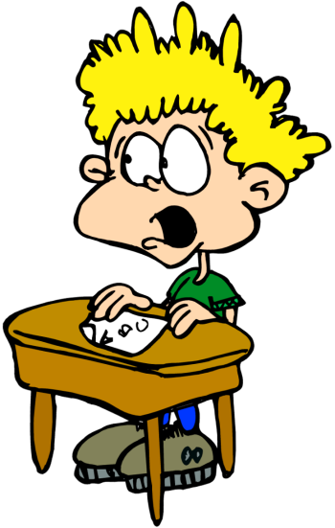
students
Step aside, please!

Slide 22

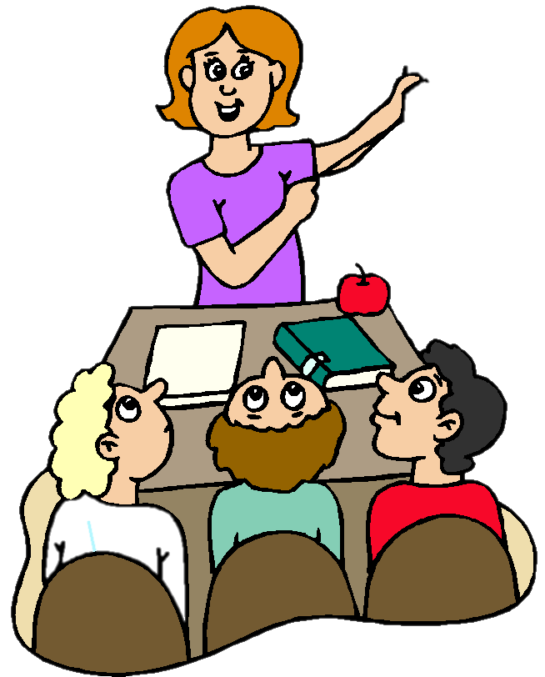
teachers
Where is London?
Who knows the answer to this question?

Slide 23


students
Can I borrow your pencil, please?

Slide 24



students
What’s the homework?

Slide 25



TEACHERs
Pack your things away!

Slide 26
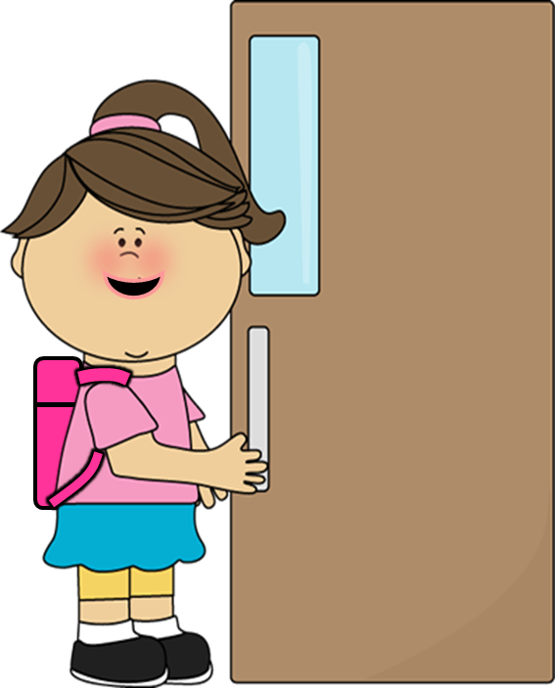
students
May I go out?

Slide 27


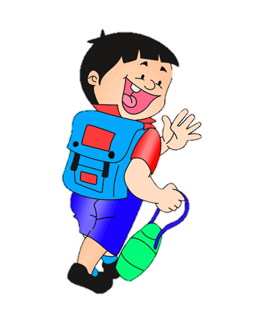
Students & teachers
Goodbye!
Bye, see you tomorrow!

