Slide 1
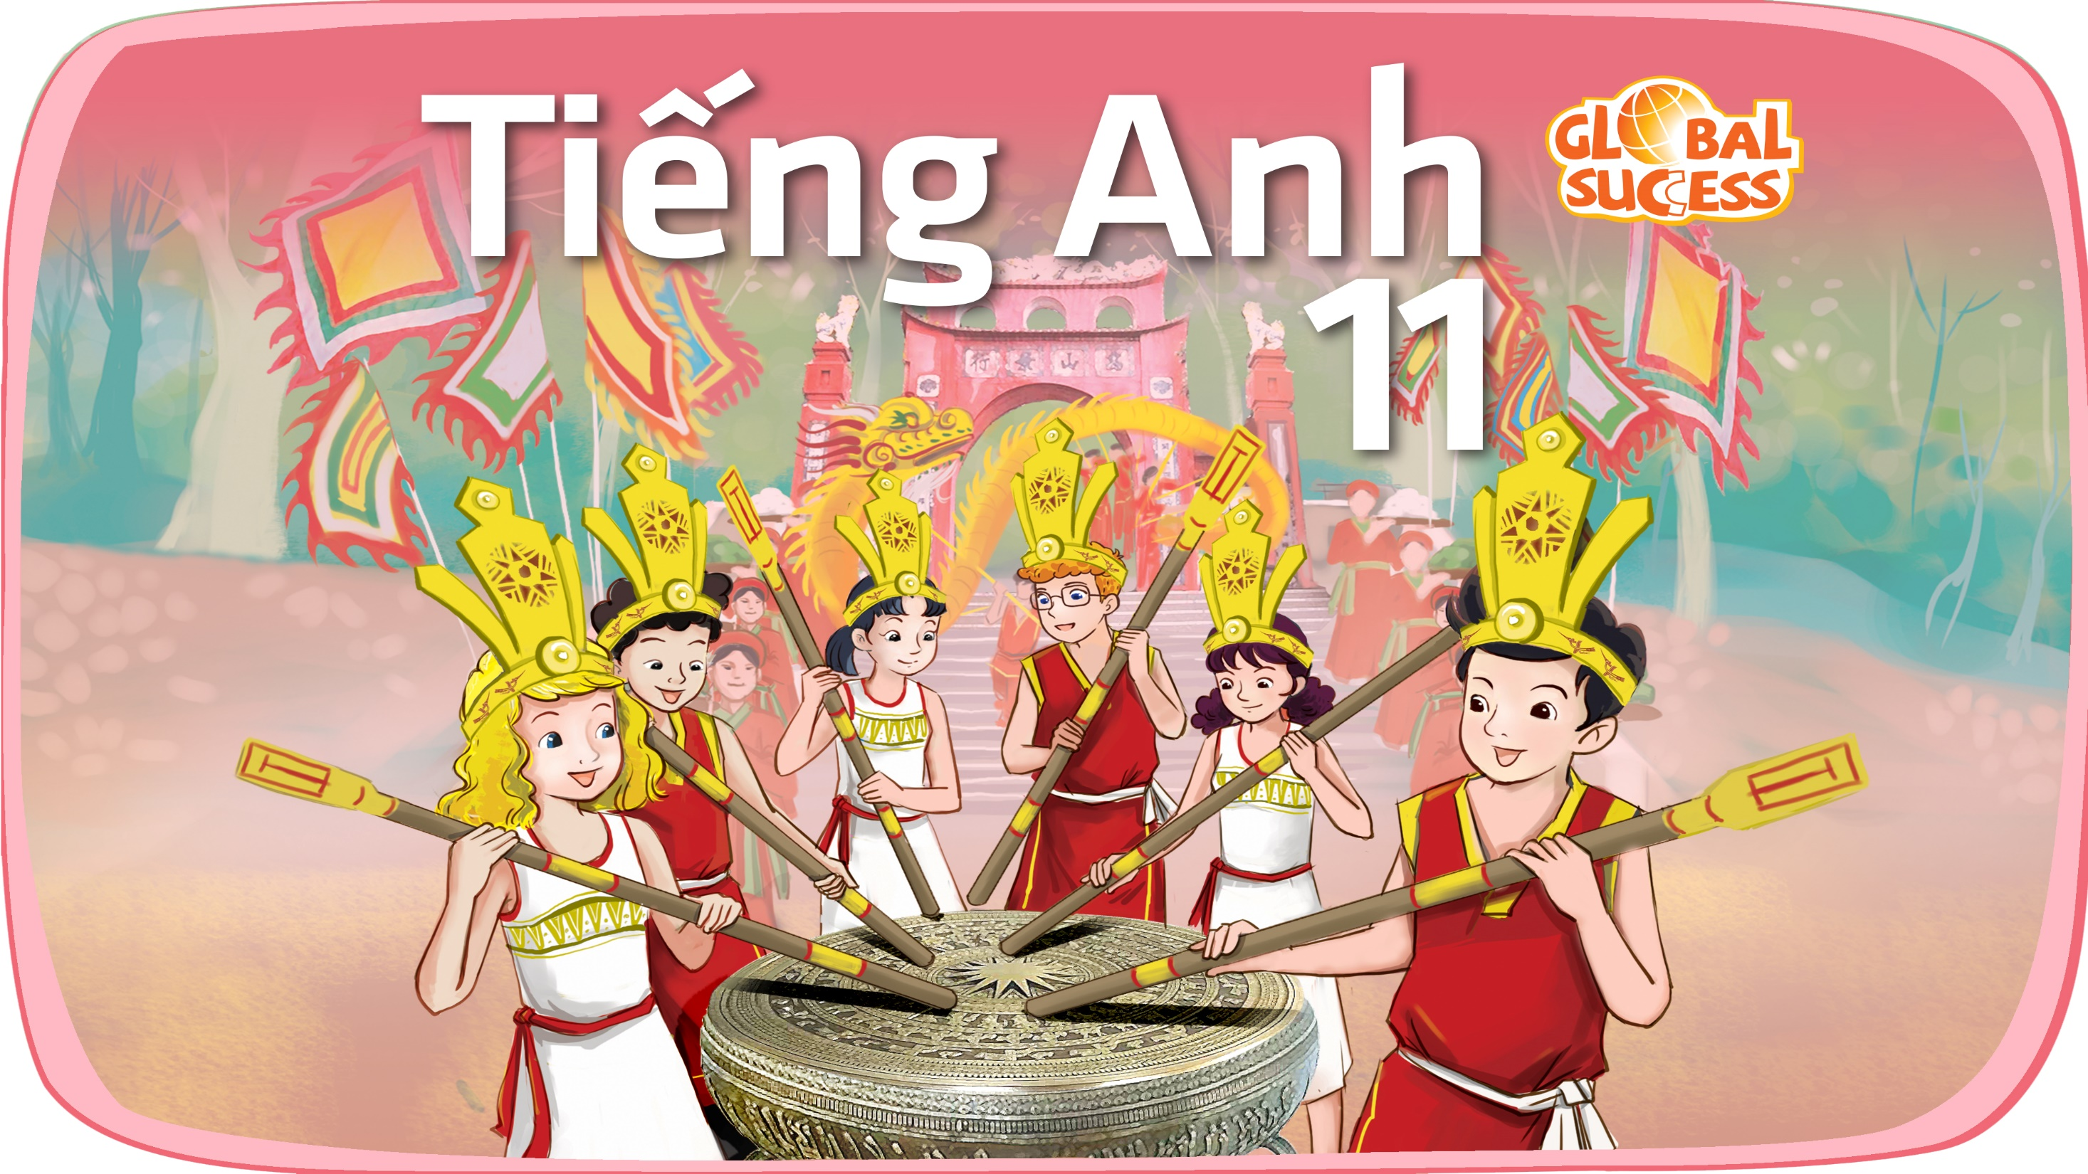

Slide 2
Unit
4
Asean and Viet Nam
Unit
FAMILY LIFE
LESSON 7
COMMUNICATION AND CULTURE / CLIL
GIVING TO COMPLIMENTS AND RESPONDING

Slide 3
LESSON 7
COMMUNICATION AND CULTURE / CLIL
WARM-UP
Video watching
Task 1: Complete the conversation.
Task 2: Make similar conversations.
EVERYDAY ENGLISH
CULTURE
Task 1: Read the text and complete the table.
Task 2: Discussion
EXTRA ACTIVITY
Discussion
CONSOLIDATION
Wrap-up
Homework

Slide 4

Watch the video about Lunar New Year and answer the questions.
Notes:
Link: https://www.youtube.com/watch?v=FFCljlSbWzw

Slide 5
WARM-UP
Why do they perform lion dance?
To get rid of evil things of last year and welcome the new year.

Slide 6
WARM-UP
According to the video, what is the message of lucky money?
It’s another way to say “you are part of
my life”.

Slide 7
WARM-UP
What is the traditional dress of Vietnam
It’s ao dai.

Slide 8
WARM-UP
What does banh tet symbolize?
It represents the moon.

Slide 9

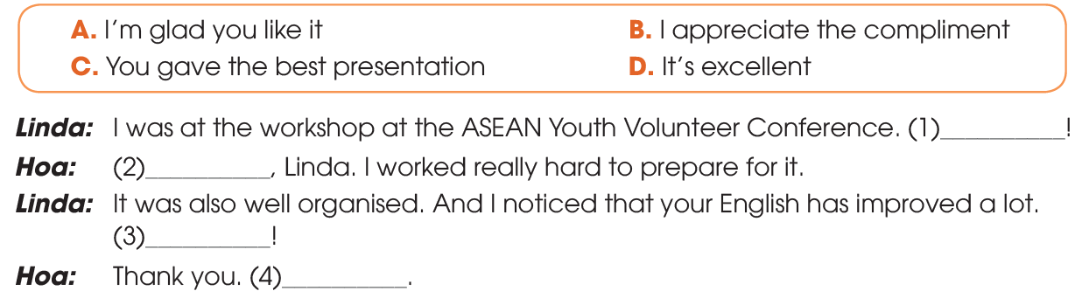

EVERYDAY ENGLISH
1
Listen and complete the conversation with the expressions in the box. Then practice it in pairs
C
A
D
B

Slide 10
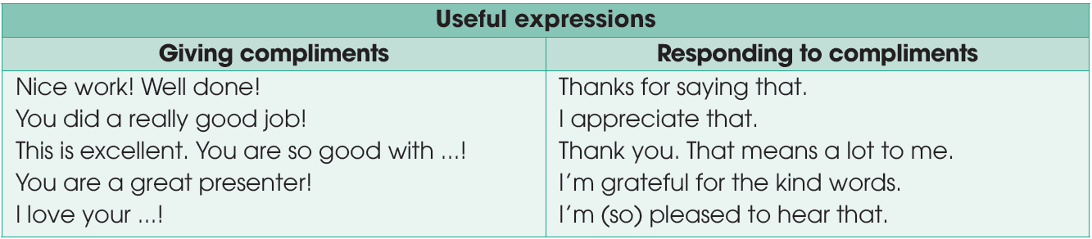
EVERYDAY ENGLISH
2
Use the model in 1 to make similar conversations for these situations. One of you is Student A, the other is Student B. Use the expressions below to help you.

Slide 11

EVERYDAY ENGLISH
Student A has completed an excellent report on ASEAN.
Student B gives compliments and Student A responds.
SITUATIONS
Student B has organised a workshop on skills for future leaders in ASEAN.
Student A gives compliments and Student B responds.

Slide 12
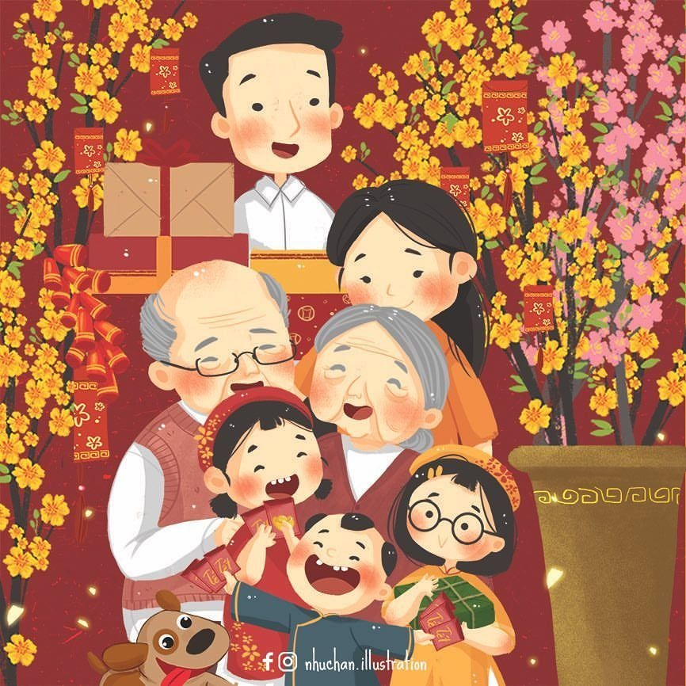
CULTURE
Lunar New Year (n)
/ˌluːnə ˌnjuː ˈjɪər/
the beginning of the year according to the calendars of China, Viet Nam, and some other East Asian countries, when there are celebrations for several days

Slide 13
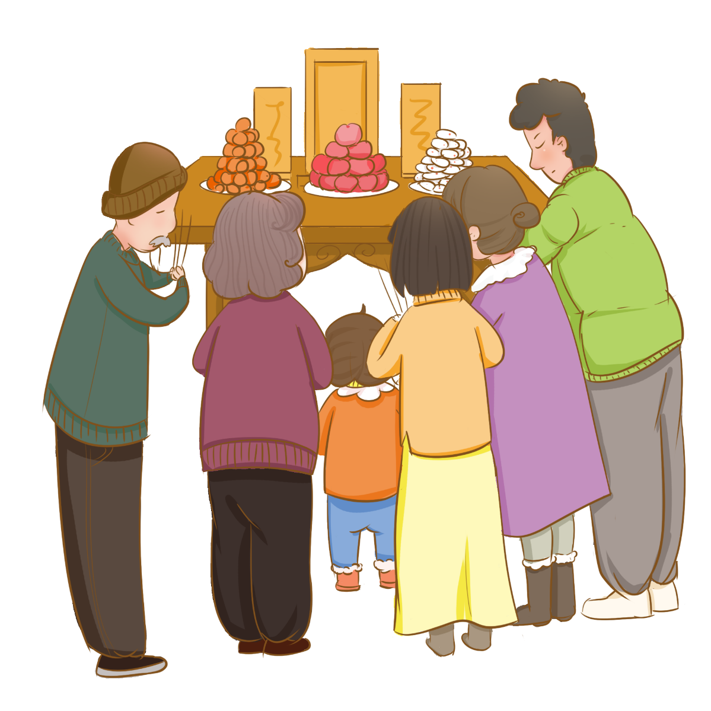
CULTURE
ancestor (n)
/ˈænsestər/
a person related to you who lived a long time ago

Slide 14
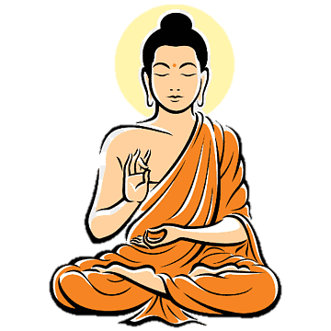
CULTURE
Buddhist (adj)
/ˈbʊdɪst/
having to do with Buddhists or Buddhism

Slide 15
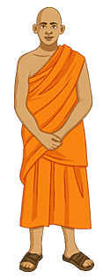
CULTURE
monk (n)
/mʌŋk/
a member of a group of religious men who do not marry and usually live together in a monastery

Slide 16

CULTURE
splash (v)
/splæʃ/
If a liquid splashes or if you splash a liquid, it falls on or hits something or someone

Slide 17
CULTURE
Form | Pronunciation | Meaning
Lunar New Year (n) | /ˌluːnə ˌnjuː ˈjɪər/ | the beginning of the year according to the calendars of China, Viet Nam, and some other East Asian countries, when there are celebrations for several days
ancestor (n) | /ˈænsestər/ | a person related to you who lived a long time ago
Buddhist (adj) | /ˈbʊdɪst/ | having to do with Buddhists or Buddhism
monk (n) | /mʌŋk/ | a member of a group of religious men who do not marry and usually live together in a monastery
splash (v) | /splæʃ/ | If a liquid splashes or if you splash a liquid, it falls on or hits something or someone

Slide 18
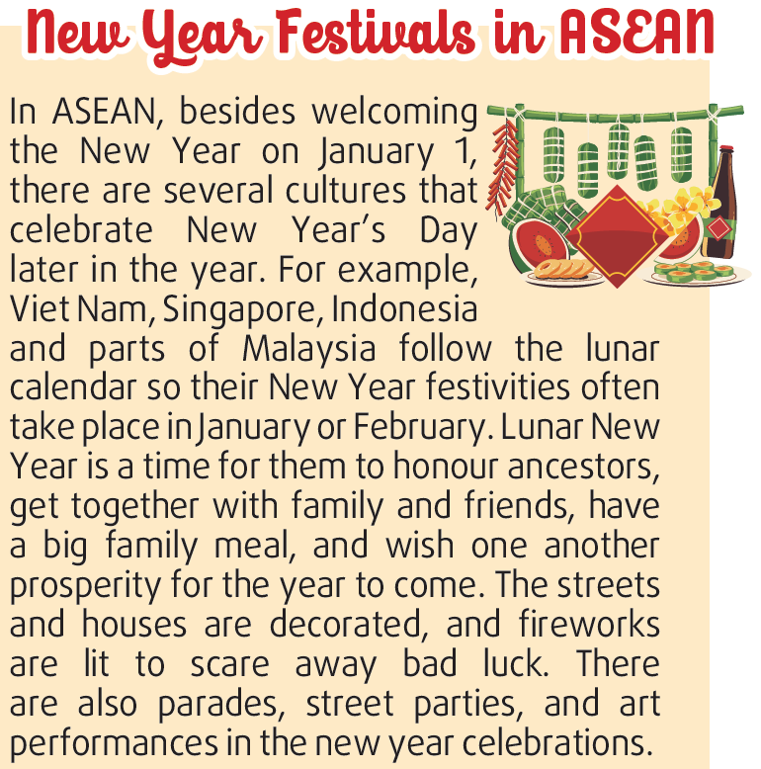
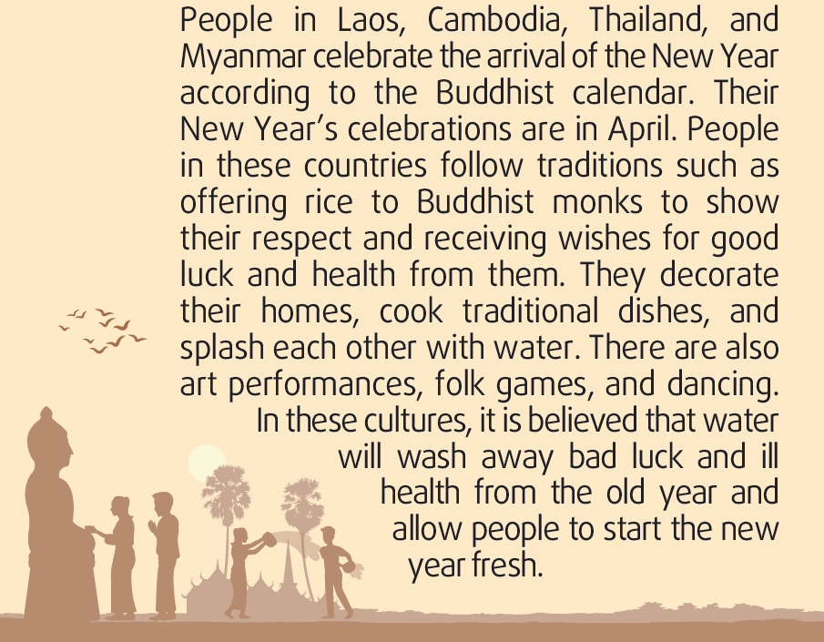
CULTURE
1
Read the text and complete the table below.

Slide 19
CULTURE
1
Read the text and complete the table below.
 | Lunar New Year | Buddhist calendar
Countries | (1) | Laos, Cambodia, Thailand & Myanmar
Time | January or February | (2)
Activities | (3) | (4)
Viet Nam, Singapore, Indonesia, and parts of Malaysia
April
honour ancestors, get together with family and friends, have a big family meal and wish one another prosperity for the year to come; the parades, street parties and art performances
offer rice to Buddhist monks to show respect and receive wishes for good luck and health, decorate homes, cook traditional dishes, and splash each other with water; art performances, folk games and dancing

Slide 20
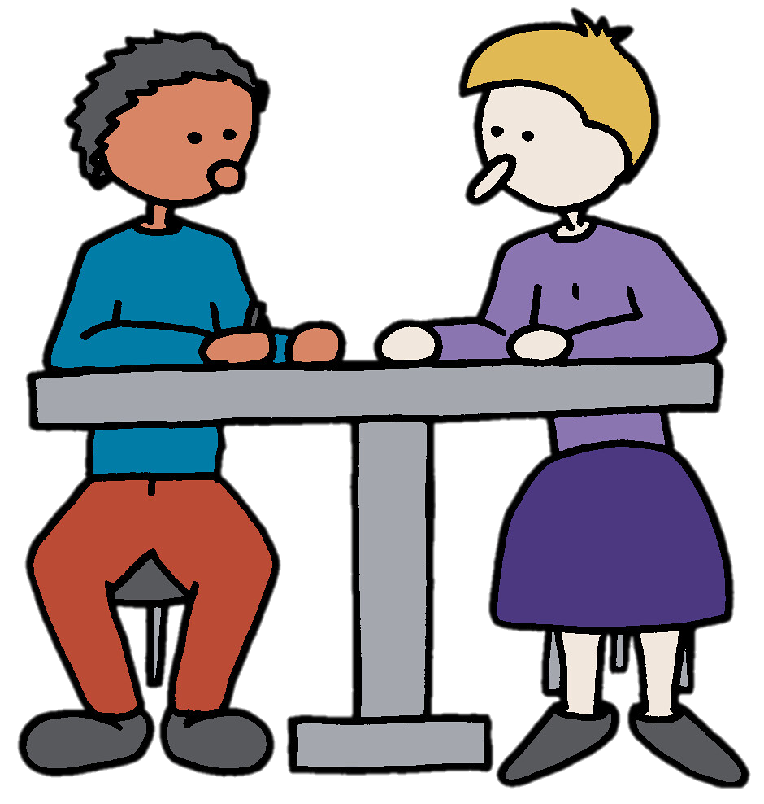
CULTURE
2
Discuss the similarities and differences between the New Year Festivals in Viet Nam and other ASEAN countries.

Slide 21
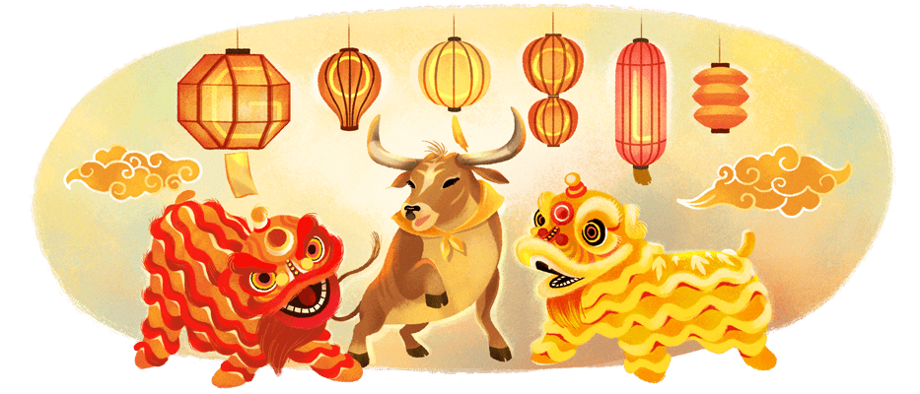
EXTRA ACTIVITY
Work in group and discuss some questions about Lunar New Year

Slide 22
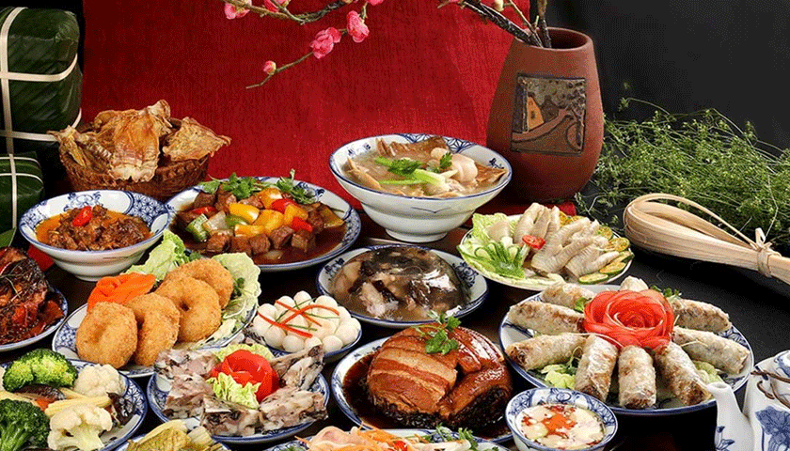
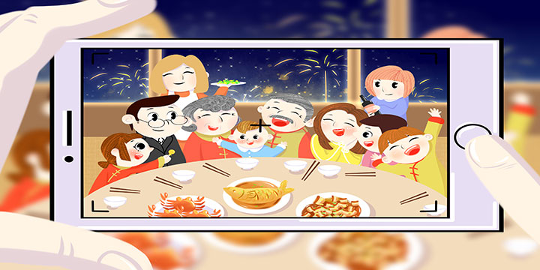
EXTRA ACTIVITY
1. Is Lunar New Year important to Vietnamese people?
2. What are the traditions of Lunar New Year?
List out some activities you would do in the Tet Holiday.

Slide 23
CONSOLIDATION
1
Wrap-up
What have you learnt today?
Give and respond to compliments
Get some knowledge about New Year festivals in ASEAN

Slide 24

CONSOLIDATION
2
Homework
Do exercises in the workbook.
Prepare for Lesson 8 - Unit 4.

Slide 25

Website: hoclieu.vn
Fanpage: facebook.com/www.tienganhglobalsuccess.vn

