Slide 1
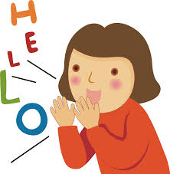
Welcome to English Class7
Unit 4: OUR CUSTOMS AND TRADITIONS
(A CLOSER LOOK1)
Let’s learn English !

Slide 2
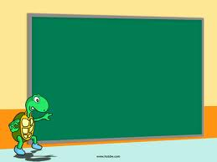
Unit 4:
OUR CUSTOMS AND TRADITIONS
A Closer look 1

Slide 3
Unit 4: OUR CUSTOMS AND TRADITIONS – A Close look 1
.
Watch out!
The words ‘custom’ and ‘tradition” can be countable or uncountable

Slide 4
Unit 4: OUR CUSTOMS AND TRADITIONS – A Close look 1
1 . Match the first halves of the sentences (A) with the second halves (B).
1. Although they are not Christian, | a. the first person to step into your house in the new year should be a man.
2. It's the custom | b. making sponge cakes for the Mid-Autumn Festival instead of mooncakes.
3. According to tradition, | c. the tradition of living with their parents.
4. There is a tradition in our school that | d. in that country for women to get married in white.
5. They broke with tradition by | e. the family has the custom of giving presents at Christmas.
6. Many young people do not follow | f. morning exercise at 5 a.m.
7. In my family there is a custom of doing | g. girls should wear ao dai on the first day of school.
e
d
a
g
b
c
f

Slide 5
Unit 4: OUR CUSTOMS AND TRADITIONS – A Close look 1
The “custome” or “tradition”could be countable or uncountable.
1. Although they are not Christian, the family has the custom of giving presents at Christmas.
2. It's the custom, in that country for women to get married in white.
3. According to tradition, the first person to step into your house in the new year should be a man.
4. There is a tradition in our school that, girls should wear ao dai on the first day of school.
5. They broke with tradition by making sponge cakes for the Mid-Autumn Festival instead of mooncakes
6. Many young people do not follow the tradition of living with their parents
7. In my family there is a custom of doing morning exercise at 5 a.m.
c
c
u
c
u
c
c

Slide 6
Unit 4: OUR CUSTOMS AND TRADITIONS – A Close look 1
2. Read the full sentences in 1 again and complete the expressions below.
1. it's the .......... For somebody to do something.
2. there's a ..................... that + clause
3. ............. ...to tradition, + clause
4. follow the .............. of doing something
5. break ............... tradition by doing something
6. have the custom .................. doing something
7. there is a custom of ................ something
custom
tradition
According
tradition
with
of
doing

Slide 7
Unit 4: OUR CUSTOMS AND TRADITIONS – A Close look 1
3. Read the following customs and traditions. Make sentences to say if you have these in your province or area, using the expressions in 2. Remember to change the verb tense if necessary.
Example
According to tradition, we have fireworks on New Year's Eve.
My area broke with tradition by not having firecrackers, on New Year's Eve
There's a tradition in our province of having fireworks on New Year's Eve.)
.

Slide 8
.
Unit 4: OUR CUSTOMS AND TRADITIONS – A Close look 1
Having firework on New Year’s Eve
Waiting until the guess finish eating before leaving the dinner table.
Touching children’s head
Decorating the house on special occasion.
Women shaking stranger’s hand
4. Now complete the following sentences with your own ideas
It’s the custom in my country that...
We broke with tradition by ...
There is a tradition in my family that ...
We have a custom of ...
According to tradition, ....

Slide 9
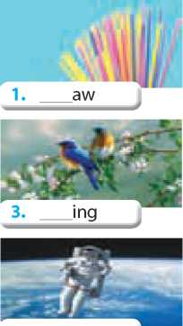
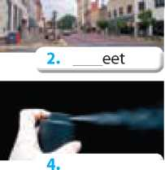
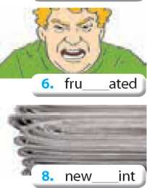
Unit 4: OUR CUSTOMS AND TRADITIONS – A Close look 1
PRONUCIATION
Cluster: /spr / and / str/
5.Complete the words under the pictures with spr or str. Then listen and repeat.
str
str
spr
spr
spr
spray
espresso
astronaunt

Slide 10
Unit 4: OUR CUSTOMS AND TRADITIONS – A Close look 1
6. Listen and circle the words with /spr/ and underline the words with /str/. Then say the sentences.
1.In my family, all the traditions of our ancestors are strictly followed.
2.The custom of saying hello to strangers has spread through our community.
3.In our district, it's the custom for residents to sweep the streets on Saturday mornings.
4.That filmstrip really highlighted our customs and traditions.
5.Parents usually want their offspring to follow the family traditions.

Slide 11
Unit 4: OUR CUSTOMS AND TRADITIONS – A Close look 1
* Homework:
- Learn vocabulary by heart and rewrite them in sentences.
- Redo the exercise in your notebook.
- Prepare for a closer look 2

