Slide 1

Unit 6: Community Services
Lesson 1.1: Vocabulary & Listening
Page 46

Slide 2
Lesson Outline
Warm-up
Vocabulary
Listening
Consolidation
Wrap-up

Slide 3
Objectives
By the end of this lesson, students will be able to…
- Practice and learn vocabularies for public places::hospital, library, police station, post office, train station
- Practice listening for specific information.

Slide 4

WARM-UP

Slide 5

Work in pairs.
Chatting
1. What are the most popular Vietnamese dishes?
2. What is the most famous food in your city/ province?
3. What community services are there in your neighborhood?

Slide 6
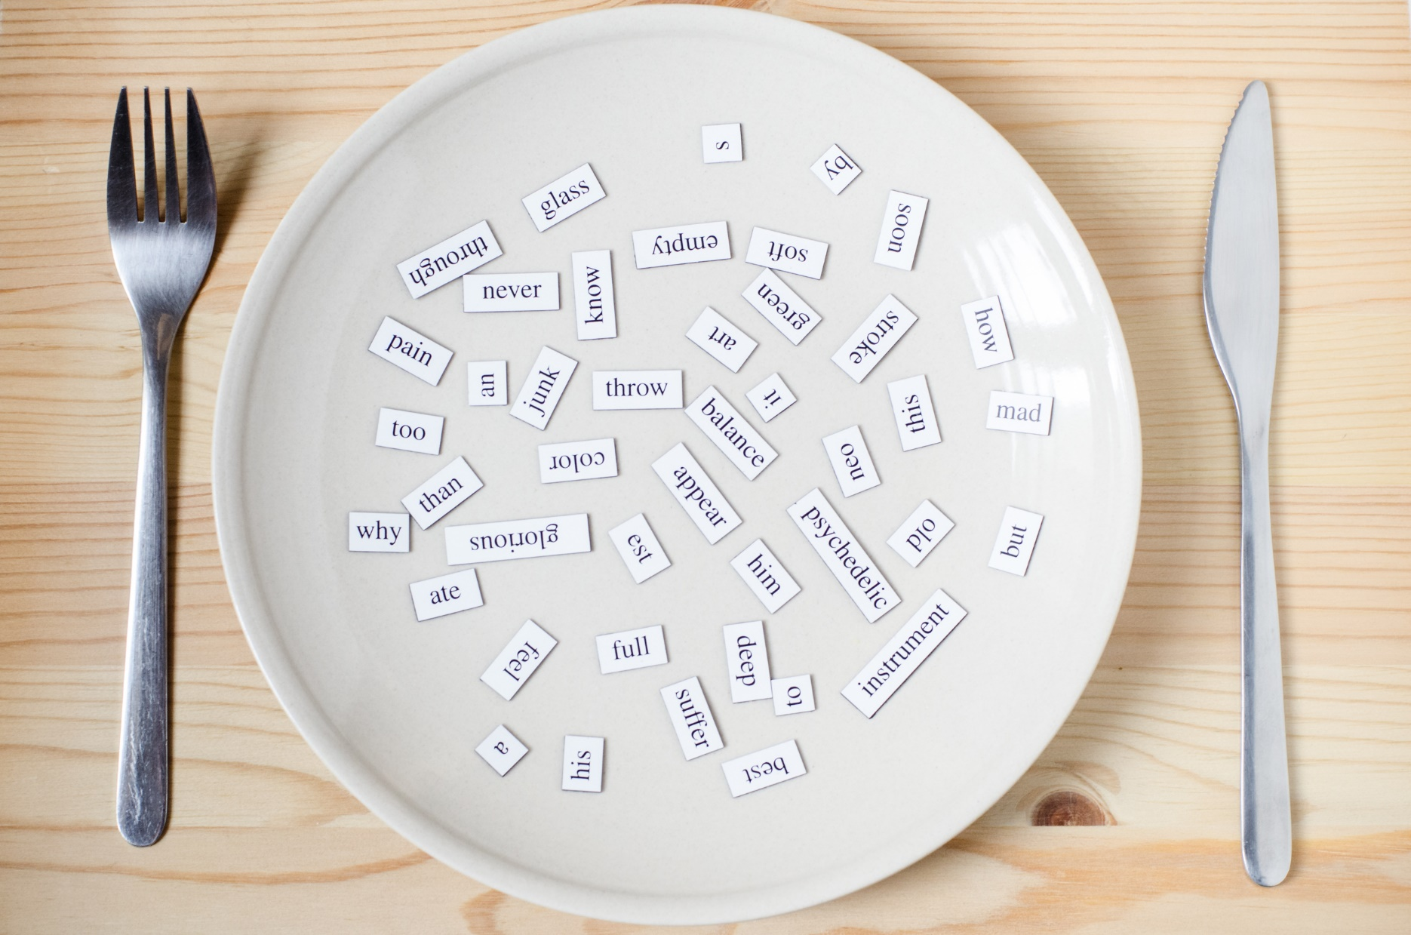
New words
hospital
library
police station
post office
train station

Slide 7

Listen and repeat. Click each phrase to hear the sound.
train station (n) /treɪn ˈsteɪʃn/ ga tàu hỏa
library (n) /ˈlaɪbreri/ thư viện
hospital (n) /ˈhɑːspɪtl/ bệnh viện
police station (n) /pəˈliːs steɪʃn/ đồn cảnh sát
post office (n) /ˈpoʊst ˈɑːfɪs/ bưu điện
bus station (n) /ˈbʌs steɪʃn/ bến xe buýt
Notes:
GV click vào từng cụm nghe âm thanh

Slide 8
Look at the IPA (International Phonetic Alphabet) and
the meaning of each word to read out the word
/treɪn ˈsteɪʃn/ ga tàu hỏa
/ˈlaɪbreri/ thư viện
/ˈhɑːspɪtl/ bệnh viện
/pəˈliːs steɪʃn/ đồn cảnh sát
/ˈpoʊst ˈɑːfɪs/ bưu điện
/ˈbʌs steɪʃn/ bến xe buýt
Notes:
GV click vào từng cụm nghe âm thanh

Slide 9

Presentation

Slide 10
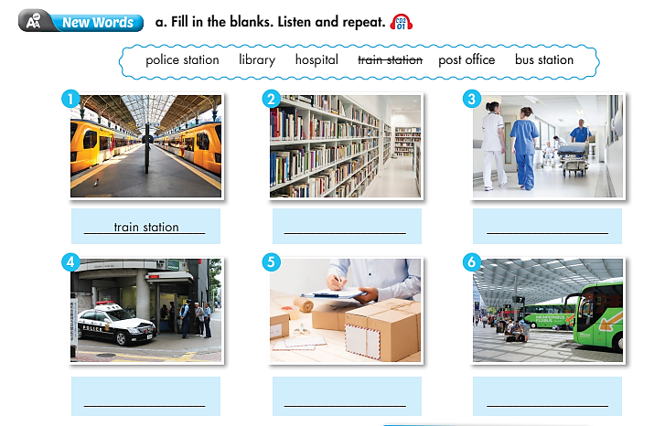
How many pictures are there? –
Six
Places
What are they? –
What are you going to do? –
Fill in the blank

Slide 11

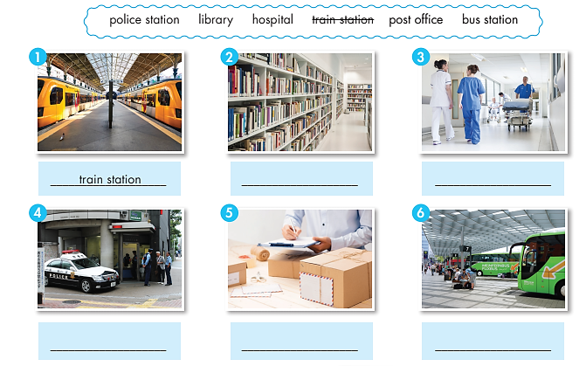
Work in pairs. Fill in the blanks
train station
library
hospital
police station
post office
bus station

Slide 12

Practice

Slide 13


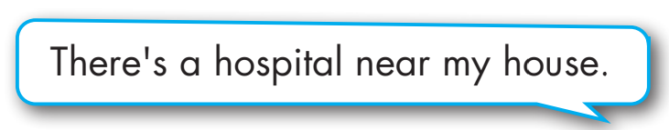
Work in pairs.
Say what public services are near your house

Slide 14
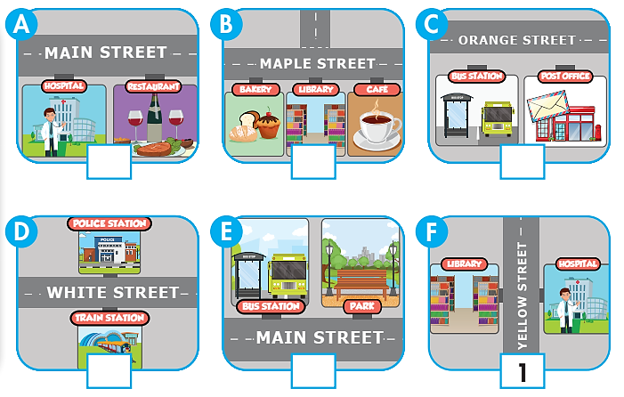
Extra Practice
WB page 32
Read the sentences and number the pictures.
1. The hospital is opposite the library on Yellow Street.
2. The library is between the café and the bakery on Maple Street.
3. The police station is opposite the train station on White Street.
4. The hospital is next to the restaurant on Main Street.
5. The bus station is next to the park on Main Street.
6. The post office is next to the bus station on Orange Street.
4
2
6
3
5
1

Slide 15

Production

Slide 16

b. In pairs: Ask and give direction to a place.

Slide 17
STUDENT A
STUDENT B
Excuse me, could you tell me how to get to the post office?
Go straight ahead. Take the first turning on your right, and it’s on your left.
Is it far from here?
No, it isn’t. And there’s a library near the post office.
You’re so nice. Thanks a lot!
You’re welcome.

Slide 18

Listening

Slide 19
Pre-Listening
Read the instruction quickly. Underline the key words. Are the speakers friends?
a. Listen to two people talking in a hotel. Are the speakers friends?
1. Yes
2. No

Slide 20
While-Listening
Now listen and choose the correct answer.  FIRST TIME
a. Listen to two people talking in a hotel. Are the speakers friends?
☞ YOUR ANSWER?
2. No
☞ WHY?

Slide 21
While-Listening
Now listen again and check.  SECOND TIME
While you are listening, focus on what Nick and the receptionist say.
Nick: Excuse me. Is there a post office near the hotel?
Receptionist: Yes, there is. Let me show you on the map. The post office is on Market Street.
☞ YOUR ANSWER?
Yes
No
☞ THE ANSWER IS …

Slide 22
Pre-Listening
b. Now, listen and fill in the blanks. FIRST TIME
1. The _______________ is on Market Street.
2. The _______________ is opposite the mall.
3. There's a _______________ near the hotel.
4. The bus station is next to the _______________.
☞ WHAT ARE YOUR ANWERS?

Slide 23
While-listening
b. Now, listen and fill in the blanks. SECOND TIME
post office
1. The _______________ is on Market Street.
2. The _______________ is opposite the mall.
3. There's a _______________ near the hotel.
4. The bus station is next to the _______________.
train station
bus station
library
☞ WHAT ARE YOUR ANWERS?

Slide 24
While-Listening
Now listen again and check.  THIRD TIME
Nick: Excuse me. Is there a post office near the hotel?
Receptionist: Yes, there is. Let me show you on the map. The post office is on Market Street.
1. The post office is on Market Street.
Nick: Oh, yes. I see it. And is there a train station near here?
Receptionist: Yes. Look. The train station is opposite the mall. You can take a bus there.
2. The train station is opposite the mall.

Slide 25
While-Listening
Now listen again and check.  THIRD TIME
Nick: OK, great. Where do I get the bus?
Receptionist: There's a bus station near the hotel.
3. There's a bus station near the hotel.
Nick: Is it far?
Receptionist: No, the bus station is next to the library. Here.
4. The bus station is next to the library.

Slide 26
Audio Scripts
Practice the conversation with a partner.
Nick: Excuse me. Is there a post office near the hotel?
Receptionist: Yes, there is. Let me show you on the map. The post office is on Market Street.
Nick: Oh, yes. I see it. And is there a train station near here?
Receptionist: Yes. Look. The train station is opposite the mall. You can take a bus there.
Nick: OK, great. Where do I get the bus?
Receptionist: There's a bus station near the hotel.
Nick: Is it far?
Receptionist: No, the bus station is next to the library. Here.
Nick: Yes, I see it. Thank you for your help.
Receptionist: You're welcome. Have a nice day!

Slide 27
Post-Listening
Listen and fill in the blanks.
opposite
1. The bus station is ________ the library.
2. The library is ________ the post office.
3. The hospital is _______ the police station and the post office.
4. The bus station is _______ the train station.
5. The train station is _______ the library.
opposite
between
next to
next to

Slide 28

CONSOLIDATION

Slide 29
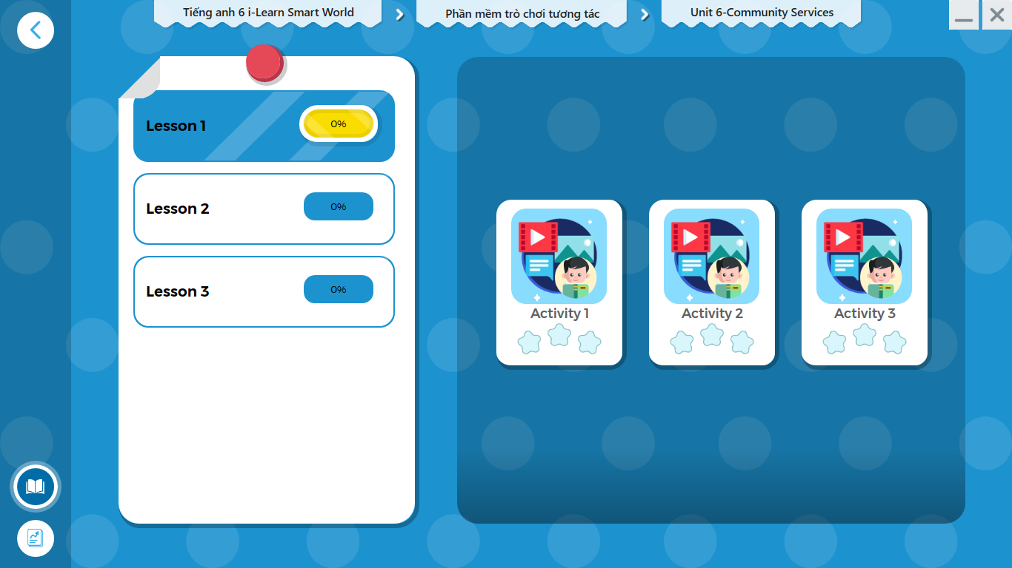
LET’S PLAY!
Click here to play the games.

Slide 30

Work in pairs.
Asking and giving direction to the bus station.
Asking for directions | Giving directions
Could you tell me how to get to…? How do I find…? Pardon me, I’m lost, how do I get to…? Which is the best way to…? Could you direct me to…? How do I get to…? What’s the best way to…? | The best way is to… Turn back/ Go back Turn left/ right (into …street/at the end of…) Go along… Take the first/ second road on the left/right. It’s on the left/right. It’s about 50 meters from here.

Slide 31

WRAP-UP

Slide 32
Today’s lesson
Vocabularies:bʌs st/
hospital (n)
library (n)
police station (n)
post office (n)
train station (n)
Listening: for specific information.
Speaking: practice functional English (offering help).

Slide 33
Homework
Learn by heart vocabularies and make sentences using them.
Do the exercises on page 32 WB.
Do the exercises in Tiếng Anh 6 i-Learn Smart World Notebook on page 34.
Prepare the next lesson (page 47 - SB).
Play the consolidation games in Tiếng Anh 6 i-Learn Smart World DHA App on www.eduhome.com.vn.

Slide 34

Enjoy your day!

