Slide 1

Unit 2
Culture Lesson
Page 34

Slide 2
Lesson Outline
Warm-up
Reading
Listening
Consolidation
Wrap-up

Slide 3
Objectives
By the end of this lesson, students will be able to talk about the family pet, using ….
Vocabulary Revision:
dog, cat, fish, bird, pig, goat, duck, cow, rabbit
Structure:
I love my ____.

Slide 4

WARM UP

Slide 5
1
4
6
1
SPIN
2
5
2
5
4
3
3
6
Next Part

Slide 6
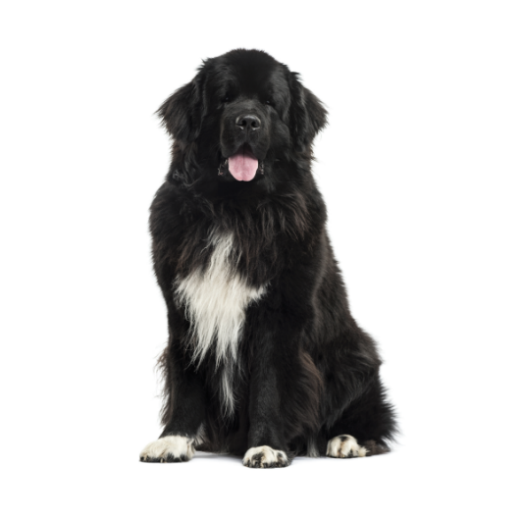
I love my ______.
Go back

Slide 7
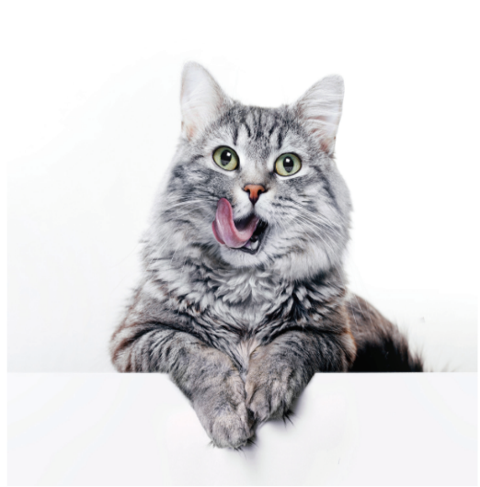
I love my ______.
Go back

Slide 8
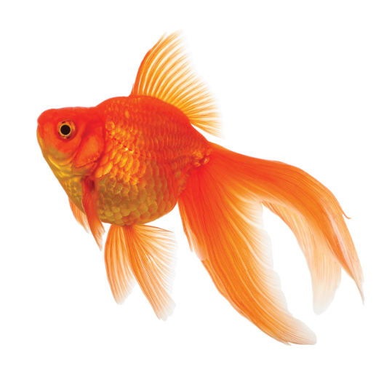
I love my ______.
Go back

Slide 9
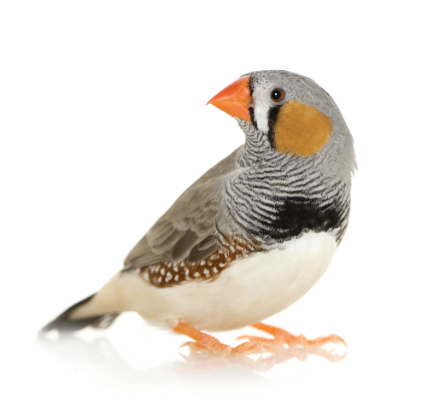
I love my ______.
Go back

Slide 10
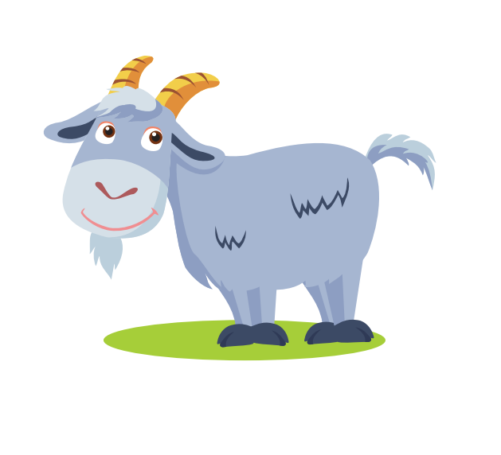
I love my ______.
Go back

Slide 11
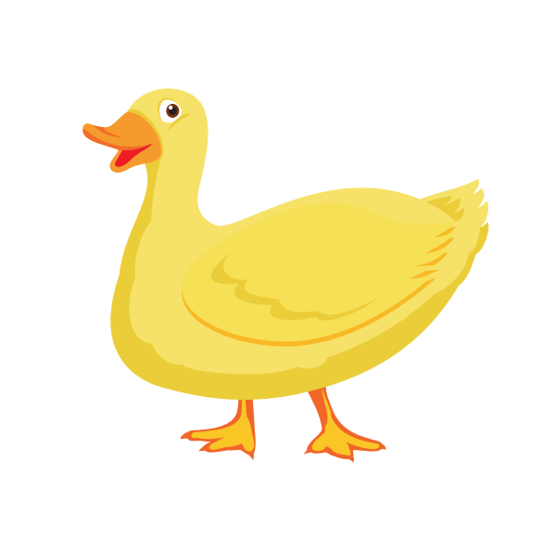
I love my ______.
Go back

Slide 12

It’s time to learn …

Slide 13

Reading

Slide 14
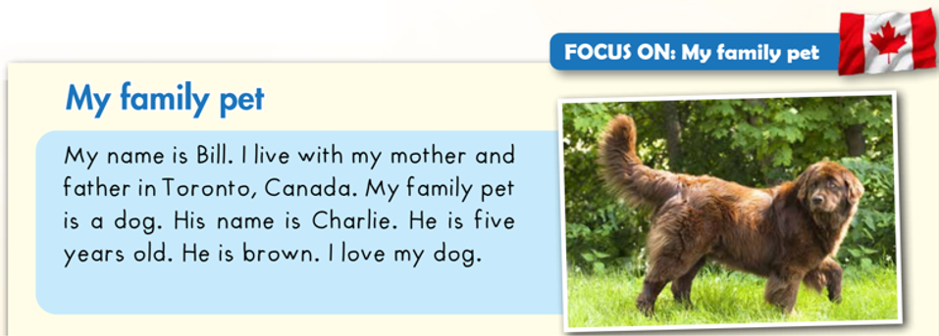
C
Read and circle.

Slide 15
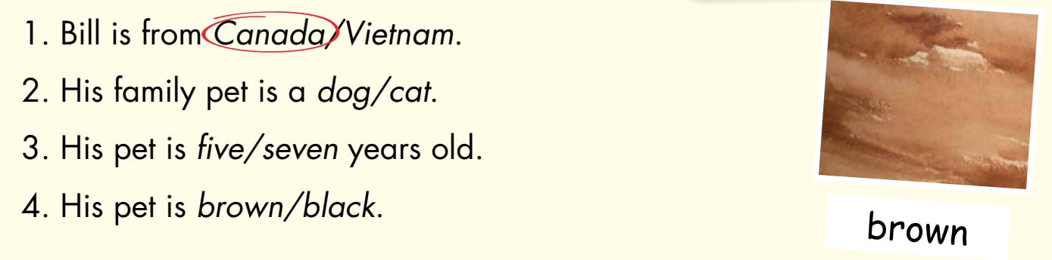
C
Read and circle.

Slide 16

Listening

Slide 17

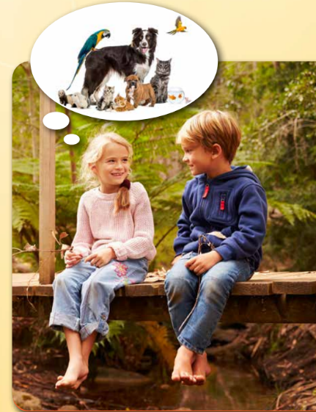
D
1. Look and listen. (CD1 Track 55)
What pets are they talking about?
The bird and cat.

Slide 18
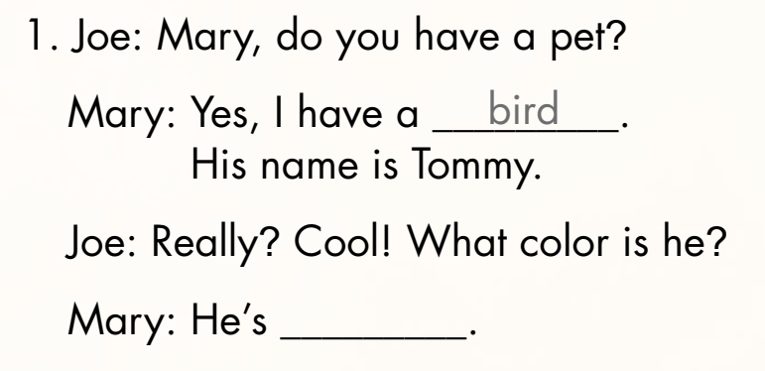
D
2. Listen and write. (CD1 Track 56)
yellow
Keys

Slide 19
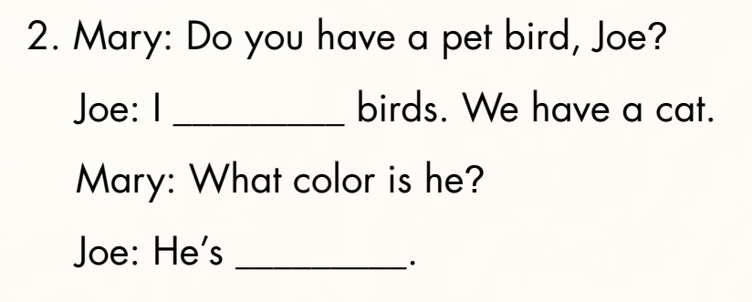
D
2. Listen and write. (CD1 Track 56)
don’t like
brown
Keys

Slide 20

Practice

Slide 21
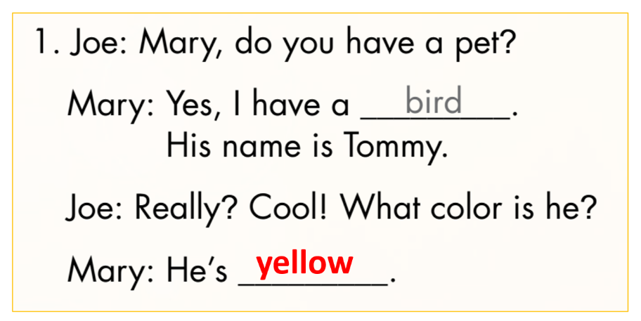
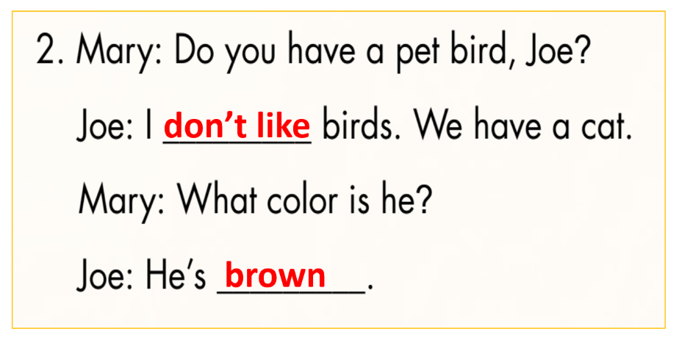
D
3. Practice with your friends.

Slide 22
Further Practice

Slide 23
Make their own conversation.
Mai: Do you have a pet ____, Linh?
Linh: Yes, I have a ____. Her name is ____.
Mai: Great! What color is she?
Linh: She’s ____.
Mai: Cool! How old is she?
Linh: She’s ____.

Slide 24
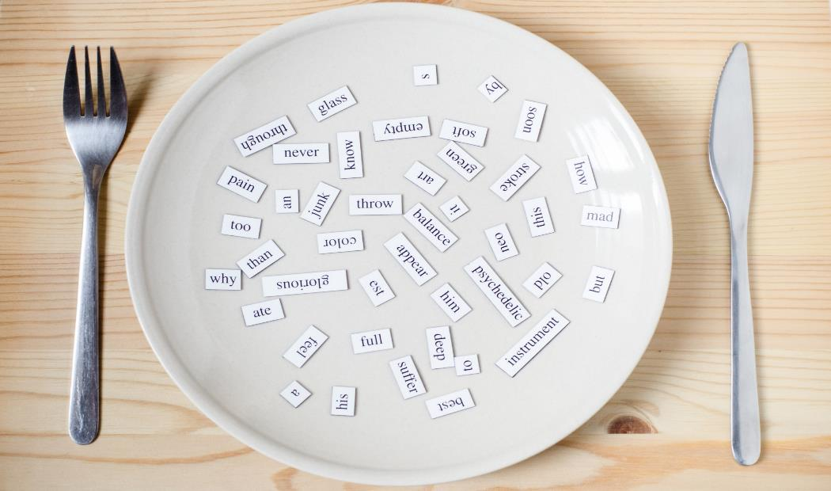
Consolidation

Slide 25
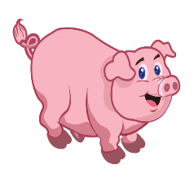

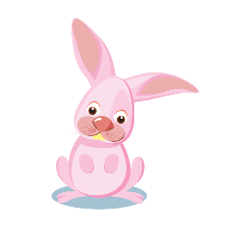


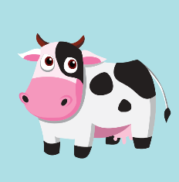


What’s missing?

Slide 26

WRAP-UP

Slide 27
Today’s lesson
Vocabulary Revision:
dog, cat, fish, bird, pig, goat, duck, cow, rabbit
Structure:
I love my ____.

Slide 28
Homework
Practice vocabularies and structure. Make sentences using them.
Do the exercises in Tiếng Anh 3 i-Learn Smart Start Workbook (page 25).
Do the exercises in Tiếng Anh 3 i-Learn Smart Start Notebook (page 19).
Play the consolidation games in Tiếng Anh 3 i-Learn Smart Start DHA App on www.eduhome.com.vn
Prepare the next lesson (page 35).

Slide 29
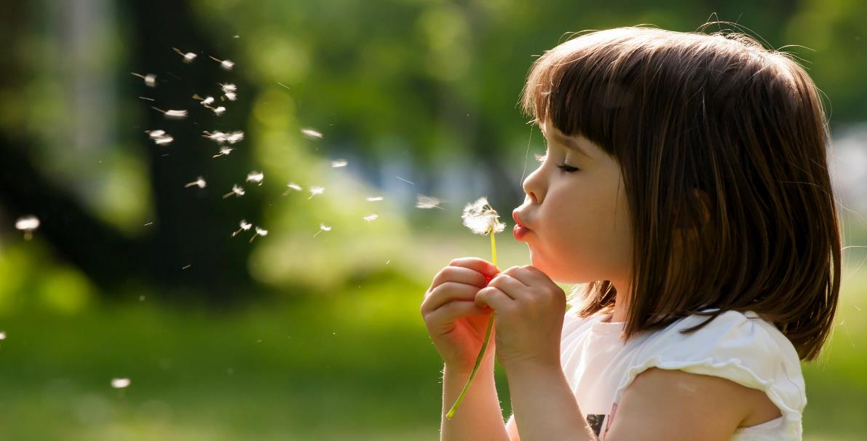
Enjoy your day!

