Slide 1
Unit 1
A long and healthy life

Slide 2
LESSON 6 : WRITING
A short message

Slide 3
LESSON 6 : WRITING
WARM-UP
Warm Up
PRE-WRITING
Task 1. Put the parts in the correct order.
WHILE-WRITING
Task 2. Write a sentence to express each message below. Begin with the words given.
Task 3. Write a short message to reply to the one in Task 1.
POST-WRITING
Peer review
CONSOLIDATION
Wrap-up
Homework

Slide 4
WARM UP

Slide 5
Questions
Question 1:
When was the last time you sent a short message?
Question 2:
What information do you usually include in your messages?

Slide 6
Mini Game - Put the Sentences in Order
Instruction:
Put these sentences in the correct order to make a short message.
A. Can you bring some fresh mangos from your garden? We’ll need them for one of the recipes.
B. Hi Linda,
C. How about coming to my house this Sunday? We can try some recipes from the book.
D. Thanks for lending me your book about healthy cooking. It’s great!
E. See you soon,
F. Mai
(Sentences displayed in boxes for students to number or arrange)

Slide 7
Mini Game - Put the Sentences in Order
B. Hi Linda,
D. Thanks for lending me your book about healthy cooking. It’s great!
C. How about coming to my house this Sunday? We can try some recipes from the book.
A. Can you bring some fresh mangos from your garden? We’ll need them for one of the recipes.
E. See you soon,
F. Mai

Slide 8
Discussion - Message Structure
What are the three parts of a short message?
Greeting
Main body
3.Closing
This is how you say hello at the beginning of a message.
This is the main part of your message. You give information, ask questions, or explain something here.
This is how you end your message politely.

Slide 9
Activity - Write the Missing Part
Complete the message by writing the main body:
Greeting: Hi Mai,
Closing: See you soon,
Main body: ______________________________________________
I’m writing to invite you to our school event next Friday.

Slide 10
Summary
Remember:
A short message usually includes:
A greeting (Hi, Dear, Hello)
One or two sentences in the main body (invitations, requests, thanks)
A closing phrase (See you soon, Write back soon)

Slide 11
Writting

Slide 12
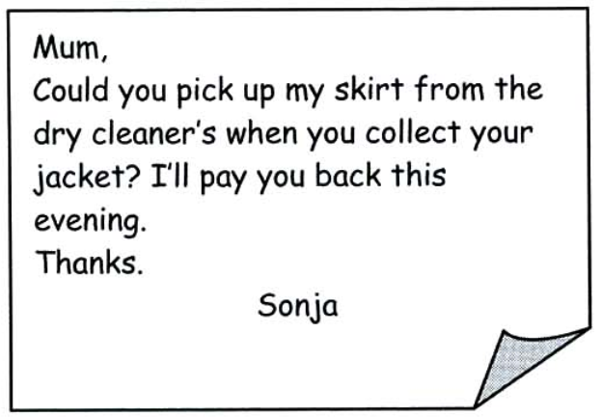
PRE-WRITING
How to write a short message?

Slide 13
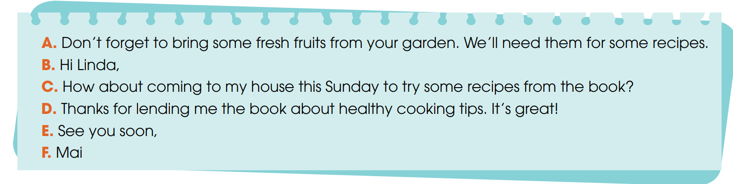
PRE-WRITING
1
Below is a short message. Put the parts in the correct order.
Key: B - D - C - A - E - F

Slide 14
PRE-WRITING
Greeting
Hi Linda,
Thanks for lending me the book about healthy cooking tips. It’s great!
How about coming to my house this Sunday to try some recipes from the book? Don’t forget to bring some fresh fruits from your garden. We’ll need them for some recipes.
See you soon,
Mai
Message
Closing

Slide 15
PRE-WRITING
Useful expressions
Greeting | Message | Closing
+ Hi, + Hello, + Dear …, | + Thank you for … + How about … + What about … + Why don’t we … + Shall we … + Remember to … + Don’t forget to … + I would like to invite you to … + Do you want to … | + See you again, + See you soon, + Write back soon, + Bye, + Love,

Slide 16
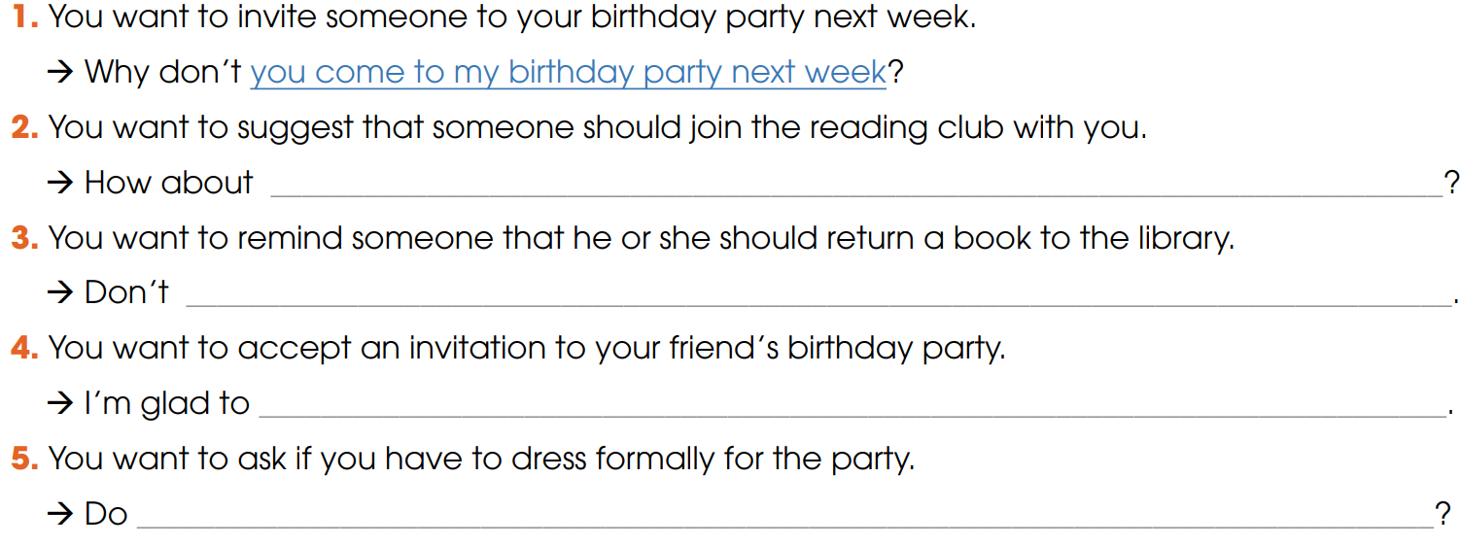
WHILE-WRITING
2
Write a sentence to express each message below. Begin with the words given.
joining the reading club with me
forget to return the book to the library
come to your birthday party
I have to dress formally for the party

Slide 17
REVIEW
GAME

Slide 18
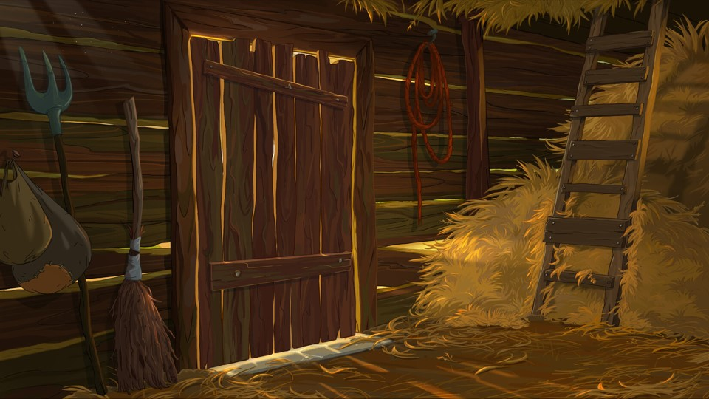
HUNGRY RABBIT
START GAME

Slide 19
How to play: Click on any number to answer the question. To reveal the answer, click on the screen. After completing the game, click the exit button.

Slide 20
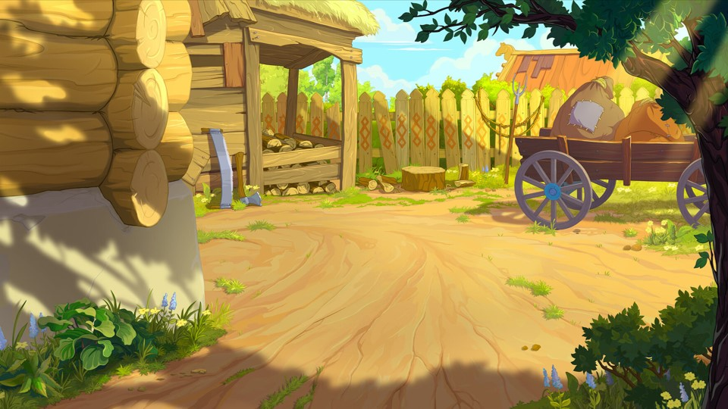
















EXIT
1
2
3
4
5
6
7

Slide 21
You want to invite your friend to join the school English club.
→ Why don’t you ____________________________?
A. sign up for the English club with me
B. join the English club last week
C. joining the English club every day
A. sign up for the English club with me
Back

Slide 22
You want to suggest watching a documentary for your assignment.
→ ________ watching a documentary to help with our assignment?
A. How about
B. Are you
C. Do you
A. How about
Back

Slide 23
You want to suggest working on the presentation together.
→ How about ___________________________________?
A. work on the presentation tomorrow
B. working on the presentation together after class
C. to working on the presentation now
B. working on the presentation together after class
Back

Slide 24
You want to remind your classmate to submit the homework by 5 p.m.
→ ________ submit your homework by 5 p.m.
A. Do you
B. Are you
C. Don’t forget to
C. Don’t forget to
Back

Slide 25
You want to invite your friend to join a volunteer activity this weekend.
→ Why don’t you ________________________________?
A. joined the volunteer activity yesterday
B. joining the volunteer activity every weekend
C. join the volunteer activity with me this weekend
C. join the volunteer activity with me this weekend
Back

Slide 26
You want to accept your friend’s invitation to go hiking.
→ ________ go hiking with you. Thanks for the invite!
A. I’d love to
B. Are you
C. Do I
A. I’d love to
Back

Slide 27
You want to ask if you need to bring your laptop to the meeting.
→ Do I need ______________________________________?
A. bring my laptop yesterday
B. bringing my laptop to the meeting
C. to bring my laptop to the meeting tomorrow
C. to bring my laptop to the meeting tomorrow
Back

Slide 28
WHILE-WRITING
3
Write a short message to reply to the one in Task 1
Suggested answer
Hi Mai,
Thank you for inviting me to your house this Sunday.
I am so glad to come to try some recipes from the book with you. Shall we meet at 10 a.m? Please tell me if I need to buy something in advance to prepare for the meal.
See you soon,
Linda.

Slide 29
POST-WRITING
4
Exchange your writing with your friend for peer review.
Writing rubric
Organization: …/10
Legibility: …/10
Ideas: …/10
Word choice: …/10
Grammar usage and mechanics: …/10
TOTAL: …/50

Slide 30
CONSOLIDATION
1
Wrap-up
What have you learnt today?
How to write and respond to a short message
Apply structures to express suggestions, invitation or acceptance, etc.

Slide 31
CONSOLIDATION
2
Homework
Do exercises in the workbook.
Prepare for Lesson 7 - Unit 1.

Slide 32
THANK YOU

