Slide 1
AURA
Modern PowerPoint Presentation

Slide 2
Welcome Message!
JOHN BLACK
CEO / FOUNDER
Frequently, your initial font choice is taken out of your hands; companies often specify a typeface, or even a set of fonts, as part of their brand guidelines. Occasionally you’ll find a job has specific requirements, such as limited room that might require a condensed face, or a lot of legal text that might require a face that’s highly legible at small sizes. However, if you find yourself with an entirely blank page, with unlimited options, the natural place to start is the largest proportion of text, and that is probably your body copy.
When selecting a typeface for body text, your primary concern should be readability. Don’t concern yourself with personality at this stage. I’m of the school of thought that believes that you’re better off mastering a few typefaces.

Slide 3
About Us!
Frequently, your initial font choice is taken out of your hands; companies often specify a typeface, or even a set of fonts, as part of their brand guidelines. Occasionally you’ll find a job has specific requirements, such as limited room that might require a condensed face, or a lot of legal text that might require a face that’s highly legible at small sizes. However, if you find yourself with an entirely blank page, with unlimited options, the natural place to start is the largest proportion of text, and that is probably your body copy.
When selecting a typeface for body text, your primary concern should be readability. Don’t concern yourself with personality at this stage. I’m of the school of thought that believes that you’re better off mastering a few typefaces.

Slide 4
OUR TEAM
Frequently, your initial font choice is taken out of your hands; companies often specify a typeface, or even a set of fonts, as part of their brand guides

Slide 5
Our Team
MARK WHITE
MARK WHITE
MARK WHITE
Market Company
Youtube Director
Google Senior

Slide 6
Our Team
JULIA WHITE
JULIA WHITE
CEO & FOUNDER
CEO & FOUNDER
Frequently, your initial font choice is taken
Frequently, your initial font choice is taken
JULIA WHITE
JULIA WHITE
CEO & FOUNDER
CEO & FOUNDER
Frequently, your initial font choice is taken
Frequently, your initial font choice is taken

Slide 7
The Problem
TITLE 01
TITLE 02
TITLE 03
Frequently, your initial font choice is taken out
Frequently, your initial font choice is taken out
Frequently, your initial font choice is taken out

Slide 8
The Solutions
RESEARCH
ADVERTISING
BRANDING
Frequently, your initial font choice is taken out
Frequently, your initial font choice is taken out
Frequently, your initial font choice is taken out
GRAPHIC DESIGN
SEO ANALYSIS
VIDEO
Frequently, your initial font choice is taken out
Frequently, your initial font choice is taken out
Frequently, your initial font choice is taken out

Slide 9
Market Validation
$345,000
$980,400
Frequently, your initial font choice is taken out
Frequently, your initial font choice is taken out

Slide 10
Project Timeline
Phenomenon whereby something new
Phenomenon whereby something new
1995
2008
Start project
2000
2015
Phenomenon whereby something new
Phenomenon whereby something new
Phenomenon whereby something new

Slide 11
Project Milestone
Task 1
30 DAYS
Task 2
15 DAYS
Task 3
30 DAYS
Task 4
80 DAYS
Task 5
60 DAYS
Task 6
40 DAYS
JAN
FEB
MAR
APR
MAY
JUN
JUL
AUG
SEP
OCT
NOV
DEC

Slide 12
Market Size
$340 Billions
$50 Millions
$3.5 Millions
TITLE 01
TITLE 02
TITLE 03
Frequently, your initial font choice is taken out
Frequently, your initial font choice is taken out
Frequently, your initial font choice is taken out

Slide 13
Our Product
Phenomenon whereby something new and somehow valuable is formed the created item may be intangible such as an idea or a physical object such as an invention, a literary work or a painting scholarly interest in creativity involves many definitions and concepts pertaining

Slide 14
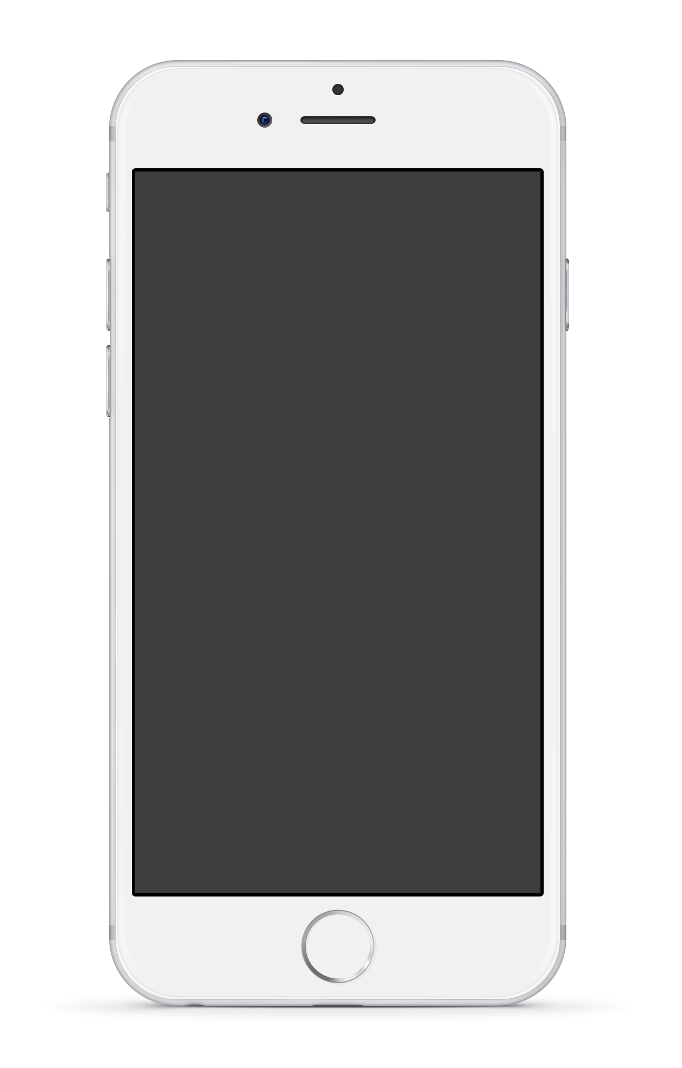
MOBILE
FEATURES
ANALYSIS
Frequently, your initial font choice is taken out of your awesome hands also we are companies often specify a typeface, or even a set of fonts when selecting a typeface for body text, your primary concern should be readability don’t concern yourself.
FEATURE 01
FEATURE 02
Frequently, your initial font choice is taken out of your awesome hands
Frequently, your initial font choice is taken out of your awesome hands

Slide 15
Product Overview
Frequently, your initial font choice is taken out of your awesome hands also we are companies often specify a typeface, or even a set of fonts when selecting a typeface for body text, your primary concern should be readability don’t concern yourself.
PICTURES
65 %
PHOTOS
65 %
CALLS
65 %

Slide 16
Features of Our App
COMPUTER REPAIRS
PRODUCE MUSIC
Phenomenon whereby something new
Phenomenon whereby something new
CUSTOMIZE YOUR ADS
OFFER 24/7 SUPPORT
Phenomenon whereby something new
Phenomenon whereby something new
TAKE PICTURES
LIVE CHAT 365
Phenomenon whereby something new
Phenomenon whereby something new

Slide 17
Web Application
COMPUTER REPAIRS
Frequently, your initial font choice is taken out of your awesome hands also
CUSTOMIZE YOUR ADS
Frequently, your initial font choice is taken out of your awesome hands also
TAKE PICTURES
Frequently, your initial font choice is taken out of your awesome hands also

Slide 18
Web Application Compare

Slide 19
App Process
TITLE 01
TITLE 02
TITLE 03
Frequently, your initial font choice is taken out
Frequently, your initial font choice is taken out
Frequently, your initial font choice is taken out

Slide 20
Business Model
Structure
Tools that allow people companies to create
Advertising
Tools that allow people companies to create
Layers
Tools that allow people companies to create
Support
Tools that allow people companies to create

Slide 21
Trending
Slides
Frequently, your initial font choice is taken out of your hands; companies often specify a typeface, or even a set of fonts, as part of their brand guides However, if you find yourself with an entirely blank page, with unlimited options

Slide 22
S.W.O.T. Analysis
S
W
O
T
STRENGTHS
WEAKNESSES
OPPORTUNITIES
THREATS
Frequently, your initial font choice is taken out
Frequently, your initial font choice is taken out
Frequently, your initial font choice is taken out
Frequently, your initial font choice is taken out

Slide 23
Marketing
Strategy

Slide 24
Marketing Strategies
Strategy 01
Frequently, your initial font choice is taken out of your awesome hands also
MARKET
Strategy 02
TOOLS
Frequently, your initial font choice is taken out of your awesome hands also
Strategy 03
Frequently, your initial font choice is taken out of your awesome hands also

Slide 25
Business
Strategy
ANALYSIS
Business
Plan
Frequently, your initial font choice is taken out of your awesome hands also we are companies often specify a typeface, or even a set of fonts when selecting a typeface for body text, your primary concern should be readability don’t concern yourself.
FEATURE 01
FEATURE 02
Frequently, your initial font choice is taken out of your awesome hands
Frequently, your initial font choice is taken out of your awesome hands

Slide 26
Revenue, branding
improve and content

Slide 27
United States Map
California
Phenomenon whereby something new and somehow valuable is formed the created item
CALIFORNIA
$126,942
NEBRASKA
$126,942
Nebraska
Phenomenon whereby something new and somehow valuable is formed the created item
NEW YORK
$126,942
Texas
Phenomenon whereby something new and somehow valuable is formed the created item
TEXAS
$126,942
New York
Phenomenon whereby something new and somehow valuable is formed the created item

Slide 28
Worldwide Map

Slide 29
Pie Graphs
Frequently, your initial font choice is taken out of your awesome hands also we are companies often specify a typeface
Frequently, your initial font choice is taken out of your awesome hands also we are companies often specify a typeface

Slide 30
Revenue from the latest 3 Years
2016
Frequently, your initial font choice is taken out of your awesome hands also
2017
Frequently, your initial font choice is taken out of your awesome hands also
2018
Frequently, your initial font choice is taken out of your awesome hands also

Slide 31
Revenue from the latest 3 Years

Slide 32
Pie Graphs
COMPUTER REPAIRS
PRODUCE MUSIC
Phenomenon whereby something new
Phenomenon whereby something new
CUSTOMIZE YOUR ADS
OFFER 24/7 SUPPORT
Phenomenon whereby something new
Phenomenon whereby something new

Slide 33
Text in One Column
Mobile social media refers to the combination of mobile devices and social media. This is a group of mobile marketing applications that allow the creation and exchange of user-generated content. Due to the fact that mobile social media run on mobile devices, they differ from traditional social media by incorporating new factors such as the current location of the user or the time delay between sending and receiving messages. According to Andreas Kaplan, mobile social media applications can be differentiated among four types group of mobile marketing applications that allow the creation and exchange of user-generated content.
Due to the fact that mobile social media run on mobile devices, they differ from traditional social media by incorporating new factors such as the current location of the user or the time the current location of the user or the time delay between sending and receiving messages. According to Andreas Kaplan, mobile social media applications can be differentiated among four types group of mobile marketing applications that allow the creation and exchange of user-generated delay between sending and receiving messages. According to Andreas Kaplan, mobile social media applications can be differentiated among four types mobile social media refers to the combination of mobile devices and social media. This is a group of mobile marketing applications that allow the creation and exchange of user-generated content. Due to the fact that mobile social media run on mobile devices, they differ from traditional social media by incorporating new factors such as the current location of the user or the time delay between sending and receiving messages. According to Andreas Kaplan, mobile social media applications can be differentiated among four types group of mobile marketing applications that allow the creation and exchange of user-generated content. Due to the fact that mobile social media run on mobile devices, they differ from traditional social media by incorporating new factors such as the current location of the user or the time delay between sending and receiving messages. According to Andreas Kaplan, mobile social media applications can be differentiated among four types

Slide 34
Text in Two Columns
Mobile social media refers to the combination of mobile devices and social media. This is a group of mobile marketing applications that allow the creation and exchange of user-generated content. Due to the fact that mobile social media run on mobile devices, they differ from traditional social media by incorporating new factors such as the current location.
Due to the fact that mobile social media run on mobile devices, they differ from traditional social media by incorporating new factors such as the current location of the user or the time the current location of the user or the time delay between sending and receiving messages. According to Andreas Kaplan, mobile social media applications can be differentiated among four types group of mobile marketing applications that allow the creation and exchange of user-generated delay between sending and receiving messages. According to Andreas Kaplan, mobile social media applications can be differentiated among four types mobile social media refers to the combination of mobile devices and social media.
Mobile social media refers to the combination of mobile devices and social media. This is a group of mobile marketing applications that allow the creation and exchange of user-generated content. Due to the fact that mobile social media run on mobile devices, they differ from traditional social due to the fact that mobile social media run on mobile devices, they differ from traditional social media by incorporating new factors such as the current location of the user or the time the current location of the user or the time delay between sending and receiving messages. According to Andreas Kaplan, mobile social media applications can be differentiated among four types group of mobile marketing applications that allow the creation and exchange of user-generated delay between sending and receiving messages.

Slide 35
Text in Three Columns
Mobile social media refers to the combination of mobile devices and social media. This is a group of mobile marketing applications that allow the creation and exchange of user-generated content. Due to the fact that mobile social media run on mobile devices, they differ from traditional social media by to the fact that mobile social media run on mobile devices, they differ from traditional social media by incorporating new factors such as the current location of the user or the time the current location of the user or the time delay between sending and receiving messages. According to Andreas Kaplan, mobile social media applications can be differentiated among four types group of mobile marketing applications that allow the creation and exchange of user-generated delay between sending and receiving messages.
Mobile social media refers to the combination of mobile marketing applications that allow the creation and exchange of user-generated content. Due to the fact that mobile social media run on mobile devices, media by incorporating new factors such as the current location of the user or the time the current location of the user or the time delay between sending and receiving messages. According to Andreas Kaplan, mobile social media applications can be differentiated among four types group of mobile marketing applications that allow the creation and exchange of user-generated delay between sending and receiving messages. According to Andreas Kaplan, mobile social media applications can be differentiated among four types mobile social media refers to the combination of mobile devices and social media.
Mobile social media refers to the combination of mobile devices and social media. This is a group of mobile marketing applications that allow the creation and exchange of user-generated content. Due to the fact that mobile social media run on mobile devices, media by incorporating new factors such as the current location of the user or the time the current location of the user or the time delay between sending and receiving messages. According to Andreas Kaplan, mobile social media applications can be differentiated

Slide 36
CONTACT US
Frequently, your initial font choice is taken out of your hands; companies often specify a typeface.
OUR HEADQUARTER
123 BARKER,
PHILADELPHIA
UNITED SATES 94044
PHONE: 123 – 001-3450-080
PBOX: MKL4532
EMAIL: MYNAME@DOMAIN.COM

Slide 37
General

Slide 38
Electronics
Miscellaneous

Slide 39
E-Commerce
Web

Slide 40
Arrows
Location
Weather

